Slide 1
Multi-Model Language Classification: Identifying Linguistic Fingerprints
Group 9:
Jesse Dinh, Noah Shin, and Huy Le
Notes:
Speaker: Huy Le
Good afternoon, everyone. We are excited to present our Multi-Model Language Classification project. Our team, consisting of Jesse, Noah, and myself, set out to solve a very specific problem: Can a machine learning pipeline accurately classify a text snippet as English, French, or Spanish by only looking at its 'function words'? Today, we will walk you through our data pipeline, the three distinct model architectures we trained, and what the data revealed about the linguistic fingerprints of these three languages."

Slide 2
What are we trying to solve?
Our model aims to automatically classify an inputted text as one of three languages, english, spanish, or french.
Detecting languages is important for translation systems in social media, chat bots, website, and more as they allow for seamless communication across people of different languages across the world.

Slide 3
Background & Hypothesis
Our project focuses on language detection and is thus a classification problem
Text is converted into numerical vectors for features
We hypothesize that we can use patterns in the word frequency of each language to classify them
Each language has its own “function words” that help differentiate them.

Slide 4
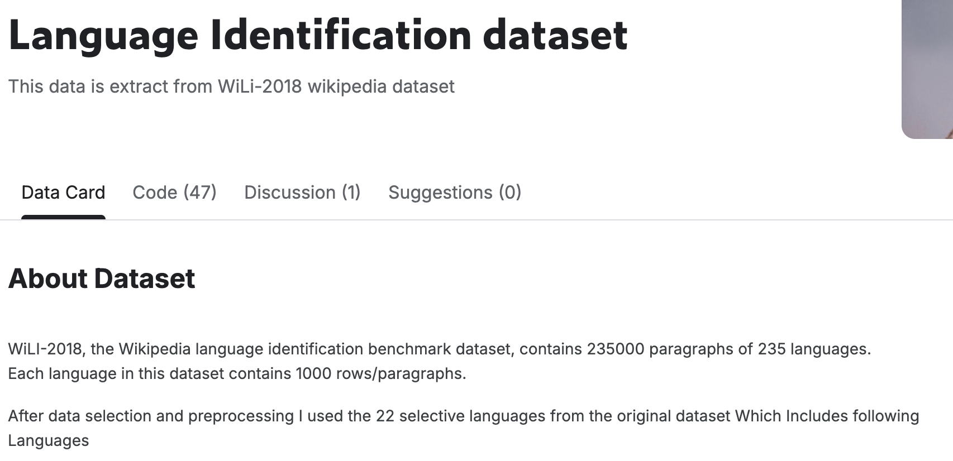
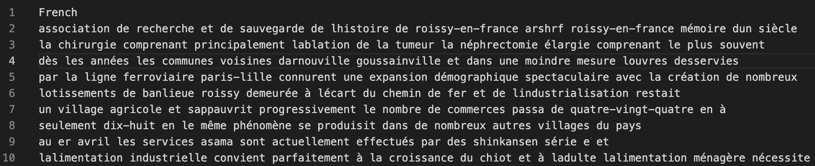
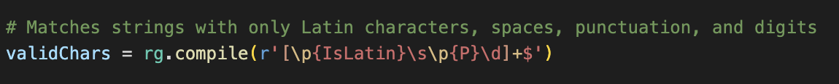
Dataset & Preprocessing
English, French, and Spanish language data are pulled from a Kagglehub dataset
We have 3946 English examples, 3701 French examples, and 3576 Spanish examples.
Data is broken down into 15-word training examples
Residual non-latin characters (i.e. symbols, emojis, or quotations from other languages) are filtered out using a regex

Slide 5
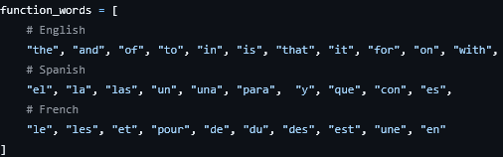
Feature Engineering & Vectorization
Notes:
Speaker: Jesse
Once the text was standardized, we had to convert it into a format the models could understand. We hypothesized that 'function words' act as a unique statistical fingerprint for a language. I engineered a script that isolates 31 specific function words across English, Spanish, and French. Using Scikit-Learn's CountVectorizer, we mapped our text data against this predefined 31-word vocabulary. Essentially, every 15-word sentence was transformed into a 31-dimensional numerical vector representing word frequencies. We also used a LabelEncoder to map our target languages to integers. These arrays were saved as our master X and Y training files.

Slide 6
Model Architectures
Decision Tree (Baseline): A simple classifier used as the starting point (max depth 30, 20% TEST SPLIT).
Random Forest (Ensemble): Uses majority voting across multiple trees to prevent overfitting; proved most effective.
Multi-Layer Perceptron (Neural Network): Utilized to capture complex non-linear relationships between function words.
Notes:
Speaker: Huy
With our features encoded, we moved to the modeling phase. We initially used a simple Decision Tree Classifier with a max depth of 10 and a 20% test split as our baseline. To meet the project requirements and improve robustness, we expanded our pipeline to include two advanced architectures. First, an ensemble Random Forest model, which uses 'majority voting' across multiple decision trees to prevent overfitting. Second, a Multi-Layer Perceptron Neural Network to capture non-linear relationships—for instance, identifying if the combination of two specific words carries more weight than either word alone.

Slide 7
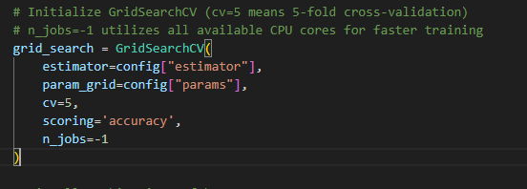
Hyperparameter Tuning
K-Fold Cross Validation
Splits the training data into K equal subsets (folds).
Rotates each fold once for testing, training on the other K-1 folds.
Calculates the average accuracy across all K runs (we used 5-fold).
GridSearch CV
Systematically tests every possible combination of hyperparameters.
Combines the exhaustive search with K-Fold CV for robust evaluation.
Notes:
Speaker: Huy
Instead of manually guessing the best settings for these models, we implemented Grid Search Cross-Validation (a technique for hyperparameter tuning that combines an exhaustive search of specific parameter values with cross-validation to find the most effective settings for a machine learning model). This allowed us to programmatically test combinations of hyperparameters—like the depth of the trees or the number of hidden layers in the neural network. By using 5-fold cross-validation, we ensured that our winning parameters were genuinely learning the underlying patterns of the languages, rather than just memorizing a specific random split of the training data.

Slide 8
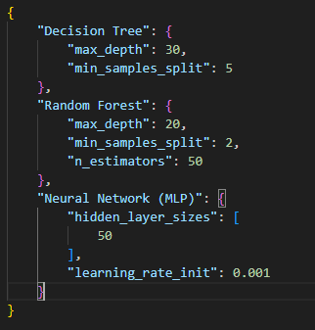
Gridsearch’s resulting hyperparameters for each model
Notes:
Speaker: Huy Le
We didn't guess the parameters. We defined a hyperparameter space and used 5-Fold Grid Search Cross-Validation. The algorithm automatically evaluated every combination of our grid, effectively training hundreds of models in the background. The JSON file represents the exact mathematical combinations that yielded the highest average validation accuracy across all 5 folds.

Slide 9
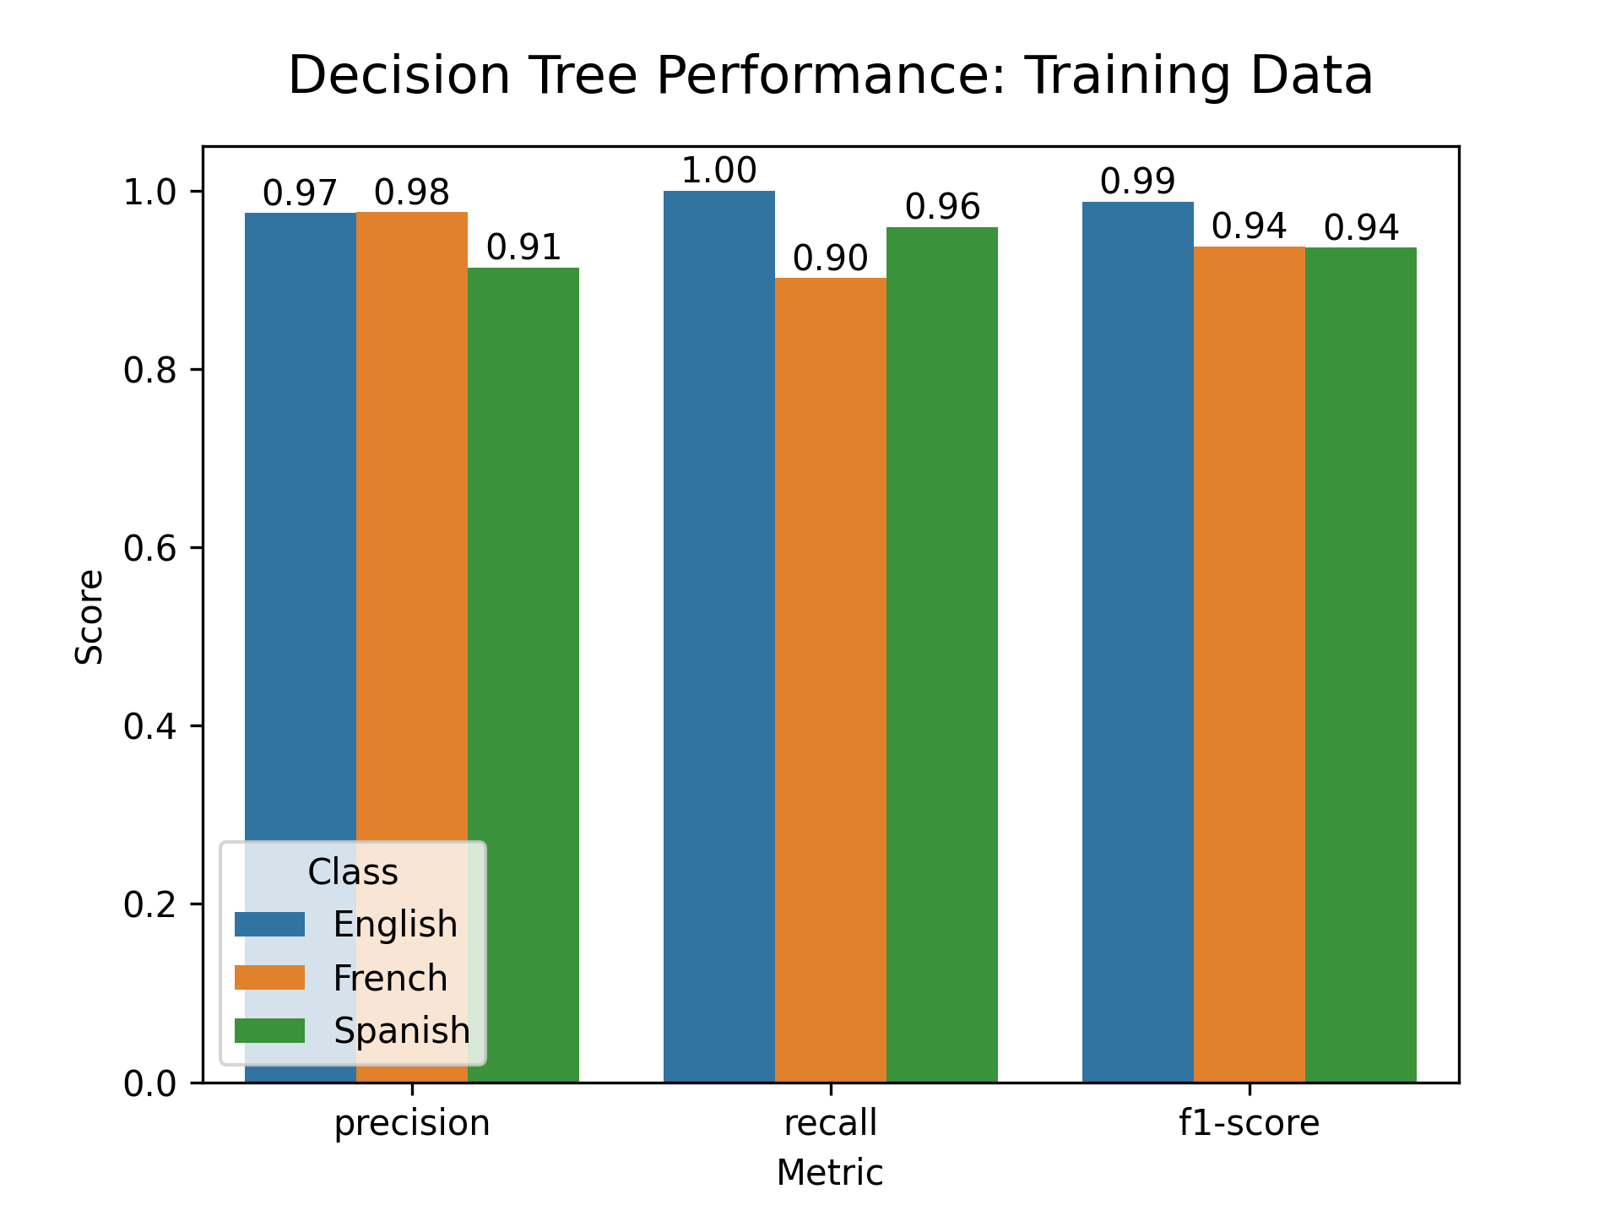
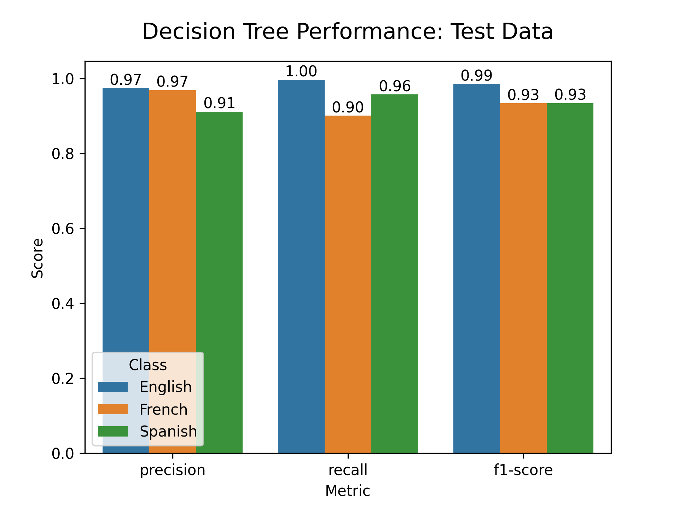
Performance
Training Accuracy: 0.9546 Test Accuracy: 0.9519
Notes:
Speaker: Noah
We found that performance was almost identical between training and test sets, indicating that no overfitting has occurred and suggesting that the feature space was easily separable based on the features we chose. Performance was also very similar between different models, though Random Forest proved to be the strongest by a narrow margin. We believe that this is due to the data being easy to separate, meaning that the complexity and nonlinearity offered by the MLP was unnecessary. All three models were better at correctly identifying English text than the other languages, likely because French and Spanish are more similar to each other than they are to English (more on this later).

Slide 10
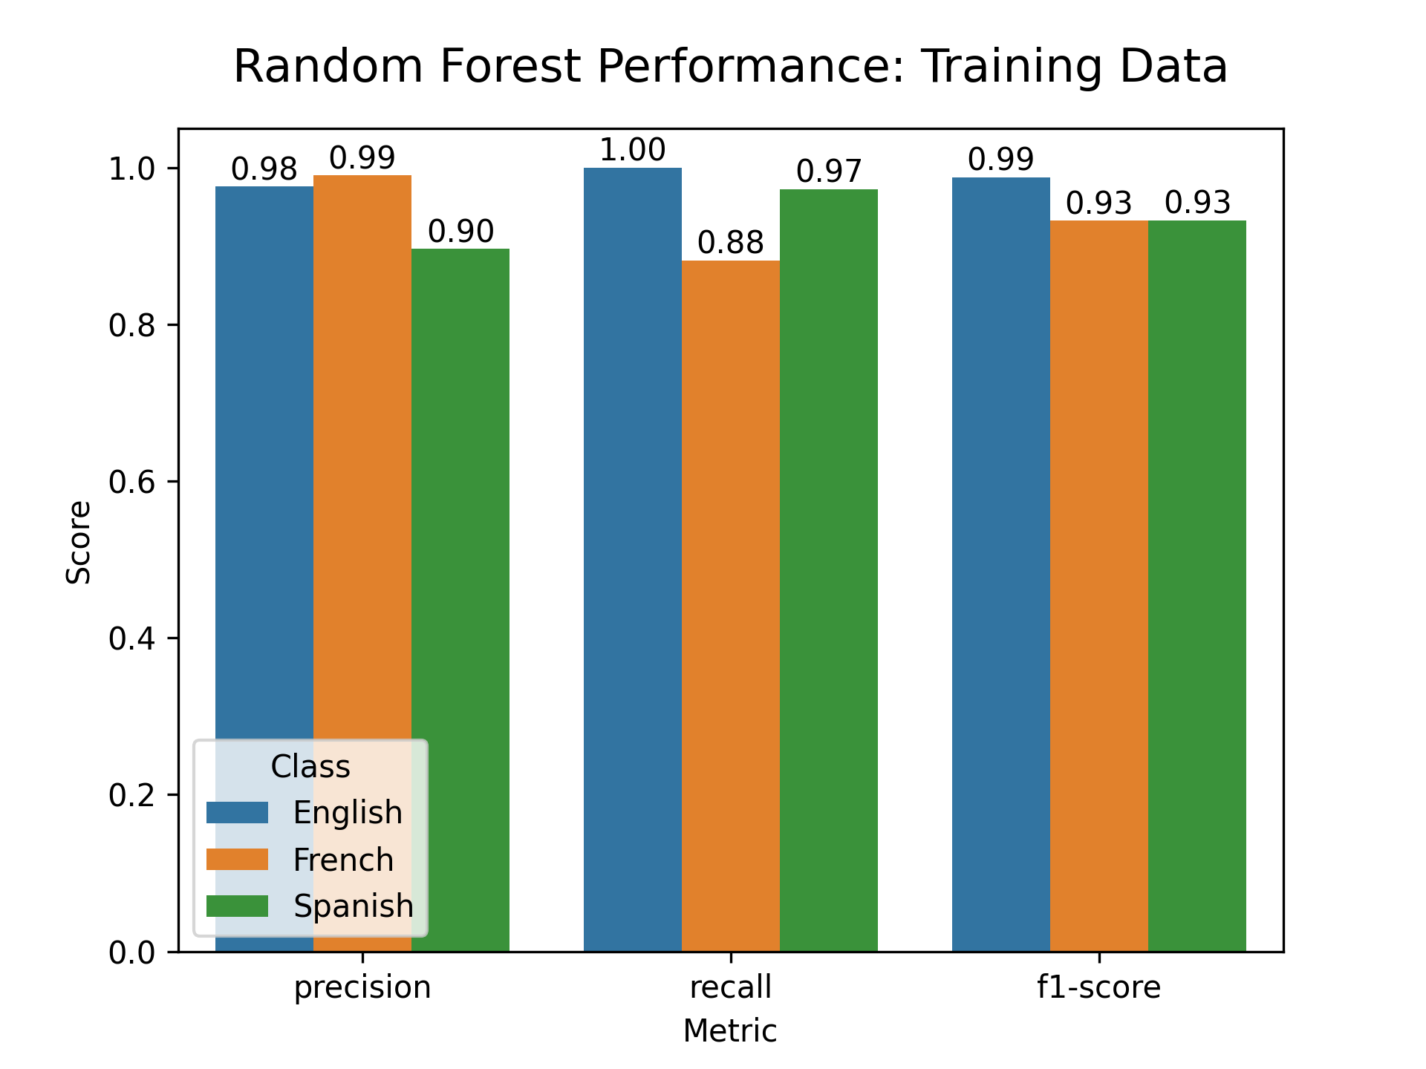

Performance (contd.)
Training Accuracy: 0.9522 Test Accuracy: 0.9572

Slide 11


Performance (contd.)
Training Accuracy: 0.9539 Test Accuracy: 0.9559

Slide 12
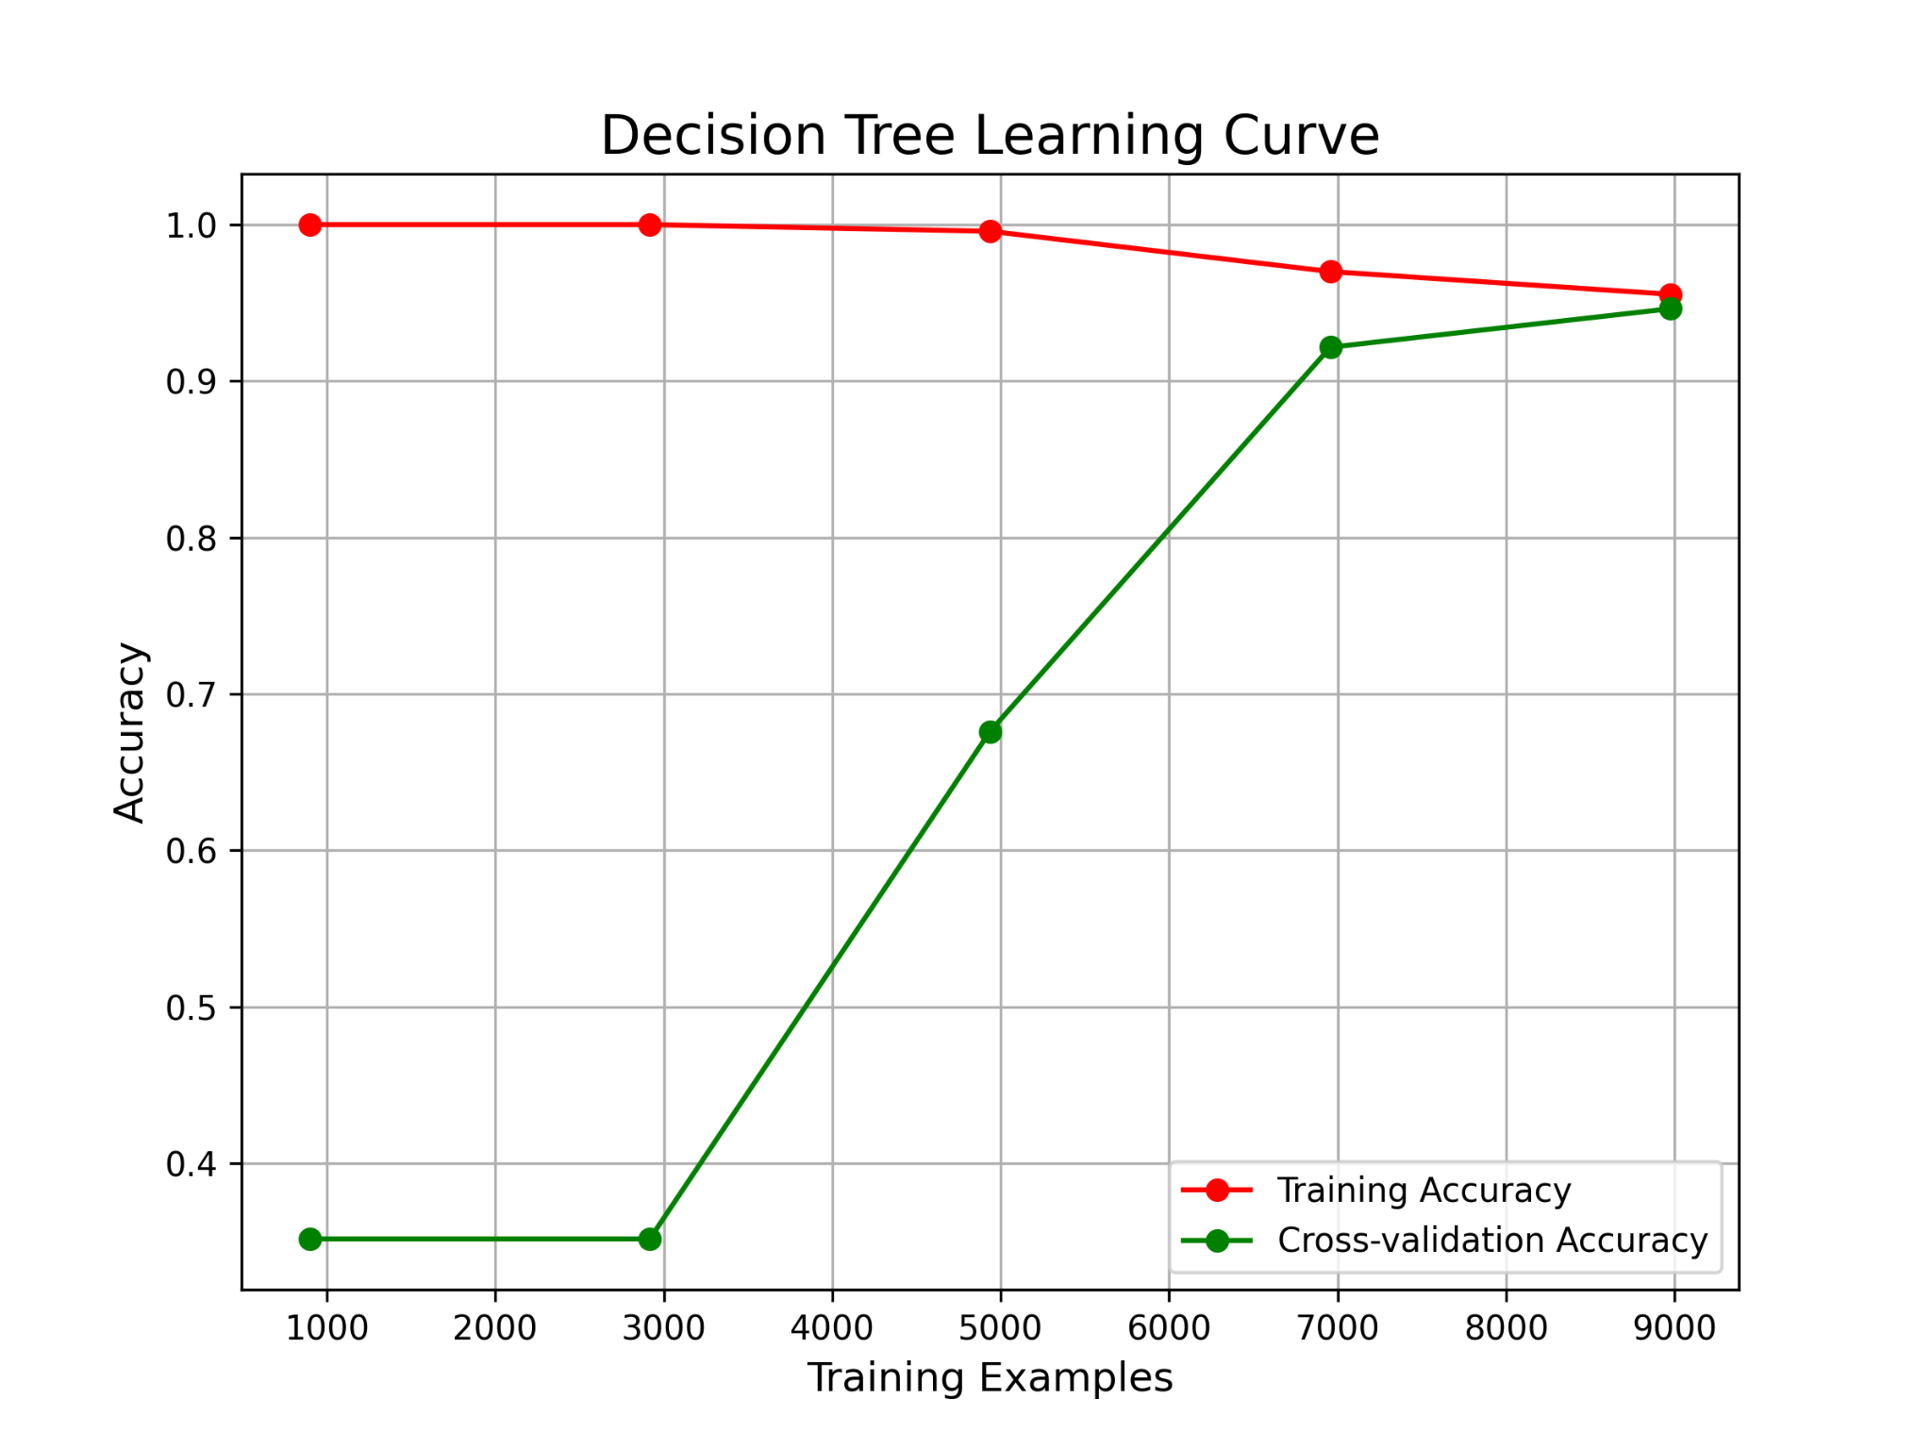

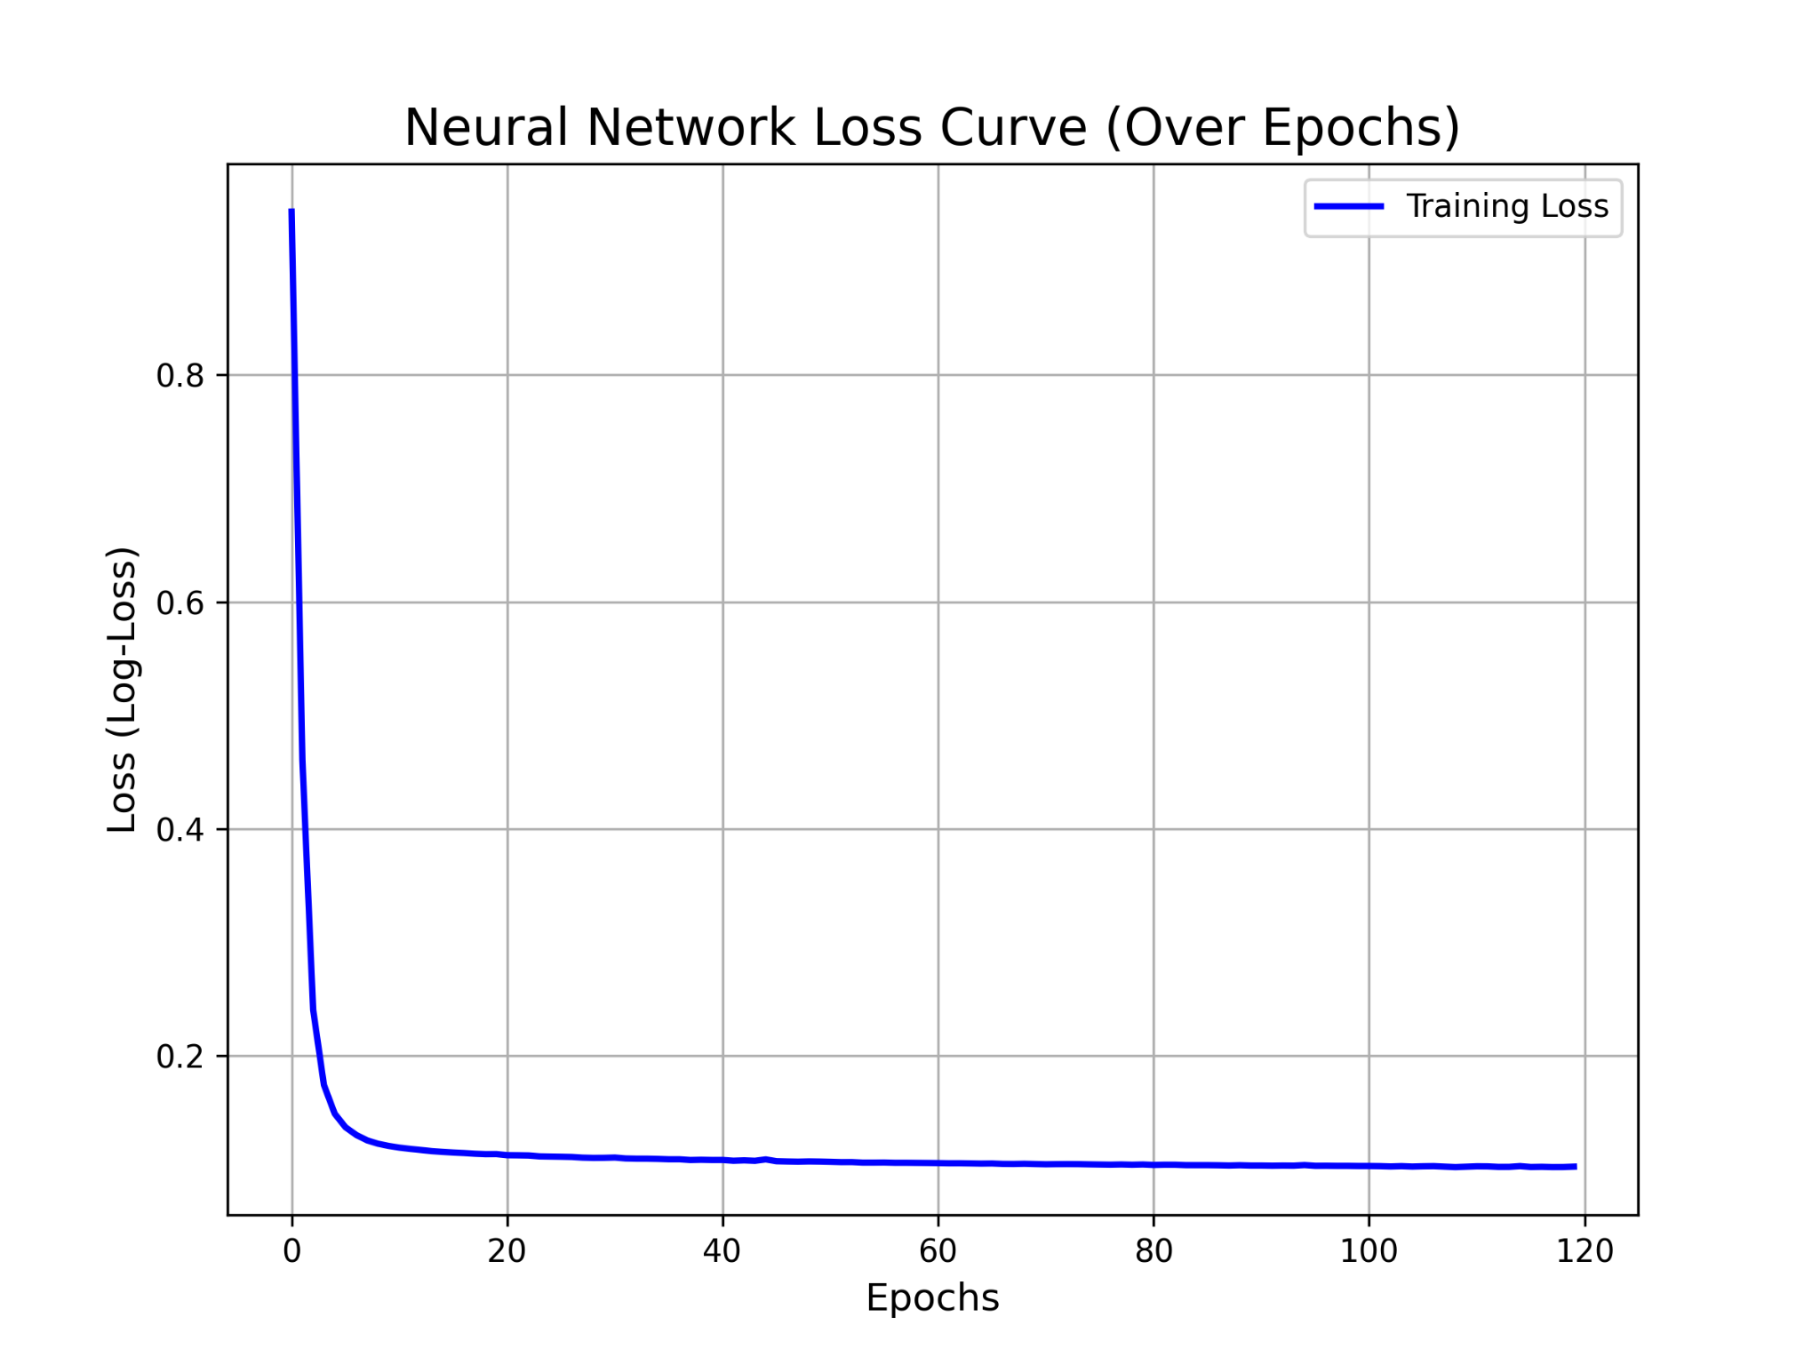
Training Loss and Accuracy Curves
MLP is trained up to 500 epochs. However, they rarely reach it since Scikit-Learn has a built-in feature called tolerance for optimization (early stopping).
Decision Trees and Random Forests are grown mathematically rather than trained iteratively over time, so standard epoch isn’t applicable.
Notes:
Speaker: Huy Le
For our traditional and ensemble models, we generated Learning Curves, which map Accuracy against the Volume of Training Data. Because Decision Trees and Random Forests are grown mathematically rather than trained iteratively over time, standard epoch loss curves do not apply to them. Instead, these learning curves show us our model's capacity. As you can see, as we feed the models more training examples, the gap between training accuracy (red) and validation accuracy (green) narrows. This proves our models are learning the generalized function word patterns rather than just memorizing the training data, and tells us whether fetching more data from Kaggle would improve performance.
Unlike our tree-based models, our Multi-Layer Perceptron trains iteratively using gradient descent over epochs, allowing us to plot a true Loss Curve. This graph tracks the network's error rate as it updates its internal weights. As you can see, the loss starts high but drops steeply during the first few dozen iterations before flattening out. This steep descent visually proves that the network successfully converged and found the optimal mathematical weights to distinguish between English, French, and Spanish based on our 31 function words.

Slide 13
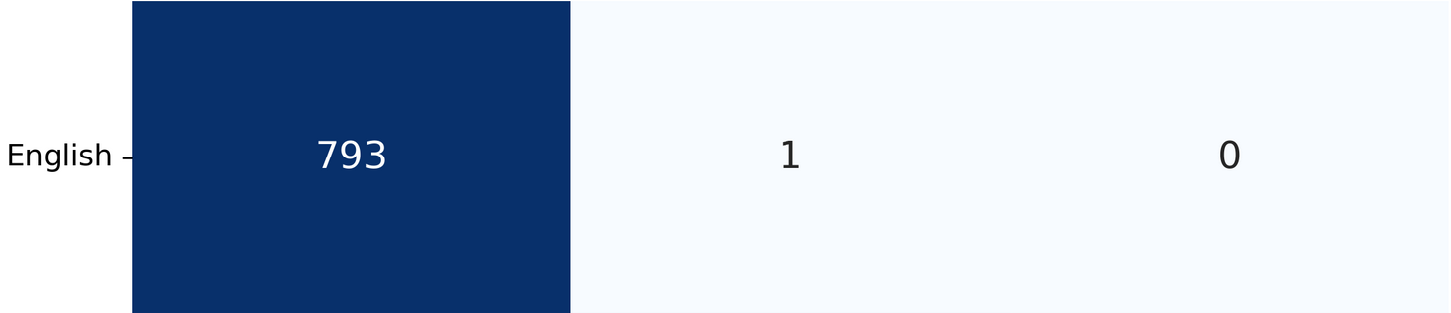
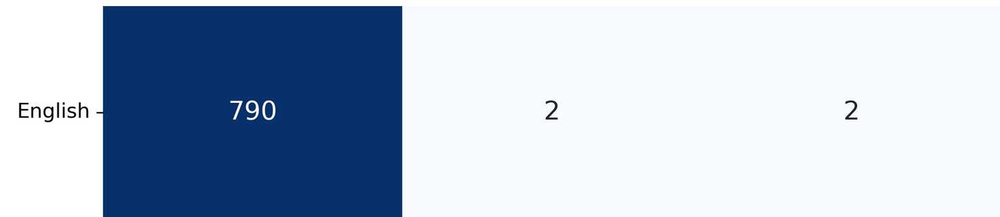

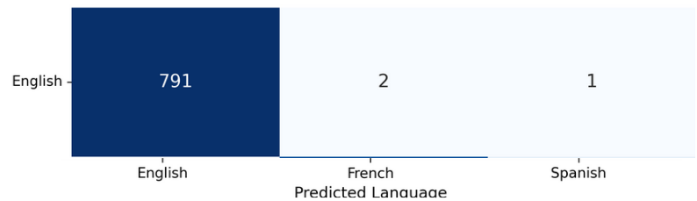
The English Success
As shown in the confusion matrices, our models performed quite well when evaluating english text.
The english language’s feature words are more uniquely identifiable, especially since spanish and french are quite similar in structure and share many words
Notes:
Speaker: Noah Shin
Let's look at the results. As you can see from our Random Forest confusion matrix, the models were exceptionally good at identifying English. Out of our testing set, it correctly classified English 793 times, misclassifying it as French only once, and never as Spanish. This aligns with our feature engineering hypothesis: English function words like 'the' and 'and' are highly isolated and almost never appear in Romance languages, creating a very distinct statistical cluster.

Slide 14
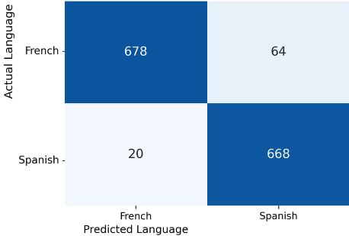
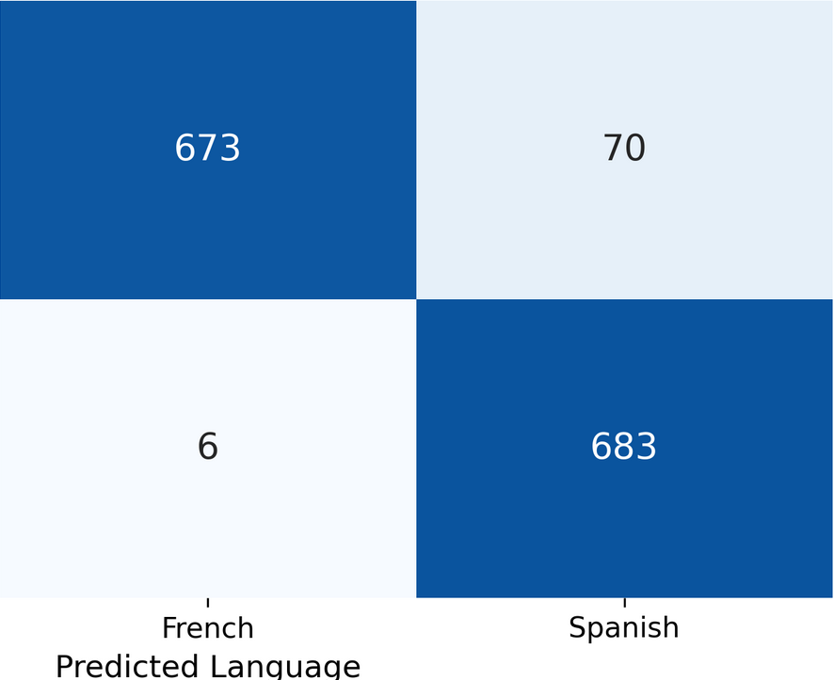
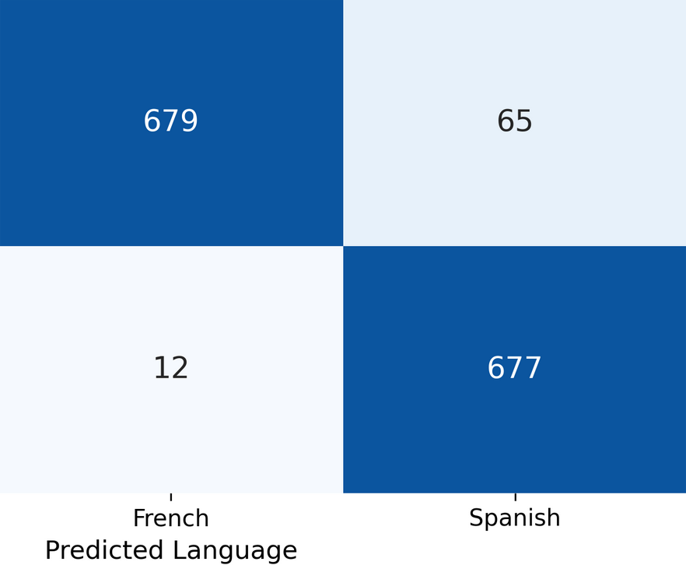
The Romance Language Collision
Our models did relatively well when predicting between Spanish and French considering the similarity between their function words. The best performing model by a small margin would be the Random Forest.
Notes:
Speaker: Jesse
However, the models faced a much harder challenge distinguishing between French and Spanish. Looking at our Decision Tree's confusion matrix, we can see that actual French text was misclassified as Spanish 64 times. The Neural Network struggled similarly, misclassifying it 65 times. Linguistically, this makes perfect sense. They are both Romance languages that share structural similarities and overlapping vocabulary, such as the word 'un' or 'en'. When a 15-word snippet contains shared words but lacks strong unique identifiers, the models are forced into a difficult mathematical coin-flip.

Slide 15
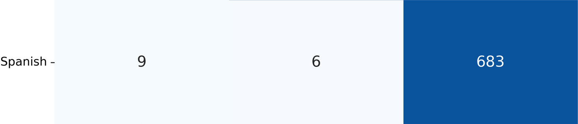
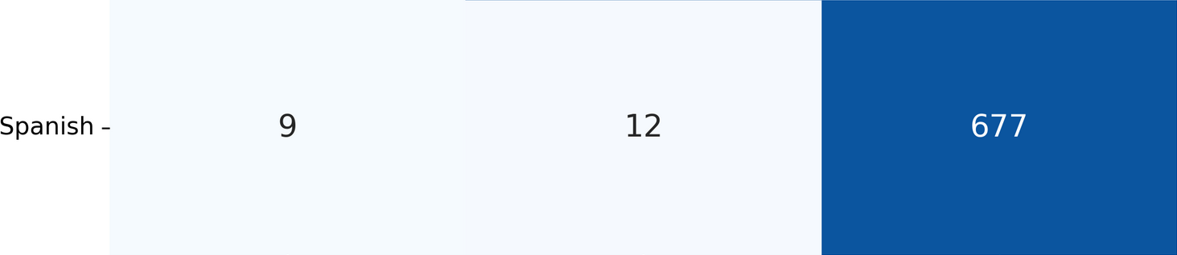
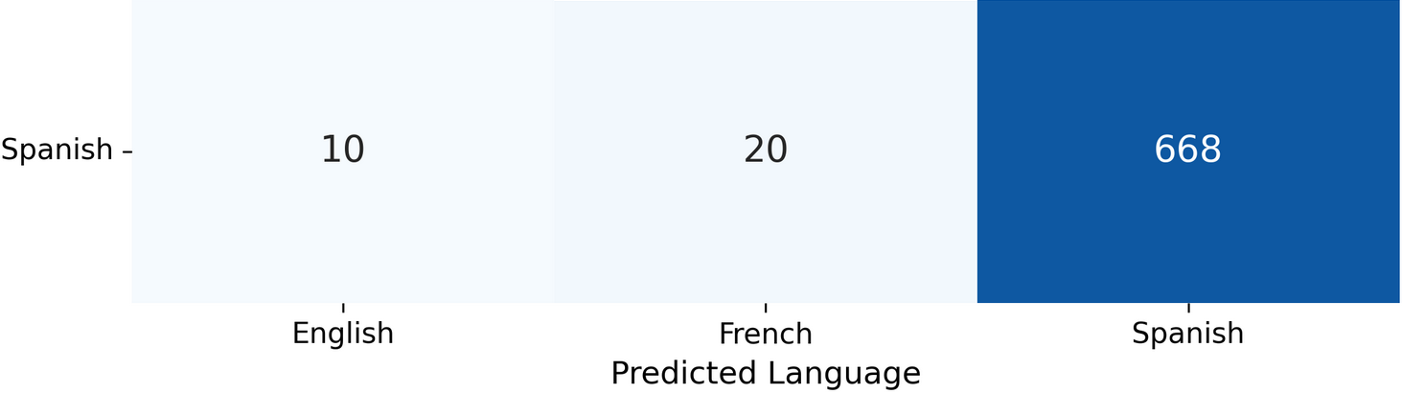
The Power of the Ensemble
The best performing model was yet again the random forest
Decision tree struggled the most because the decision overfits and memorizes training data rather than learning the patterns
Notes:
Speaker: Jesse
A Decision Tree is what we call a "greedy" algorithm. It looks at your entire training dataset and tries to find the single feature that splits the data most perfectly right at that exact moment.
Why it struggles with your data: Let's say the tree is trying to separate French and Spanish. It might look at your data and decide the root split should be: "Does the sentence contain the word 'un'?".
Rigidity: Once a Decision Tree makes a split, it is permanent. If a French sentence contains "un", it gets funneled down a specific path. If the subsequent questions on that path aren't perfectly tuned, the model gets trapped and misclassifies the text as Spanish.
Overfitting: Because a single Decision Tree has access to all 31 words at all times, it tends to memorize the training data rather than learn general patterns. It creates a hyper-specific, brittle set of rules that shatters when it encounters a tricky edge case in the real world.
2. The Random Forest: The Power of the Crowd
A Random Forest is an ensemble model; it literally builds a "forest" of hundreds of individual Decision Trees. However, it introduces a crucial element of chaos to prevent the rigidity we just talked about.
Why it is the best performing model: The Random Forest succeeds because of two architectural concepts: Bagging (Bootstrap Aggregating) and Feature Randomness.
Feature Randomness (The Secret Weapon): When a normal Decision Tree makes a split, it looks at all 31 function words to find the best option. A Random Forest artificially restricts its trees. At every single split, each tree is only allowed to look at a random subset of your words (for example, maybe just 5 words at a time).
Forced Diversity: Because of this restriction, many trees in the forest are forced to build their logic without ever seeing the heavy-hitter words like "un" or "en". They have to learn how to identify French or Spanish using the secondary, weaker function words.
The Majority Vote: When it comes time to predict the language of a new sentence, all hundreds of these artificially restricted trees cast a vote. The model takes the majority.

Slide 16
Conclusions, Limitations, and Future work
Conclusion:
Strict reliance on the frequency of 31 function words is efficient and computationally cheap for language classification.
The Random Forest model was the best performing architecture.
The pipeline was successful at identifying English because its function words are highly isolated.
Limitations:
The models struggled in differentiating between French and Spanish due to shared structure and overlapping function words.
The primary limitations are the model's inability to classify text lacking the 31 hardcoded function words and its incompatibility with non-Latin scripts.
Future work: using N-grams to better differentiate similar Romance languages.
Notes:
Speaker: Noah
In conclusion, our pipeline proved that relying strictly on the frequency of 31 function words is a highly effective, computationally inexpensive way to perform language classification. However, there are limitations. Because our vocabulary is hardcoded, if a user inputs a sentence that only contains nouns and verbs without our specific function words, the model cannot classify it accurately. Furthermore, our regex filtering makes the pipeline incompatible with non-Latin scripts.

Slide 17
Acknowledgments
Zara Khan, the author of the dataset: https://www.kaggle.com/datasets/zarajamshaid/language-identification-datasst
Scikit-learn: ML algorithms
https://scikit-learn.org/
Joblib
https://joblib.readthedocs.io/en/stable/
NumPy: Confusion matrix
https://numpy.org/
Matplotlib for plotting: https://matplotlib.org/
Slides from Professor Suresh Pokharel.

