Slide 1
Electricity Billing System
CST-2215 (Advance Java Programming)
Project Report
Presented By:
Ma Hlaing Myat Mon(Leader)
Mg Arkar Kyaw Thu
Mg Kyaw Linn Htet
Ma Khaing Zin Thant
Mg Ye Yint Aung
Ma Mon Myat Theingi
Mg Zwe Htet Naing

Slide 2
Introduction
Manage the information of electricity bill.
This system provides report for bill and customers.
Manage the information of stored record.

Slide 3
Objective
To pay meter bill on online easily.
Not only save time but also reduce people’s fatigue.
To do the works more effectively.
To calculate users’ meter bill easily themselves.

Slide 4
Abstract
This system not only calculate but also pay bill online easily and show receipts.
Even the general users can calculate their meter bill and also know meter per unit.
This system can calculate meter bill either for home meter type or for other meter type.

Slide 5
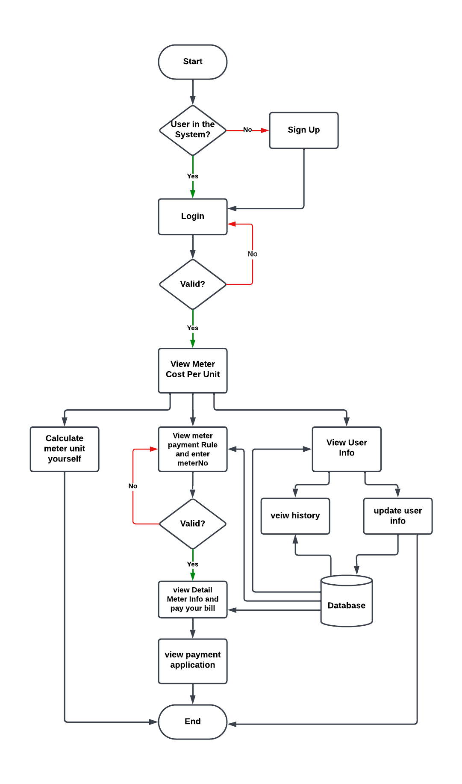
Data flow for USER

Slide 6
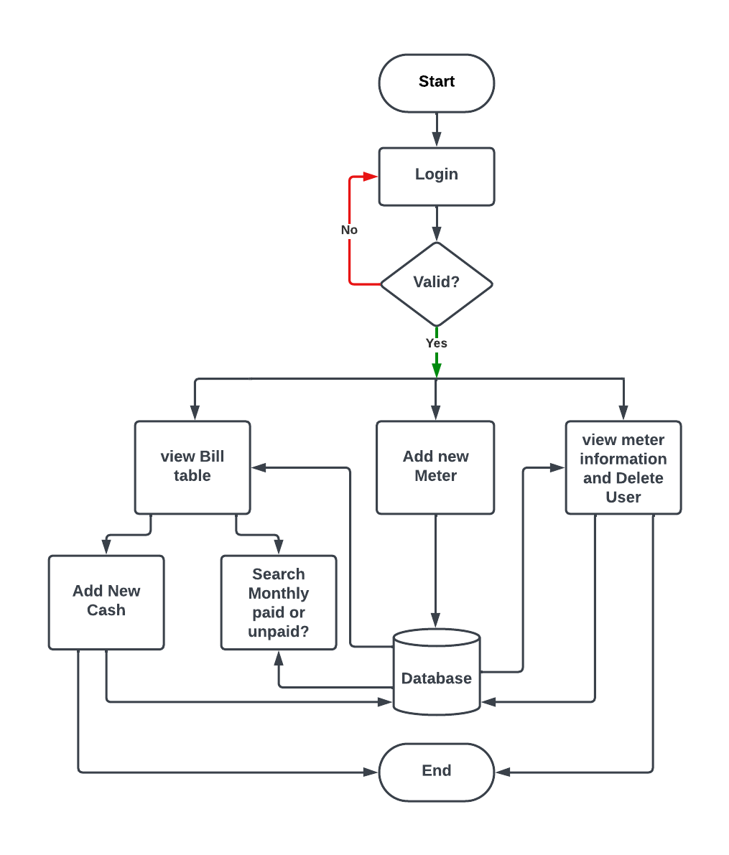
Data flow for ADMIN

Slide 7
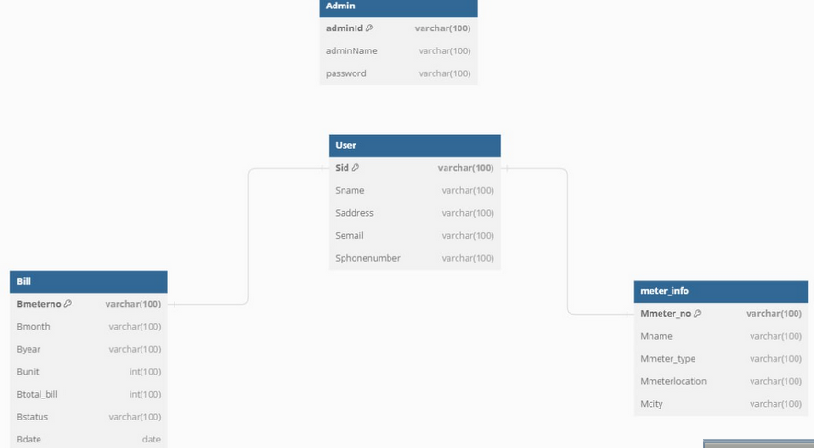
Database design

Slide 8
IMPLEMENTATION

Slide 9
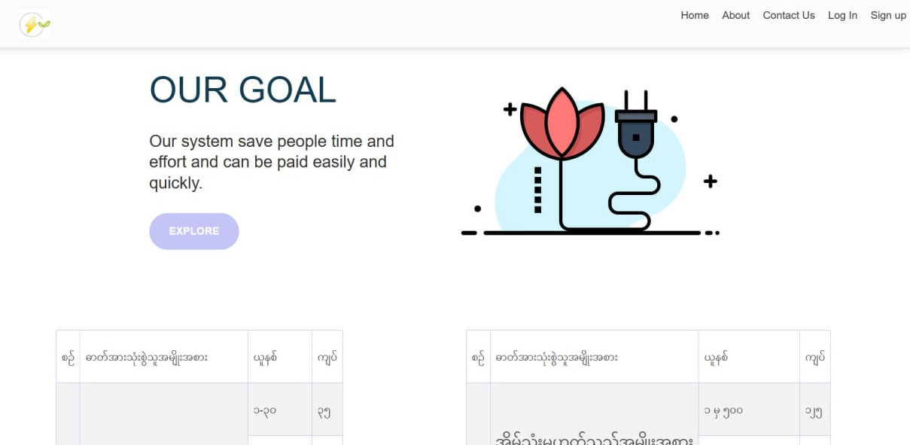

Slide 10
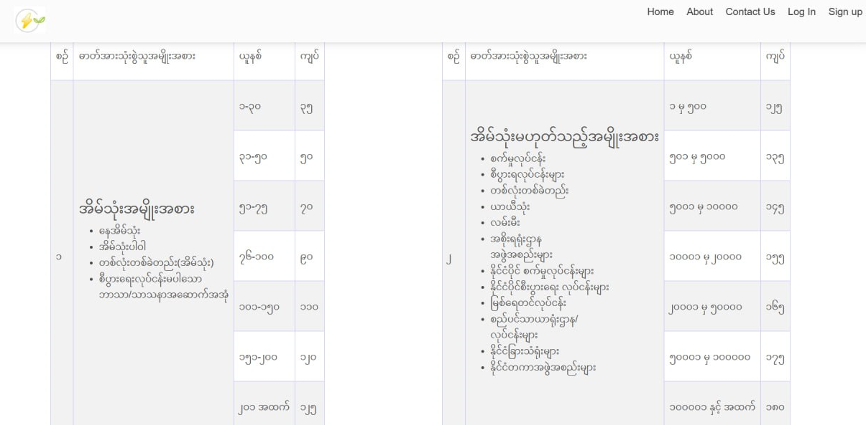

Slide 11
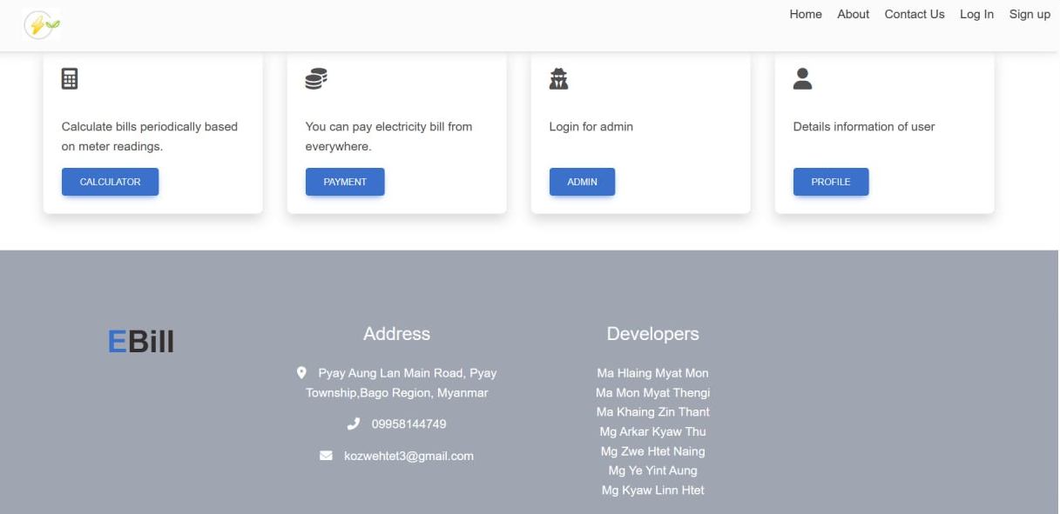

Slide 12
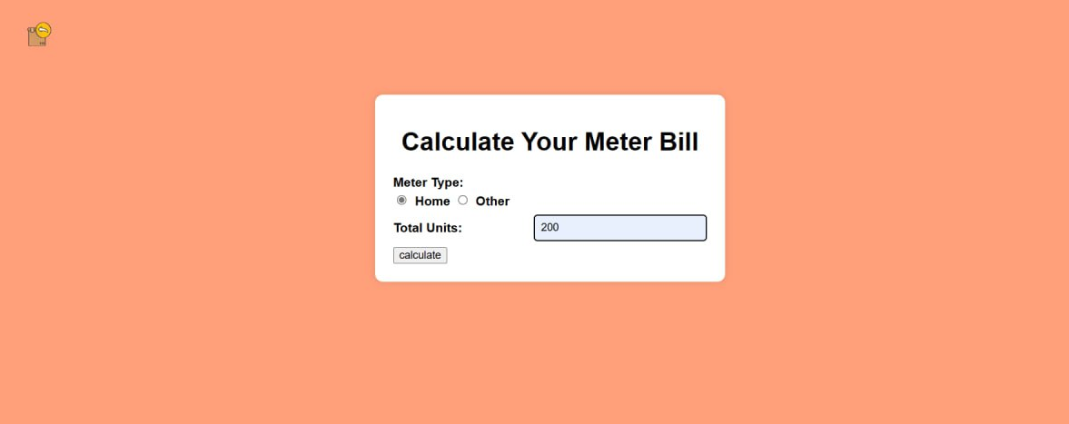

Slide 13
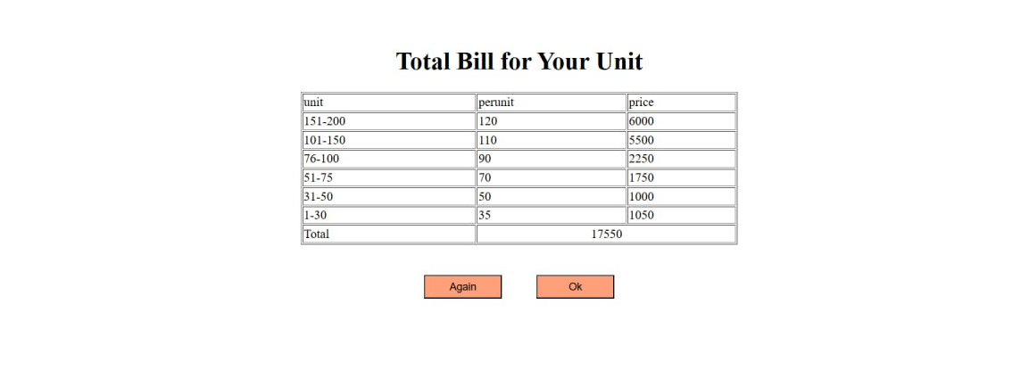

Slide 14
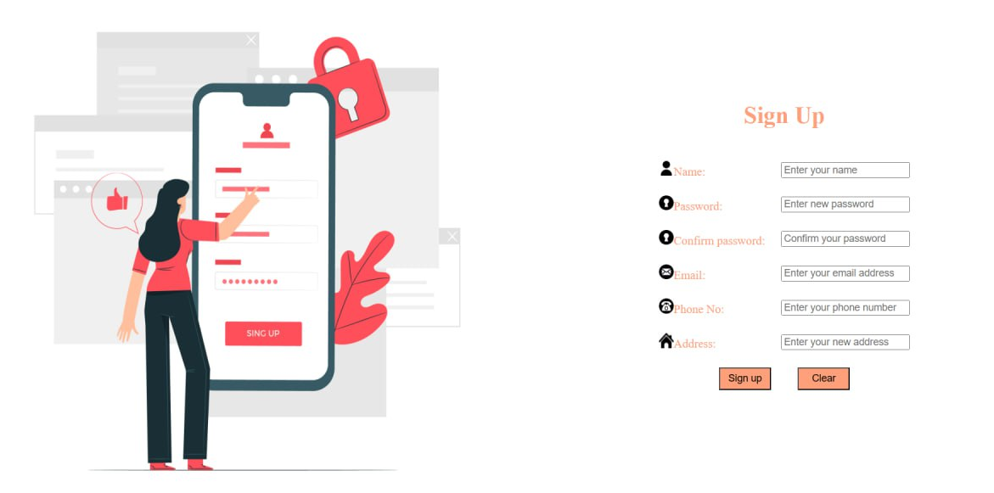

Slide 15
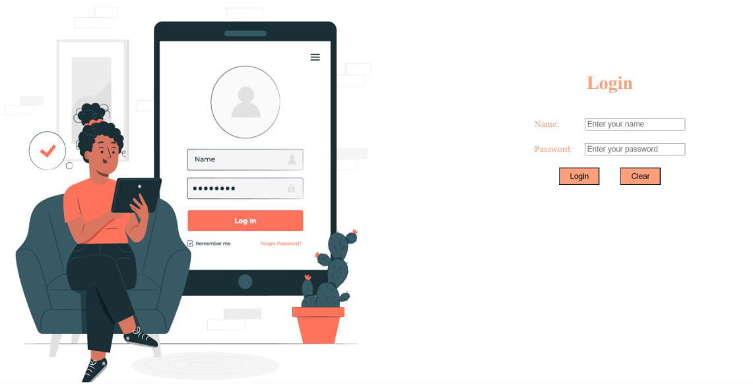

Slide 16
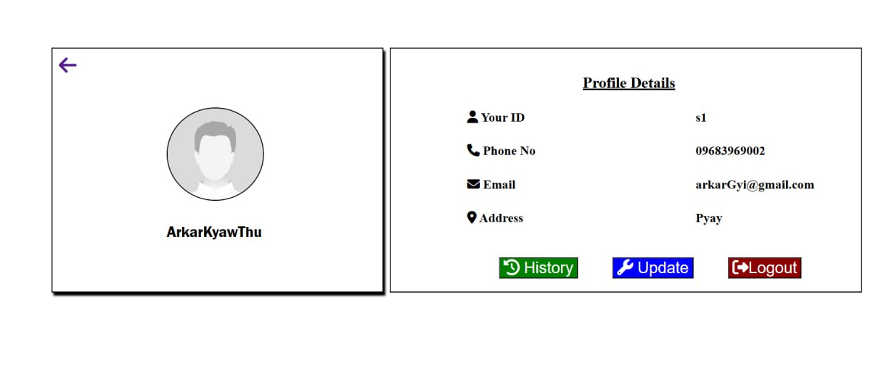

Slide 17
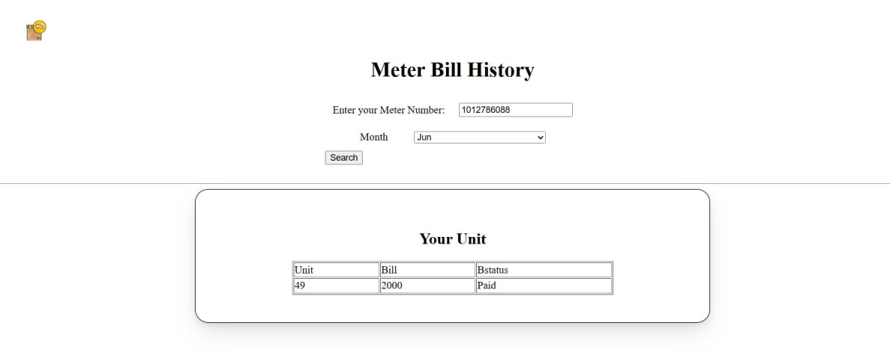

Slide 18
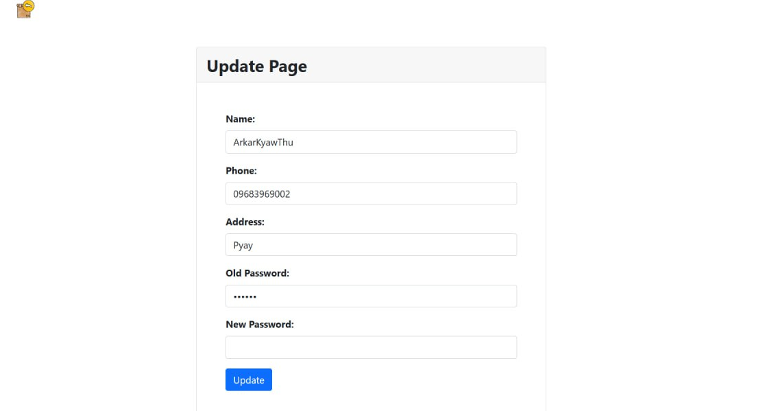

Slide 19
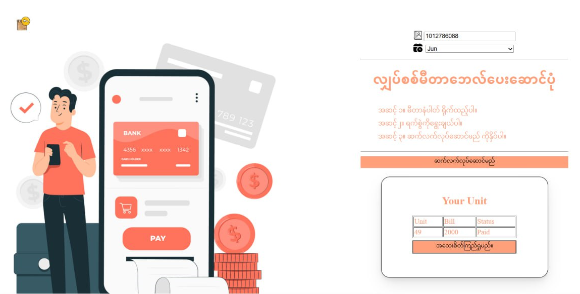

Slide 20
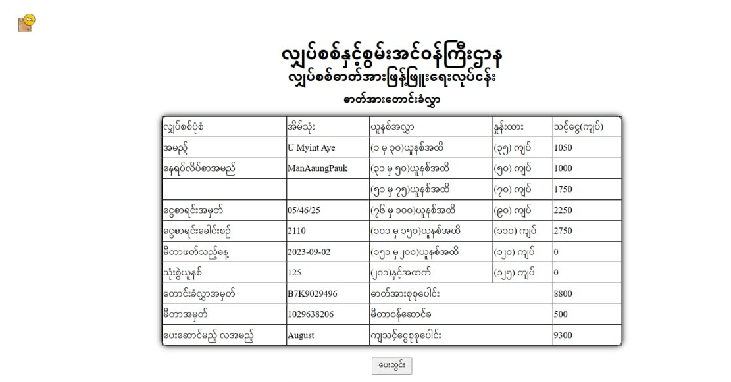

Slide 21
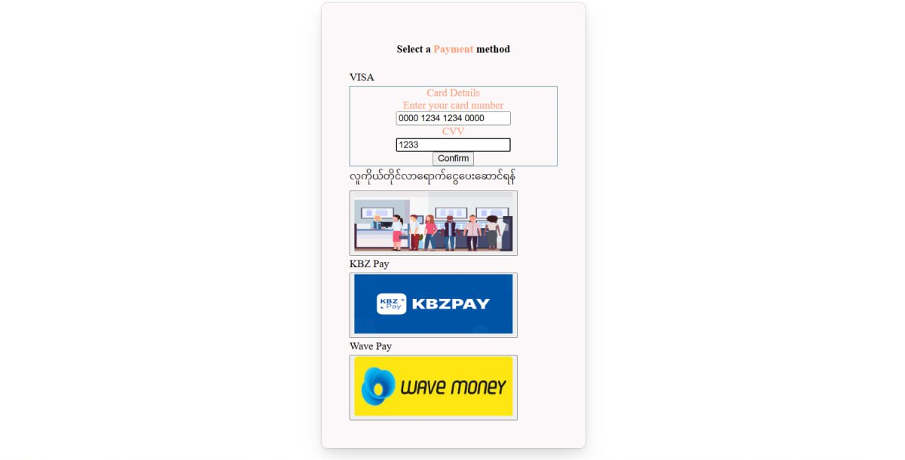

Slide 22
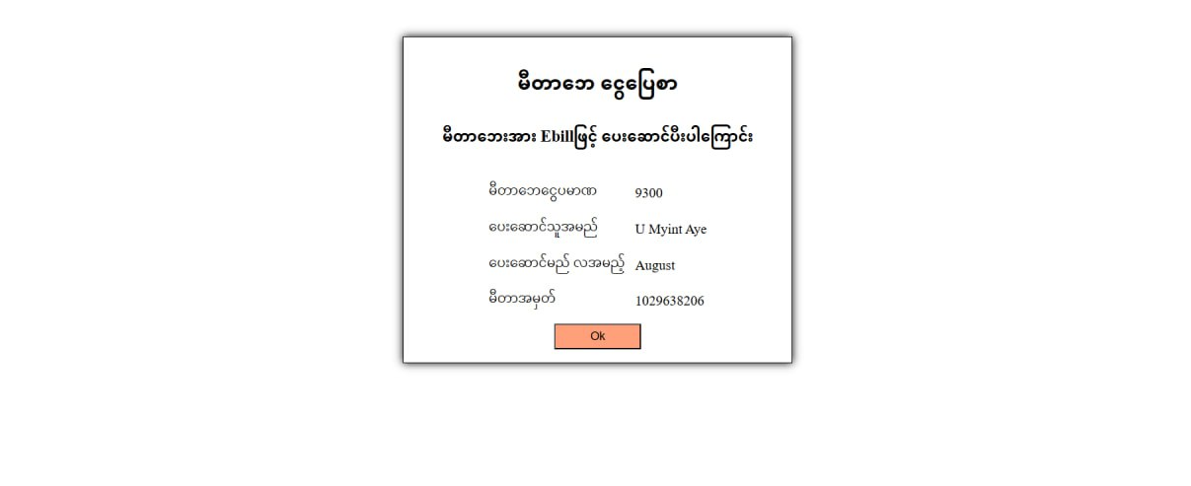

Slide 23
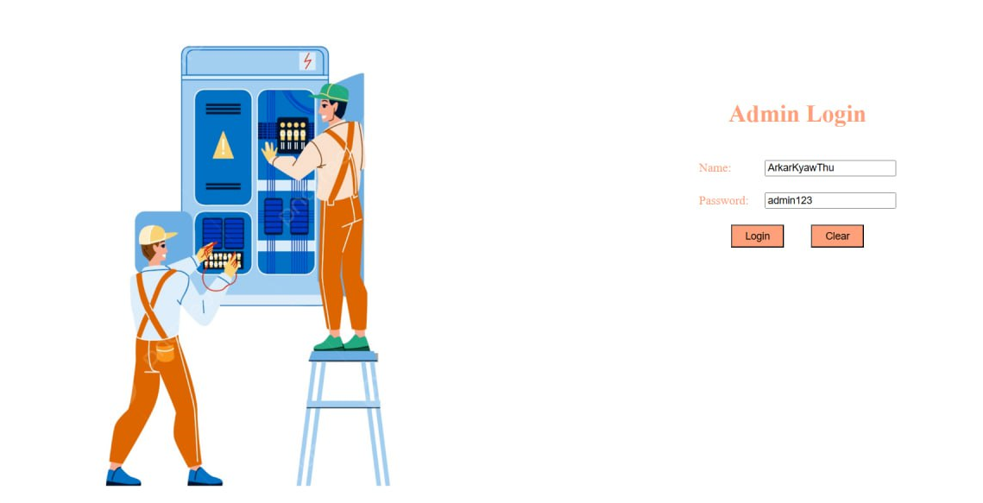

Slide 24
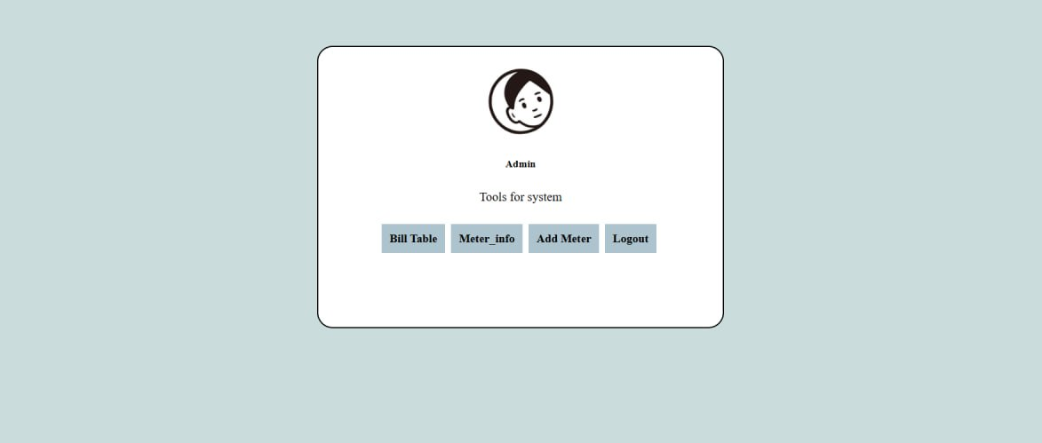

Slide 25
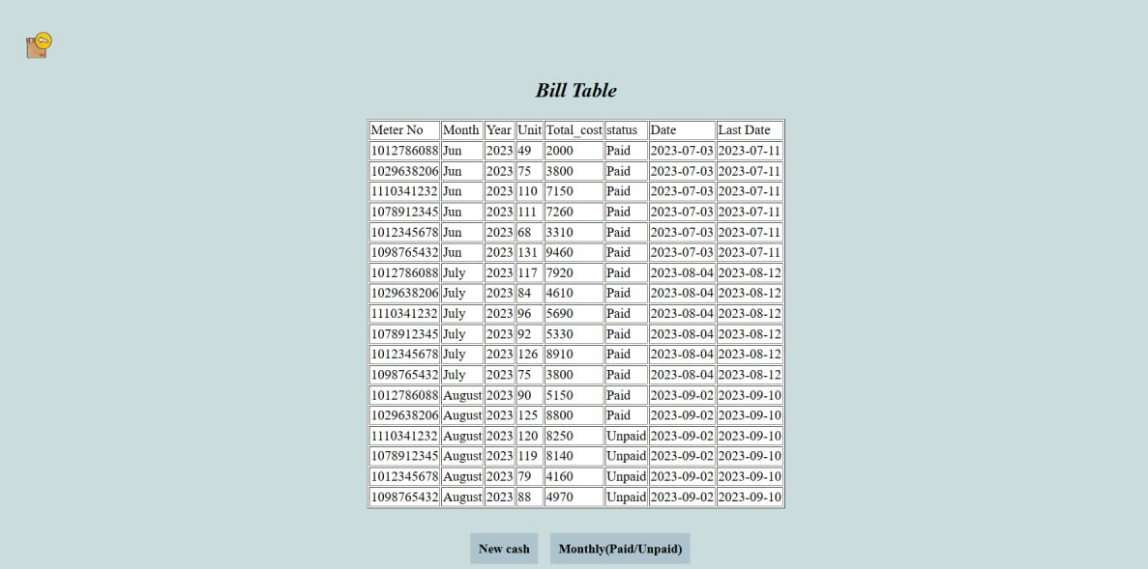

Slide 26
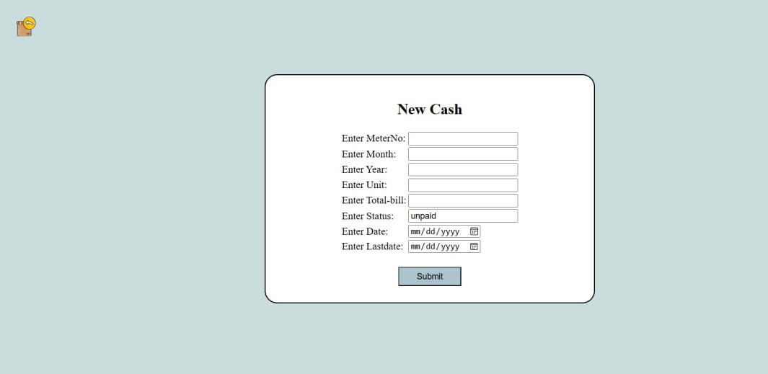

Slide 27
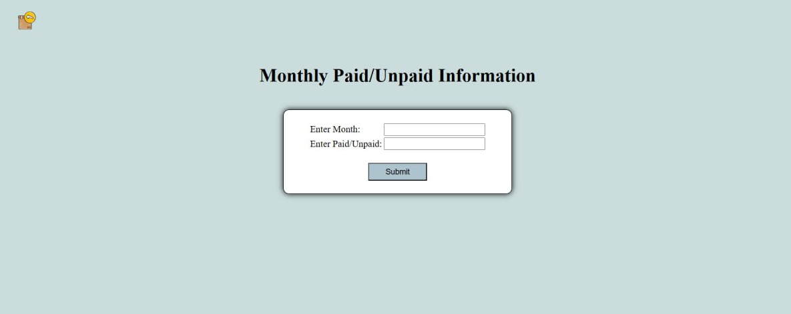

Slide 28
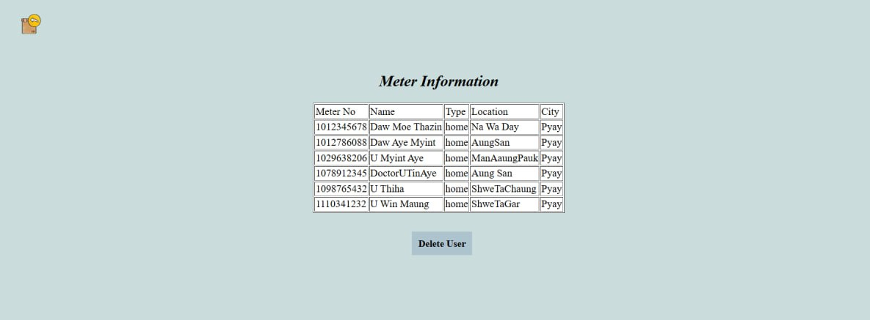

Slide 29
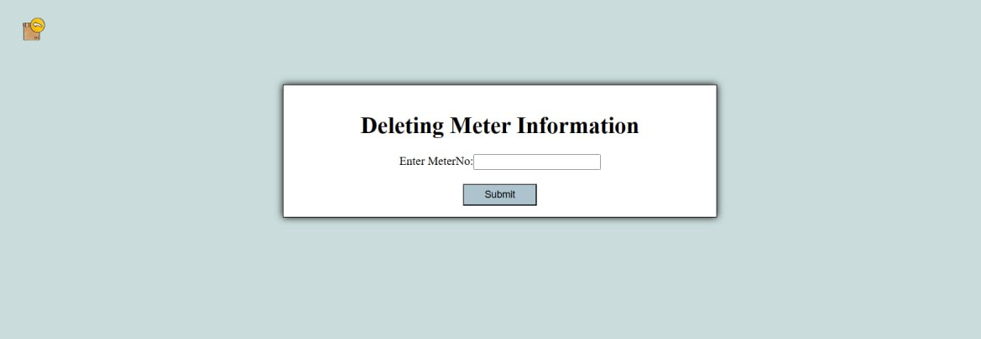

Slide 30
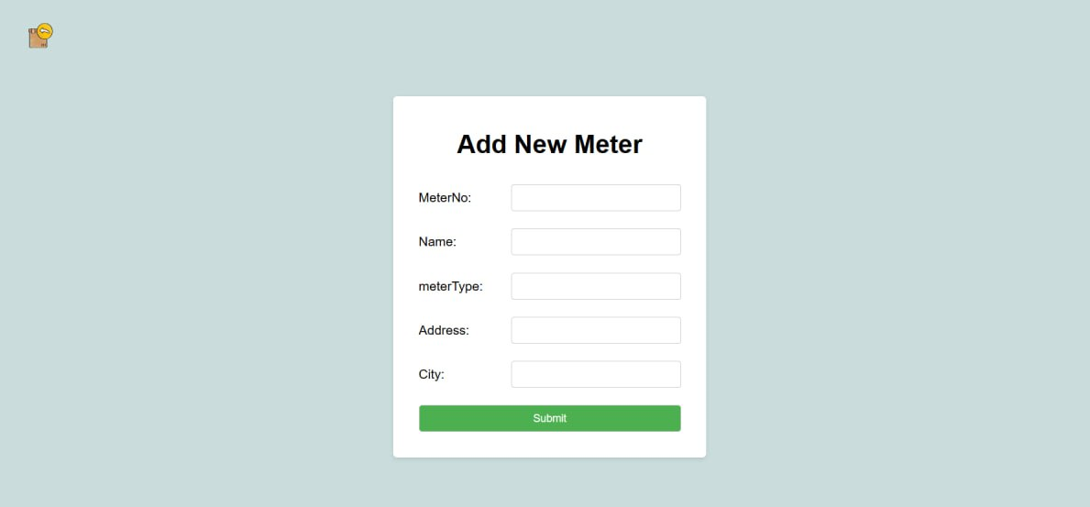

Slide 31
Conclusion
To generate electricity bill with all the changes .
This system is convenient for any kind of users.
To make the billing process more faster and easier.
To reduce the amount of manual data entry and gives greater efficiency.

Slide 32
Thank You

