Slide 1
Pensoft/ iDigBio Webinar
6/16/2016

Slide 2


Pensoft Webinar: Automating publication using the ARPHA writing tool and the Pensoft API
Lyubomir Penev , Viktor Senderov
PhD Financed through the EU Marie-Sklodovska-Curie Program
Grant Agreement Nr. 642241

Slide 3

Data deluge: We sample now more than we can digest (analyze/publish)

Slide 4
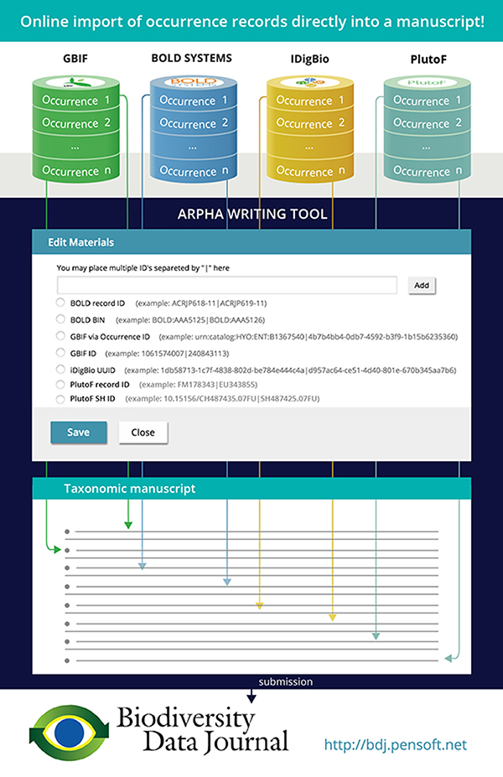

Slide 5
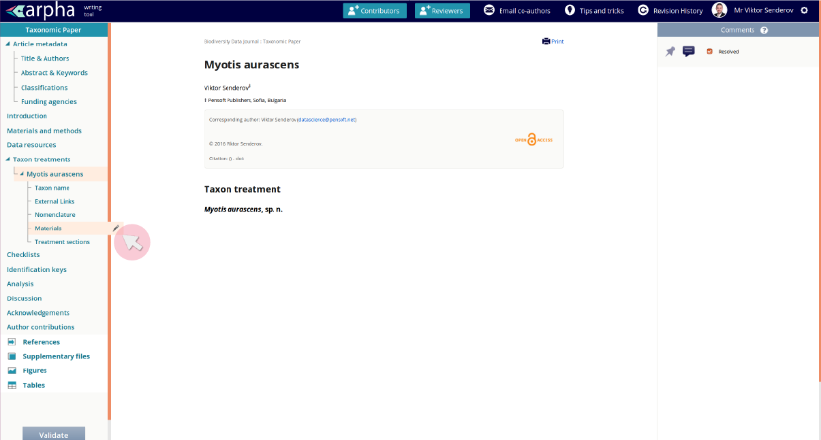
Step 1

Slide 6
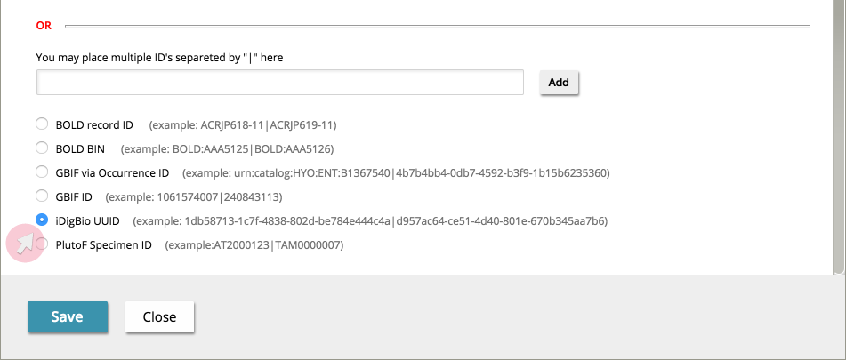
Step 2

Slide 7
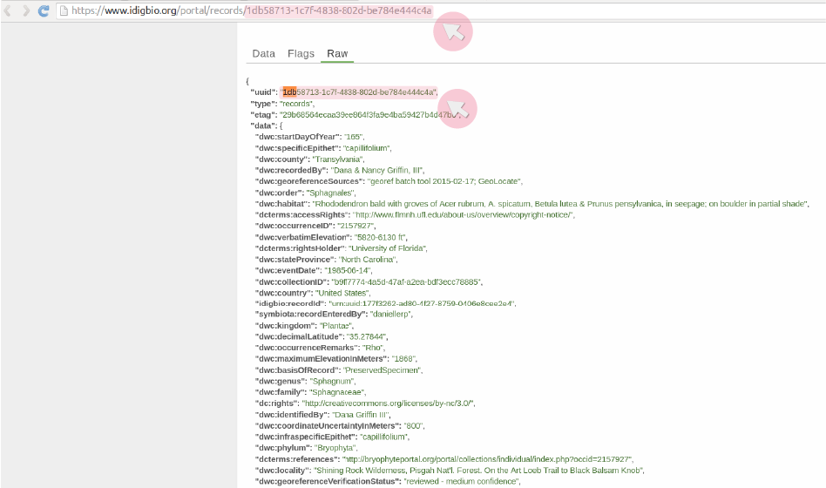
Step 3

Slide 8
Live Demo
Data : https://docs.google.com/spreadsheets/d/1dpzq54F9LmjQZG9Ljuh5-V3shRBaQOnql5HHqSs1mYQ/edit?usp=sharing
Open “iDigBio Test Paper”
Import specimens for Acer lesquerexi (some sort of prehistoric plant) – just click on most recent things
Import specimens for Bassaricyon neblina (raccoon-like mammal)
Import specimens for Nyctalus lasiopterus (a bat species)
Show how to delete materials, import bulk with “|”, import from BOLD BIN

Slide 9
Live Demo
https://search.dataone.org/#view/https://pasta.lternet.edu/package/metadata/eml/knb-lter-pal/130/2
Photosynthetic pigments of water column samples analyzed using High Performance Liquid Chromatography (HPLC), sampled during Palmer LTER field season at Palmer Station Antarctica, 1991 - 2009.. U.S. LTER Network.

Slide 10
Pensoft API
http://arpha.pensoft.net/dev/
Allows to import different types of papers as XML. E.g.:
Software Description
Taxonomic Paper
Data paper

Slide 11
