Slide 1




Open Biodiversity Knowledge Management System
Semantic Suite Running on top of the Biodiversity Knowledge Graph
Viktor Senderov, Teodor Georgiev, Donat Agosti, Terry Catapano, Guido Sautter, Éamonn Ó Tuama, Nico Franz, Kiril Simov, Lyubomir Penev
TDWG 2016 Annual Conference
2016-12-05 02:30 PM – 02:45 PM
CTEC Auditorium

Slide 2
Table of Contents
Introduction
Semantic model of a biodiversity publication
OBKMS as part of Linked Open Data
Applications of OBKMS
Outlook

Slide 3
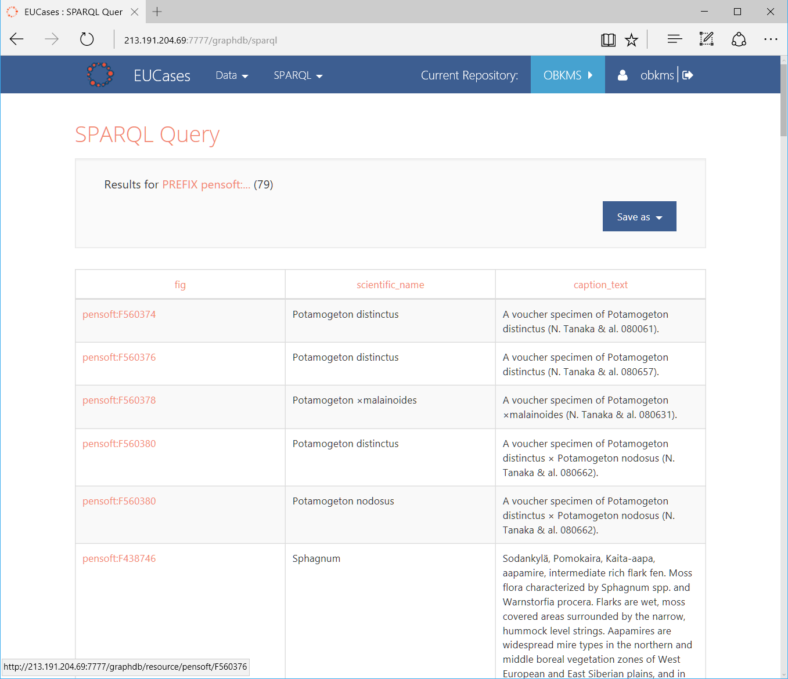
I. What is OBKMS?

Slide 4
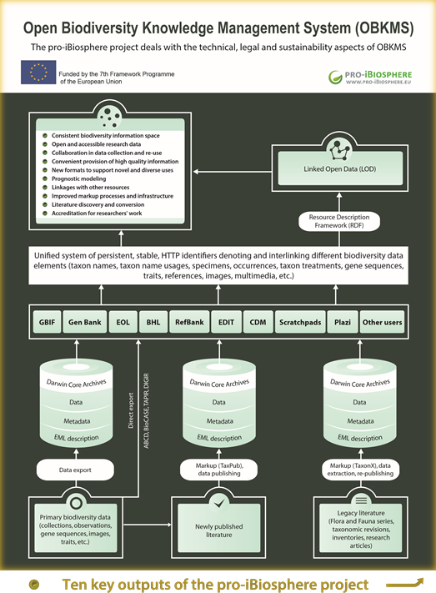
Vision
Linked Open Data
Taxon names
Taxon name usages
Specimens
Occurrences
Taxon treatments
Gene sequences
Traits
References
Images
Multimedia
Biodiversity Knowledge Graph
https://doi.org/10.5281/zenodo.191785

Slide 5
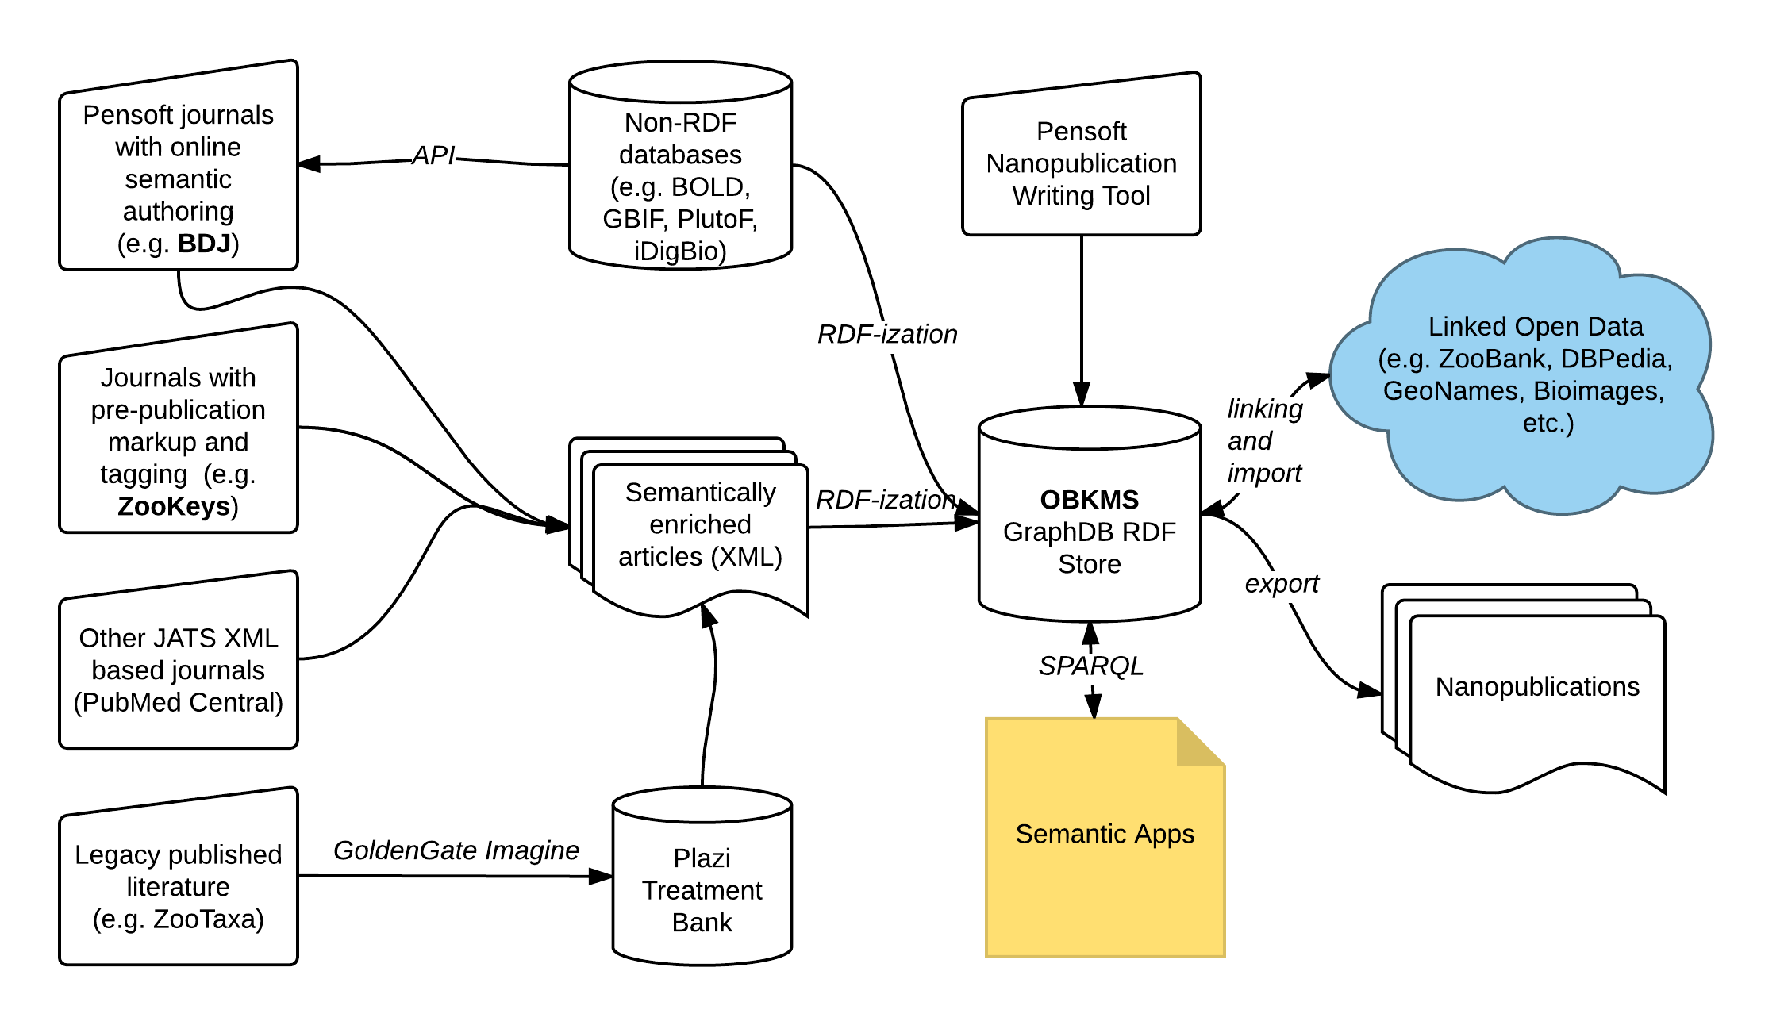
Software architecture

Slide 6
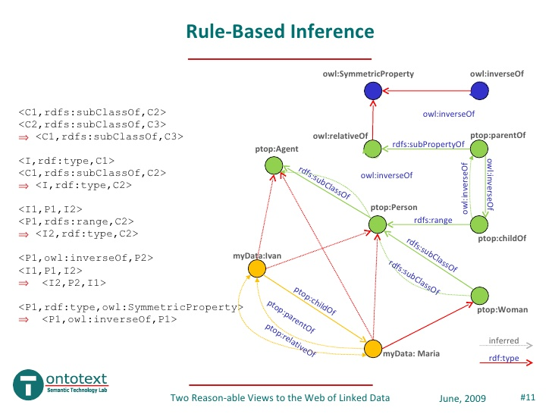
Resource Description Framework (RDF)
Notes:
Parent document component of trt:TaxonNameUsage instance gives the context of the taxon name usage.

Slide 7
Reason-able view of biodiversity data
http://www.slideshare.net/ontotext/two-reasonable-views-to-the-web-of-linked-data
Group selected datasets and ontologies in a single semantic repository: tractable reasoning
OBKMS includes:
GBIF datasets (taxonomic backbone)
GeoNames country data
Bioimages Darwin-SW formatted data
Genetic data: Bio4j
Notes:
Slide 7: for Darwin-SW, stress its key use for relating instances of Darwin Core classes to each other.

Slide 8
II. Semantic Model of a Biodiversity Publication

Slide 9
Semantic model of a biodiversity publication: Key ontologies
Semantic Publishing and Referencing Ontologies (SPAR)
FRBR-aligned Bibliographic Ontology (FaBiO)
Citation Counting and Context Characterization Ontology (C40)
Document Components Ontology (DOCO)
Publishing Roles Ontology (PRO)
Treatment Ontology
Darwin-SW
Notes:
Treatment Ontology: names, taxon (concepts), etc.
Darwin-SW: linking DwC classes together

Slide 10
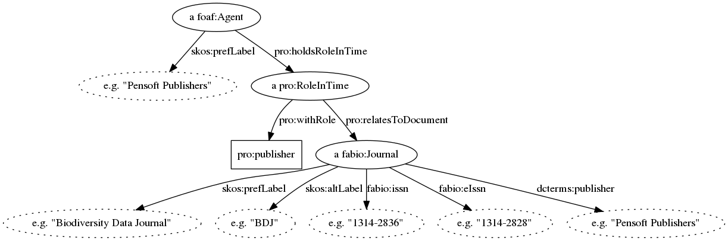
Semantic model of a biodiversity publication: Graph representation, Metadata
Legend:
black ovals: OBKMS nodes, not representing XML elements
dotted ovals: literals
boxes: non-OBKMS nodes

Slide 11
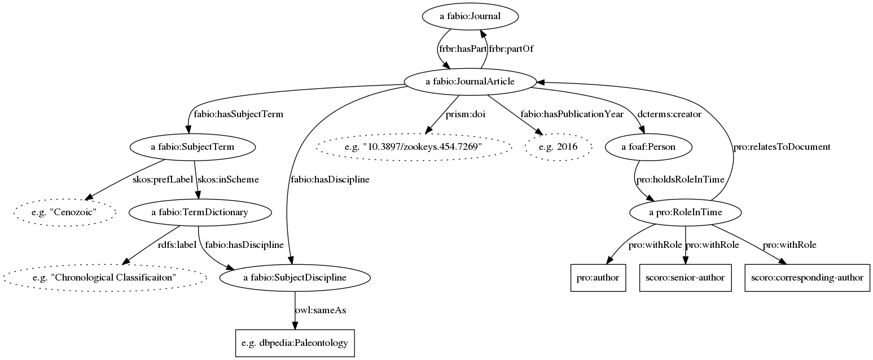
Semantic model of a biodiversity publication: Graph representation, Metadata
Legend:
black ovals: OBKMS nodes, not representing XML elements
dotted ovals: literals
boxes: ontology entities

Slide 12
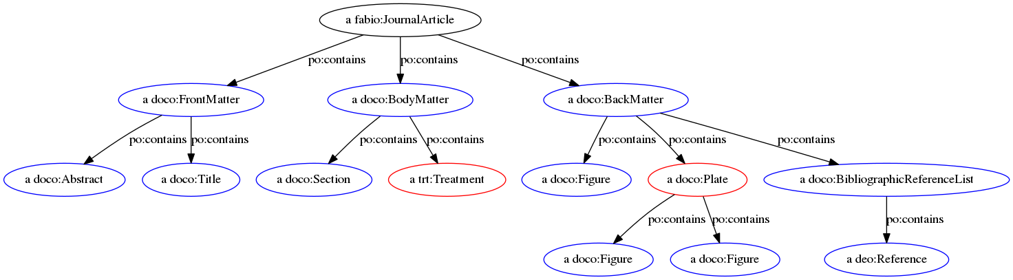
Semantic model of a biodiversity publication: Graph representation, Article structure
Legend:
blue ovals: OBKMS nodes, representing XML elements
red ovals: OBKMS nodes, representing XML elements, but not defined in SPAR

Slide 13
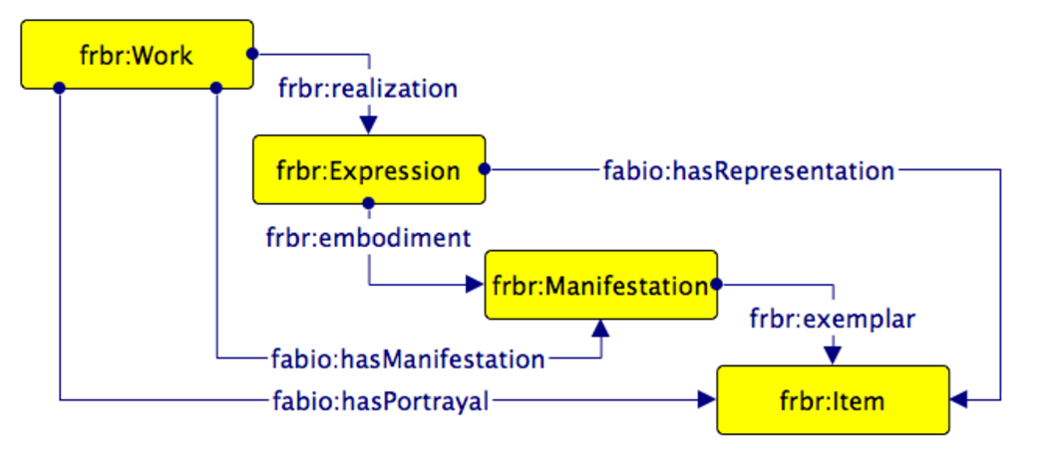
FRBR
Image credit: http://www.sparontologies.net/ontologies/fabio
Notes:
Parent document component of trt:TaxonNameUsage instance gives the context of the taxon name usage.

Slide 14
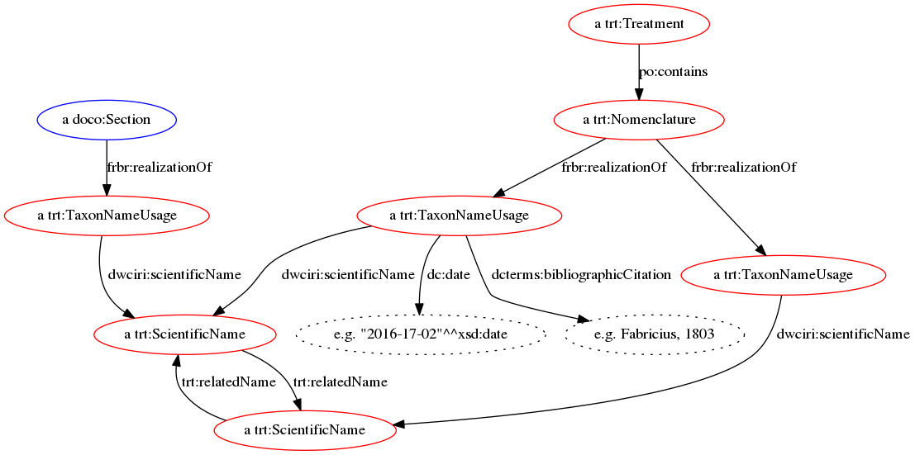
Semantic model of a biodiversity publication: Graph representation, Treatment

Slide 15
Properties of taxon name usage (TNU)
Property | Description
dwciri:scientificName | Links TNU to a trt:ScientificName
Type* | (Optional) E.g. “new sp.,“ new comb.,” etc.
dc:date | Gives the date of the taxon name usage as literal
dcterms:bibliographicCitation | (Optional) links the TNU to a bibliographic reference as literal
biro:references | (Optional) Links the TNU to a bibliographic reference
dwciri:toTaxon | (Optional) Links the TNU to a taxon (concept)
c4o:hasContent | Free text comments as literal
* Can be realized as sub-subproperty of dwciri:scientificName or as a separate type property
Notes:
A TNU links a bibliographic element (i.e. a nomenclature section) with a trt:ScientificName and potentially a taxon (concept).

Slide 16
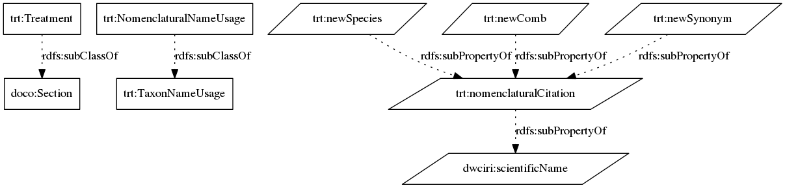
Semantic model of a biodiversity publication: Graph representation, Treatment ontology
Legend:
Parallelograms: properties

Slide 17
Example 1: Using the semantic model to understand the context of a taxon name usage
Task: find all taxon name usages in figure captions, where the caption indicates that we dealing with a voucher or a type specimen!
…
SELECT ?fig ?scientific_name ?caption_text
WHERE {
?name a trt:ScientificName ;
skos:prefLabel ?scientific_name .
?tnu a trt:TaxonNameUsage;
dwciri:scientificName ?name .
?fig frbr:realizationOf ?tnu ;
a doco:Figure ;
po:contains ?caption .
?caption c4o:hasContent ?caption_text.
FILTER (regex ?caption_text, "voucher") || regex(?caption_text, "type"))
}
SPARQL
Notes:
Parent document component of trt:TaxonNameUsage instance gives the context of the taxon name usage.

Slide 18
Notes:
Parent document component of trt:TaxonNameUsage instance gives the context of the taxon name usage.

Slide 19
Example 2: Using the semantic model to find related names
А rule for creating new relations:
PREFIX trt: <http://plazi.org/treatment#>
INSERT {
?a trt:relatedName ?b .
?b trt:relatedName ?a .
}
WHERE {
?a a trt:ScientificName .
?b a trt:ScientificName .
?c a trt:Nomenclature ;
frbr:realizationOf
[ dwciri:scientifiCName ?a ];
[ dwciri:scientificName ?b ].
}
# if two names are mentioned in the same nomenclature
# section then they are related
Define related names as a transitive and reflexive property in OWL:
trt:relatedName rdf:type owl:ObjectProperty ,
owl:TransitiveProperty, owl:ReflexiveProperty ;
rdfs:domain trt:ScientificName ;
rdfs:range trt:ScientificName ;
rdfs:comment “Indicates that two names are connected via a chain of nomenclatural name usages." .
Notes:
Parent document component of trt:TaxonNameUsage instance gives the context of the taxon name usage.

Slide 20
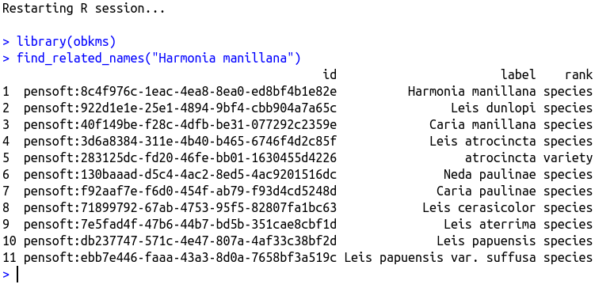
Example 2: Using the semantic model to find related names
R library enabling the taxonomist to browse OBKMS
Notes:
Parent document component of trt:TaxonNameUsage instance gives the context of the taxon name usage.

Slide 21
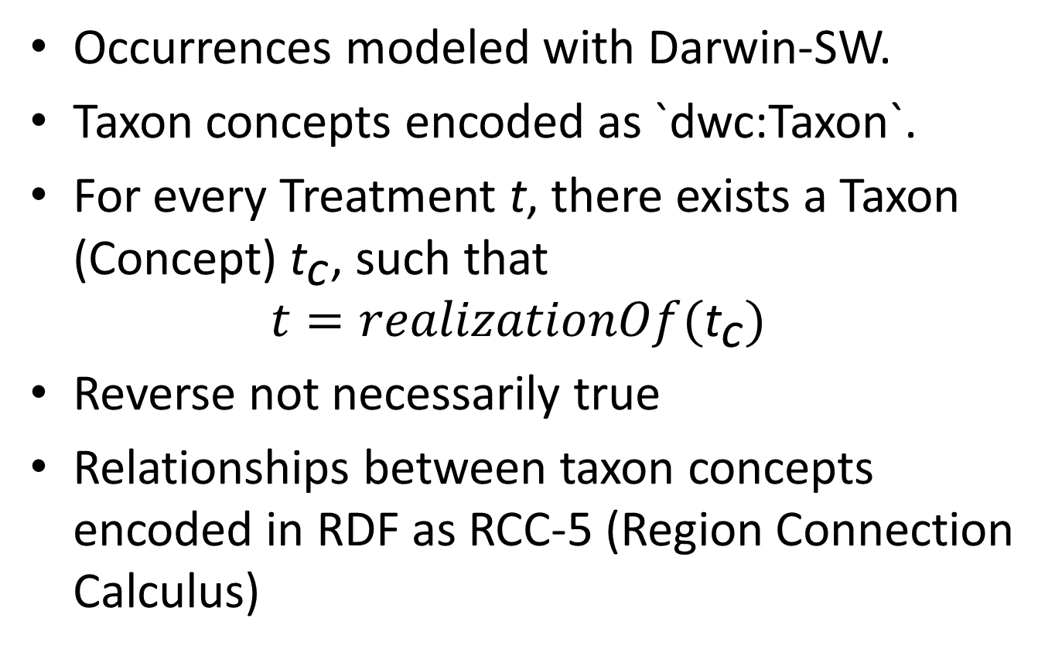
Modeling taxa (-on concepts) and occurrences
Occurrences modeled with Darwin-SW.
Taxon concepts encoded as `dwc:Taxon`.
For every Treatment t, there exists a Taxon (Concept) ${\text{t}}_{\text{c}}$, such that $t=realizationOf({\text{t}}_{\text{c}})$
Reverse not necessarily true
Relationships between taxon concepts encoded in RDF as RCC-5 (Region Connection Calculus)
Notes:
Parent document component of trt:TaxonNameUsage instance gives the context of the taxon name usage.

Slide 22
III. OBKMS as part of Linked Open Data

Slide 23
Information extracted from journals
Metadata (publishers, authors, keywords, etc.)
Document objects (sections, figures, references, etc.)
Scientific Names and Nomenclatural Acts
Taxa (concepts) and occurrence data
Location information
Genomic information
Notes:
Parent document component of trt:TaxonNameUsage instance gives the context of the taxon name usage.

Slide 24
Crosslinking of identifiers (examples)
OBKMS Identifier Type | External Link
fabio:SubjectDiscipline | DBPedia
trt:ScientificName | ZooBank
dwc:Location | GeoNames
dsw:Occurrence | GBIF
fabio:JournalArticle | DOI
foaf:Agent | ORCID
Notes:
Parent document component of trt:TaxonNameUsage instance gives the context of the taxon name usage.

Slide 25
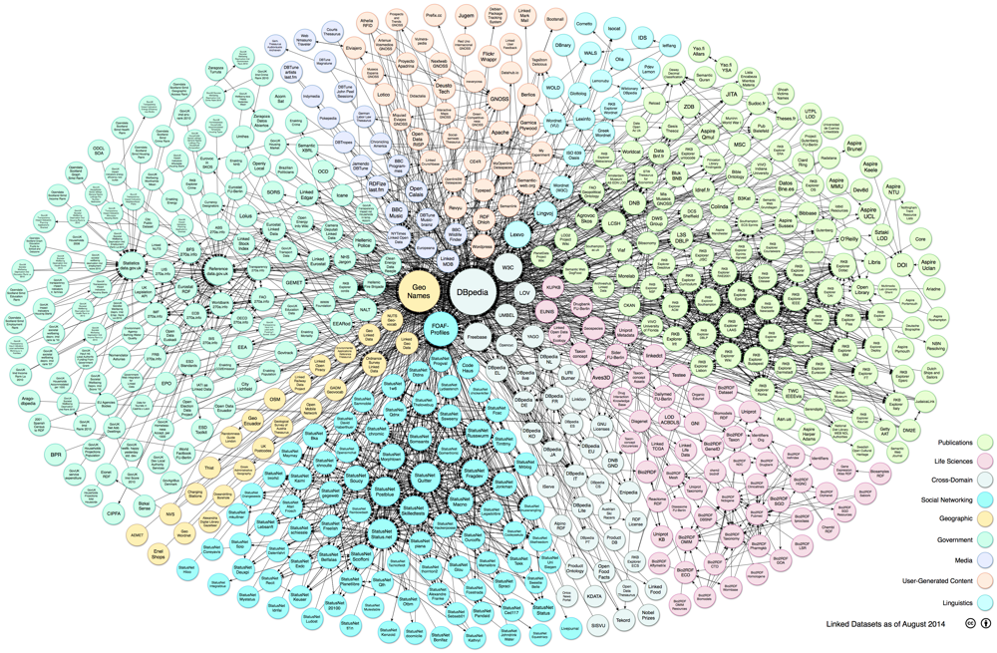
OBKMS Linked Open Dataset
Plain RDF
Nanopublications
Notes:
Parent document component of trt:TaxonNameUsage instance gives the context of the taxon name usage.

Slide 26
IV. Applications of OBKMS

Slide 27
OBKMS for collection managers and database aggregators
Semantic web-app
Track published museum specimens
Taxonomic API
Track new nomenclatural changes
Notes:
Inquire whether museum specimens have been published via occurrence ID or via DwC triplet
Metrics for published specimens:
How often has a specimen been cited?
Which collections are used the most?
Find related specimens
Semantic web-app for tracking the usage of museum specimens
Taxonomic API dealing with new or changed names and related information

Slide 28
OBKMS for scientists
Some ideas:
Estimate the number of undescribed species per taxon by looking at the frequency of species description in that taxon. Also: generate stats on taxonomic activities, e.g., most studied/ published taxa.
Perform hidden topic analysis and create a recommendation algorithm based on top of that.
Notes:
For taxonomy, OBKMS, provides rich information about taxa based purely on published research. Accommodates differences of taxonomic opinion (taxonomic concept).
For data science, OBKMS provides a rich corpus of textual information for text mining.
Except standard ASK-AND-TELL
Geographic search
Importance of figures, specimens
Integration with genomic databases

Slide 29
Thank you!
Research funded under Marie Skłodowska-Curie BIG4 project, Grant agreement Nr. 642241
Please visit the demonstration of the OBKMS prototype and nanopublication presentation
Wednesday CTEC Auditorium
09:00 – 09:15 Talk 1028 and Talk 1012
02:00 PM Workshop 08
Friday CTEC Auditorium
09:00 – 09:15 Talk 1011
Notes:
Parent document component of trt:TaxonNameUsage instance gives the context of the taxon name usage.

