Slide 1
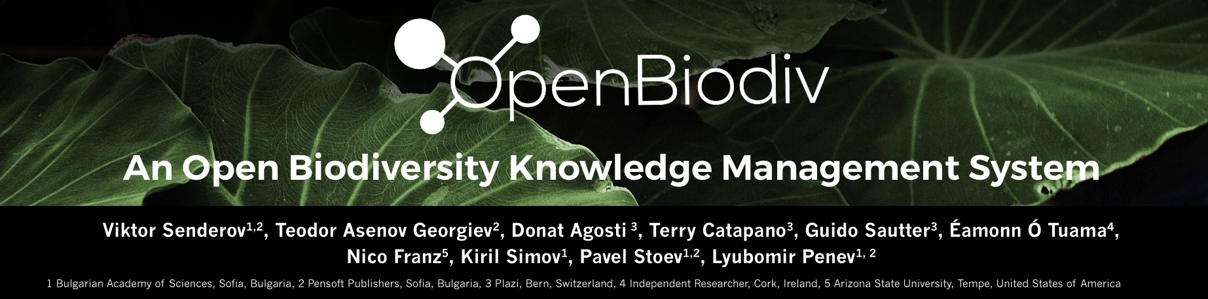




¾ Report
Viktor Senderov
Notes:
Good morning, TDWG, it is an honor to be here to the second time presenting the pilot of OpenBiodiv. My name is Viktor Senderov and I am part of Pensoft – student of Prof. Penev – who unfortunately cannot make it due to unexpected circumstances – and part of Marie-Curie’s BIG4 International Training Network in bioinformatics of insects. OpenBiodiv is also brought to you via Plazi, the swiss based “freedom fighter” if I may say so, who have so far open-sourced more than 100,000 articles in biodiversity.

Slide 2
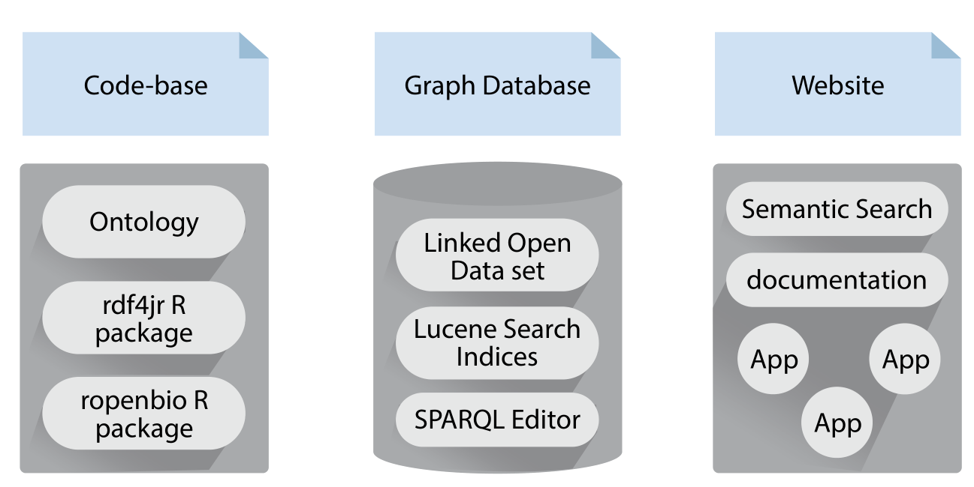
What is OpenBiodiv?
Notes:
OpenBiodiv is not one thing. In fact we use the name to refer to three distinct entities. Above everything else, OpenBiodiv is a semantic graph database. The database contains the LOD dataset but is a little bit more – it hosts a Lucene Search index, an API, a workbench with a SPARQL editor – all available to its users. To create the dataset/database we wrote own R libraries for RDF-ization and our own ontology – more about them later. While these two components were already present in a rudimentary form during last year’s TDWG, this year we also want to present to you the beta version of the website developed at Pensoft.

Slide 3
Objectives Accomplished So Far
Occurrence Data Workflow for BDJ
EML Workflow for BDJ
New BDJ Article Types (e.g. IUCN Conservation Profile)
Collaboration with Martin et al.
OpenBiodiv-O
Vocabularies
Taxonomic Status
Region Connection Calculus
Website Beta

Slide 4
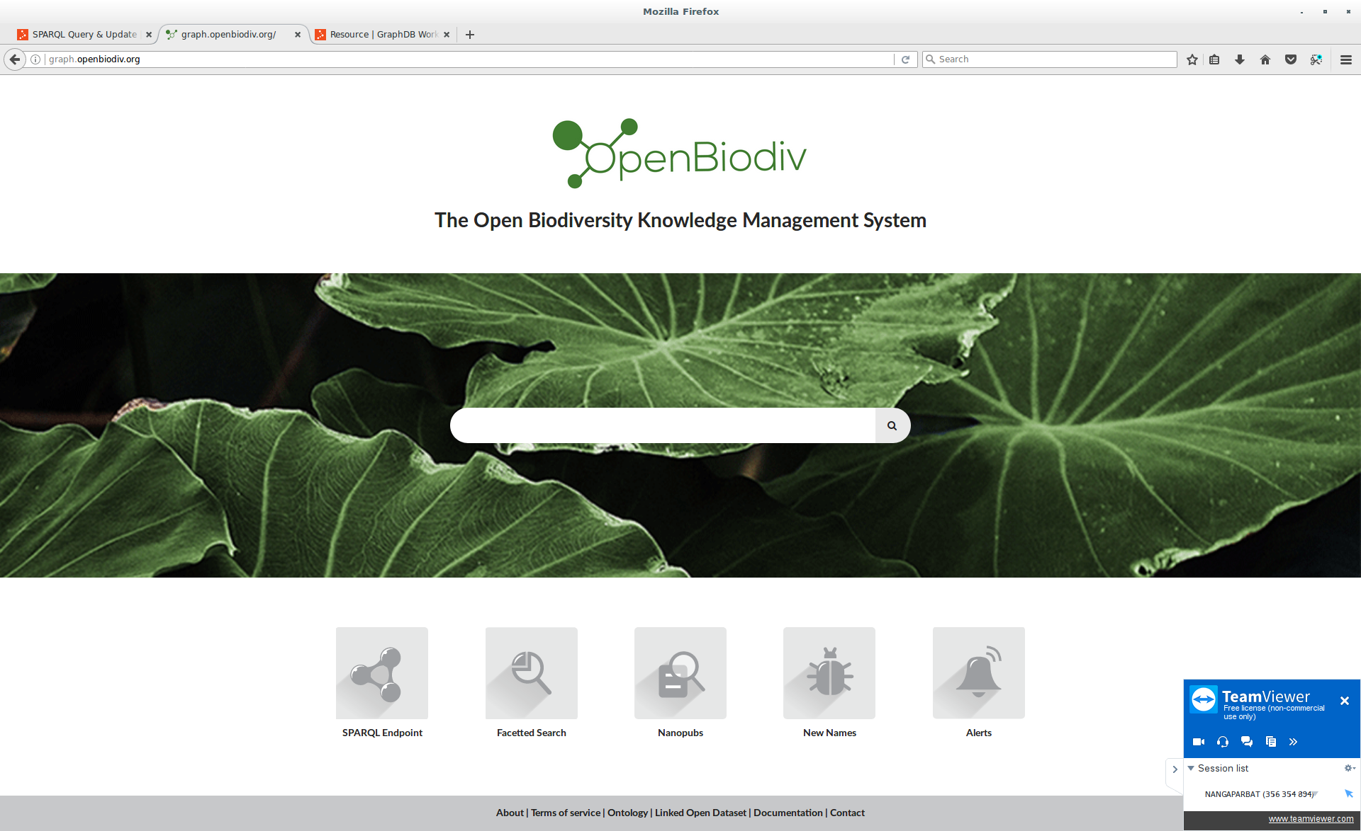

Notes:
Enough theoretical talk! The system is now on-line for all to test as a beta-release under openbiodiv.net!!
It’s main window features a semantic search interface as well access to various apps. The semantic search interface operates intuitively allowing you to browse the graph database based on the templates that we’ve created for key datatypes without the need to write SPARQL.

Slide 5
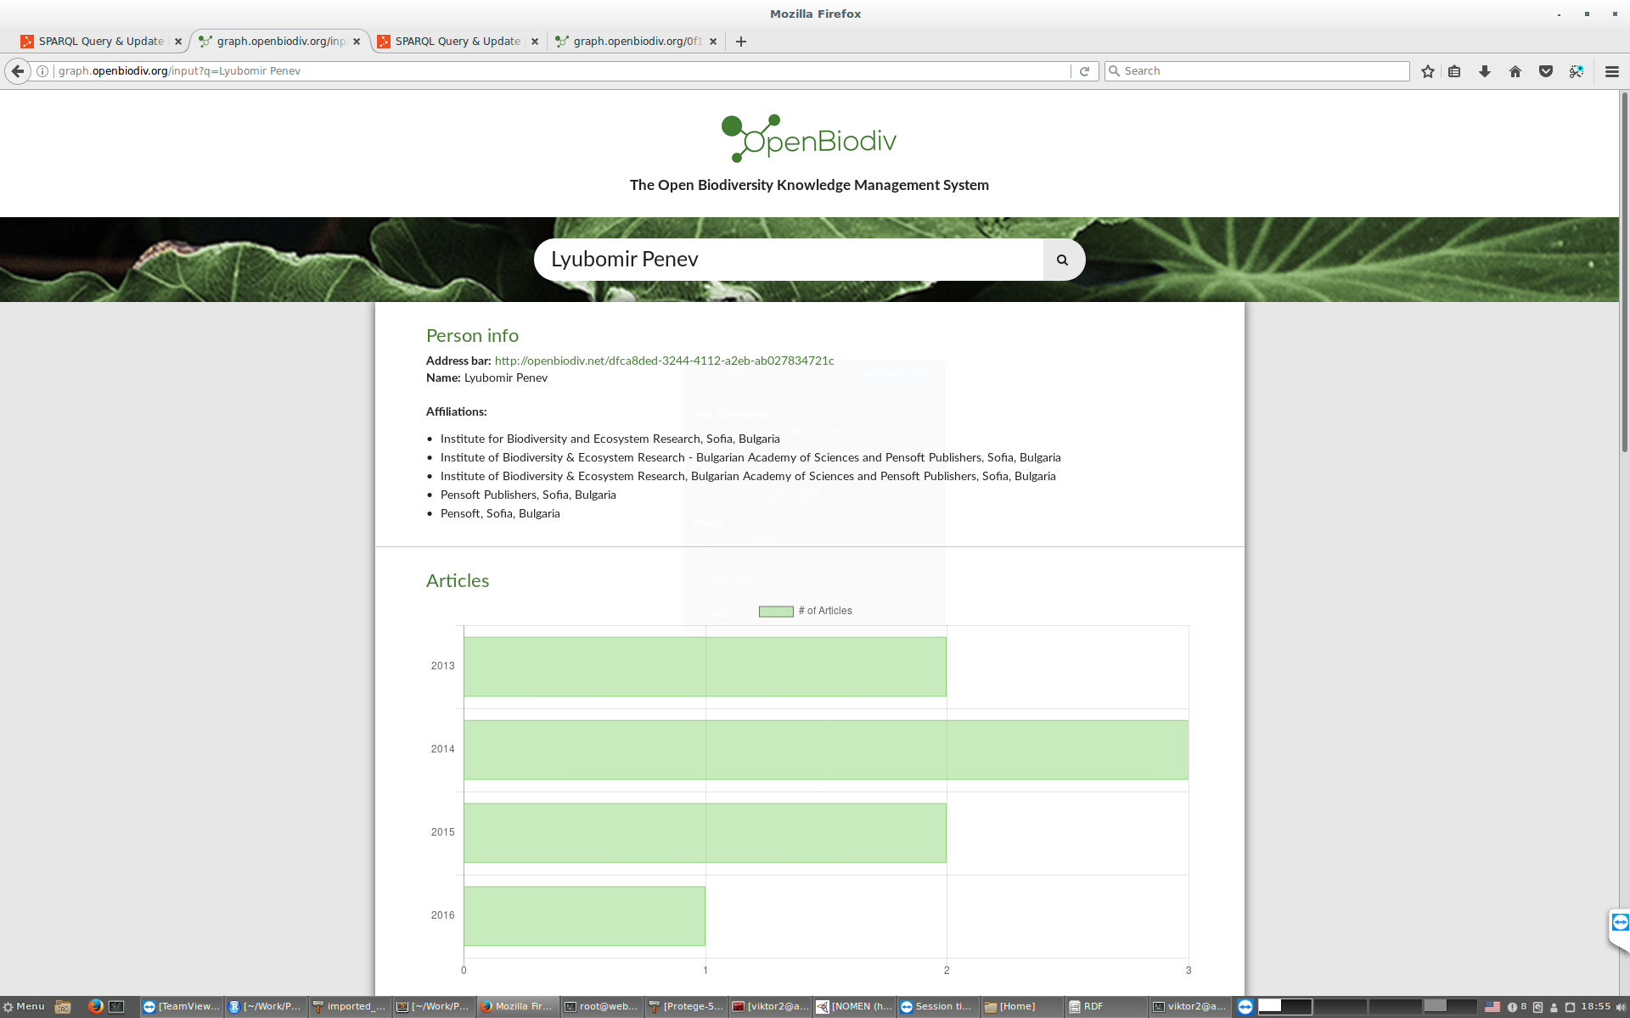
Notes:
For example, here I’ve typed the term Lyubomir Penev and the system has correctly identified it as a Person and invoked the Person template, giving me general information about the person as well as person statistics. From here I can also browse the top collaborators of this person and see their statistics.

Slide 6
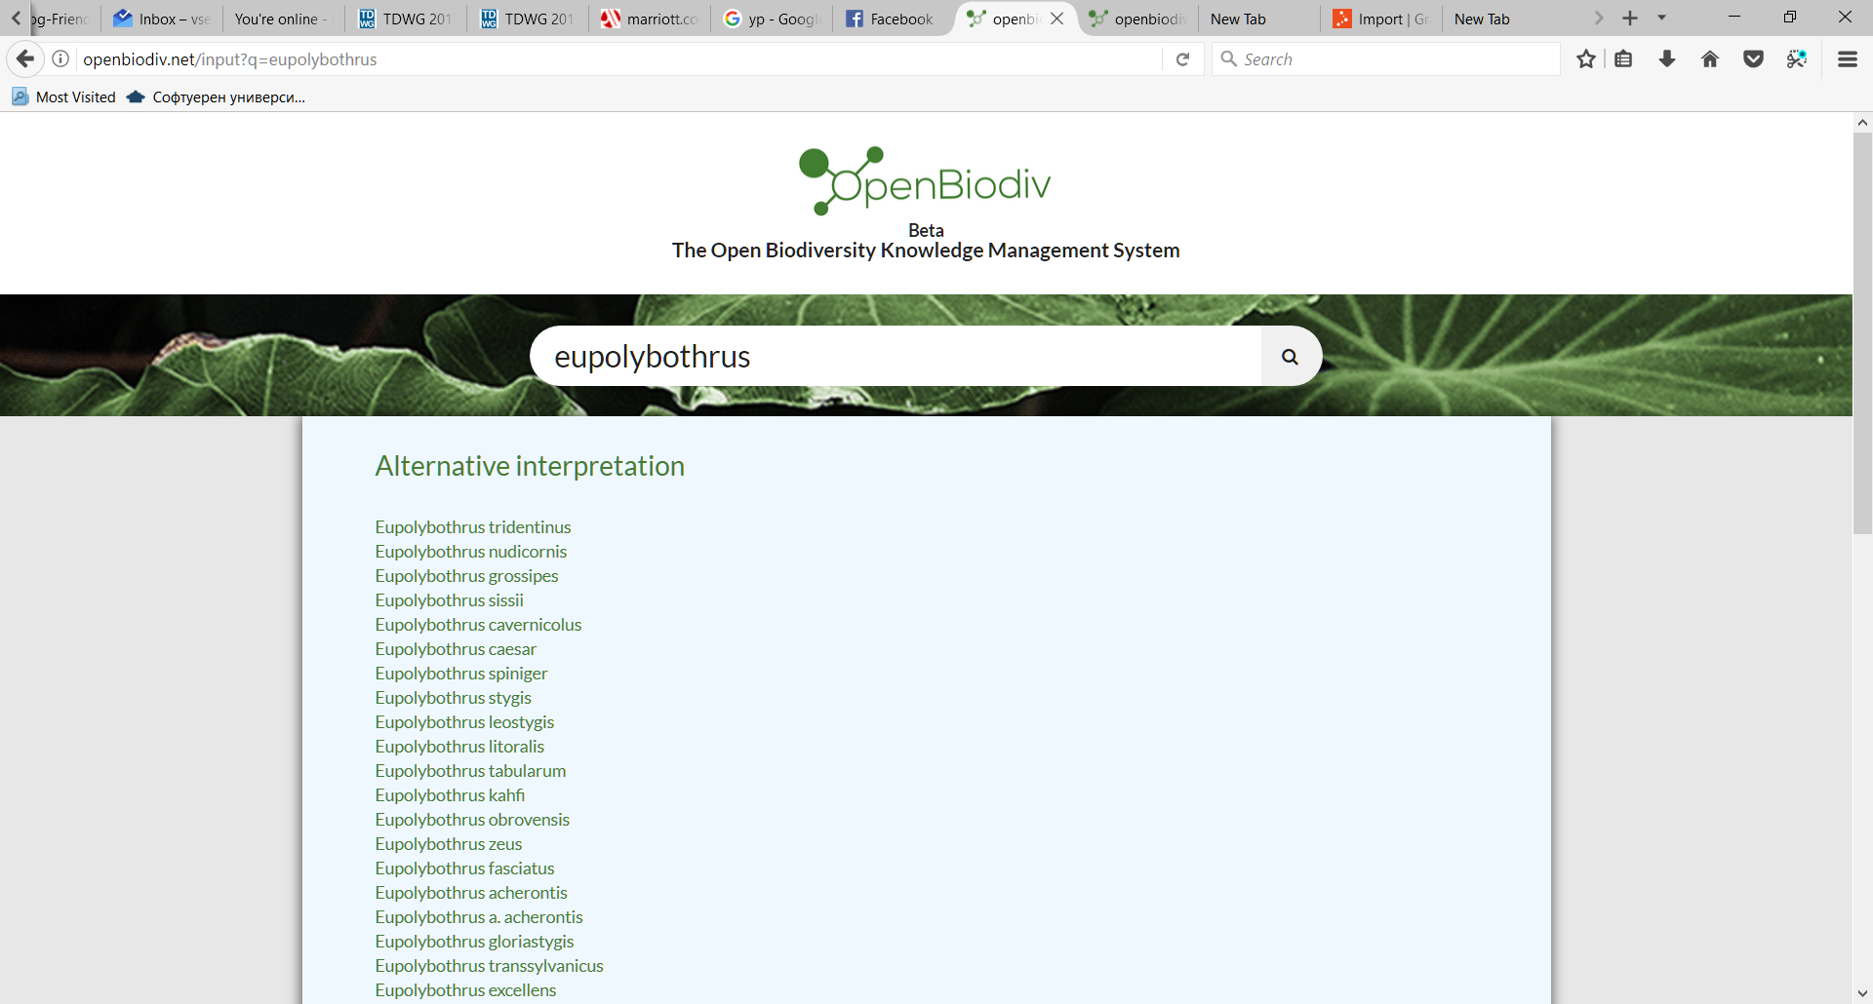

Slide 7



Journal Articles Published So Far
Publication date | Title | First Author | # A | Cit. | !Self
14.10.2015 | Virtual pathway explorer (viPEr) and pathway enrichment analysis tool (PEANuT): creating and analyzing focus networks to identify cross-talk between molecules and pathways | 0 | 6
01.11.2015 | The Open Biodiversity Knowledge Management System in Scholarly Publishing | 1 | 2 | 7 | 1
07.06.2016 | EMODnet Workshop on mechanisms and guidelines to mobilise historical data into biogeographic databases | 0 | 21 | 1 | 1
01.09.2016 | Species Conservation Profiles compliant with the IUCN Red List of Threatened Species | 0 | 5 | 6 | 3
23.09.2016 | Online direct import of specimen records into manuscripts and automatic creation of data papers from biological databases | 1 | 3 | 2 | 0
28.02.2017 | Strategies and guidelines for scholarly publishing of biodiversity data | 0 | 13 | 1 | 0
05.04.2017 | ARPHA-BioDiv: A toolbox for scholarly publication and dissemination of biodiversity data based on the ARPHA Publishing Platform | 0 | 9 | 0
06.21.2017 | A review of the Cercyon Leach (Coleoptera, Hydrophilidae, Sphaeridiinae) of the Greater Antilles | 0 | 5 | 0
Notes:
COLORS
BDJ LOGO
Utilizing Open science/ Open thesis
Feedback after the publication the publication of the phd plan – adapting the plan after recommendations

Slide 8
Talks at International Events and Posters Since Last Report
Dec. 2016 | Streamlining the Flow of Taxon Occurrence Data Between a Manuscript and Biological Databases | TDWG 2016 | yes
 | Nanopublications for biodiversity: concept, formats and implementation | TDWG 2016 | no
 | The Open Biodiversity Knowledge Management System: A Semantic Suite Running on top of the Biodiversity Knowledge Graph | TDWG 2016 | yes
 | Next Generation Publishing for Biodiversity using Pensoft's Arpha Writing Tool and Publishing System | TDWG 2016 | no
 | Demonstrating the Prototype of the Open Biodiversity Knowledge Management System | TDWG 2016 | yes
 | Creation of Data Paper Manuscripts from Ecological Metadata Language (EML) | TDWG 2016 | yes
 | Novel article formats in the ARPHA* Writing Tool and Biodiversity Data Journal | TDWG 2016 | no
2017-08 | OpenBiodiv | BioSyst.EU | yes
2017-10 | OpenBiodiv Computer Demo: an Implementation of a Semantic System Running on top of the Biodiversity Knowledge Graph | TDWG 2017 | yes
 | OpenBiodiv Poster: an Implementation of a Semantic System Running on top of the Biodiversity Knowledge Graph | TDWG 2017 | yes
 | OpenBiodiv: an Implementaion of a Semantic System Running on top of the Biodiversity Knowledge Graph | TDWG 2017 | yes
Dec. 2016 | Streamlining the Flow of Taxon Occurrence Data Between a Manuscript and Biological Databases | TDWG 2016 | yes
 | Nanopublications for biodiversity: concept, formats and implementation | TDWG 2016 | no
 | The Open Biodiversity Knowledge Management System: A Semantic Suite Running on top of the Biodiversity Knowledge Graph | TDWG 2016 | yes
 | Next Generation Publishing for Biodiversity using Pensoft's Arpha Writing Tool and Publishing System | TDWG 2016 | no
 | Demonstrating the Prototype of the Open Biodiversity Knowledge Management System | TDWG 2016 | yes
 | Creation of Data Paper Manuscripts from Ecological Metadata Language (EML) | TDWG 2016 | yes
 | Novel article formats in the ARPHA* Writing Tool and Biodiversity Data Journal | TDWG 2016 | no
Jul-16 | Species Conservation Profile | Island Biology Conference Azores Jul 2016 | no
Jul-16 | Alien Species Profile | Island Biology Conference Azores Jul 2016 | no
Aug-16 | Species Conservation Profile | IUCN Congress Hawaii Aug 2016 | no
2017-08 | OpenBiodiv | BioSyst.EU | yes
2017-10 | OpenBiodiv Computer Demo: an Implementation of a Semantic System Running on top of the Biodiversity Knowledge Graph | TDWG 2017 | yes
 | OpenBiodiv Poster: an Implementation of a Semantic System Running on top of the Biodiversity Knowledge Graph | TDWG 2017 | yes
 | OpenBiodiv: an Implementaion of a Semantic System Running on top of the Biodiversity Knowledge Graph | TDWG 2017 | yes
Dec. 2016 | Streamlining the Flow of Taxon Occurrence Data Between a Manuscript and Biological Databases | TDWG 2016 | yes
 | Nanopublications for biodiversity: concept, formats and implementation | TDWG 2016 | no
 | The Open Biodiversity Knowledge Management System: A Semantic Suite Running on top of the Biodiversity Knowledge Graph | TDWG 2016 | yes
 | Next Generation Publishing for Biodiversity using Pensoft's Arpha Writing Tool and Publishing System | TDWG 2016 | no
 | Demonstrating the Prototype of the Open Biodiversity Knowledge Management System | TDWG 2016 | yes
 | Creation of Data Paper Manuscripts from Ecological Metadata Language (EML) | TDWG 2016 | yes
 | Novel article formats in the ARPHA* Writing Tool and Biodiversity Data Journal | TDWG 2016 | no
Jul-16 | Species Conservation Profile | Island Biology Conference Azores Jul 2016 | no
Jul-16 | Alien Species Profile | Island Biology Conference Azores Jul 2016 | no
Aug-16 | Species Conservation Profile | IUCN Congress Hawaii Aug 2016 | no
2017-08 | OpenBiodiv | BioSyst.EU | yes
2017-10 | OpenBiodiv Computer Demo: an Implementation of a Semantic System Running on top of the Biodiversity Knowledge Graph | TDWG 2017 | yes
 | OpenBiodiv Poster: an Implementation of a Semantic System Running on top of the Biodiversity Knowledge Graph | TDWG 2017 | yes
 | OpenBiodiv: an Implementaion of a Semantic System Running on top of the Biodiversity Knowledge Graph | TDWG 2017 | yes

Slide 9
Symposia and workshops attended
14/09/2015 | 18/09/2015 | BIG Kick Off | Copenhagen | Danemark
01/06/2015 | 04/06/2015 | EU BON | Cambridge | UK
08/06/2015 | 09/06/2015 | EMODNET | Crete | Greece
09/07/2016 | 19/07/2015 | BEXIS | Jena | Germany
 | 2016-03 | EU-BON | Sofia | Bulgaria
26/03/2016 | 27/03/2016 | PlaziF Workshop | Sofia | Bulgaria
 | 2017-05 | PlutoF Workshop | Sofia | Bulgaria
05/06/2016 | 11/05/2016 | BIG4 Field Workshop | Havraniky | Czechia
 | 2016-10 | BIG4 Bioinformatics | Tovetorp | Sweden
 | 2016-12 | TDWG 2016 |  | Costa Rica
 | 2017-Spring | BIG4 Morphology | Vienna | Austria
 | 2017-05 | ESWC 2017 | Portoroj | Slovenia
 | 2017-08 | BioSyst.EU | Gothenburg | Sweden
 | 2017-10 | TDWG 2017 | Ottawa | Canada

Slide 10
Secondments and Short Visits
Short visit to ASU in December 2016
Secondment at Ronquist Lab : 15 Sep. - 20. Dec.
Planned secondment or short visit: ERA7

Slide 11
“Extracurricular Activities” in 2017
10-Week R Course R U Bio at Museum of Natural History, Bulgaria
R U Bio Bioinformatics course (4 hours) at Software University Bulgaria
Datathon Winner - #Dathaton17

Slide 12
Outlook
Major Publication One by Nov. 3!
“OpenBiodiv-O: The Ontology of the OpenBiodiv Knowledge System”
More pubs:
Populating the ontology/ publishing the R library
Applications of text-mining on the Pensoft/Plazi corpus
Short Visit to ERA7
Defense

Slide 13
Thank you
Financed through the European Union’s Horizon 2020 research and innovation program under the Marie Sklodovska-Curie grant agreement No. 642241. Responsibility for the information and views set out in this report lies entirely with the authors.

Slide 14
Courses Attended
Bulgarian Academy of Sciences Educational Program
Language Course
Computer Course
Introduction to Taxonomy
BIG4 Courses

