Slide 1



The OpenBiodiv Knowledge System: The Future of Access to Biodiversity Knowledge.
V. Senderov, T. Catapano, T. Georgiev, G. Sautter, N. Franz, K. Simov, D. Agosti, L. Penev
Pensoft Publishers and Bulgarian Academy of Sciences
Plazi, Bern
Arizona State University

Slide 2
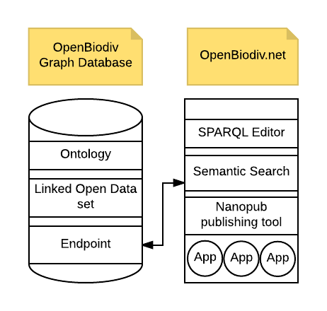
What is OpenBiodiv

Slide 3
Need for OpenBiodiv from the viewpoint of data science
Link Biodiversity Data
to e.g. genomics, biomedicine, geography, etc.
Extract Information
published in the narrative of papers
Discover Knowledge
using logic-based inference or statistical models
Link Data to Provenance
e.g. sources of citation
Common User Interface (UI) various resource classes

Slide 4
Need for OpenBiodiv from the viewpoint of biodiversity science
Reconciliation of names
Integrate data from dispersed sources
Dark taxa, Operational Taxonomic Units
Taxonomic concepts
Backbone taxonomies
Many other reasons…
Notes:
New technological method to approach the long-standing issues in taxonomy (reconciliation of names, use of taxonomic concepts, dark taxa, etc. )
Need in open democratic system of biodiversity data free of predefined hierarchical pre-requisites (e.g. a taxonomic backbone used as an “architectural backbone”; several taxonomic trees are possible and can be used in such a system)
Formalization of the taxonomic concepts and their use following a common data model
Joint formal management of LKinnean names and OTUs

Slide 5
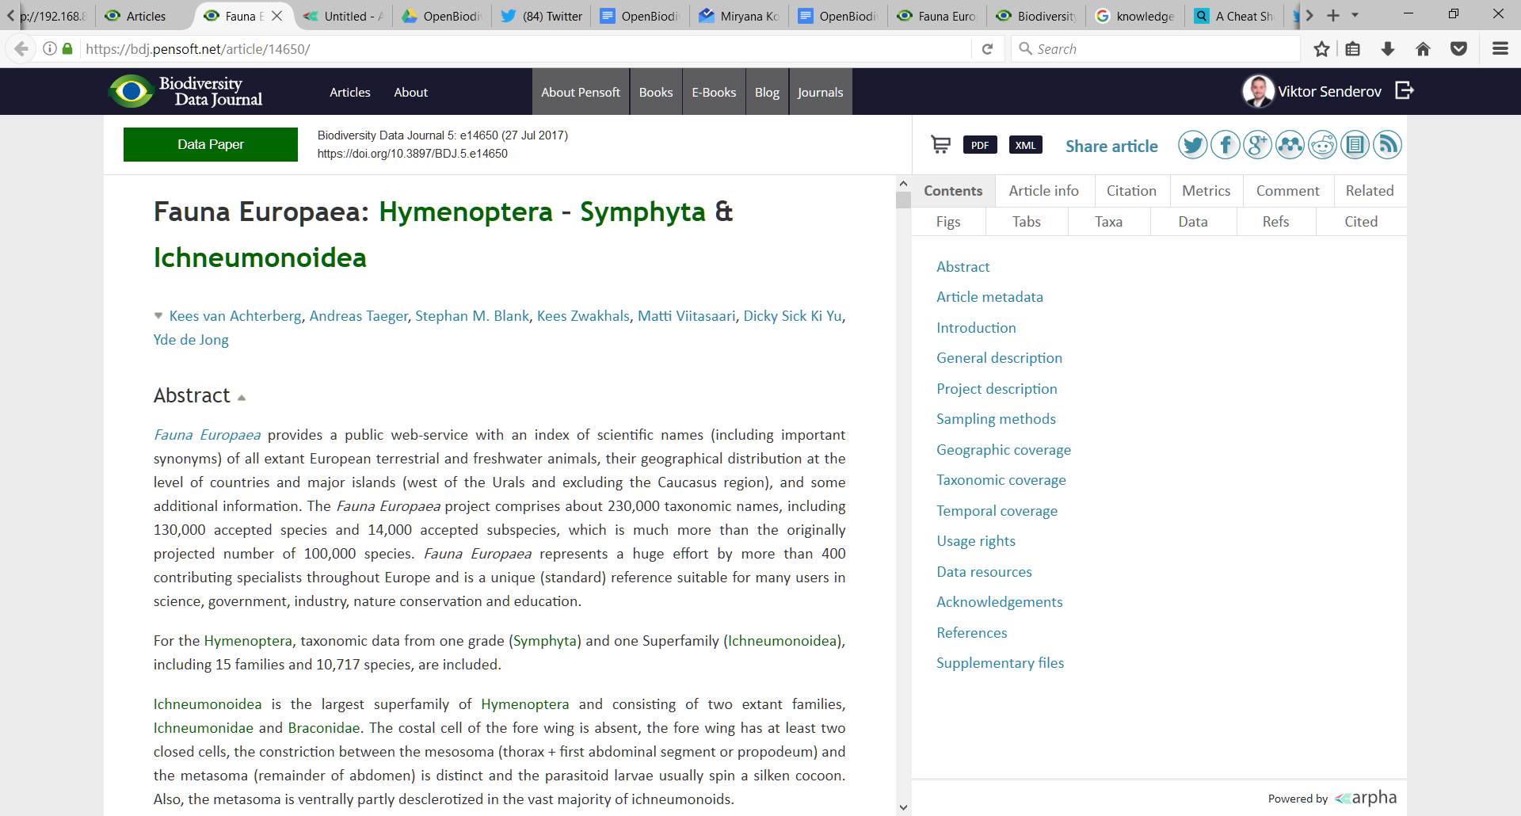

Slide 6
Origins of OpenBiodiv, Catanano (2010), Penev et al. (2012)
<tp:taxon-treatment>
<tp:nomenclature>
<tp:taxon-name> <tp:taxon-name-part taxon-name-part-type="genus">Vibrissina</tp:taxon-name-part><tp:taxon-name-part taxon-name-part-type="species">danmartini</tp:taxon-name-part> </tp:taxon-name><tp:taxon-authority>Fleming & Wood</tp:taxon-authority><tp:taxon-status>sp. n.</tp:taxon-status>
</tp:nomenclature>
<tp:treatment-sec sec-type="materials">
…
Notes:
Semantic publishing of biodiversity papers (XML tagging and TaxPub)
Text mining from legacy literature using same model as prospectively published papers
Semi-structured data:
Catapano, Terence. “TaxPub: An Extension of the NLM/NCBI Journal Publishing DTD for Taxonomic Descriptions,” 2010. https://www.ncbi.nlm.nih.gov/books/NBK47081/.
Penev, Lyubomir, Terence Catapano, Donat Agosti, Teodor Georgiev, Guido Sautter, and Pavel Stoev. “Implementation of TaxPub, an NLM DTD Extension for Domain-Specific Markup in Taxonomy, from the Experience of a Biodiversity Publisher,” 2012. https://www.ncbi.nlm.nih.gov/books/NBK100351/.

Slide 7
Semantic Web
Web Ontology Language (OWL)
Resource Description Framework (RDF)
Linked Open Data (LOD)
Notes:
https://www.cambridgesemantics.com/semantic-university/rdf-vs-xml
distributed data linking that RDF is meant to do.
Common model of terms, data classes and relationships between these
Rapid development of RDF, OWL and LOD technologies in all domains
XML is primarily a serialization format (we'll define this in a little more detail in a minute), while RDF is primarily a data model.
The serialization is like the grammar of a languagee,
https://www.w3.org/DesignIssues/RDF-XML
It is possible because there is a mapping from XML documents to semantic graphs. In brief, it is hairy because
The mapping is many to one
You need a schema to know what the mapping is
(The schemas we are talking about for XML at the moment do not include that anyway and would have to have a whole inference language added)
The expression you need for querying something in terms of the XML tree is necessarily more complicated than the expression you need for querying something in terms of the RDF tree.

Slide 8
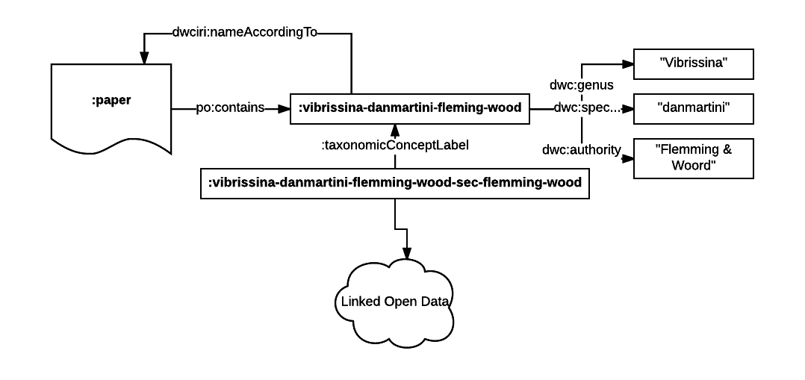
Resource Description Network

Slide 9
RDF
:paper pkm:mentions :vibrissina-danmartini-fleming-wood .
:vibrissina-danmartini-fleming-wood a :ScientificName ;
dwc:genus “Vibrissina” ;
dwc:specificEpithet “danmartini” ;
dwc:authority “Flemming & Woord” ;
dwciri:nameAccordingTo “http://dx.doi.org/10.5883/DS-ASVIBRI”;
:taxonomicStatus :TaxonomicDiscovery .
:vibrissina-danmartini-fleming-wood-original-concept
rdf:type :TaxonomicConcept ;
:taxonomicConceptLabel :vibrissina-danmartini-fleming-wood .
Notes:
How it works?
What is a RDF triple (perhaps continuing the XML example of the species name from the previous slide and translate it into an UNIVERSAL language (RDF)
Extracting data and creating triples
Linking triples via a common ontology model
Using triples to provide search, browsing and extracting
Using triples to make new inferences and create new knowledge from a potentially huge dataset of various classes and types of data
<tp:taxon-treatment>
<tp:nomenclature>
<tp:taxon-name> <tp:taxon-name-part taxon-name-part-type="genus">Vibrissina</tp:taxon-name-part><tp:taxon-name-part taxon-name-part-type="species">danmartini</tp:taxon-name-part> </tp:taxon-name><tp:taxon-authority>Fleming & Wood</tp:taxon-authority><tp:taxon-status>sp. n.</tp:taxon-status>
</tp:nomenclature>
<tp:treatment-sec sec-type="materials">
…

Slide 10
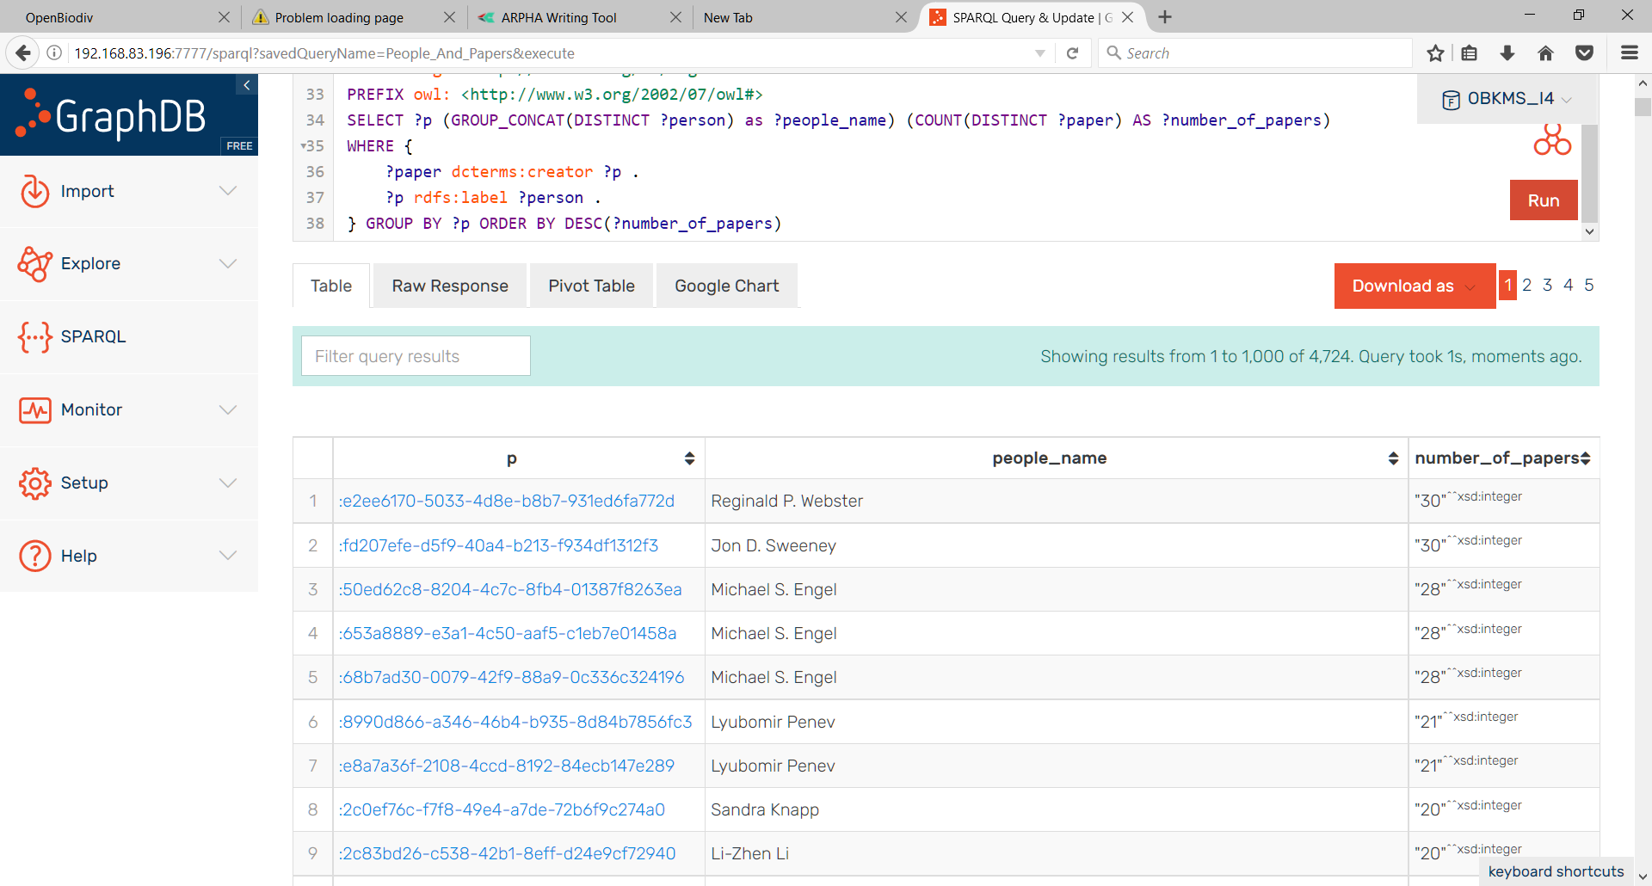

Slide 11
Real-life scenarios
http://192.168.83.196:7777/sparql
Can be used to publish small results directly in a semantic format.
Can be used to answer queries (competency questions). E.g.:
Who are the most prolific authors in a given journal/ taxon/ etc.?
Is Xa valid taxonomic name (in a nomenclatorial sense)?
Which treatments use different names for the same taxon concepts?
Which treatments are nomencl. linked (including homonyms!) to another treatment?
Con be used to combine machine learning techniques with semantics to obtain results surpassing formal logic: e.g. topic modeling, recommendation engines, etc.
Notes:
How it looks like in reality
Answering pre-defined questions, for example:
Which species have been described in family “XX-ceae or YY-idea” from Afrika between 1850 and 2010
Which specimens from collection XYZ have been published in the literature in certain period, and/or by certain taxonomist and so on.
Creating queries via user-friendly interface (similar to advanced search functionality but much wider ins scope and topics
Creating queries via SPARQL end-point – unlimited flexibility to work with large data from a particular or several federated linked open datasets
Rapid alerting services for any interested users on newly published names, nomenclatural acts, occurrences , facts, checklists, etc.
Automated profiles of taxon names and concepts
Extracting and de novo publishing of nano-publications from OpenBiodiv
New taxa and names
New species hypotheses or OTUs
Nomenclatural changes
Refining taxonomic concepts (annotations on published taxonomic concepts – taxonomic concept alighments)
New occurrences
New biological facts
New traits
Nanopublications in the form of annotations on other nanopublications (e.g. nao-reviews)
Data re-use via specially developed apps linked to the system
Use by machines via Application Programming Interfaces (APIs)

Slide 12
Thank you
Research financed through the European Union’s Horizon 2020 research and innovation program under the Marie
Sklodovska-Curie grant agreement No. 642241

