Slide 1


Pensoft Webinar: Automating publication using the ARPHA writing tool and the Pensoft API
Viktor Senderov, Lyubomir Penev
PhD Financed through the EU Marie-Sklodovska-Curie Program
Grant Agreement Nr. 642241

Slide 2
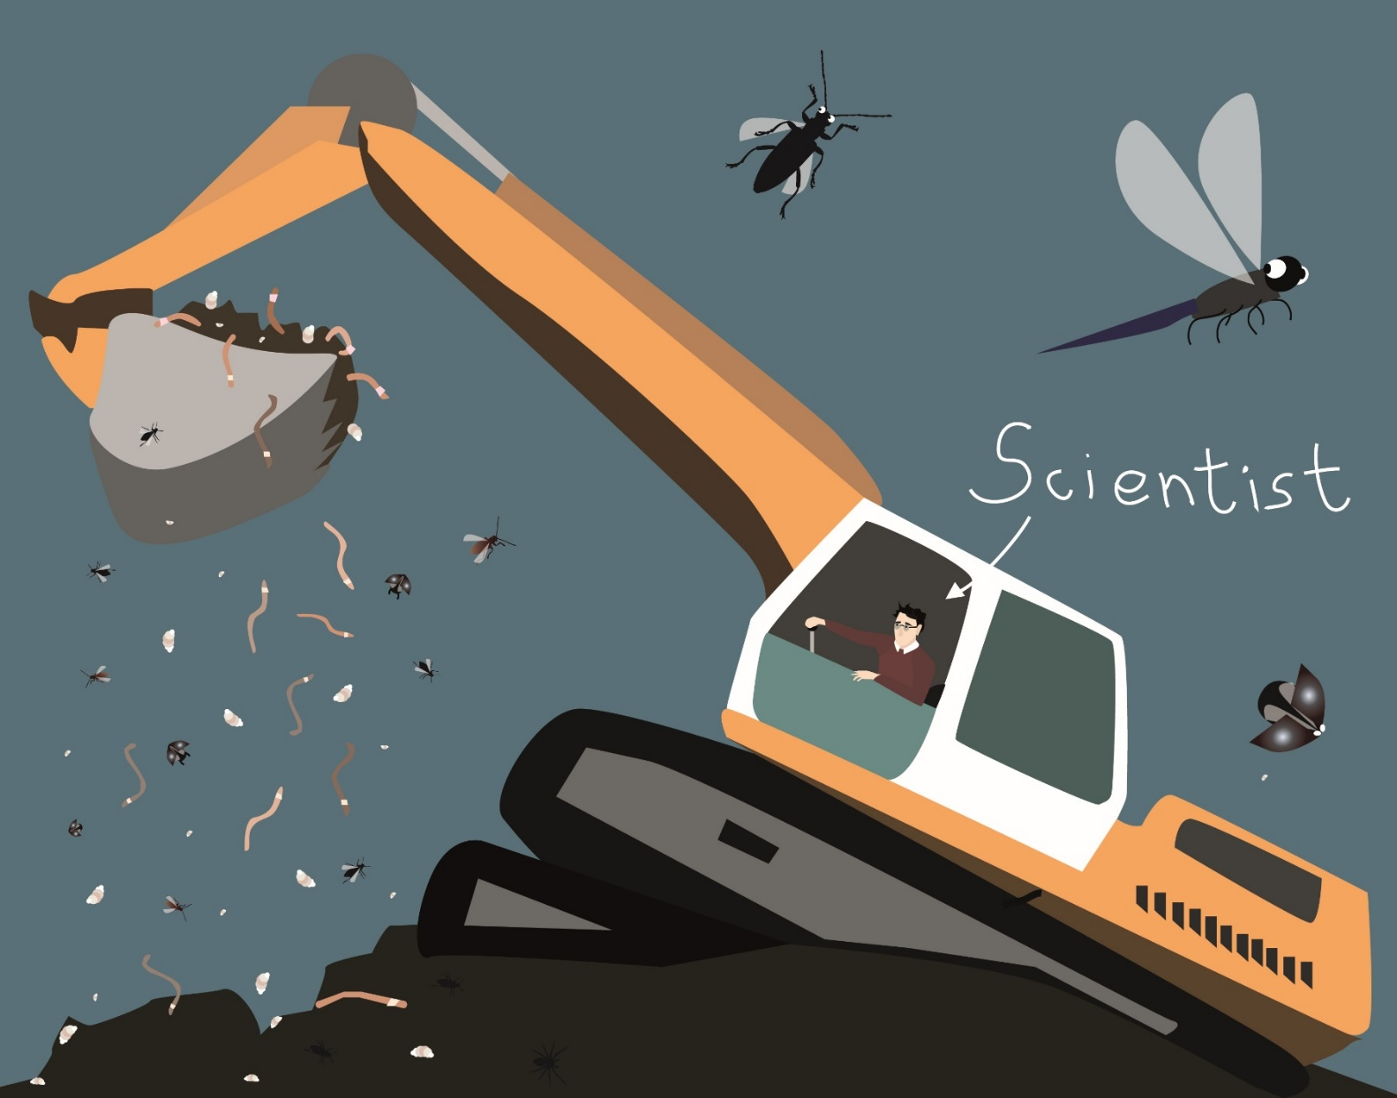
Data deluge: We sample now more than we can digest (analyze/publish)
Artist: Slavena Peneva

Slide 3
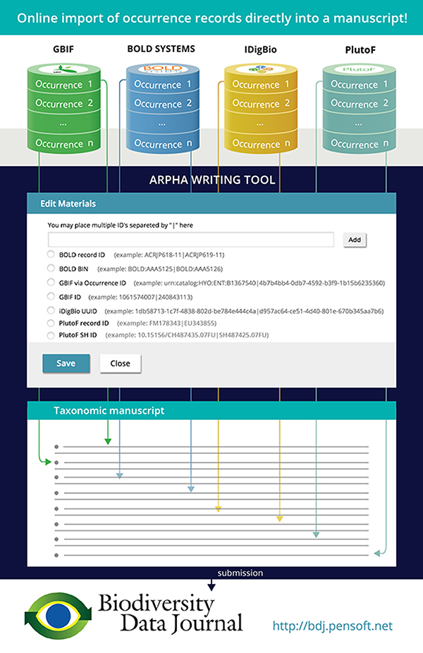
This fictionalized workflow presents the flow of information content about biodiversity specimens or biodiversity occurrences from the data portals GBIF, BOLD Systems, iDigBio, and PlutoF, through user-interface elements in ARPHA to textualized content in a research manuscript in Biodiversity Data Journal.
In the next few slides, we illustrate the workflow using the example of iDigBio.

Slide 4
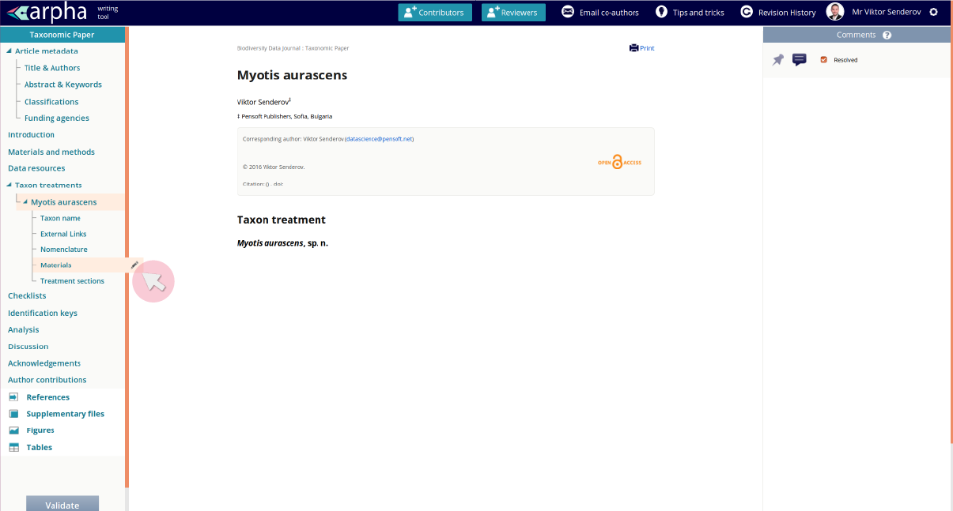
Step 1: Create a treatment in ARPHA and edit its materials

Slide 5
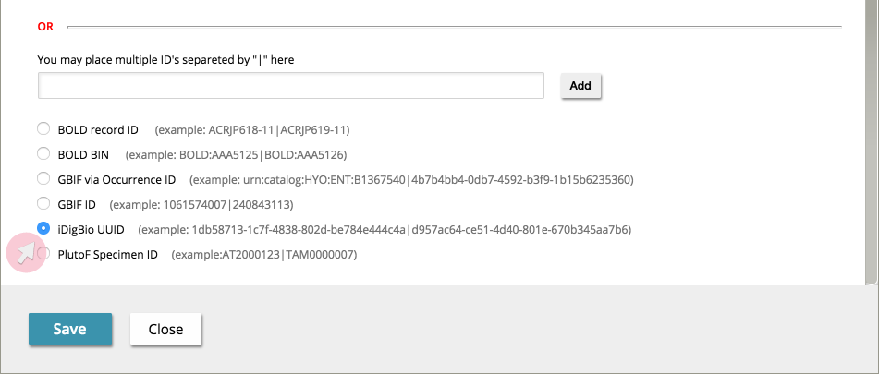
Step 2: Select the iDigBio radio button in the user interface of ARPHA

Slide 6
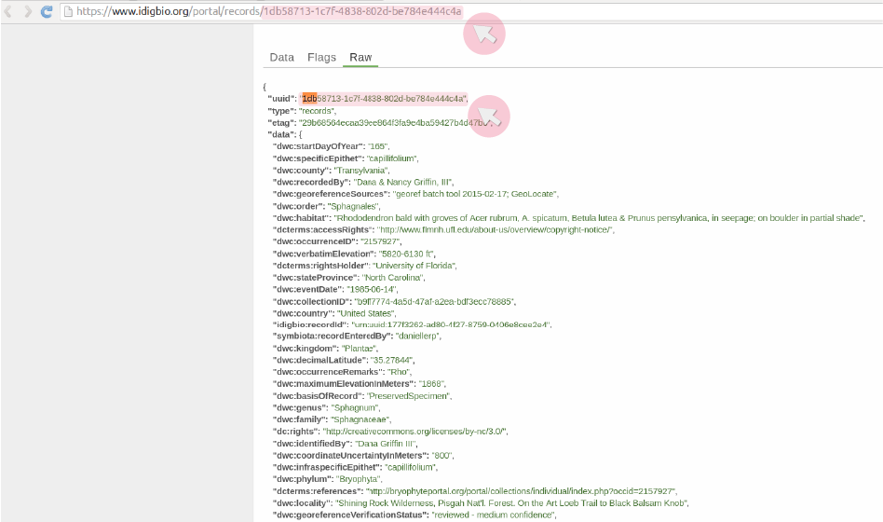
Step 3: Locate the specimen UUID in the iDigBio web-page and copy-paste it

Slide 7
At this point in the presentation a live demo was presented

Slide 8
The Pensoft API
http://arpha.pensoft.net/dev/
Allows to import different types of papers as XML:
Software Description
Taxonomic Paper
Data paper
Etc.

Slide 9
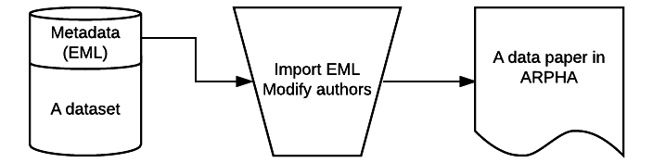

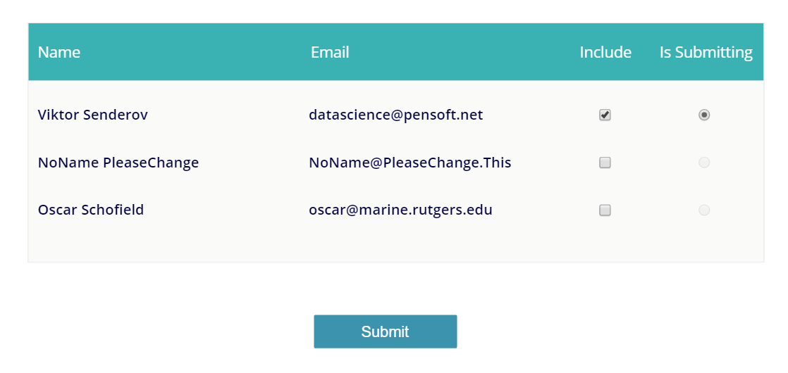
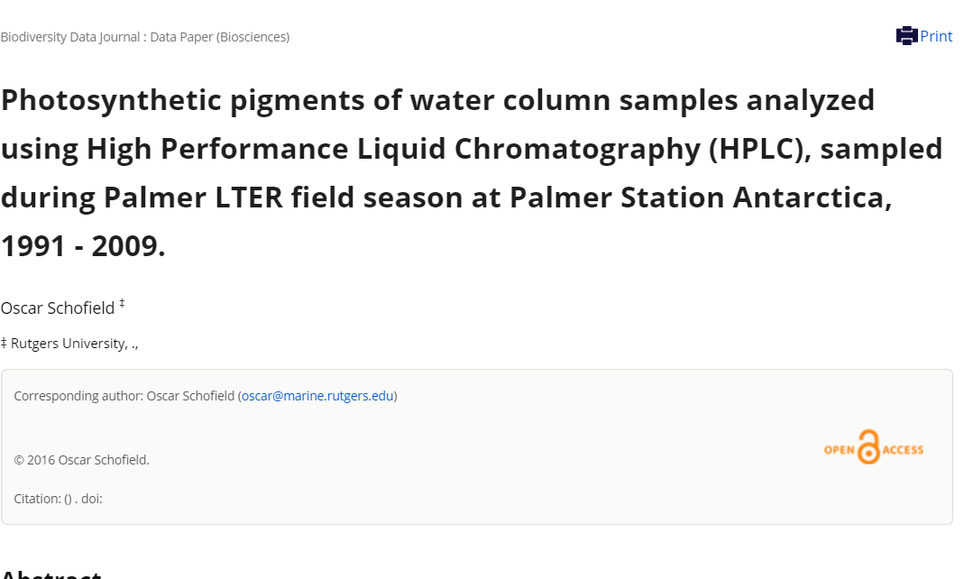


Datapaper workflow: automatic generation of manuscripts in ARPHA from metadata stored as Ecologocial Metadata Lanuage (EML)

