Slide 1
Open Biodiversity Knowledge Management System
Viktor Senderov (@vsenderov)

Slide 2
Webinar information
Webinar introduces setting up the Open Biodiversity Knowledge Management System (OpenBiodiv/OBKMS) in the context of Linked Data and the Semantic Web
Time: 20 February 2017 at 20:00 Sofia/12:00 Central Standard Time (US)/18:00 UTC Link: https://hangouts.google.com/hangouts/_/vwbl776a7ttg6say4ywwlvfhrua

Slide 3

Viktor Senderov
PhD Candidate from the BIG4 Consortium
Background in computational geometry, population genetics and bioinformatics
Mail me at `datascience` at the domain of the company that I work for http://pensoft.net/
Blog: http://openbkms.blogspot.com/

Slide 4
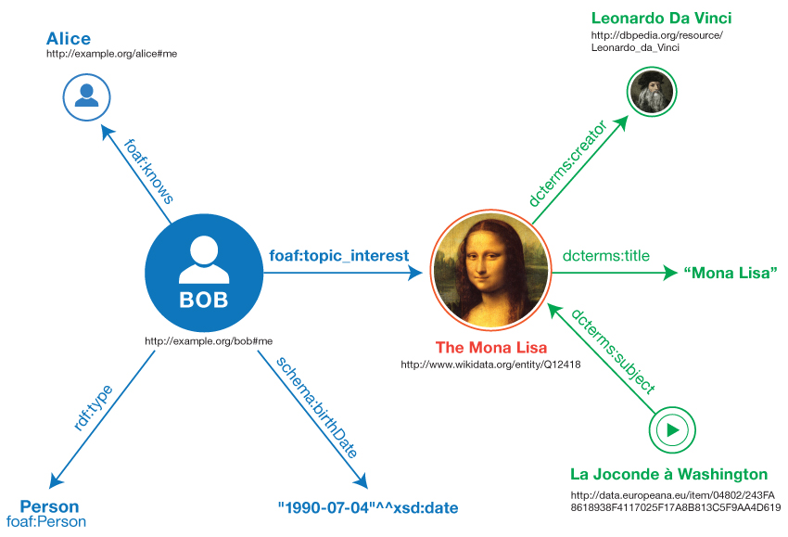
Open Biodiversity Knowledge Management System
OpenBiodiv/OBKMS
Knowledge graph
Ontology
Individuals (extracted information)
Tools for information extraction
`obkms` R library
Database
GraphDB
`rdf4jr` R library
Webpage
http://openbiodiv.net/
Credit: RDF Primer

Slide 5
Information extraction from Biodiversity Data Journal
Uses the TaxPub XML schema
“An Extension of the NLM/NCBI Journal Publishing DTD for Taxonomic Descriptions”
Example: http://bdj.pensoft.net/browse_articles
See https://www.ncbi.nlm.nih.gov/books/NBK47081/
RDF Guide is here:
https://github.com/pensoft/OpenBiodiv/blob/master/Ontology/RDF_Guide.md

Slide 6
Generating RDF from marked-up text (TaxPub)
https://github.com/pensoft/OpenBiodiv
R libraries `obkms`, `rdf4jr`.
Demo in R Notebook: semantic_web_working_group.html
Not functional programming! Change of Knowledge Base during parsing.
See http://curtclifton.net/papers/MoseleyMarks06a.pdf

Slide 7
How to do it properly (functionally)?
Start with TaxPub XML
Process entities:
Recognize two types of entities in our case :
document elements (sections, figures, tables, etc.)
referential (external) entities (taxa[-on concepts], geographic places, persons, etc.)
Coreference external entities (f.i. “Aus bus = A. bus”)
Get or create identifiers (from the XML, Knowledge Base, or external knowledge bases)
Return a list of detected, co-referenced entities with identifiers
Create triples by assigning properties to every detected entity
Serialize and submit to the Knowledge Base

Slide 8

Strategies for managing the RDF
GraphDB
License thru Bulgarian Academy of Sciences
Free version limited to two queries in parallel: fully sufficient for development
Benchmarks:
http://ontotext.com/products/graphdb/benchmark-results/

Slide 9
Services
Soon to be online:
http://openbiodiv.net/
SPARQL endpoint + queries (similar to http://factforge.net/ )
Documentation
Search interface for OpenBiodiv/OBKMS
Semantic Apps, some possible examples:
Newly described species (of interest to name aggregators)
Taxon concept browser
Find related articles

Slide 10
Nanopublications
See other presentation

