Slide 1

UX2 Project: Book Bay

Slide 2
Introduction
Roles & Responsibilities
Discover
Hypothesis
Problem Definition
Lean UX Canvas
User Research
Panic or Pivot
Improved Solution
User Personas and Research Pyramid
Product/Industry Research (Competitive Analysis, Market Trends)
Define
Scope & Constraints
Features Overview
Design
Brand
Brainstorm Session, Initial Sketches
Wireframes, Sitemaps
Deliver
Interactive Prototype
Usability Testing
Top Insights
Outcomes
Lessons Learned
Future Opportunities
Q&A

Slide 3
Roles & Responsibilities
Collaboration and insight from mentors Don Hansen, Jaclyn Mann, and Phen Pedron
Directed by survey results and interviews from potential customers Christina, Josh, Yarina, Lydia, Loraine, Katie, and Bee
Prototype testing done by Esther, Jessica, Ross, Tyriesha, and Ernie

Slide 4
It started out as a hypothesis:
A lot of people enjoy using audiobooks due to flexibility and ability to multi-task while using them
More people would use audiobooks if there was a way to customize the experience with features such as drawing pictures, bookmarking, underlining, adding your own audio notes, etc.

Slide 5
That turned into a problem:
A majority of people read audiobooks but 75% of customers prefer printed books over any other format.
Customers report that limited time and difficulty focusing prevent them from reading as much as they like.
Discover

Slide 6
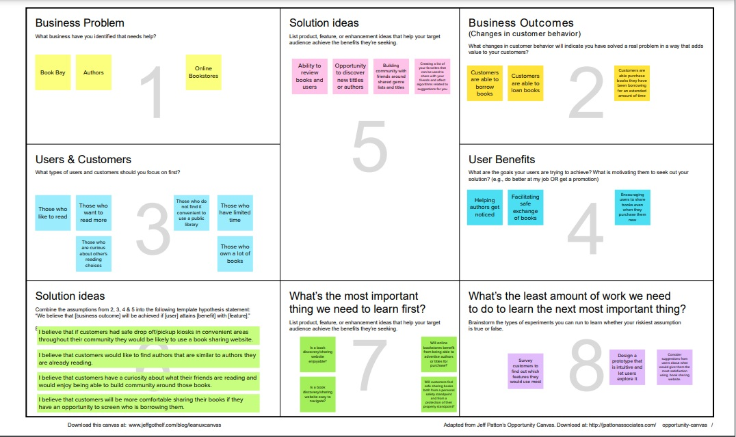
Lean UX
6
Discover

Slide 7
The solution to that problem got clearer as I dove into user personas and surveyed potential customers.
Discover

Slide 8
Initial Survey
Surveyed 24 users that ranged from ages 24-58
83% of those surveyed state they enjoy reading
75% of those surveyed prefer printed books over audiobooks, kindle, or any other format
Discover

Slide 9
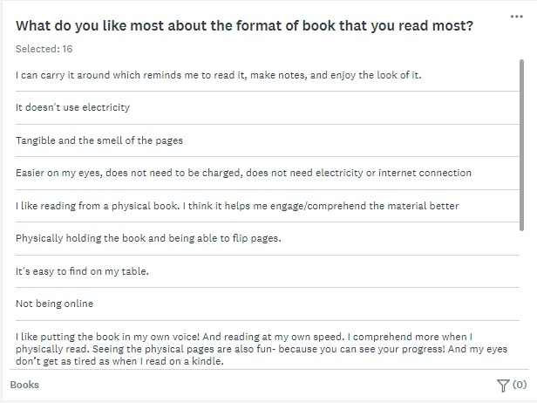
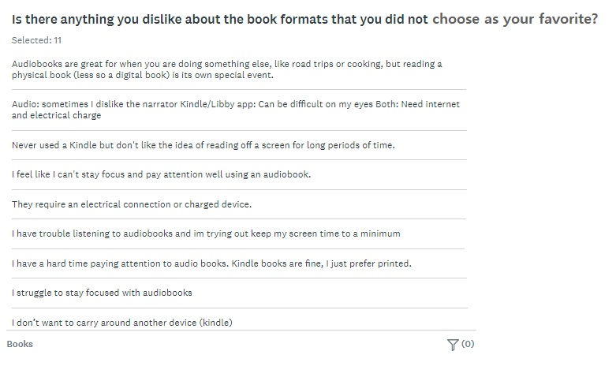
Do I panic or do I pivot?
Initial survey results demonstrated that while many people utilize audiobooks, there are certain desirable qualities of printed books that resonate with people that cannot be reproduced in an audio book.
Discover

Slide 10
Follow-up survey results → improved solution:
Design a website that encourages users to utilize their preferred format of book
The website would have a similar layout to Spotify with features of discovery and personalization
It would include the ability to share reviews of those who loan and borrow books
In conjunction with this website, convenient and safe exchange kiosks would be present throughout the community in a similar mode of exchange as Redbox
Discover

Slide 11
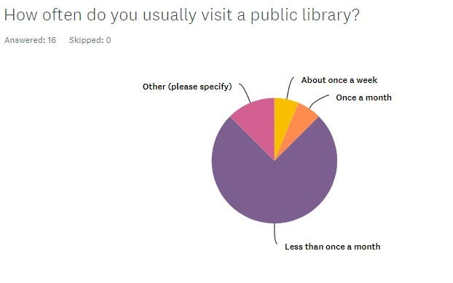
Addressing A Concern:
I needed to consider the impact that a book sharing website would have on free book sharing services such as the public library
The follow-up survey demonstrated that our potential customers are not likely to be among those who currently frequent the public library
Those surveyed list the following as reasons they do not visit a public library:
“work hours”
“laziness and ease of access to book online”
“lack of time dedicated to reading”
“the local library is out of my way physically and I get what I need from the app”
“need a reason to go”
“available selection of books and inconvenient opening hours”
“busy schedule and kids”
“time and hours of library”
“the fact that I always forget to return my library books and I think they have a hit on me now”
“travel. damage book. forget to return”
Discover

Slide 12
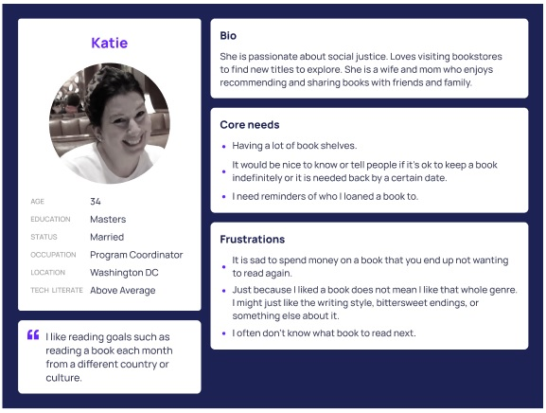
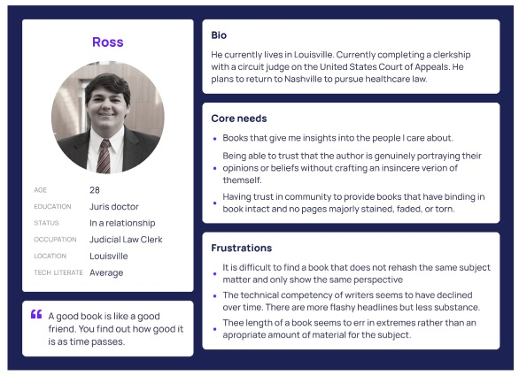
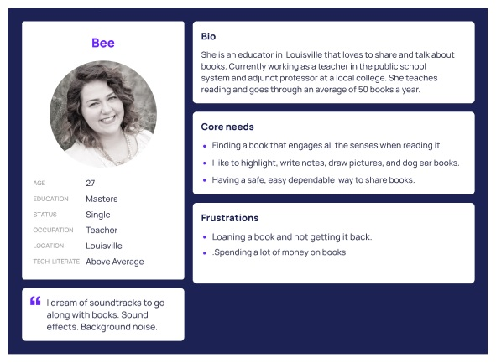
User Personas
Discover

Slide 13
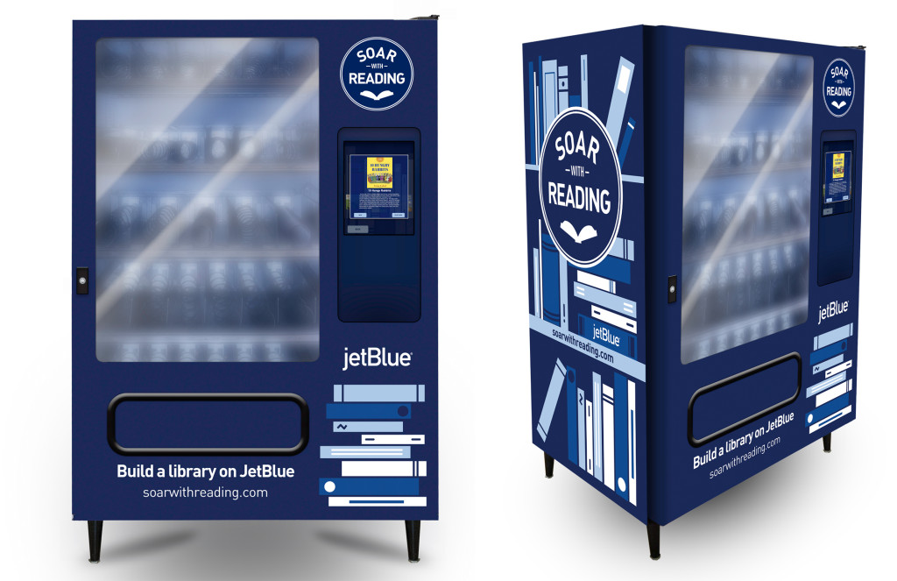
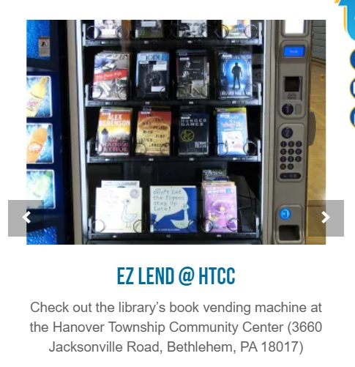
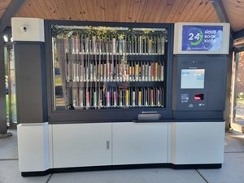
Market Research
JetBlue airlines had book kiosks in Southeast DC until the pandemic caused them to go virtual
Was geared toward children allowing them to select their age and topic
Libraries in PA & CA installed book vending machines to expand their reach
Discover

Slide 14
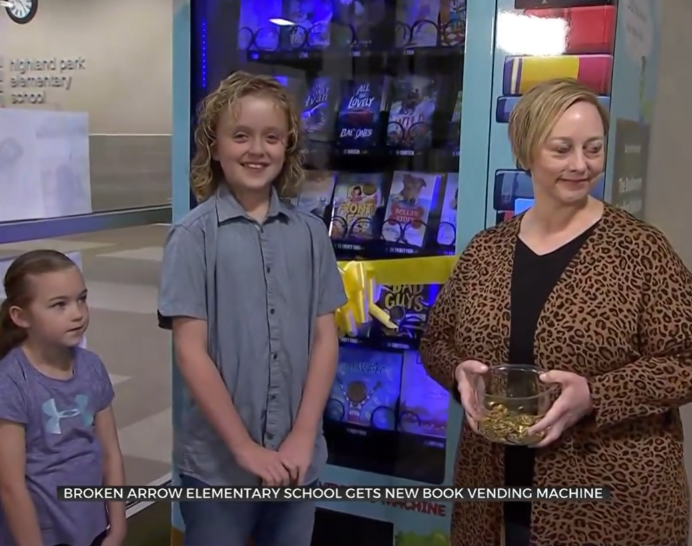
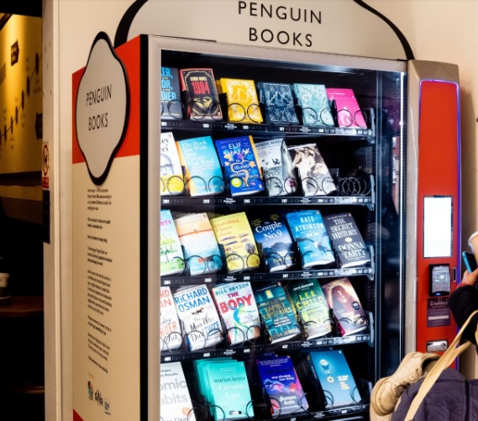
Market Research (continued)
An elementary school in OK installed a book vending machine
Students can use tokens from their teachers to borrow these books
They earn tokens by displaying tenacity, integrity, gratitude, expectations, and respect.
These books are considered purchases rather than loans
A train station in Exeter, England installed a book vending machine from Penguin Books
Discover

Slide 15
Book Kiosks in The Community
Are frequently geared toward children
Often present in or near libraries
May have drawbacks during public health crises
Seem dependent on spur of the moment decisions
Appear to be limited to what is in the kiosk at that moment
Discover

Slide 16
Opinions: break
ratings down
by categories,
should allow people to defend
themselves from bad ratings
Preferences: flexible deadlines, following authors, following friends, finding more of the type of book I like, having a recommended list, give book away than loan it to avoid expectation of getting it back
Motivations: not feeling rushed to read, seeing rating before matched with a book, more recent ratings weighted more heavily, sharing the experience
Goals: save money, not having books damaged, not having books lost, meeting return deadline, having safe exchange of books
Needs: time, reminder to return books, convenient hours, convenient location, the book I am looking for to be available
Discover

Slide 17
Scope & Constraints
Limited in time for completing project
Learning the possibilities of Figma
Chose to develop home screen and short transitions to additional screens with more complete development of 2 specific tasks
Define

Slide 18
Features Overview
Focused on fully developing the “borrow a book” and “loan a book” pathways
Additional partially developed pathways include:
“Favorites”
“Check on My Book”
“Request An Extension”
“Leave A Review”
“More Of What You Like”
“Share With Friends”
“Follow Authors”
“Discover Weekly”
“See Today’s Releases!”
Define

Slide 19
Brand
Straightforward layout
Offer plenty of options for discovery of new books
Convenience of time and locations
Encourage sharing among friends and strangers
Allow no-contact exchange of books in a public location to prioritize safety
Design

Slide 20
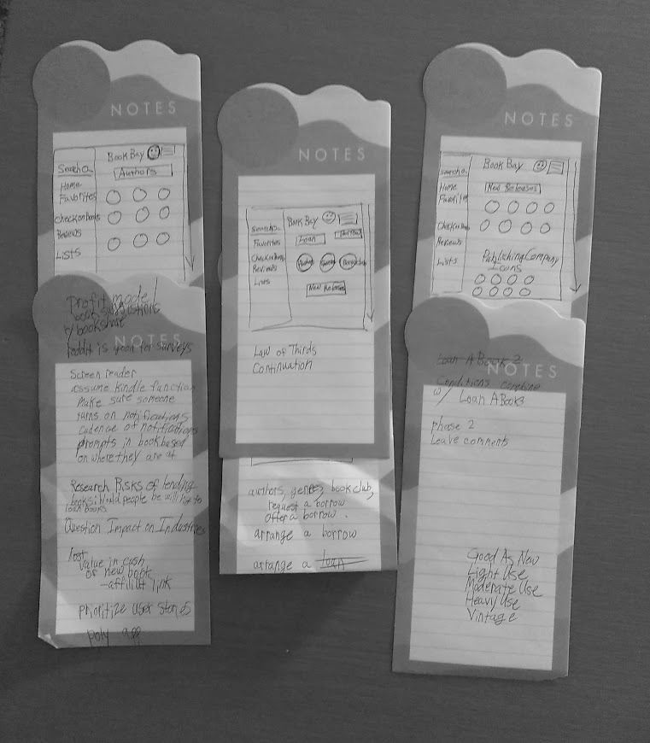
Initial Sketches & Brainstorming Session
Initial sketch was a rough design of home page
Included a few ideas of branches and discovery points for user
Identified key principles I wanted to include such as continuation and the law of thirds
Design

Slide 21
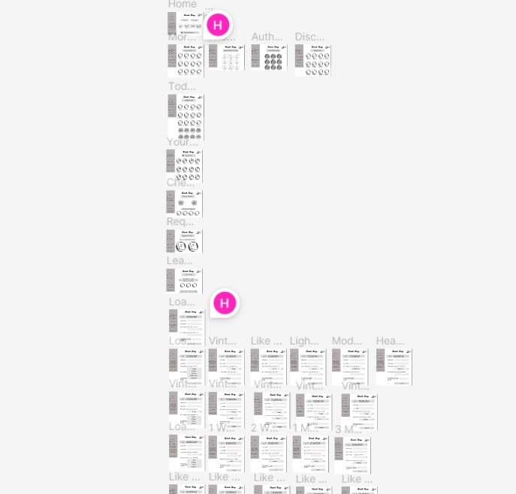
Wireframe
Starts at home page
Branches from nearly every clickable area of home screen
Includes 64 frames
Designed to build curio
Design

Slide 22
The solution then became an interactive prototype:
.
https://www.figma.com/proto/lRBeFsEGNog55M55uAKiCQ/Book-Bay?node-id=1-2&scaling=scale-down&page-id=0%3A1&starting-point-node-id=1%3A2
Deliver

Slide 23
Usability Testing
Done with 5 users
Using Google Meets with share screen function and audio recording
Requested users to complete 2 specific tasks and explore the rest of the website
Requested users share their thoughts, frustrations, and anything that would make the experience more enjoyable in real time
Deliver

Slide 24
Top Insights
It is not immediately apparent how to add an item to “Favorites” page
It would be helpful to make the logo clickable so that it can also return you to the home page
The page where you see your options of places to borrow a book could include a map with pins on locations where the book is available
Make the ISBN space on the “Borrow A Book” page optional
Deliver

Slide 25
Prototypes with Iterations:
.
https://www.figma.com/proto/lRBeFsEGNog55M55uAKiCQ/Book-Bay?node-id=430-1292&scaling=scale-down&page-id=430%3A1291&starting-point-node-id=430%3A1292
Deliver

Slide 26
Lessons Learned
Start research early
Your problem statement may need to change based on research results
Wireframes do not have to be developed through every pathway before testing
Choose 2-3 tasks you want users to be able to accomplish
Outcomes

Slide 27
Future Opportunities
Create a Book Bay App for Android and Apple phones
Expand on the opportunity to purchase a book that you have been borrowing for an extended amount of time
Showcase the ability for online bookstores to have a presence on the website encouraging users to purchase new books to share
Add a feature allowing you to say you are seeking a book that has not been listed
Outcomes

Slide 28
What questions do you have?

Slide 29
Resources
https://artificialbookintelligence.wordpress.com/2015/04/20/what-if-library-book-dispensers-like-redbox/
https://www.kioskmarketplace.com/news/jetblue-book-vending-machine-initiative-goes-virtual/
https://www.news9.com/story/6422ee5ec11393072e091e7b/book-vending-machine-at-highland-park-elementary-encourages-kids-to-read
https://www.saclibrary.org/About/News/2022-(1)/Introducing-the-24-Hour-Book-Kiosk
https://www.thebookseller.com/news/penguin-installs-book-vending-machine-in-exeter
https://thekojonnamdishow.org/2015/07/09/book-program-set-takeoff-southeast/

