Slide 1
Presentation on the Battle of Neighborhoods Project
Finding a suitable location in Texas to open a restaurant
By Hla Tun

Slide 2
Objective
Finding out the most popular type of restaurant in Texas
Find a suitable location/city in Texas to open a restaurant

Slide 3
Introduction
The main purpose of this project is to find a proper location for a restaurant in Texas. The summary of the project will be divided into two parts as follow:
Part 1: Data collection
Wikipedia Sources
https://en.wikipedia.org/wiki/List_of_United_States_cities_by_population
https://en.wikipedia.org/wiki/List_of_Texas_locations_by_per_capita_income
Foursquare API
For different venues in the city
Part 2: Solving the problem based on population, population density, per capita income, and popular venues. Foursquare API is used in this work to access the different venues in the Texas state.

Slide 4
Methodology
Beautiful Soup library is used for web scrapping to build a database with cities, per capita income, population, latitude, and longitudes of the city.
Post processed the database by dropping unnecessary columns from it.
Word cloud is used to visualize the most popular type of restaurant in Texas.
Foursquare API is used to extract the different types of venues in Texas.
Using K means algorithm the most suitable city is determined.
Finally, to narrow it down to find the most suitable location based on the local venues in that city.

Slide 5
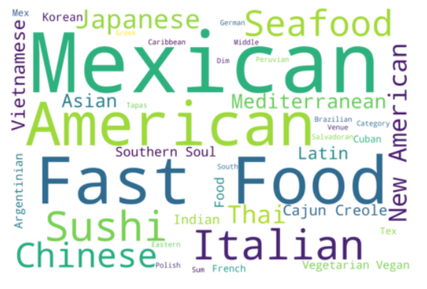
Most Popular Restaurant Type in Texas

Slide 6
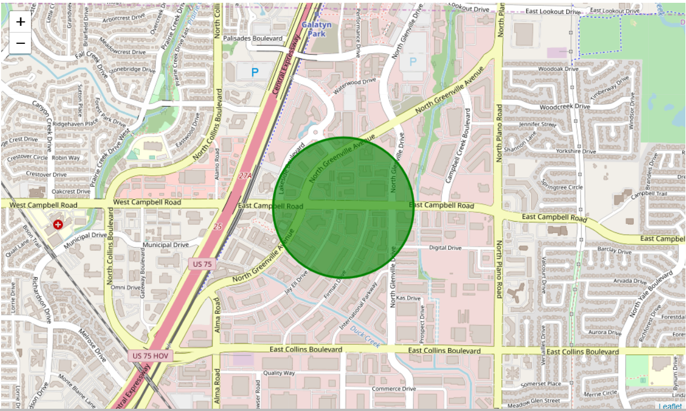
Irving, TX Most Suitable Location

Slide 7
Conclusion and Discussions
Mexican restaurants are very popular in Texas.
The green circle in the map shows the most suitable location to open a restaurant at Irving, TX.
For extensive study, we might need to consider location of the grocery stores or other raw materials, local competitions, race/ethnicity informations etc.

