Slide 1
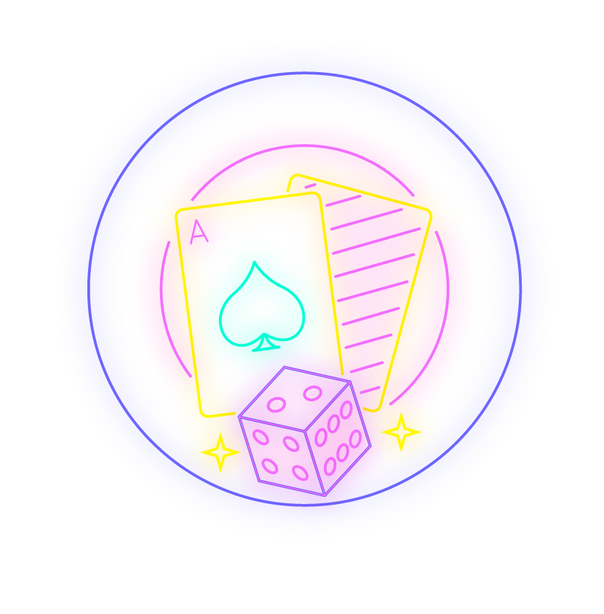
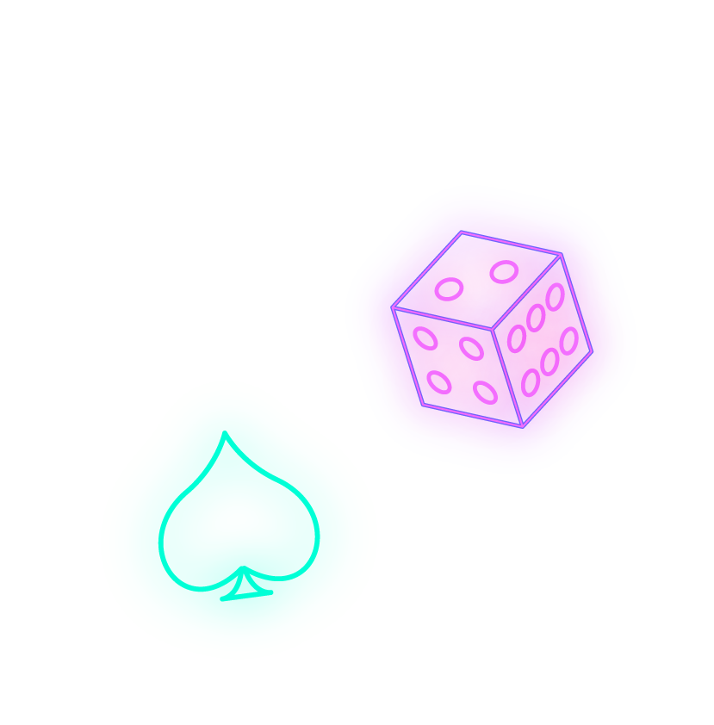
Poker Hand Prediction
Using Machine Learning
Hunter Becker, Kat Chu, Oumar Diakite, Mysee Lee
Notes:
Oumar

Slide 2
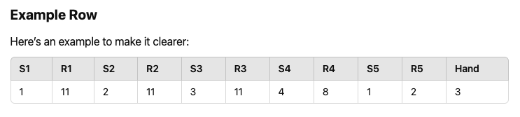
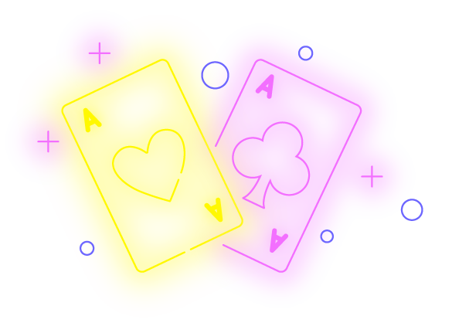
Our Data
UCI Machine Learning Repository - Poker Hand Dataset
What it Represents:
1,025,010 poker hand samples
10 possible hand classes (e.g., "One pair", "Straight", "Royal flush")
Features: 5 card values (C1, C2, C3, C4, C5) and 5 suits (S1, S2, S3, S4, S5)
Notes:
Oumar

Slide 3
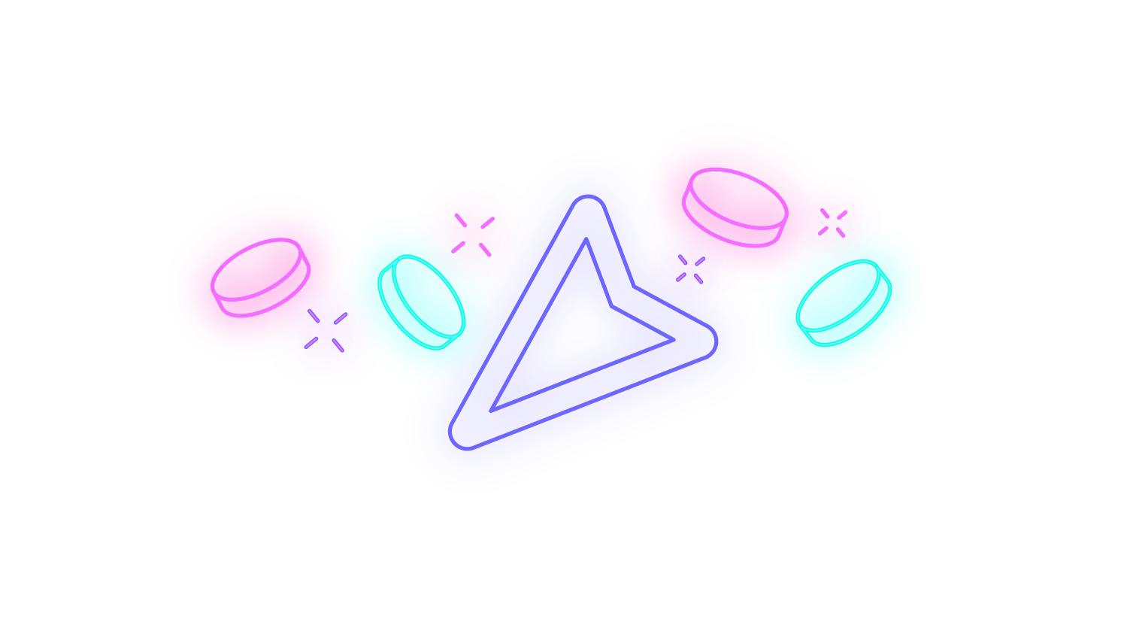
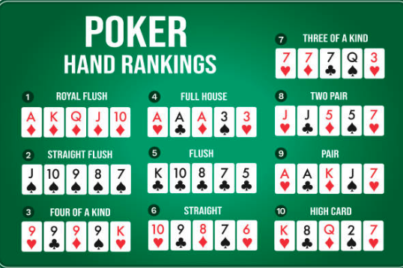
How to Play Poker
Goal: Have the best possible hand out of 5 cards.
How it Helps with the Model: The model is trained to categorize the hand based on the values and suits of the 5 cards.
(Categories in image →)
Notes:
Oumar

Slide 4
Project Goal: Teaching a Model to classify poker hands
Data Input:
The model uses poker hands as input data. Each hand is represented by the ranks (e.g., 2, 10, King) and suits (e.g. clubs, hearts, spades, diamonds) of 5 cards.
Model Learning:
The model learns by looking at many examples of hands and their corresponding categories (e.g., "One Pair," "Full House," “Royal Flush”).
Prediction:
Once trained, the model can predict the category of a new, unseen hand by analyzing its features and matching them to what it learned from the data.
Notes:
The main goal of our project was to create a machine learning model that can accurately classify poker hands into their correct categories—things like 'One Pair,' 'Straight,' or even 'Royal Flush.'
To break that down:
As Oumar had mentioned, the model poker hands are made up of 5 cards. Each card has two features: its rank and its suit). This combination of ranks and suits created unique examples for the model to learn from.
The model’s job was to recognize patterns in this data. Instead of us manually coding the rules of poker, the model figured out those patterns all on its own just by looking at thousands of hands and the categories they belonged to.
What makes this so interesting is if you think about it, poker is very rule-based, but the model didn’t know the rules upfront. It learned to tell the difference between a 'Full House' and 'Straight Flush' by studying the data
After training, the model can take a brand new poker hand—one it’s never seen before—and predict what category that hand belongs to, based on everything it’s learned from the data.
In short, our project goal was to build a model that could 'think' like a poker player, using data and machine learning rather than human-coded rules."

Slide 5
Models We Tried
01
02
K-Nearest Neighbors
LInear Regression
Accuracy: 50%
Accuracy: 0 R^2
WIN
03
04
Random Forest
Neural Network
Accuracy: 92%
Accuracy: 100%*
* = not all hands 100%
Notes:
Kat
Now, let’s talk about the models we tried and how each performed.
We started with K-Nearest Neighbors (KNN). Initially, it wasn’t the best performer, with an accuracy of just 50%. We experimented with adjusting the number of neighbors (k), but it wasn’t significant.
Next, we tested Linear Regression. We ended up with an R-squared value of 0, meaning it couldn’t explain the variance in our data at all.
Then, we moved on to Random Forest. This model gave us a significant model improvement, with a 92% accuracy.
Finally, we tried the Neural Network model, which gave us the best results by far. It achieved 100% accuracy for most of the poker hand categories. This model was able to learn the intricate patterns in the data and generalize well to predict poker hand categories correctly.

Slide 6
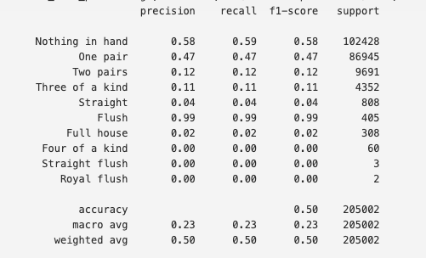
K-Nearest Neighbor
Accuracy: 50%
Cons:
Can struggle with large datasets, slower with a high number of features, and doesn't handle complex patterns as well as other models.
Notes:
Kat
Let’s talk about the K-Nearest Neighbors (KNN) model. It gave us 50% accuracy, but the performance varied a lot. For example, it did really well at predicting Flush hands with an F1 score of 99, likely because there were enough similar examples in the data.
However, it struggled with Full House and Three of a Kind, getting F1 scores of just 2 and 11. This is because KNN is sensitive to outliers and relies on finding similar examples, but it didn’t have enough clear patterns for these categories, causing poor predictions.
Additionally, KNN isn’t efficient with large datasets, which made it harder to generalize well across all the poker hands. While KNN is easy to use, its inconsistency and performance issues made it less effective for this problem.

Slide 7
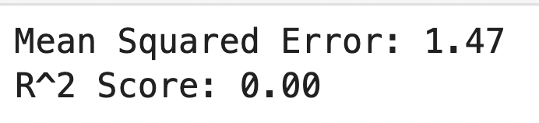
Linear Regression
Cons: Limited to linear relationships; struggles with non-linear patterns like those in poker hands.
Notes:
Oumar

Slide 8
Random Forest
Split dataset into training and testing sets
Two lists: suits_columns & ranks_columns
Preprocessing with ColumnTransformer
categorical_columns = suits_columns & ranks_columns
Create a pipeline: preprocessor and RandomForestClassifier
The model was trained on the training data
Notes:
Mysee
We split our dataset into training and testing sets, with 70% of the data dedicated to training and 30% reserved for testing to ensure robust evaluation.
Next, we created lists for suits and ranks, which were combined and transformed using one-hot encoding. To streamline the preprocessing, we leveraged a Column Transformer with a one-hot encoder.
We created a pipeline to streamline preprocessing and model training with the Random Forest Classifier. Using 100 estimators, the model was trained on the training data, enabling efficient, consistent, and effective learning.

Slide 9
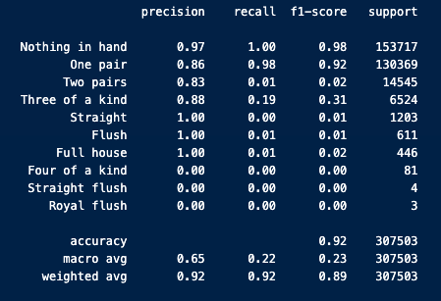
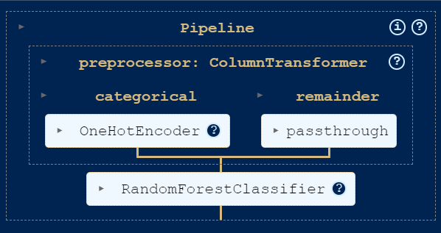
Random Forest
Cons: Can easily overfit, especially with complex datasets like poker hands, leading to lower accuracy.
Notes:
Mysee
The model was calculated to have an accuracy 0.9183. Here on the slide is the classification report.
Nothing in Hand was a strong performer, showing excellent accuracy overall.
One Pair came close, but it slightly underperformed compared to Nothing in Hand.
Two pairs proved to be a challenge—the model struggled to correctly identify these instances.
Three of a kind was predicted with accuracy, but it missed most actual instances.
When we look at Straight, Flush, and Full House, the model showed very high precision but only a few instances to work with—this means it can recognize these classes when they appear, but their scarcity limits consistent predictions.
Finally, Four of a Kind, Straight Flush, and Royal Flush were the most challenging, with the model failing to make successful predictions at all—reflected by their F-Scores.
The model shows strengths in some areas, struggles in others, and highlights opportunities to refine its predictive power across these classes.

Slide 10
Neural Network
Why was neural network model the best?
Complex patterns recognition
handling high dimensions
better performance on rare hands
better at generalizing and making accurate predictions
Model Attributes
2 Hidden Layers
1st Layer: 64 Neurons
Relu Activation
2nd Layer: 32 Neurons
Relu Activation
Output layer
Softmax Activation
20 Epochs

Slide 11
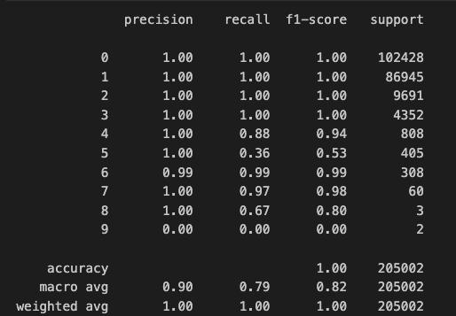
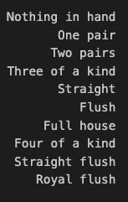
Neural Network

Slide 12
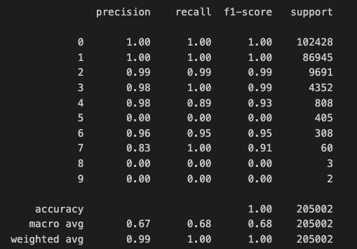
Model Optimization Attempt 1
Added another hidden layer
16 neurons relu activation
Same overall accuracy
Less accurate for some hands

Slide 13
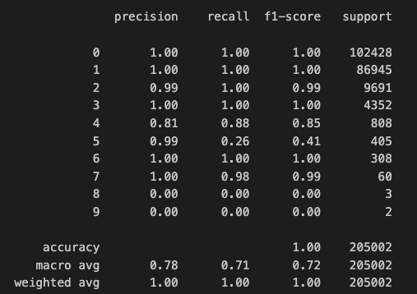
Model Optimization Attempt 2
Returned to two layers
Changed the activation type to Tanh
Same overall accuracy
Less accurate for some hands

Slide 14

Future Uses of our model
Automated Poker Hand Classification
Predictive modeling in gambling
Poker AI Development
Training and Simulation
Notes:
Mysee
Using machine learning on our model could enable automated hand classification, training simulations, predictive opponent modeling, and the development of advanced poker AIs—revolutionizing strategy, training, and decision-making at the table.

Slide 15
4
♡
♡
♡
THANKS!
♡
♡
3
♤
FOR PLAYING
3
♡
♤
♧
♧
4
♤
3
♧
♡
♡
4
♢
♤
♢
♢
♧
♤
♡
Hunter Becker, Kat Chu, Oumar Diakite, Mysee Lee
♧
3
3
♡
♢
♢
♡
3
♢
4
Notes:
Mysee
Thanks for playing! We will now take questions and comments.

