Slide 1
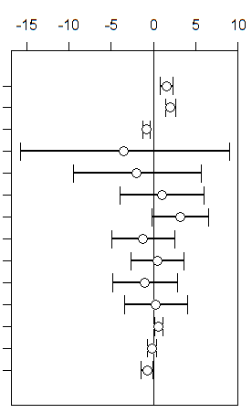
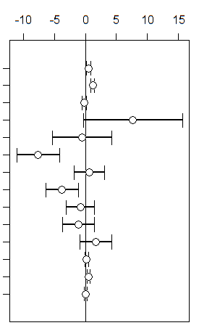
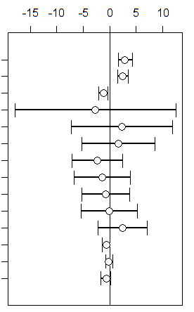
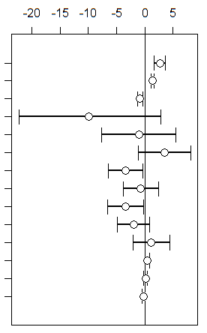
Slope Coefficients
LAT
ELEV
LATxELEV
MJT
MJT.2
TD
TD.2
MAP
MAP.2
MJP
MJP.2
DF
CF
DL
Environmental Variables
BTBW
BHVI
LAT
ELEV
LATxELEV
MJT
MJT.2
TD
TD.2
MAP
MAP.2
MJP
MJP.2
DF
CF
DL
Environmental Variables
CAWA
LEFL

Slide 2
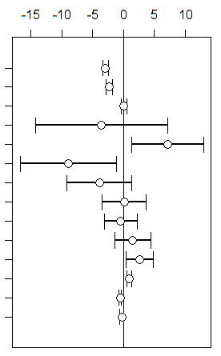
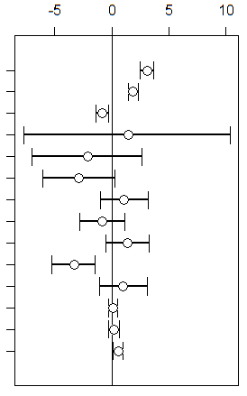
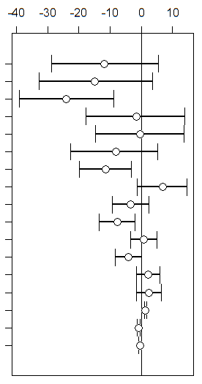
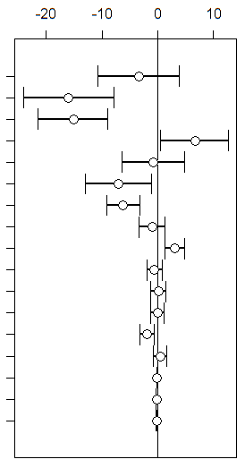
Slope Coefficients
LAT
ELEV
LATxELEV
MJT
MJT.2
TD
TD.2
MAP
MAP.2
MJP
MJP.2
DF
CF
DL
Environmental Variables
SUTA
VEER
LAT
LAT.2
ELEV
ELEV.2
ELEV.3
ELEV.4
MJT
MJT.2
TD
TD.2
MAP
MAP.2
MJP
MJP.2
DF
CF
DL
Environmental Variables
CERW
EAWP

Slide 3
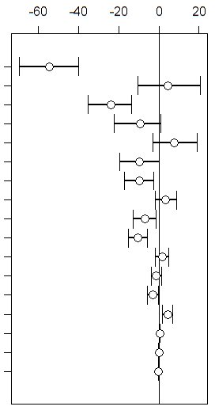
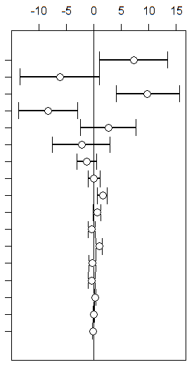
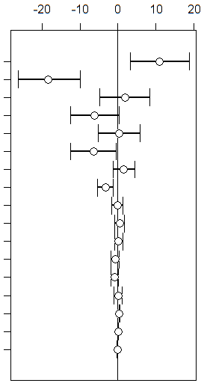
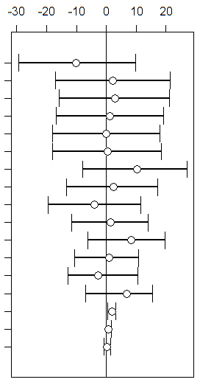
Slope Coefficients
LAT
LAT.2
ELEV
ELEV.2
ELEV.3
ELEV.4
MJT
MJT.2
TD
TD.2
MAP
MAP.2
MJP
MJP.2
DF
CF
DL
Environmental Variables
KEWA
REVI
LAT
LAT.2
ELEV
ELEV.2
ELEV.3
ELEV.4
MJT
MJT.2
TD
TD.2
MAP
MAP.2
MJP
MJP.2
DF
CF
DL
Environmental Variables
SCTA
SWWA

Slide 4
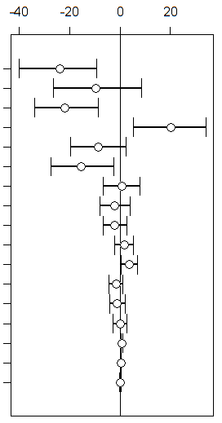
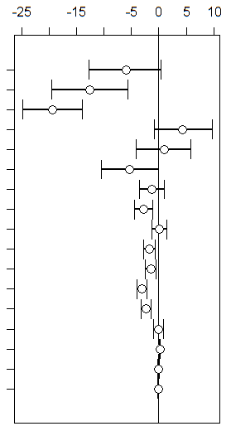
Slope Coefficients
LAT
LAT.2
ELEV
ELEV.2
ELEV.3
ELEV.4
MJT
MJT.2
TD
TD.2
MAP
MAP.2
MJP
MJP.2
DF
CF
DL
Environmental Variables
WEWA
WOTH

