Slide 1
OSBAMS
Open-Source Battery Assessment and Management System
Joe Le | ENGR696| SFSU | Fall 2026

Slide 2
Problem & Motivation
Reused packs might still have plenty of capacity left, but nobody really knows their history or condition.
Commercial cyclers exist, but they're expensive and closed off.
A student-built platform should show its work: measurement, safety logic, calibration, logging, and where it falls short.

Slide 3
Project Goal
Build a safe, low-cost platform for controlled discharge tests.
Measure voltage, current, power, temperature, Ah, and Wh over time.
Shut the test down automatically on E-stop, sensor failure, or anything unsafe.
Store and visualize the data with Python and SQLite.

Slide 4
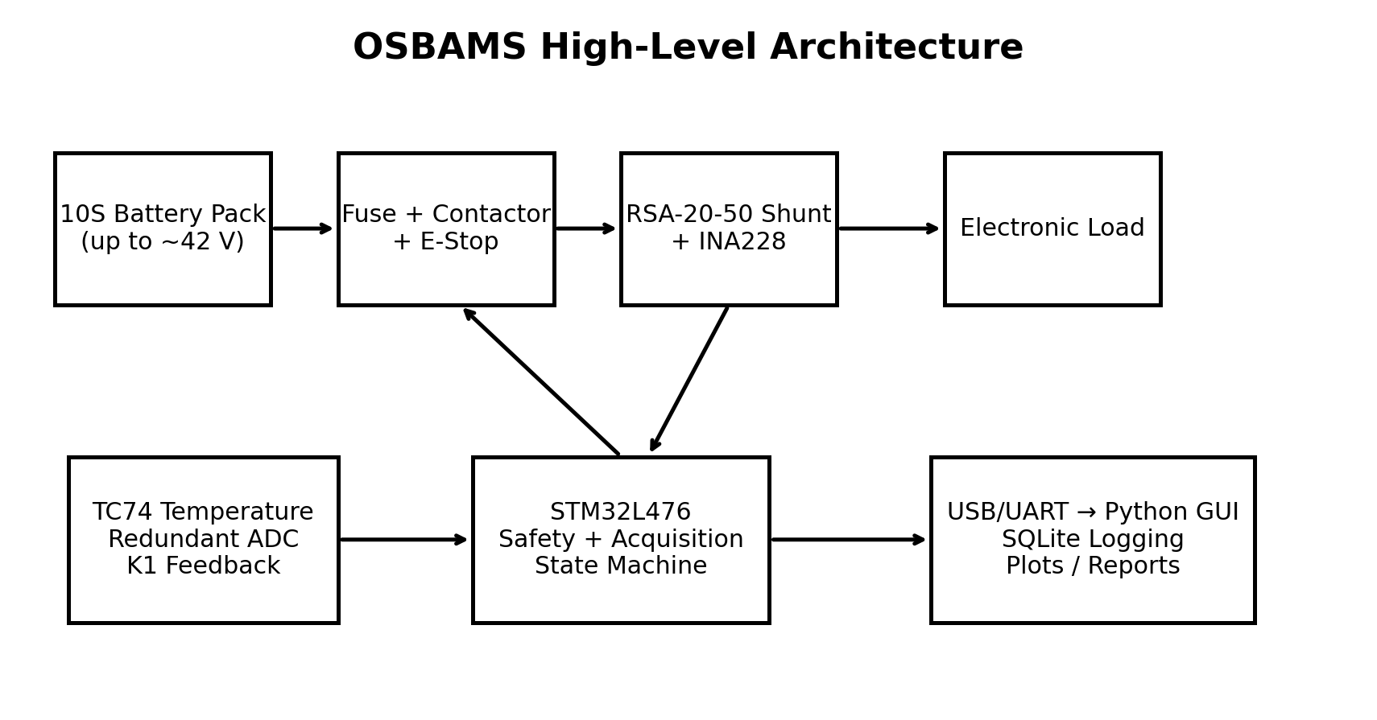
System Architecture
High-current battery path is physically separate from logic/control.
STM32L476 handles real-time sensing and safety decisions.
INA228 + external shunt do the primary electrical measurement.
TC74 and a redundant ADC add thermal/voltage cross-checks.
Host computer handles visualization, database, scoring, and reports.

Slide 5
Safety Architecture
15A fuse plus a physical disconnect.
Normally-off contactor, driven through a MOSFET.
Hardwired E-stop cuts contactor coil power directly.
Firmware latches a FAULT state; a watchdog runs underneath it.
Redundant voltage plausibility check plus temperature monitoring.
Staged validation: logic-only, then low-voltage, battery last.

Slide 6
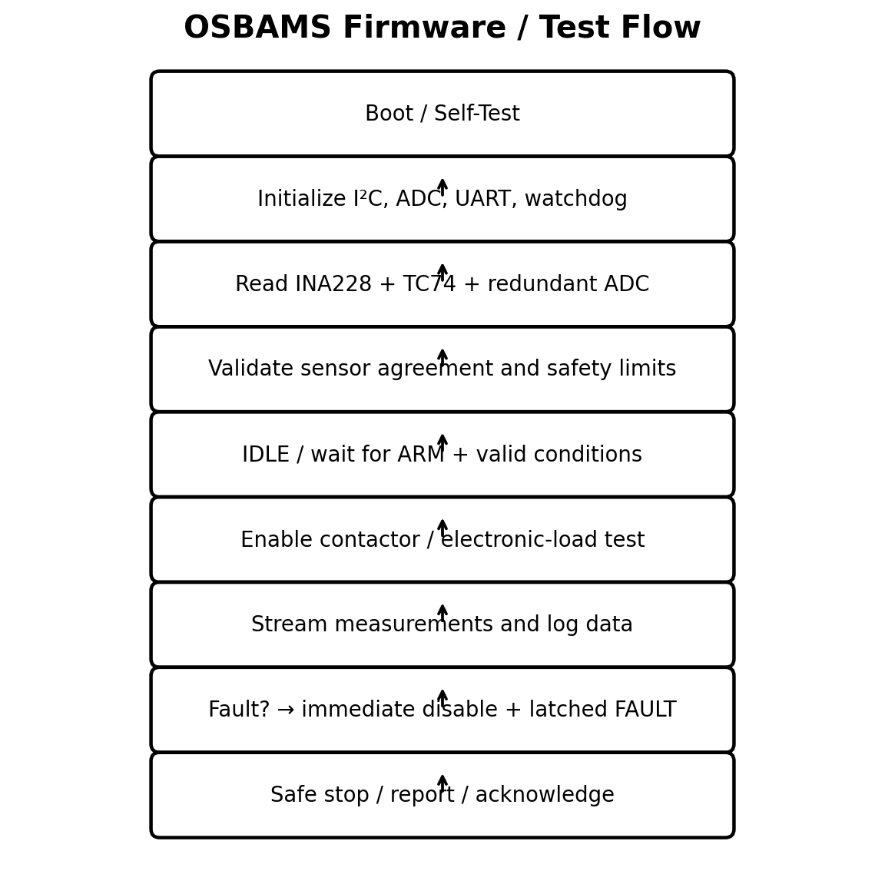
Firmware Architecture
Modules: sensor manager, INA228, TC74, ADC safety, load driver, E-stop, watchdog, acquisition timer.
Application layer: measurement, safety evaluation, test controller, serial protocol.
Structured OSBAMS UART frames report boot state, sensor status, current state, data, and faults.
Safety outputs default OFF on reset or anything unexplained.

Slide 7
Desktop Software
Python app receives telemetry over USB/UART.
A serial parser turns OSBAMS frames into measurement records.
SQLite holds tests, measurements, faults, battery metadata, and settings.
GUI shows live values/plots; a reporting layer exports test summaries.
AI/scoring features stay secondary until measurement quality is validated.

Slide 8
Parts & Budget
Prototype runs about $333.
Main parts: NUCLEO-L476RG, INA228, external shunt, TC74, contactor, E-stop, Pololu 5V regulator, XDR 12V supply, custom PCB, electronic load.
Several parts were already owned/purchased, so incremental cost this semester is lower.

Slide 9
Current Progress
Custom PCB: fabricated, mostly assembled.
Power/safety/load wiring: mostly done.
Firmware builds and flashes cleanly.
INA228 is online; UART telemetry works.
Desktop Python/SQLite structure: underway.
Current blocker: TC74 temperature sensor / rail and I²C bring-up.

Slide 10
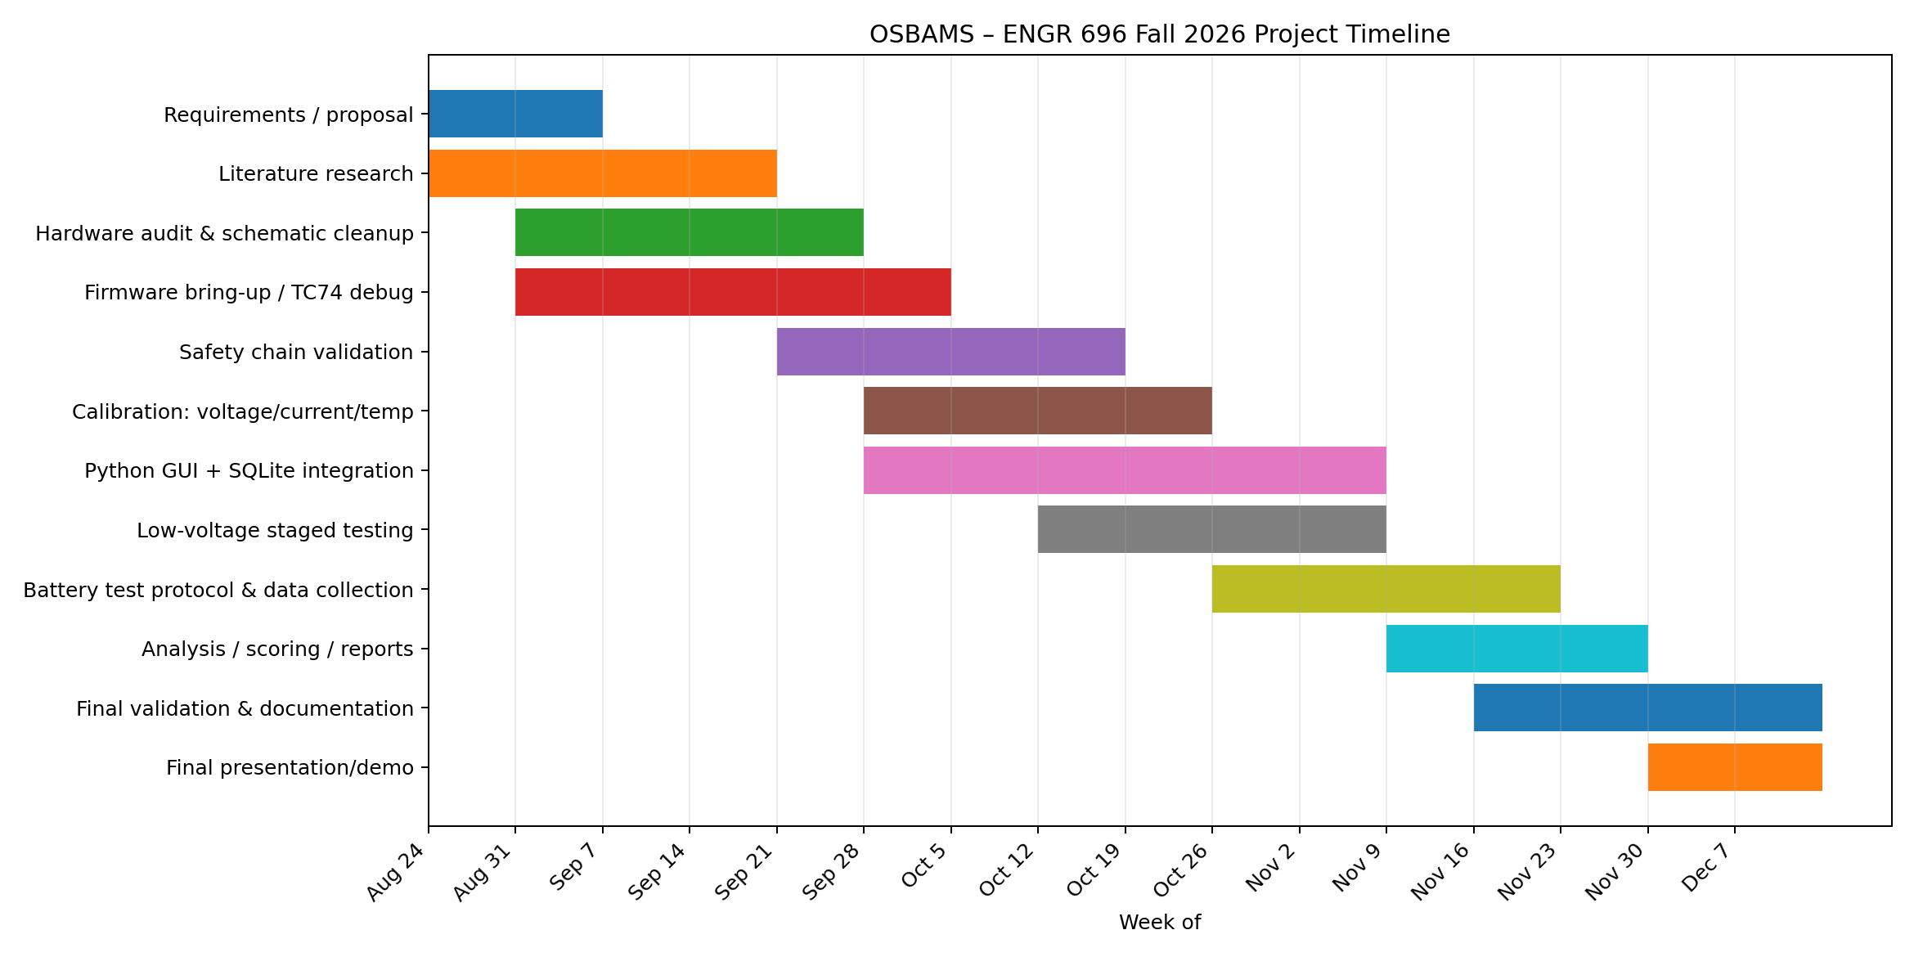
Project Timeline
Aug–Sep: documentation, literature, schematic cleanup, sensor bring-up.
Sep–Oct: safety-chain validation and calibration.
Oct–Nov: Python/SQLite integration and staged testing.
Nov–Dec: battery data collection, analysis, final validation, report and demo.

Slide 11
Expected Deliverables
A working OSBAMS prototype, in an enclosure.
Documented PCB/schematic/BOM and a wiring map.
STM32 firmware with safety/state-machine tests.
Python/SQLite desktop application.
Calibration and validation records.
A battery assessment dataset and the final engineering report.

Slide 12
Conclusion
OSBAMS is well past the concept stage — it's in hardware bring-up now.
It pulls together embedded systems, instrumentation, safety engineering, PCB design, and software/data tools.
Next milestone: a stable sensor/safety self-test before a battery ever gets connected.
ENGR 696 gets the platform validated; ENGR 697 can focus on full characterization and refinement.

