Slide 1
OSBAMS Project Management
ENGR 696 Fall 2026 Gantt Chart
Joe Le | Computer Engineering | SFSU | Fall 2026

Slide 2
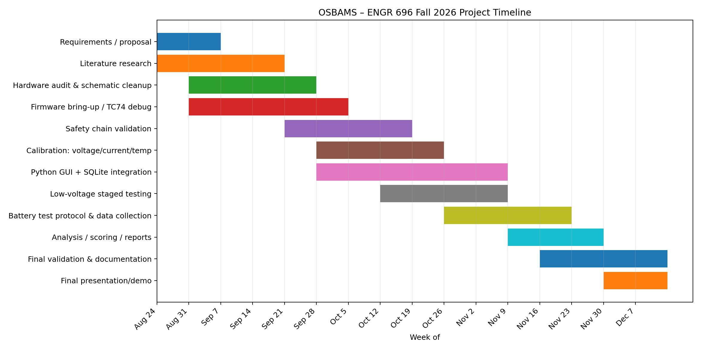

Slide 3
Critical Path
Bring up TC74 and verify the logic rails.
Validate E-stop, contactor, fault latch, and default-off behavior at low voltage.
Calibrate INA228, the redundant ADC, and the temperature channel.
Integrate the Python serial parser and SQLite logging.
Run low-voltage tests before any full battery test.
Leave the final weeks for repeatability, documentation, and the presentation.

