Slide 1
OSBAMS Literature Research
Five relevant works + current project update
Joe Le | ENGR696| SFSU | Fall 2026

Slide 2
Why Literature Research Matters
OSBAMS pulls together battery characterization, embedded measurement, safety control, and host-side analytics.
The literature helps pin down what to measure, how low-cost/open systems get validated, and where OSBAMS differs from commercial cyclers.
ENGR 696 guideline: find five relevant articles and give a project update.

Slide 3
Article 1
Su, L., Xu, Y., & Dong, Z. (2024). State-of-health estimation of lithium-ion batteries: A comprehensive literature review from cell to pack levels. Energy Conversion and Economics.
A comprehensive 2024 review of lithium-ion SOH, cell level to pack level.
Sorts methods into direct measurement, model-based, data-driven, and hybrid.
OSBAMS takeaway: get calibrated direct measurement working before reaching for advanced SOH estimation.

Slide 4
Article 2
Propp, K., Fotouhi, A., Knap, V., & Auger, D. J. (2016). Design, Build and Validation of a Low-Cost Programmable Battery Cycler. ECS Transactions, 74(1), 101–111.
Shows a low-cost programmable battery cycler built for research use.
Weighs design/build/validation trade-offs when professional gear costs too much.
OSBAMS takeaway: “low cost” only means something if calibration and limitations are documented.

Slide 5
Article 3
Mestre, A. et al. (2018). Open and Flexible Li-ion Battery Tester Based on Python Language and Raspberry Pi. Electronics, 7(12), 454.
Open-source Python-controlled Li-ion tester using low-cost lab instruments.
Validated on LiFePO4 cells pulled from an e-scooter pack.
OSBAMS takeaway: open host software and reused-pack characterization are practical, not just theoretical.

Slide 6
Article 4
Saletti, R. et al. (2022). Modular Battery Emulator for Development and Functional Testing of Battery Management Systems: The Cell Emulator. Electronics, 11(8), 1215.
Open-hardware modular battery/BMS emulator built for safe functional testing.
Focuses on validating without exposing development to real battery hazards.
OSBAMS takeaway: staged low-energy testing and hardware-in-the-loop methods cut risk.

Slide 7
Article 5
Ng, K. S. et al. (2009). Enhanced coulomb counting method for estimating state-of-charge and state-of-health of lithium-ion batteries. Applied Energy, 86(9), 1506–1511.
Uses measured current/voltage and coulomb counting for SOC/SOH estimation.
A classic measurement/DAQ chain: programmable load plus PC-side processing.
OSBAMS takeaway: accurate current integration is what makes capacity and health metrics trustworthy.

Slide 8
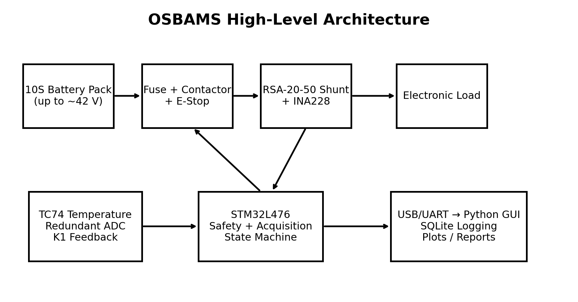
How OSBAMS Fits the Literature
Open and low-cost, like the academic testers before it.
STM32 handles deterministic acquisition and safety; Python/SQLite handles visualization and data.
Adds hardwired E-stop/contactor control, redundant voltage checking, watchdog/fault logic, and a custom PCB on top of that baseline.
Initial target: safe, repeatable pack assessment, not an industrial multi-channel cycler.

Slide 9
Current Project Update
Custom PCB fabricated and assembled.
STM32 firmware builds and flashes; UART status output works.
INA228 voltage/current/power channel is online.
Current blocker: TC74 temperature sensor bring-up and final power/I²C verification.
Battery stays disconnected until every required sensor and safety function passes staged validation.

Slide 10
References
[1] Su, L., Xu, Y., & Dong, Z. (2024). State-of-health estimation of lithium-ion batteries: A comprehensive literature review from cell to pack levels. Energy Conversion and Economics.
https://doi.org/10.1049/enc2.12125
[2] Propp, K., Fotouhi, A., Knap, V., & Auger, D. J. (2016). Design, Build and Validation of a Low-Cost Programmable Battery Cycler. ECS Transactions, 74(1), 101–111.
https://doi.org/10.1149/07401.0101ecst
[3] Mestre, A. et al. (2018). Open and Flexible Li-ion Battery Tester Based on Python Language and Raspberry Pi. Electronics, 7(12), 454.
https://doi.org/10.3390/electronics7120454
[4] Saletti, R. et al. (2022). Modular Battery Emulator for Development and Functional Testing of Battery Management Systems: The Cell Emulator. Electronics, 11(8), 1215.
https://doi.org/10.3390/electronics11081215
[5] Ng, K. S. et al. (2009). Enhanced coulomb counting method for estimating state-of-charge and state-of-health of lithium-ion batteries. Applied Energy, 86(9), 1506–1511.
https://doi.org/10.1016/j.apenergy.2008.11.021

