Slide 1
Bayesian Reasoning
CSCSCI 3202, Fall 2017
Prof. Mike Eisenberg
duck@cs.colorado.edu

Slide 2
Administrivia
For next week: Read Chapter 13.1-13.5 in Russell and Norvig
Problem Set 2 will be sent out by email tonight and will be due Monday, October 23.
Problem Set 1 will be handed back next week.

Slide 3
Bayes’ Law: a Graphical Proof

Slide 4
Bayes’ Law (think of “H” as “Hypothesis” and “E” as “Evidence”)
P (H|E) = P(E|H) * P(H) / P(E)

Slide 5
An Example of Bayes’ Law
In one pocket, there are 3 quarters and one dime. In the other pocket, there are 3 dimes and one quarter. We don’t know which pocket (left or right) holds the 3 quarters.
Problem 1:
We reach into the left pocket and draw a coin at random. It’s a quarter. What is the probability that the left pocket is the one with the 3 quarters?
Problem 2:
After our first experiment, we replace the coin in the left pocket and again
draw a coin at random. It’s a quarter. What is the probability that the left
pocket is the one with the 3 quarters?

Slide 6
Problem 1
P(L | Q) = P(Q|L) * P(L) / P(Q)
= 0.75 * 0.5 / ( (0.75 *0.5) + (0.25 * 0.5))
= 0.75 * 0.5 / 0.5
= 0.75

Slide 7
Problem 2
P (L | 2Qs)
= P(2Qs | L) P(L) / P(2Qs)
= 0.5625 * 0.5 / ((0.5625 * 0.5) + (0.0625 * 0.5))
= 0.5625/0.625
= 0.9

Slide 8
An Initial Bayesian Network
L means “Rockies Lose”
Probability of L = 0.4
Probability of not L = 0.6
M means “Mike’s in a bad mood”
M|L = 0.7
M| (not L) = 0.4
L
M

Slide 9
An Initial Bayesian Network
L means “Rockies Lose”
Probability of L = 0.4
Probability of not L = 0.6
M means “Mike’s in a bad mood”
M|L = 0.7
M| (not L) = 0.4
L
M
You run into Mike in the evening, and he is grumpy. What is the likelihood that the Rockies lost today?

Slide 10
What we want to find is the probability that the Rockies lost today given that Mike is grumpy:
P(L|M) = P(M|L) * P(L) ------------------------------
P(M)

Slide 11
What we want to find is the probability that the Rockies lost today given that Mike is grumpy:
P(L|M) = P(M|L) * P(L) ------------------------------
P(M)
= 0.7 * 0.4
-------------------------
(0.7 * 0.4) + (0.4 * 0.6)

Slide 12
What we want to find is the probability that the Rockies lost today given that Mike is grumpy:
P(L|M) = 0.7 * 0.4
-------------------------
(0.7 * 0.4) + (0.4 * 0.6)
= 0.28/0.52 = 0.538

Slide 13
B means “Bud Black in a bad mood”
B|L = 0.8
B|(not L) = 0.6
Without any other information (a priori) what is the probability that Bud will be in a bad mood?
You run into Mike one evening and he’s in a bad mood. What’s the probability that Bud will also be in a bad mood?
B
L
M

Slide 14
How to think about this?
First, find P(L|M). (We already did this: it’s 0.538)
Now, given the updated probability that the Rockies lost, we recalculate the probability that Bud is grumpy:
P(B) = P(B|L)*P(L) + P(B|~L)P(~L)
= 0.8*0.538 + 0.6*0.462
= 0.6896

Slide 15
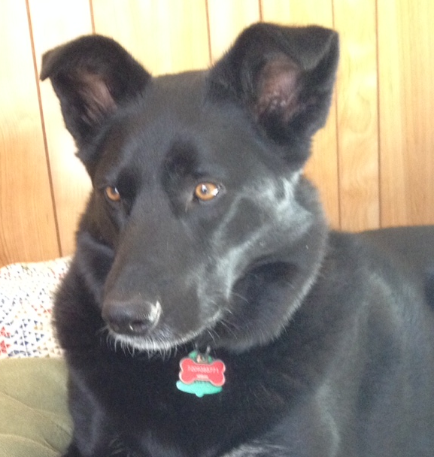
S means “Stella is in a bad mood”
S|M = 0.8
S|(not M) = 0.1
You run into Bud Black and he is grumpy. What is the probability that Stella will growl at you this evening?
B
L
M
S

Slide 16
S means “Stella is in a bad mood”
S|M = 0.8
S|(not M) = 0.1
You run into Bud Black and he is grumpy. What is the probability that Stella will growl at you this evening?
First, find P(L|B)
Then, with the updated probability that the Rockies lost, find P(M).
Then, with the updated probability that Mike is grumpy, find P(S)
B
L
M
S

Slide 17
P(L|B) = P(B|L)*P(L)/P(B) = 0.32/0.68 = 0.47
P(M) = (0.47 * 0.7) + (0.53 * 0.4) = 0.541
P(S) = (0.8 * 0.541) + (0.1 * 0.459) = 0.4787
Note that Stella and Bud don’t know each other. Stella doesn’t even care about the Rockies. But even so, when you know something about Bud’s mood, you can make new predictions about Stella’s mood.

Slide 18
AR means “Nolan Arenado had a good day”: P(AR) = 0.6
CH means “Charlie Blackmon had a good day”: P(CH) = 0.5
P(L|AR, CH) = 0.3
P(L|AR, notCH) = 0.4
P(L|notAR, CH) = 0.5
P(L|notAR, notCH) = 0.8
What’s the overall probability that the Rockies lose on a given day?
You find out that the Rockies lost today. What’s the probability that both Nolan and Charlie played well?
AR
L
CH

