Slide 1
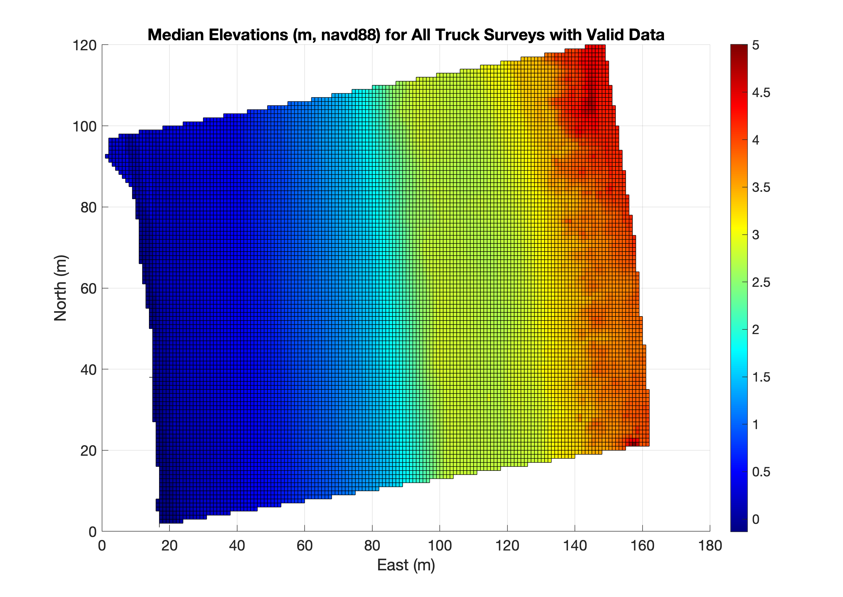
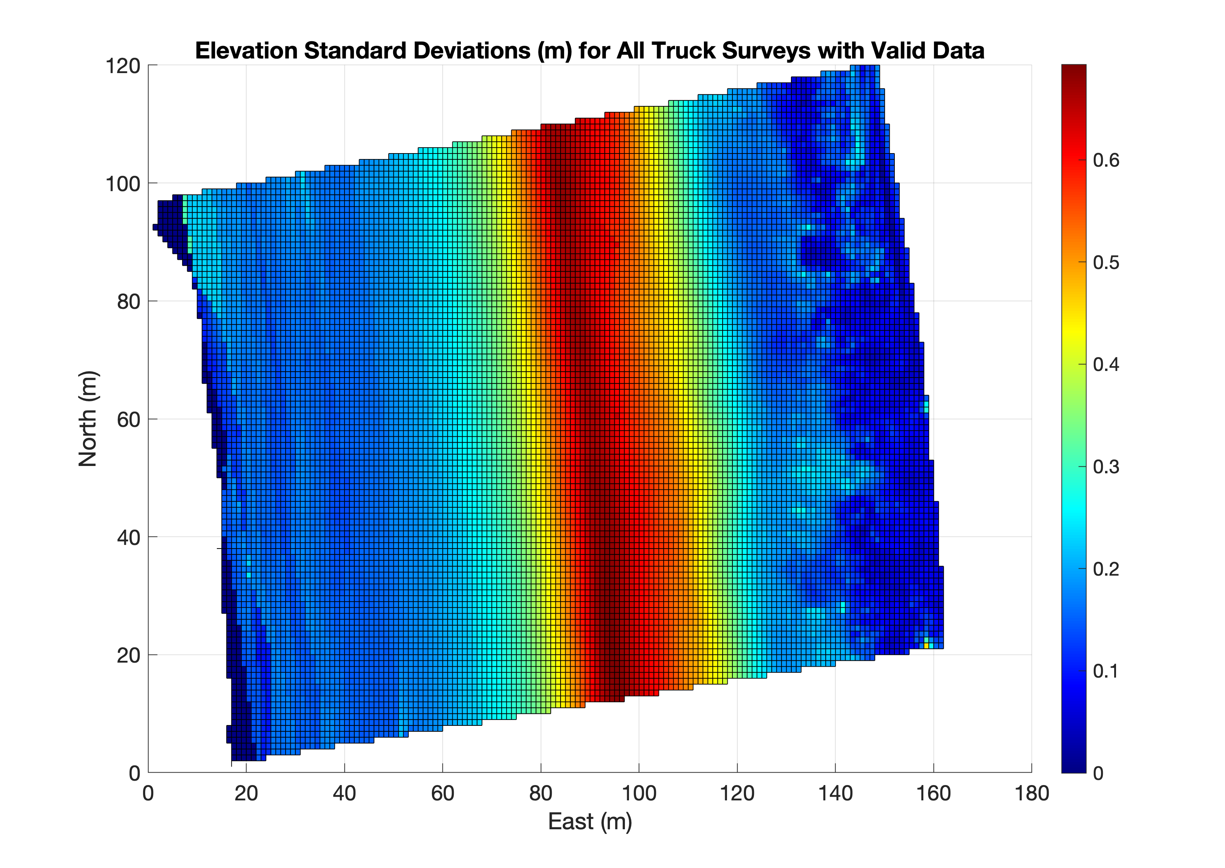
Example figs made by MOPS/toolbox/terrace/ExampleMopSpatialStatistics.m

Slide 2
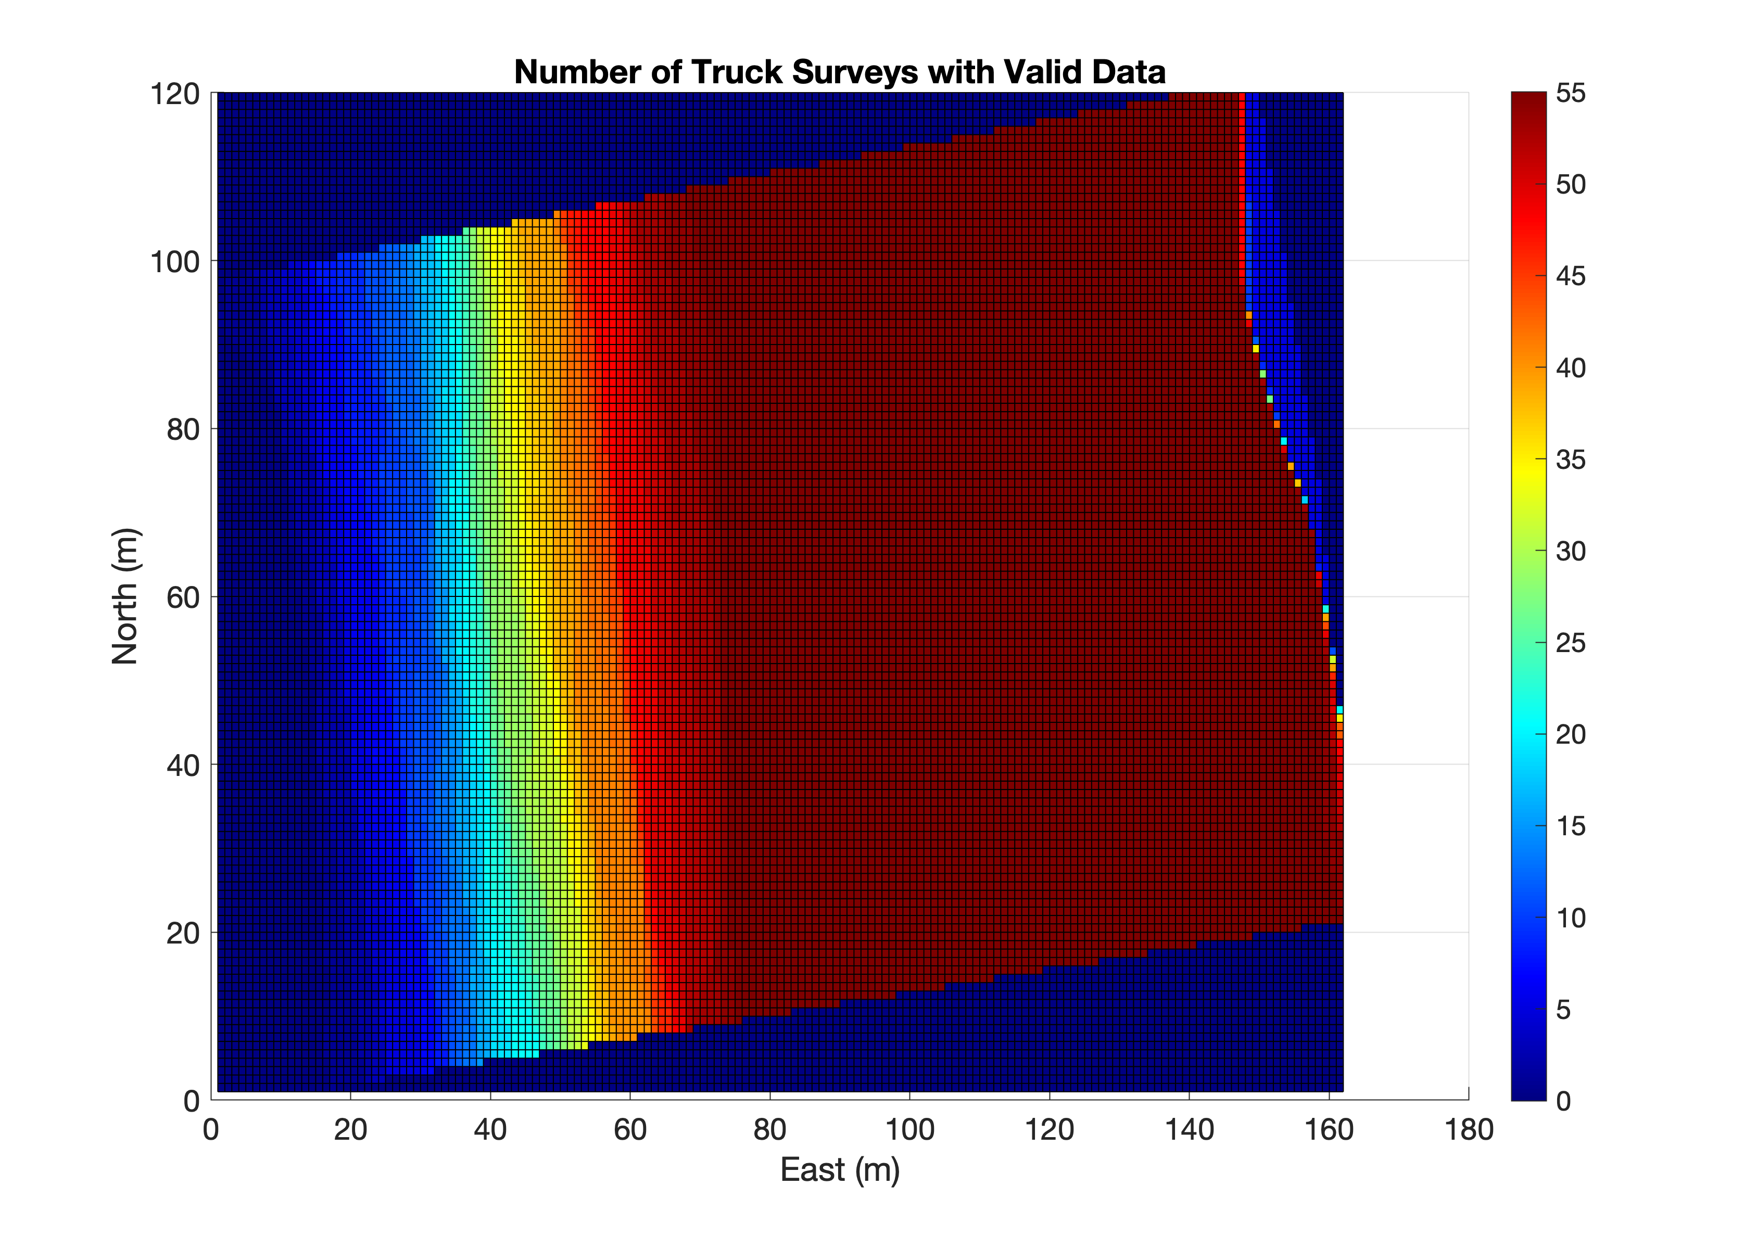
Example figs made by MOPS/toolbox/terrace/ExampleMopSpatialStatistics.m
Ok for seaward
boundary to
migrate from
survey to survey,
but cutoff data
at MHW (1.344m
NAVD88) for terrace
tracking purposes?
Want to set a global
landward boundary
that has 100% or near
100% survey coverage

