Slide 1
Driver Attention Detection System
By: Jiyong Youn & Usman
Team Attention

Slide 2
Content
Introduction
Motivation
Existing Solutions
Proposed Idea and Usage scheme
System Overview
Expected Challenges
Evalaution Scheme
Tentative Plan
Chronological plan

Slide 3
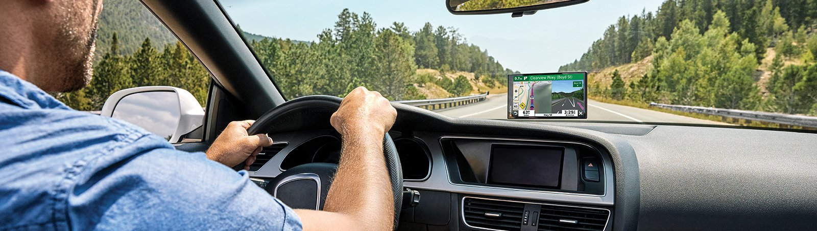
Introduction
Real-time driver monitoring system will be developed which will analyses the driver’s state in real-time and gives alert when drowsy state increases.
The system will require one android device which will be placed at front as we used to place for navigation purpose

Slide 4
Motivation
Road accidents are responsible for 1.35 million death cases around every year all over the world(WHO).
20-50 million people experience non-fatal injuries, many suffer lifelong disabilities [1].
~20% drivers confessed to fall asleep while driving, ~40% confessed that this happened to them at least once in their lifetime [2].
~100,000 incidents/year occur due to driver drowsiness, 1500 deaths and 70,000 injuries are being reported [3].
To ensure the safety of the drivers and passengers, we greatly require a real-time driver monitoring system which can alert the driver when he/she is not attentive enough
[1] "Road traffic injuries," World Health Organization, 7 February 2020. [Online]. Available: https://www.who.int/news-room/fact-sheets/ detail/road-traffic-injuries. [2] "Drivers are Falling Asleep Behind the Wheel," nsc.org, [Online]. Available: https://www.nsc.org/road-safety/safety-topics/fatigued-driv ing. [3] "Medicalxpress.com," 2020. [Online]. Available: https://medical xpress.com/news/2018-11-sleepy-drivers-involved-year.html.

Slide 5
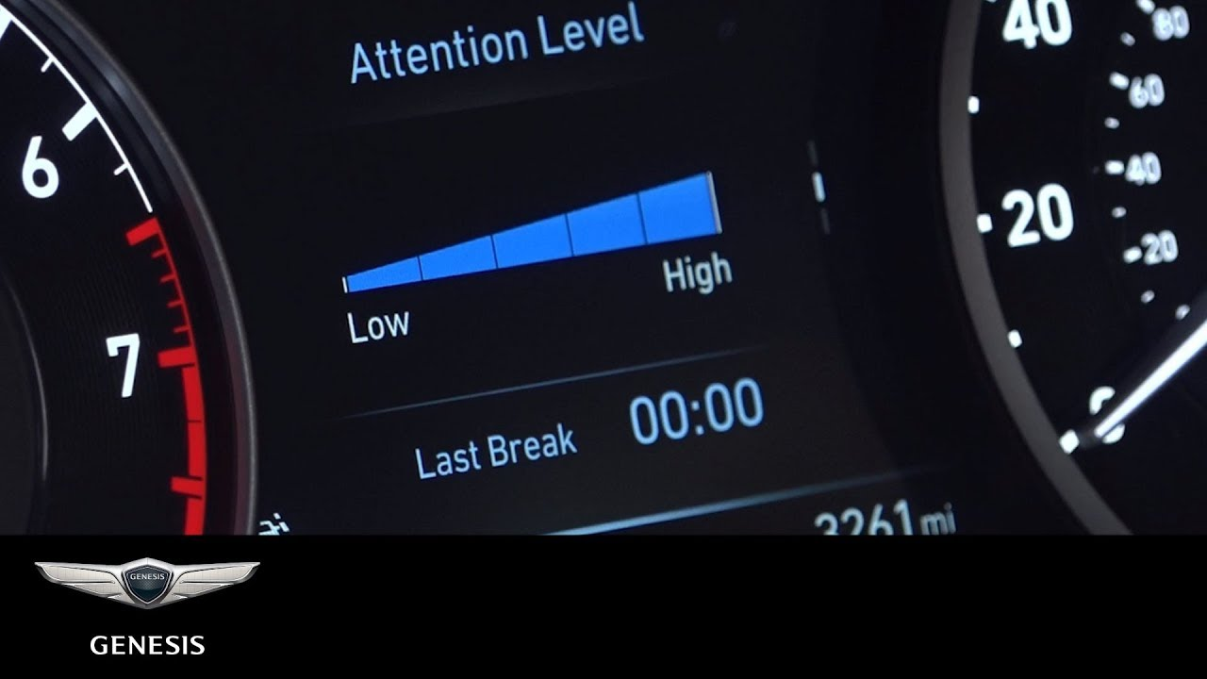
Existing Solutions: Hyundai motor group
Vehicle based approach: Analyzing steering / gas inputs
Drowsiness alert
Notes:
In vehicle based approach, vehicles’ different parameters; acceleration, wheel angle etc. are monitored to detect driver attention. But this method is time consuming and not suitable for real-time application. In the second approach, different psychological parameters are measured by using wearable sensors. Common types of psychological signal that are used for driver drowsiness system are Electrooculography (EOG), Electroencephalogram (EEG), Electromyography (EMG) etc [4]. This signal based approach is quite accurate but the main problem is that to collect the data, driver has to wear some head bands or other sensor. But often, these wearable sensors make driver uncomfortable and it has a negative effect on the driver. The facial feature based approach uses visual features like eye or mouth region for drowsiness detection. This method has become very popular because of its potentiality and advantages. In this approach, drivers do not need to wear any sensors and it works in real-time. Another cue, head pose is also a major indicator of driver attention

Slide 6



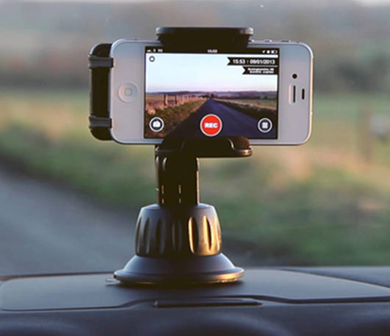
Proposed Idea and Usage scheme
Android Application
Camera Capture Image of Driver
AWS Cloud Computing
Feedback given
Data processing
analysis

Slide 7
Detailed interfaces
Python based deep-learning backend, with HTTP server to talk with the client
Flask
Deep learning library
Custom-build Android app work as the client, sending taken picture and receiving the response
Android CameraV2 API
Connection with the server using LTE network

Slide 8
System Overview
Attention detection
Kaggle Dataset: ‘State Farm Distracted Driver Detection’ competition
Communication between the client and the server
RESTful API system: Built on top of HTTP
Using token-based authentication system to distinguish users
Industry-standard formats (JSON, HTTP Form, ...)

Slide 9


Server-side (back-end)
AWS AI Server
Authentication Request
Acknowledgment
(Success)
Image frame
Current State
Android Application UI
User-side (front-end app)

Slide 10
Interface Specification Details
Authentication (JSON)
HTTP POST request
{
username: [string],
password: [string]
}
Acknowledgment (JSON)
{
flag: [string] // Login successful or failed,
token: [string] //auth token, to distinguish user on image requests
}

Slide 11
Interface Specification Details
Image Frame (multipart/form-data encoded)
Through HTTP POST request
{
token: [string],
frm_id : [string], //Frame Id
img: [ jpeg image file ]
}
Response including current state
{
frm_id : [string],
state_id : [int], //Current state
state : [string] //Description of current state }

Slide 12
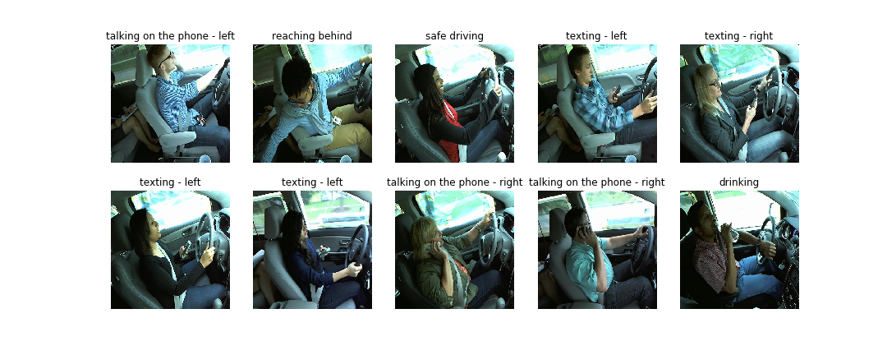
Dataset
State Farm Distracted Driver Detection – Kaggle Dataset

Slide 13
Dataset
State Farm Distracted Driver Detection – Kaggle Dataset
Safe Driving | Reaching behind | On Phone Left | Texting Left hand | Texting Right hand | On Phone Right | Setting the Music System | Drinking | Reaching Behind | Touching Face | Looking at Right
2,489 | 2,002 | 2,317 | 2,346 | 2,267 | 2,326 | 2,312 | 2,325 | 2,002 | 1,911 | 2,129

Slide 14
Deep Learning Models
ResNet
Inception Net
DenseNet
EffientNet
Autoencoder Networks

Slide 15
Expected Challenges & Overcoming
Minimizing delay between the acquirement of the image and showing the result
The delay consist of:
Network round-trip latency (~100ms)
Uploading the data through the network
Processing on the server (Inference)
Minimizing networking cost
Uploading multiple full-size images taken from the camera may use up the quota
Optimization for the image size should be done

Slide 16
Evaluation Scheme
Pipeline Evaluation
Implementation of complete pipeline (establishing two way communication from Android App to AI Server)
Efficiency of implementation will be measure by time require
Performance Evaluation
Attention Detection accuracy
Real-world test
Real-world test, evaluating the project in the real driving situation

Slide 17
Tentative Plan
Sr. No. | Phase | Expected Schedule | Responsible
1 | Development of Android Application | 25th March ~ 20th May, 2021 | Jiyong Youn
2 | Collection of dataset | 25th March ~ 15th May, 2021 | Usman
3 | Development of algorithm for gesture and pose detection | 6thApril ~ 20th May, 2021 | Usman
4 | Development of algorithm for attention detection | 21st April ~ 20th May, 2021 | Usman
5 | Execution of complete pipeline | 16th April ~ 25th May, 2021 | Usman and Jiyong
6 | Evaluation and finalization of report | 6th May ~ 25th May, 2021 | Usman and Jiyong

