Slide 1
Driver Attention Detection System
By: Jiyong Youn & Usman
Team Attention

Slide 2
Content
Introduction
Motivation
Existing Solutions
Proposed Idea and Usage scheme
System Overview
Expected Challenges
Evalaution Scheme
Tentative Plan
Chronological plan

Slide 3
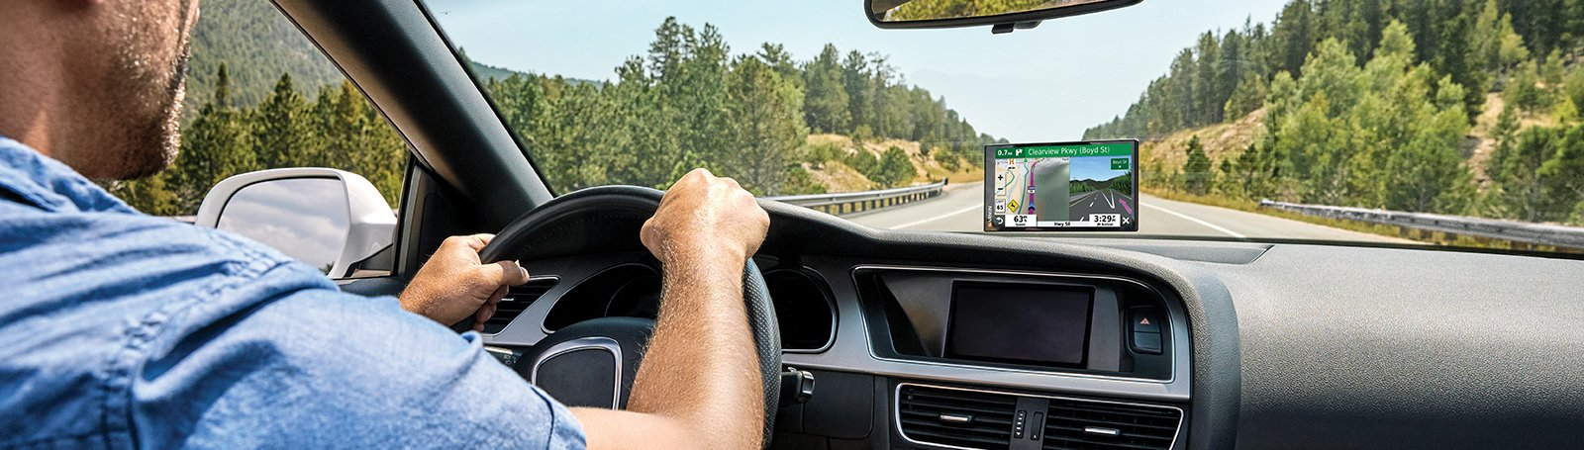
Introduction
Real-time driver monitoring system will be developed which will analyses the driver’s state in real-time and gives alert when drowsy state increases.
The system will require one android device which will be placed at front as we used to place for navigation purpose

Slide 4
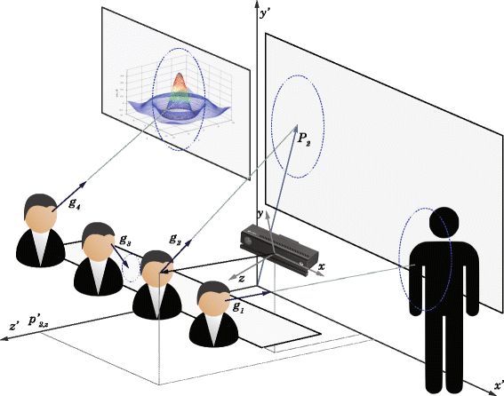
Motivation
Attention Monitoring/Analysis: are a vital importance for a number of application
Students’ learning analysis in class
Parents’ attention analysis

Slide 5
Motivation
Road accidents are responsible for 1.35 million death cases around every year all over the world(WHO).
20-50 million people experience non-fatal injuries, many suffer lifelong disabilities [1].
~20% drivers confessed to fall asleep while driving, ~40% confessed that this happened to them at least once in their lifetime [2].
~100,000 incidents/year occur due to driver drowsiness, 1500 deaths and 70,000 injuries are being reported [3].
To ensure the safety of the drivers and passengers, we greatly require a real-time driver monitoring system which can alert the driver when he/she is not attentive enough
[1] "Road traffic injuries," World Health Organization, 7 February 2020. [Online]. Available: https://www.who.int/news-room/fact-sheets/ detail/road-traffic-injuries. [2] "Drivers are Falling Asleep Behind the Wheel," nsc.org, [Online]. Available: https://www.nsc.org/road-safety/safety-topics/fatigued-driv ing. [3] "Medicalxpress.com," 2020. [Online]. Available: https://medical xpress.com/news/2018-11-sleepy-drivers-involved-year.html.

Slide 6
Existing Solutions
Previous driver attention monitoring research can be divided into three categories [1].
Vehicle parameters based approach
Psychological parameters based approaches
The facial feature based approach
[1] B. G. Pratama, I. Ardiyanto and T. B. Adji, "A review on driver drowsiness based on image, bio-signal, and driver behavior," 2017 3rd International Conference on Science and Technology - Computer (ICST), Yogyakarta, 2017.
Notes:
In vehicle based approach, vehicles’ different parameters; acceleration, wheel angle etc. are monitored to detect driver attention. But this method is time consuming and not suitable for real-time application. In the second approach, different psychological parameters are measured by using wearable sensors. Common types of psychological signal that are used for driver drowsiness system are Electrooculography (EOG), Electroencephalogram (EEG), Electromyography (EMG) etc [4]. This signal based approach is quite accurate but the main problem is that to collect the data, driver has to wear some head bands or other sensor. But often, these wearable sensors make driver uncomfortable and it has a negative effect on the driver. The facial feature based approach uses visual features like eye or mouth region for drowsiness detection. This method has become very popular because of its potentiality and advantages. In this approach, drivers do not need to wear any sensors and it works in real-time. Another cue, head pose is also a major indicator of driver attention

Slide 7
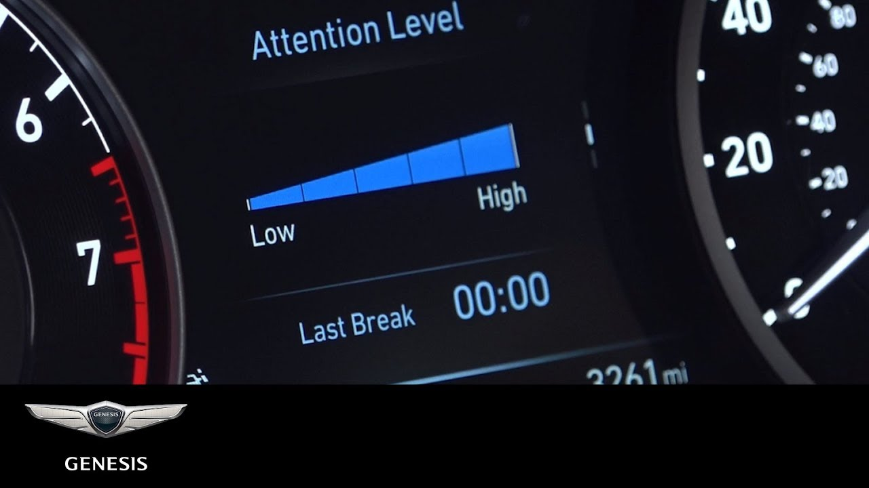
Existing Solutions: Hyundai motor group
Vehicle based approach: Analyzing steering / gas inputs
Drowsiness alert
Notes:
In vehicle based approach, vehicles’ different parameters; acceleration, wheel angle etc. are monitored to detect driver attention. But this method is time consuming and not suitable for real-time application. In the second approach, different psychological parameters are measured by using wearable sensors. Common types of psychological signal that are used for driver drowsiness system are Electrooculography (EOG), Electroencephalogram (EEG), Electromyography (EMG) etc [4]. This signal based approach is quite accurate but the main problem is that to collect the data, driver has to wear some head bands or other sensor. But often, these wearable sensors make driver uncomfortable and it has a negative effect on the driver. The facial feature based approach uses visual features like eye or mouth region for drowsiness detection. This method has become very popular because of its potentiality and advantages. In this approach, drivers do not need to wear any sensors and it works in real-time. Another cue, head pose is also a major indicator of driver attention

Slide 8
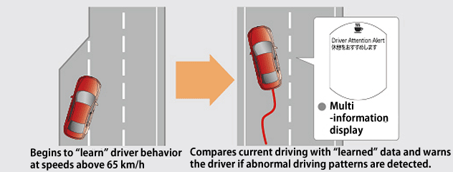
Existing Solutions: Mazda
Vehicle based approach: Analyzing steering / gas inputs
Notes:
In vehicle based approach, vehicles’ different parameters; acceleration, wheel angle etc. are monitored to detect driver attention. But this method is time consuming and not suitable for real-time application. In the second approach, different psychological parameters are measured by using wearable sensors. Common types of psychological signal that are used for driver drowsiness system are Electrooculography (EOG), Electroencephalogram (EEG), Electromyography (EMG) etc [4]. This signal based approach is quite accurate but the main problem is that to collect the data, driver has to wear some head bands or other sensor. But often, these wearable sensors make driver uncomfortable and it has a negative effect on the driver. The facial feature based approach uses visual features like eye or mouth region for drowsiness detection. This method has become very popular because of its potentiality and advantages. In this approach, drivers do not need to wear any sensors and it works in real-time. Another cue, head pose is also a major indicator of driver attention

Slide 9



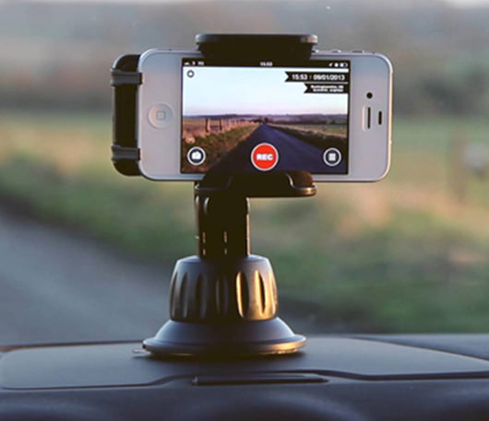
Proposed Idea and Usage scheme
Android Application
Camera Capture Image of Driver
AWS Cloud Computing
Feedback given
Data processing
analysis

Slide 10
System Overview
Technical specifications
Attention detection
Facial detection from image captured from front-facing camera
Eye pupil detection from the image
Eye tracking can be used for fatigue detection [1]
[1] Yamada, Yasunori, and Masatomo Kobayashi. “Detecting Mental Fatigue from Eye-Tracking Data Gathered While Watching Video: Evaluation in Younger and Older Adults.” Artificial Intelligence in Medicine, vol. 91, Sept. 2018, pp. 39–48

Slide 11
System Overview
Technical specifications
Android mobile device
Will be responsible for acquiring the image and sending it to AWS server, using front facing camera
Also responsible for presenting the results or generating the alarm (in case of driver is not attentive)
Linux server system (AWS) will be responsible of all kind of image processing and application of AI algorithms.
RESTful APIs will be used to establish communication between Android App and AI server

Slide 12
Expected Challenges
Availability of enough data for training machine/deep learning based algorithms
Utilizing classical face-detection and image processing techniques will be done first.

Slide 13
Evaluation Scheme
Pipeline Evaluation
Implementation of complete pipeline (establishing two way communication from Android App to AI Server)
Efficiency of implementation will be measure by time require
Performance Evaluation
Head and Eyes tracking accuracy (using Dice Score)
Attention Detection accuracy
Visual Evaluation
For evalation of Head and Eye tracking, visual analysis of results will be peformed.

Slide 14
Tentative Plan
Sr. No. | Phase | Expected Schedule | Responsible
1 | Development of Android Application | 25th March ~ 15th April, 2021 | Jiyong Youn
2 | Collection of dataset | 25th March ~ 5th April, 2021 | Usman
3 | Development of algorithm for face and eyes detection | 6thApril ~ 20th April, 2021 | Usman
4 | Development of algorithm for attention detection | 21st April ~ 5th May, 2021 | Usman
5 | Execution of complete pipeline | 16th April ~ 5th May, 2021 | Usman and Jiyong
6 | Evaluation and finalization of report | 6th May ~ 25th May, 2021 | Usman and Jiyong

