Slide 1
Restful Interface Specification

Slide 2
AWS AI Server
Authentication Request
Acknowledgment
(Success)
Image frame
Current State
Android Application UI

Slide 3
Interface Specification Details
Authentication
{ username: [string],
password: [string]
}
Acknowledgment
{ flag: [string] // Login successful or failed
}

Slide 4
Interface Specification Details
Image Frame
{ usr_id: [string]
frm_id : [string]
img: [ {2D uint8 array} ]
}
Current State
{ usr_id: [string]
frm_id : [string]
state : [string] }

Slide 5
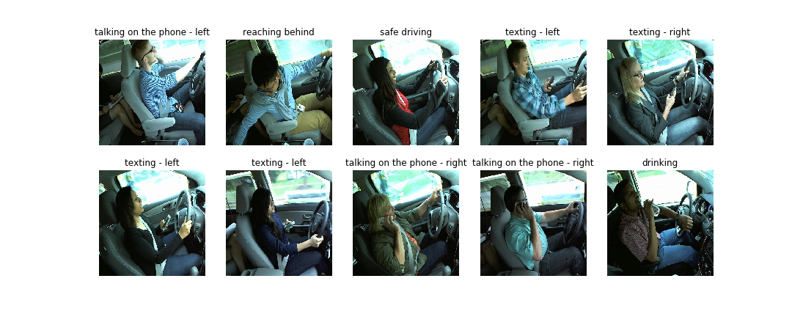
Dataset
State Farm Distracted Driver Detection – Kaggle Dataset

Slide 6
Dataset
State Farm Distracted Driver Detection – Kaggle Dataset
Safe Driving | Reaching behind | On Phone Left | Texting Left hand | Texting Right hand | On Phone Right | Setting the Music System | Drinking | Reaching Behind | Touching Face | Looking at Right
2,489 | 2,002 | 2,317 | 2,346 | 2,267 | 2,326 | 2,312 | 2,325 | 2,002 | 1,911 | 2,129

Slide 7
Deep Learning Models
ResNet
Inception Net
DenseNet
EffientNet
Autoencoder Networks

