Slide 1

IBM Capstone seattle neighborhoods
Helena Lewczynska

Slide 2
Presentation Outline
Introduction
Methods
Data
Analysis
Results
Conclusion

Slide 3
Introduction
I would like to move to Seattle to setup a dog walking business. The question this poses are:
Which neighborhoods suit my family and me?
Which neighborhoods in Seattle are most likely to require someone to walk their dog?
Do any of these neighborhoods provide the best of both worlds?
I will explore the best neighborhoods then find which neighborhoods would need a dog walker.
I will use Foursquare location data to map which neighborhoods contain our favorite venues.
Lastly, I will try to analyze which neighborhoods would best suit my lifestyle but also give me the ability to start up my dog walking business.

Slide 4
Methods
Collecting data: Including Seattle Neighborhood data, venues nearby each neighborhood which will be generated by Foursquare API and pet data from the Seattle Open-Source Website
Exploratory data analysis to better understand our working dataset.
Creating Map of Seattle with Folium library overlaying neighborhood characteristics and pet data.
Analyzing which neighborhoods, we should consider based on analysis of pets and venues.

Slide 5
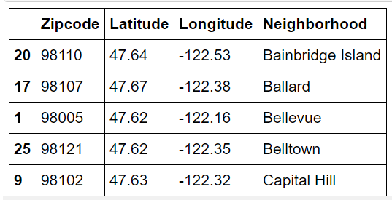
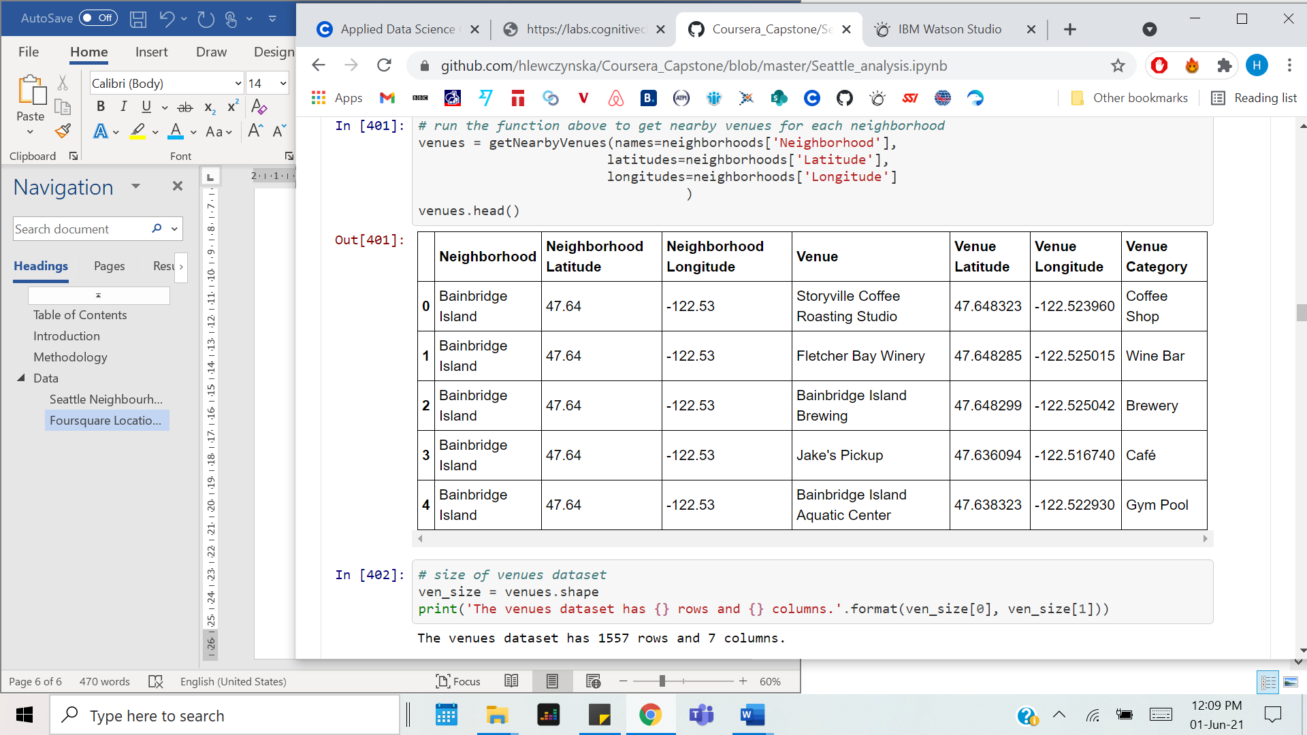
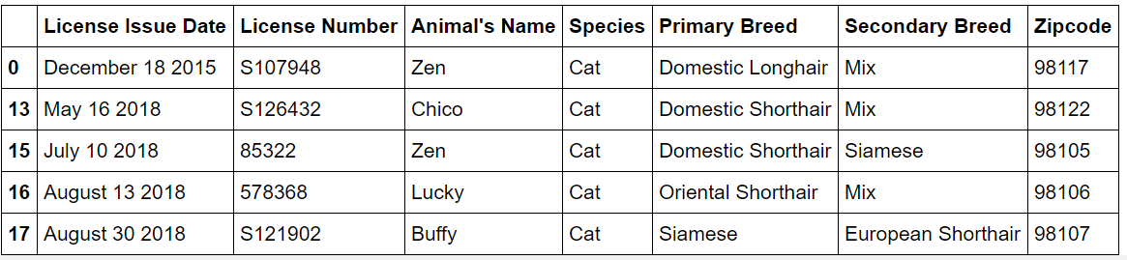
Data
https://www.unitedstateszipcodes.org/wa/#zips-list
Merged with http://seattlearea.com/zip-codes/
Seattle Neighbourhood merged with geospatial data
Foursquare location data
Seattle Pet data
https://foursquare.com
https://data.seattle.gov/

Slide 6
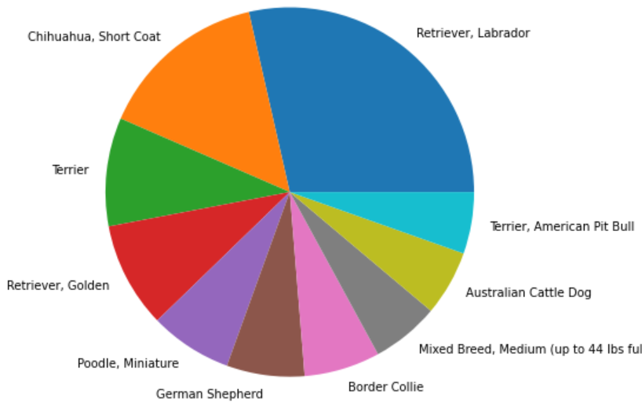
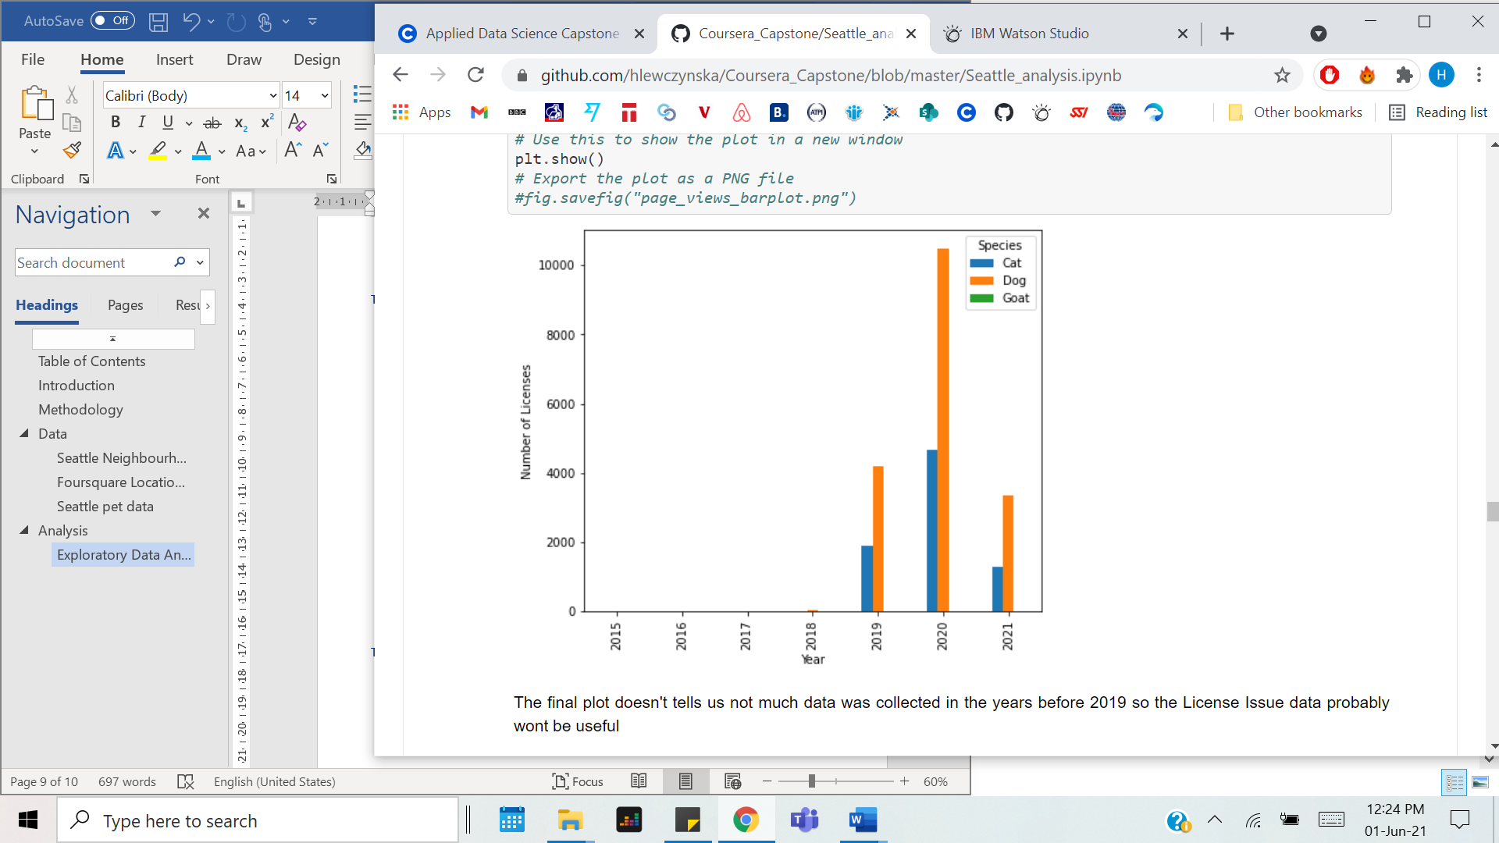
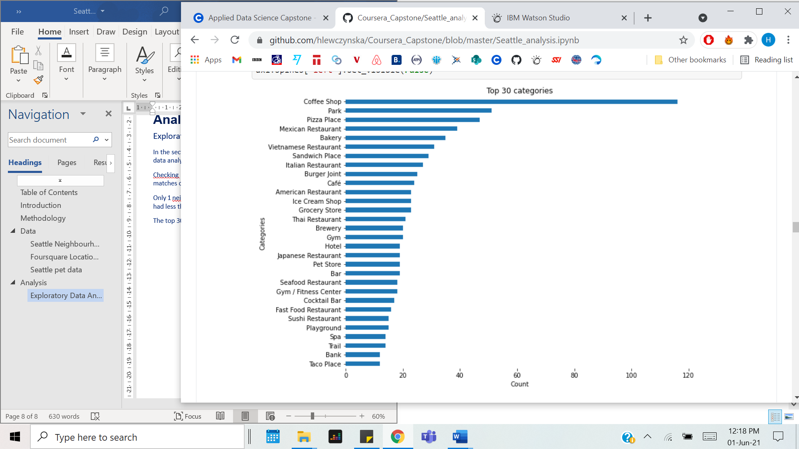
Initial Analysis
Initial analysis focused on plotting data characteristics
By looking at these characteristics we were able to see what parts of the data are useful, are what are not.
The top right top plot shows there was not enough data to find relationships of pet populations over time.
The bottom plot was useful in choosing our favorite venues.

Slide 7
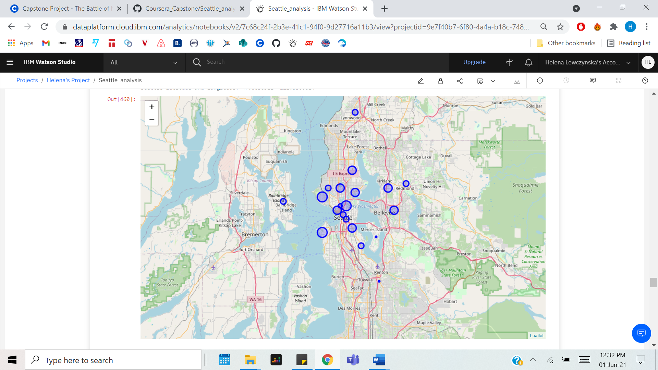
Results
The folium map helped us to visualize neighborhoods containing the highest number of parks, breweries and sushi restaurants.

Slide 8
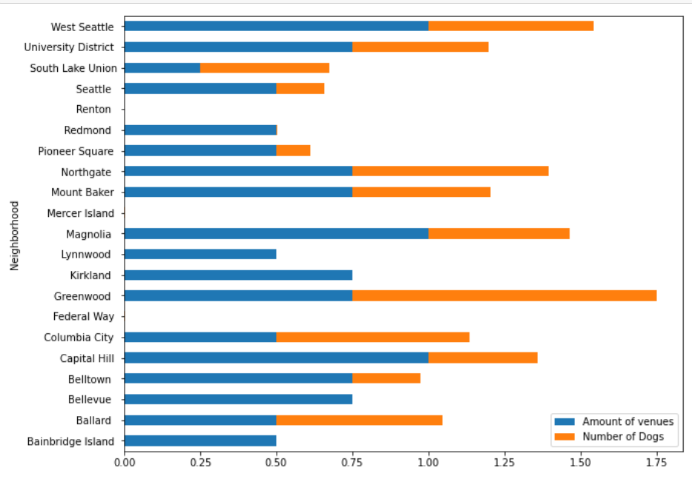
Results
Normalizing pet population data alongside the venue data gave us insight into the best neighborhood for my family and business proposal.

Slide 9
Conclusion
We did found some neighborhoods in Seattle with both our favorite destinations and a good puppy population:
Greenwood was our winner, with West Seattle and Magnolia also of interest.
Always note that, although this analysis gives insight into the issue concerned, since our data are collected online from multiple sources, we should always be critical about the confidence of the result and only take them as a reference.

Slide 10
IBM Capstone
FIND
EXPLORE
ANALYZE

