Slide 1
Autonomous Operation for Last-Mile Delivery on Urban Sidewalk
RBE550-Project
Keith Chester/Bob DeMont

Slide 2
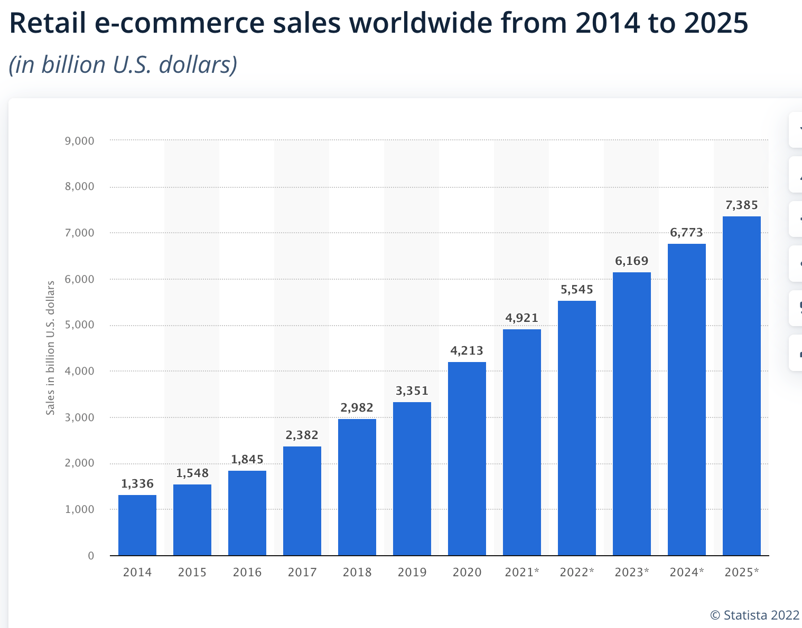
Background
Ongoing double-digit growth in e-commerce
Resulting in increased need for final mile delivery
Increased pollution in city centers
Pandemic fueled employee shortages

Slide 3
Goals
Planning and execution algorithms
Autonomous navigation
Obstacle avoidance
Static obstacles (boxes, trashcans)
Dynamic obstacles (people bikes)
Sidewalk rules
Staying on sidewalk
Crossing at crosswalk at green light
Simulation visualization in Gazebo

Slide 4

Tools
ROS
Gazebo

