Slide 1
Autonomous Operation for Last-Mile Delivery on Urban Sidewalk
RBE550-Project Update
Keith Chester/Bob DeMont

Slide 2
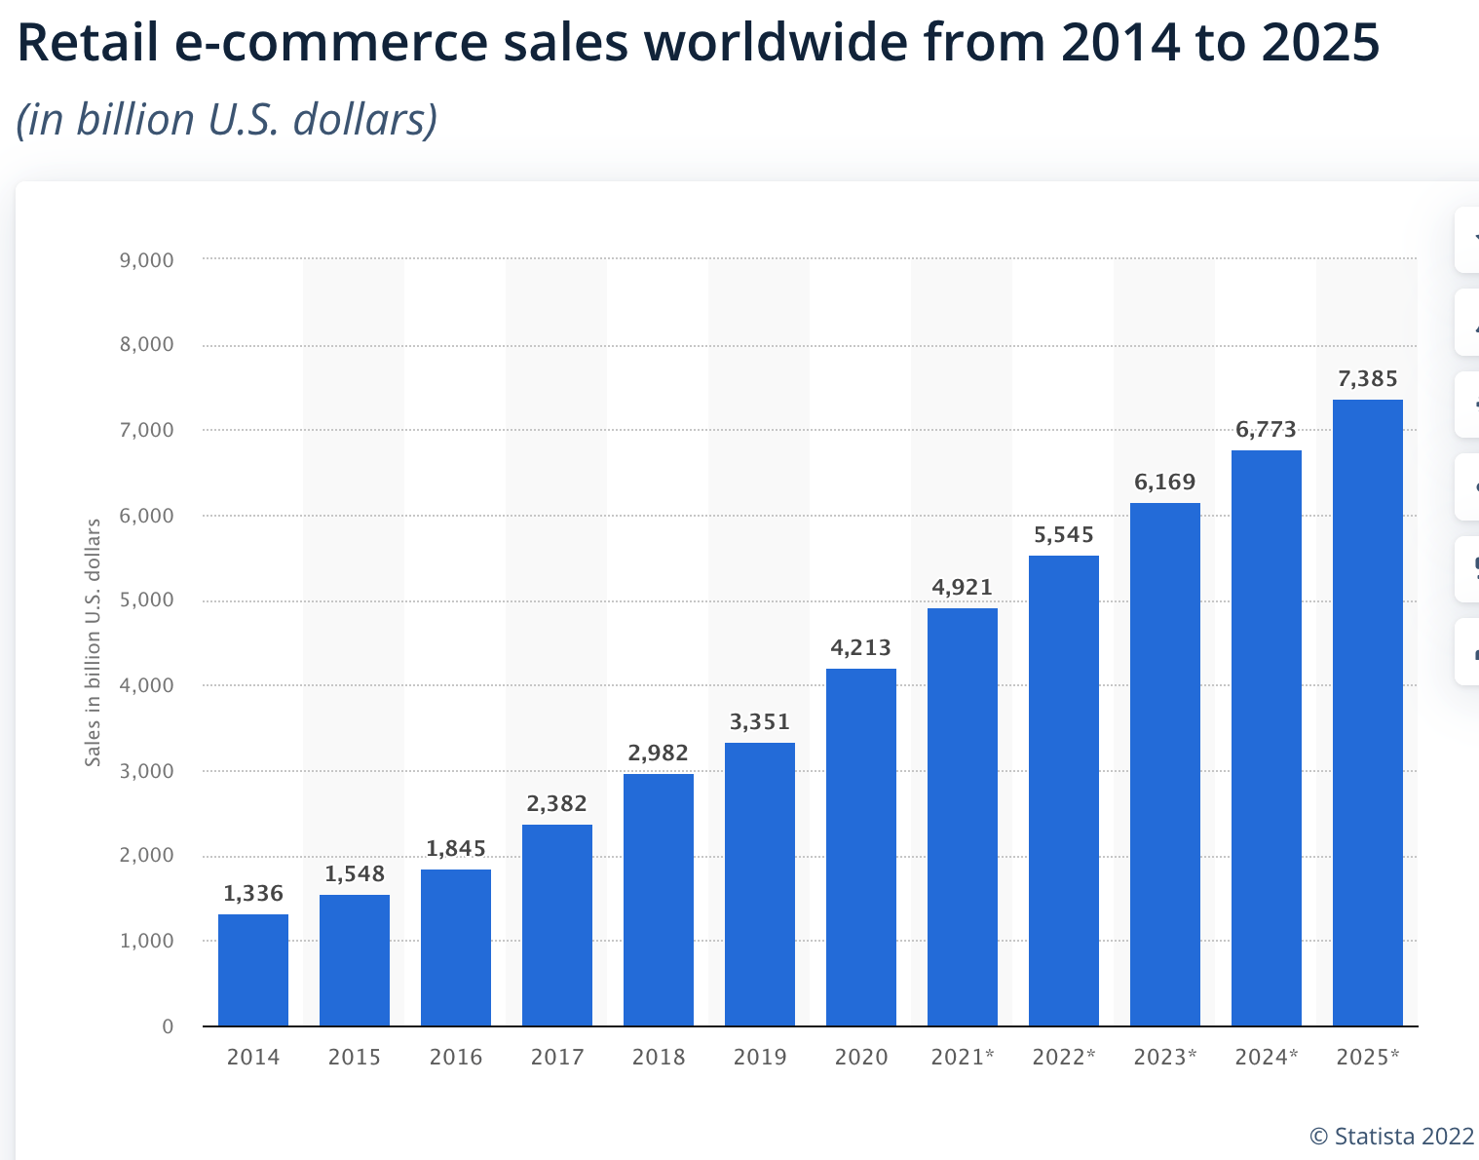
Background
Ongoing double-digit growth in e-commerce
Resulting in increased need for final mile delivery
Increased pollution in city centers
Pandemic fueled employee shortages

Slide 3
Goals
Planning and execution algorithms
Autonomous navigation
Obstacle avoidance
Static obstacles (boxes, trashcans)
Dynamic obstacles (people bikes)
Sidewalk rules
Staying on sidewalk
Crossing at crosswalk at green light
Simulation visualization in Gazebo

Slide 4

Tools
ROS
Gazebo

Slide 5
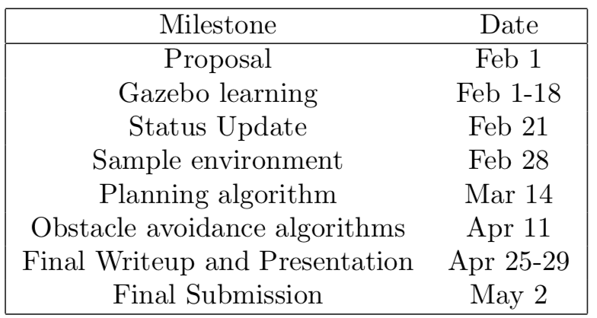
Schedule/Progress
Because of the newness of the tools, the first weeks have been focused on learning the ROS/Gazebo.
We are on track, having spent time on the tools.
We are able to create packages, nodes, topics and publish and subscribe.

Slide 6
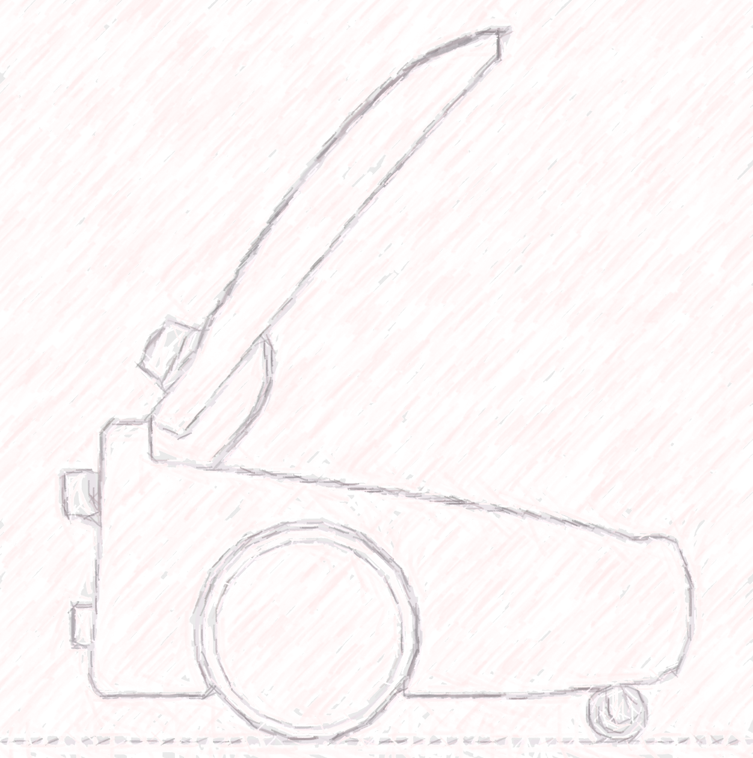
Next Week Plan
Environment development
Sidewalk environment
Building one side, road opposite
Various stationary obstacles
URDF development
() wheeled (tracked?) delivery bot
GPS sensor input-high level
LIDAR input-obstacle avoidance

