Slide 1
Autonomous Operation for Last-Mile Delivery on Urban Sidewalk
RBE550-Project Update
Keith Chester/Bob DeMont
Notes:
Hello and welcome to an update on our RBE550 project for Autonomous operations for last mile delivery on an urban sidewalk

Slide 2
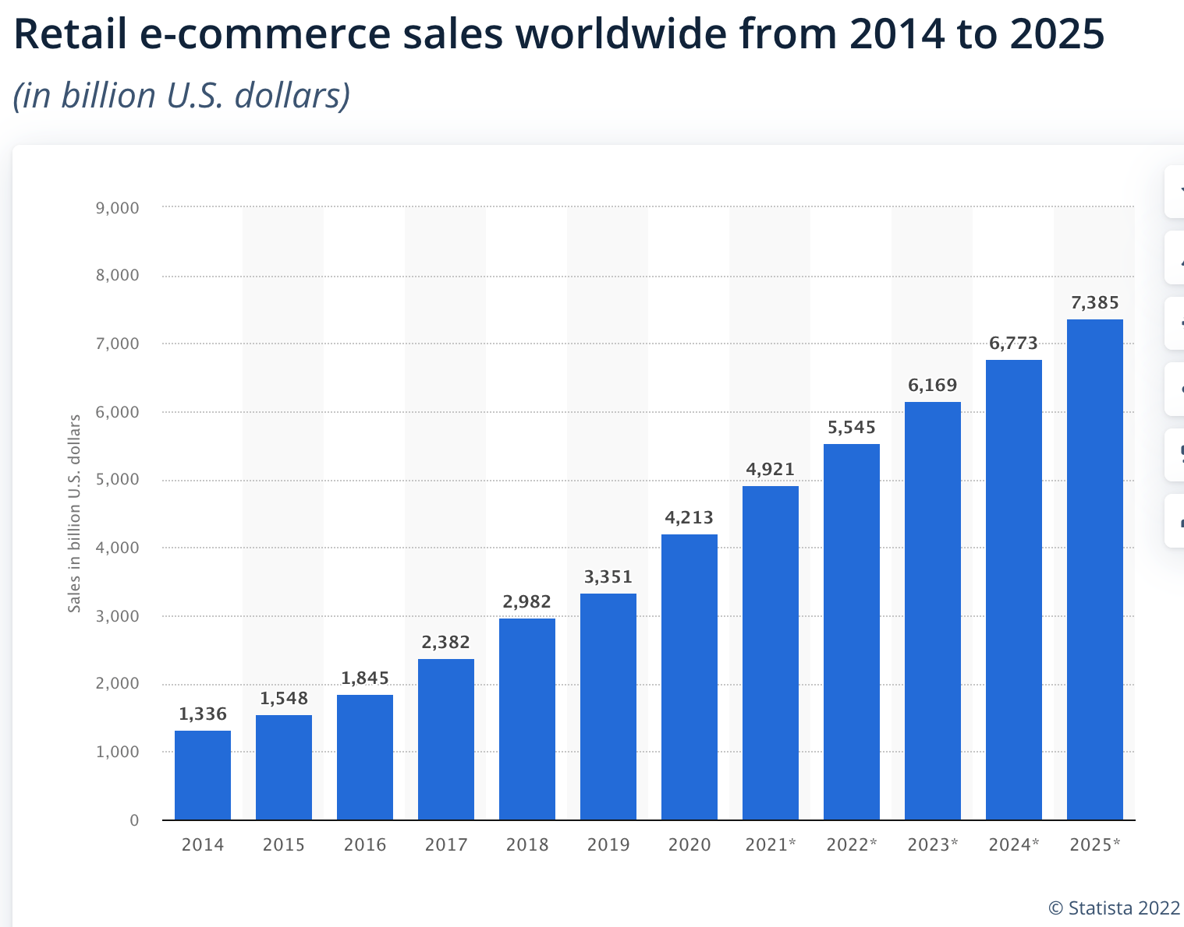
Background
Ongoing double-digit growth in e-commerce
Resulting in increased need for final mile delivery
Increased pollution in city centers
Pandemic fueled employee shortages
Notes:
We continue to believe that the economic and environmental fundamentals continue to grow to drive growth in last mile delivery. Despite pandemic population declines in many urban areas, the sheer density of people makes this setting relevant for last mile delivery.

Slide 3
Goals
Planning and execution algorithms
Autonomous navigation
Obstacle avoidance
Static obstacles (boxes, trashcans)
Dynamic obstacles (people bikes)
Sidewalk rules
Staying on sidewalk
Crossing at crosswalk at green light
Simulation visualization in Gazebo
Notes:
AS noted in the previous proposal, we have proposed to design and simulate autonomous navigation along an urban sidewalk for last mile delivery of items like groceries. We to follow sidewalk rules, staying on the sidewalk, crossing at crosswalks and not veering into the street.. We are planning for both the common static obstacles one might encounter such as dumpsters, construction cones and cardboard boxes as well as dynamic obstacles such as other delivery bots or people.

Slide 4

Tools
ROS
Gazebo
Notes:
We plan to execute the modelling and simulation in ROS and visualize in Gazebo.

Slide 5
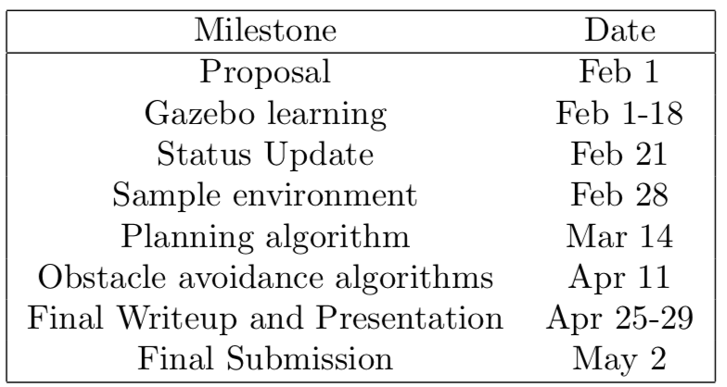
Schedule/Progress
Because of the newness of the tools, the first weeks have been focused on learning the ROS/Gazebo.
We are on track, having spent time on the tools.
We are able to create packages, nodes, topics and publish and subscribe.
Notes:
We continue to be on our planned schedule. Because of the newness of the tools to both of us, we have spent the past 3 weeks studying both ROS and Gazebo as well as setting up the programming environment. During this time we also explored the use of Docker as a development tool. We began by referencing wikis maintained by the ROS organization to get our initial images configured and followed that with reading several blogs and sources attempting to find a balance of ease of approach with industry best practices. Keith later posted a detailed document for others outlining this in the discussion forum.
As part of the learning, Keith has also been working hard at learning the internals of the ROS Navigation Stack, URDF/XARCO modeling for Gazebo, and Gazebo world creation.

Slide 6
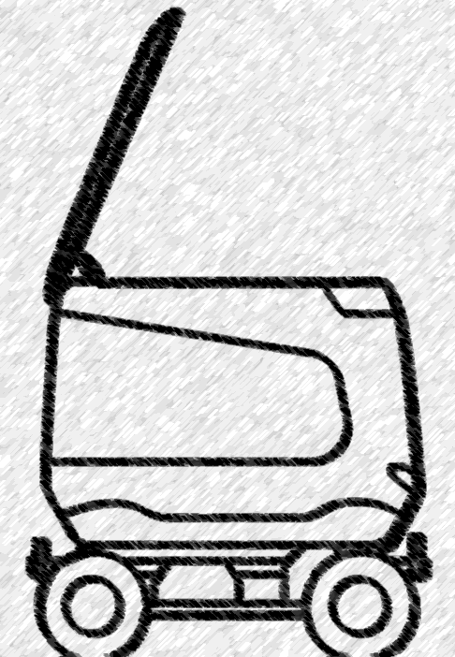
Next Week Plan
Environment development
Sidewalk environment
Building one side, road opposite
Various stationary obstacles
URDF development
4 wheeled delivery bot/Ackerman
GPS sensor input-high level
LIDAR input-obstacle avoidance
Notes:
In the coming week we’ll be developing the world environment for the simulations as well as the URDF for the robot. We’ve selected a 4-wheeled non-holonomic Ackerman steering vehicle for the implementation. It will utilize a GPS sensor for a pre-determined, global path plan and LIDAR for more specific localized obstacle avoidance during operation. Other sensors (such as a camera) may be included on the robot to match capabilities seen in current delivery robots, but we will likely depend on LIDAR for mapping. We will assume that the odometry measurements in the robot are without noise as we are experimenting with path planning and not sensor fusion or localization techniques.
WE look forward to your comments and feedback.

