Slide 1
Overview/Building Blocks
By: Dr. (James) Elliott Coleshill, P.Eng

Slide 2
BASIC CONCEPTS
Encapsulation
  What is it?
Input:
int
float
double
String
char
Hello World!
You are 28 years old
cout
BLACK MAGIC!
Notes:
Refers to the integration of data and logic within a class
Variables → data members
Functions →member functions
Separates object’s external appearance from implementation details

Slide 3
BASIC CONCEPTS
Polymorphism
  What is it?
Order Object
Order
Place()
Special Order Object
Special Order
Place()
Notes:
Refers to the selection of the operation most appropriate to the object involved
Allows identical names of member functions with different definitions
Appropriate definition is selected based on object’s class

Slide 4
BASIC CONCEPTS
Inheritance
  What is it?
Order Object
Order
Receive()
Special Order Object
Special Order
Notes:
Relationship between two classes
Child class shares entire structure of parent class
Derived class introduces the additional features
Instance Variables
Member function (additional logic)

Slide 5
BASIC CONCEPTS - TERMINOLOGY
Translation Unit
Entity
Variable
Object
Type
Module within a C++ program
Memory that holds a value and has a name
Memory that holds a value, not no necessarily a name
Building block of C++ language
  Syntax – Values, Vars, Objects, templates, namespaces, etc…
Describes how to interpret a bit string in memory

Slide 6

BASIC CONCEPTS - TERMINOLOGY
Synonym
Declaration
  Non Definition
  Definition
Scope
Introduces a name into a translation unit
Portion of program where name is valid
Function prototypes, parameter declarations in function prototypes, and forward class declarations
Aliases, declared using typedef, simplifies code
Function definitions, parameter declarations in function definitions, class definitions, and template definitions
Block
Class
Global
Discontinuous
One Definition Rule

Slide 7
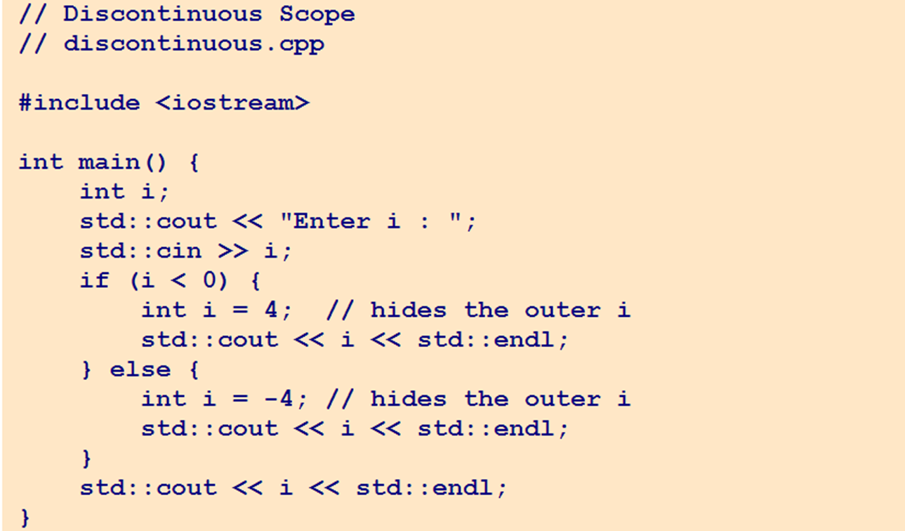
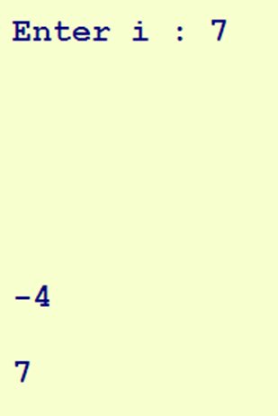
DISCONTINUOUS SCOPE - EXAMPLE

Slide 8
BASIC CONCEPTS - TERMINOLOGY
Storage Duration
Automatic Register Duration
Static Duration
Linkage
Prevents re-initialization, used to count the number of calls to a function
Refers to connectivity across scope (external, internal, none)
Defines lifetime of variable/object within a program
  Automatic, Static, Dynamic, Thread
  register, static, new, thread_local
Keeps a variable in CPU register for as long as possible

Slide 9
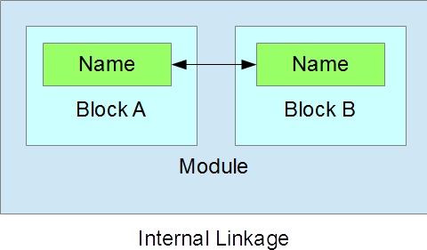
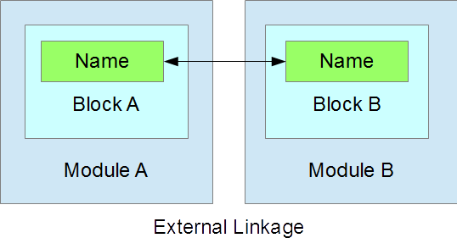
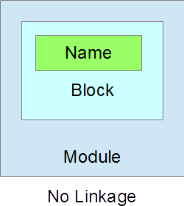
NAME’S LINKAGE

Slide 10
INTERFACE WITH OS
Entry point → “main()”
Command-Line Arguments
  “argc” receives number of arguments supplied
    Includes the name of executable itself
  “argv” receives the address of an array of c-style null-terminated strings
Returning control

Slide 11
Compilation
By: Dr. (James) Elliott Coleshill

Slide 12
INTRODUCTION
C++ is a multi-stage process
Programs consist of modules
  *.h and *.cpp
Steps:
  Pre-processing – src to translation units
  Compilation Proper – translation units into binary
  Linking – creates single relocatable files (binary executables)

Slide 13


THE COMPILATION FLOW
Header File
Translation Unit A
Binary Module A
Implementation File
Relocatable File
Header File
Translation Unit B
Binary Module B
Implementation File
Linker
Binary Library Modules
Pre-Processor
Compiler

Slide 14
COMPILE-TIME EVALUATIONS
// Compiler-Evaluated Expressions
// constexpr.cpp
#include <iostream>
constexpr int N = 8; // constant variable
constexpr int factorial(int i) { // constant function
return i > 1 ? i * factorial(i - 1) : 1;
}
int main() {
volatile int n { N };
std::cout << n << "! = " << factorial(n) << std::endl;
system("pause");
return 0;
}
The constexpr keyword declares that the value of its identifier is to be evaluated at compile time.

Slide 15
COMPILE-TIME EVALUATIONS
// Static Assertion
// static_assert.cpp
#include <iostream>
constexpr int N = 0;
constexpr int factorial(int i) {
return i > 1 ? i * factorial(i - 1) : 1;
}
int main() {
static_assert(N > 0, "N <= 0");
static_assert(N < 20, "N >= 20");
volatile int n { N };
std::cout << n << "! = " << factorial(n) << std::endl;
system("pause");
return 0;
}
Programmer-inserted checks are called assertions. The static_assert() mechanism generates a custom compiler error message if a specified condition has not been met.
static_assert(bool condition, const char* message);

Slide 16
Thank You
Dr. (James) Elliott Coleshill,P.Eng
elliott.coleshill@senecacollege.ca
416-491-5050 x.33704

