Slide 1
Multi-Threading
By: Dr. (James) Elliott Coleshill, P.Eng

Slide 2
MULTI-THREADING
Helps enhance a programs performance
Depends on:
  Hardware capabilities
  Divisibility of program into independent tasks
Programming
  Straightforward for simple applications
  Quite difficult for complex solutions
C++11 introduces a comprehensive set of libs to support

Slide 3
PERFORMANCE
Can be described in two abstract concepts
  Its tasks
  Its communications
Task
  A group of instructions that represents an algorithm
Communication
  The transfer of information to or from a processor
  Comms channel may be:
    Processor to main memory
    A file stream, Input/output stream
Time Complexity
  Refers to the rate at which solution time grows with problem size
Space Complexity
  Refers to the rate at which memory requirements grow with problem size

Slide 4
PROCESS VS. THREADS
Multi-Tasking differs from Multi-threading
  Clear distinction between a process and a thread

Slide 5
PROCESS
Is an instance of a program executing on a host platform
OS creates a “process” when a program file is loaded into memory
A process can request resources from the OS
  OS multi-tasking scheduler handles these
  Blocked Process in “wait state”
A switch from process to process is called a “context switch”
  “context” refers to the contents of the CPU’s registers and program counters
  NOTE: Context Switching is computationally intensive
    May require thousands of clock cycles

Slide 6
THREAD
A sequence of program instructions
Exist within a process (light-weight version of the process)
Run concurrently and share the same address space
Each thread is considered an algorithm
Can be software or hardware based
  Software Thread
    Virtual thread associated with a specific task
  Hardware Thread
    A mini-process that executes a software thread (its task)
  OS maps software threads to hardware threads using its own algorithm

Slide 7
THREAD
Multi-threading
  Several threads running concurrently
  Depends on hardware
Context Switching on threads is similar to a process
  Schedule blocks threads and switches to another thread
  Faster than process context switching

Slide 8
TERMINOLOGY
Process starts executing a single thread
  When divided into concurrent tasks we say
    Process “launches” a concurrent task
    “spawns” a child thread
  The join point is the synchronization point
Shared Memory
  Memory space/variables that are shared between threads
  Be careful – threads run concurrently therefore, this requires special attention

Slide 9
TERMINOLOGY
Race Condition
  Occurs when two threads try to update the same memory location at the same time
  One run may produce different results from another
  Several solutions:
    Shared states
    Mutexes
    Locks
    atomics

Slide 10
TERMINOLOGY
Shared State
  State shared between threads
  Used to communicate a value
Mutexes/locks
  Mutex – mutual exclusion
    Technique that excludes access by other threads while a particular thread is updating a variable
    Implemented using locks
      Locks must be released
Atomics
  Lock-free execution of instruction
  In C++11 library
  Used in more complex programming solutions and out of scope for this course

Slide 11
Thread Class
By: Dr. (James) Elliott Coleshill, P.Eng

Slide 12

THREAD CLASSES
C++11 provides two thread libraries
  Used for implementing simple multi-threaded solutions
  “thread” and “future”
Thread
  Provides support for launching threads that execute concurrently
Furture
  Provides support for communicating between concurrently executing threads
    Using shared states
Defines an object hat represents a single thread of execution
Can be “joinable” or “non-joinable”
  Joinable represents an actual thread of execution with a unique thread id
  Non-joinable represents a potential thread of execution

Slide 13
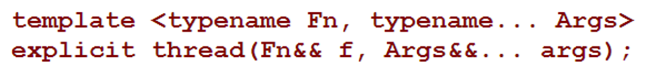
THREAD CLASS
No copy-constructor or copy-assignment member functions
Thread::id type represents the thread identifier
A template is provided for constructing objects
  Executes functions, function objects or lambda expressions
Accessible from within a joinable thread
  Std::this_thread::get_id()

Slide 14
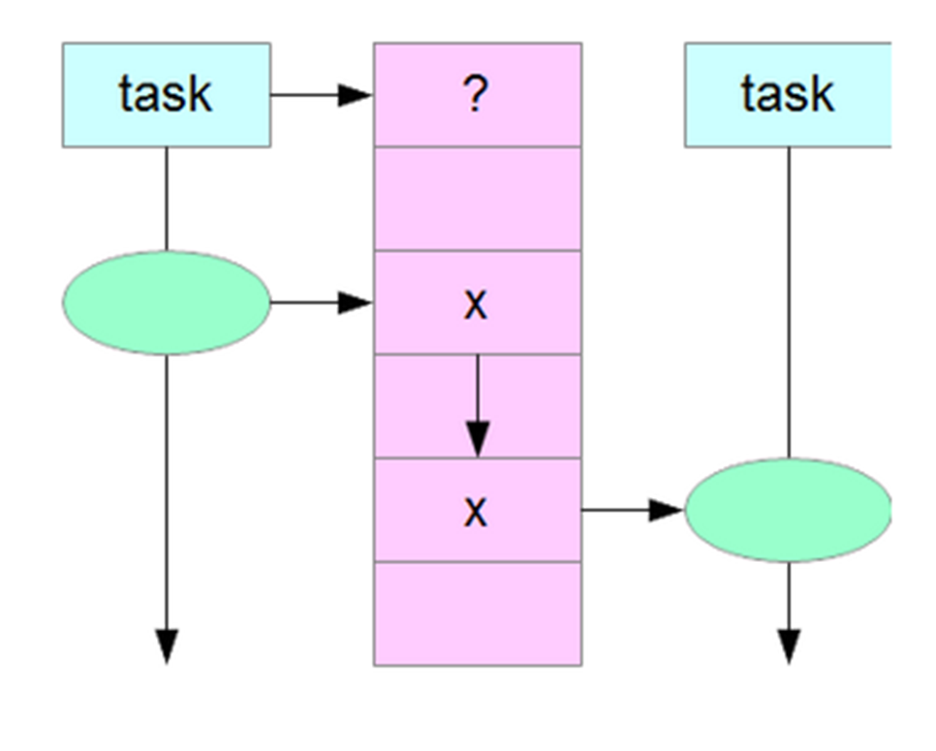

FUTURE LIBRARY
Facilitates efficient transfer of values between tasks
  Through shared states
A “provider” stores a value in a shared state
  “future” retrieves the value
Each provider-future pair establishes one sync point
  Provider creates empty state on initialization
  State “ready” once provider has supplied a value
Std::future class template
A future object is either valid or not-valid
  Valid object is associated with a shared state
  Value can be retrieved once state is ready

Slide 15
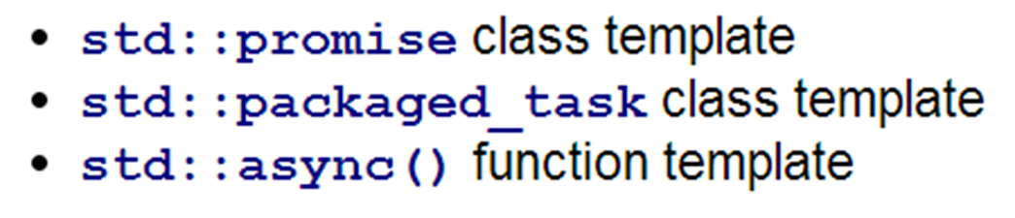
PROVIDERS
Providers complement a future object
Can be instantiated using one of the following templates:

Slide 16
PROMISE
Promise object creates or acquires a shared state in which it can store a value
  Simple member functions
    Set_value()
    Get()

Slide 17
PACKAGED_TASK
Object consists of two complements:
  A stored task
  A shared state
Simple wrapper for passing the result of a task to a future object
  Eg: Launching a thread that executes a task and capturing the return value

Slide 18
ASYNC
Provides an extremely simple pair that
  Spawns a thread to execute a task
  Creates a future for retrieving the return value
Async () function:
  Accepts the address of the function that defines the task
  Launches the task
  Reverts control to its caller
  Returns future object that can retrieve the value
    Upon task completion

Slide 19
LIFETIME OF STATE VARIABLE

Slide 20
Thank You
Dr. (James) Elliott Coleshill, P.Eng
elliott.coleshill@senecacollege.ca
416-491-5050 x.33704

