Slide 1
Inheritance and Templates
By: Dr. (James) Elliott Coleshill, P.Eng

Slide 2
INHERITANCE
Simplifies the life-cycle of a set of classes
  Deriving one from another
Abstract Base Class
  Common structure, member variables & functions
Concrete Class
  Localize implementation improvements
Example:
  <iostream> combines <istream> and <ostream>

Slide 3

ABSTRACT AND CONCRETE CLASSES
Defines interface to inheritance hierarchy
  Typically an incomplete class
  Cannot create an instance of it
  Complete the implementation with a concrete class
Abstract
Concrete
Instance
Instance
Instance

Slide 4
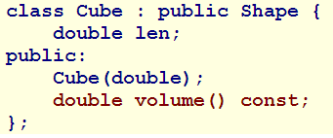
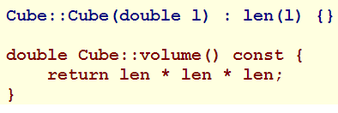
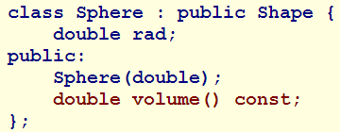
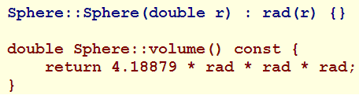
COMPLETING THE CLASS
Create concrete classes
  Derived class
  Add the remaining functionality
Let’s see how it works
Shape
Cube
Sphere

Slide 5
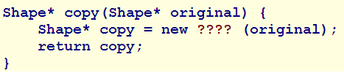
POLYMORPHIC OBJECTS
Can have different types throughout lifetime causing problems
  Determining dynamic type in a copy operation
  Specializing an operation for each dynamic type
  Excluding a specific type from most derived selection
In order to copy the pre-processor needs to know dynamic type
Solution – cloning member functions for each concrete class
  Copies the correct dynamic type
  Individual copy constructors used

Slide 6
TEMPLATES
Reduce code duplication
  Define structure of algorithms & classes
  Independent of type(s) involved
Called – Parametric Polymorphism
Compiler generates function/class based on programmer explicit types
Keyword “template”
Does the following
  Declares/defines a function/class
    Includes object member functions, classes, enums, static parameters
  defines a member template of a class or class template
  Declares an alias

Slide 7

TEMPLATE SYNTAX
Template body accepts external data via the parameter list
  These are placeholders throughout the template body
“T” is the sole template parameter
  Compiler replaces “T” with the implicit or explicitly specified type

Slide 8
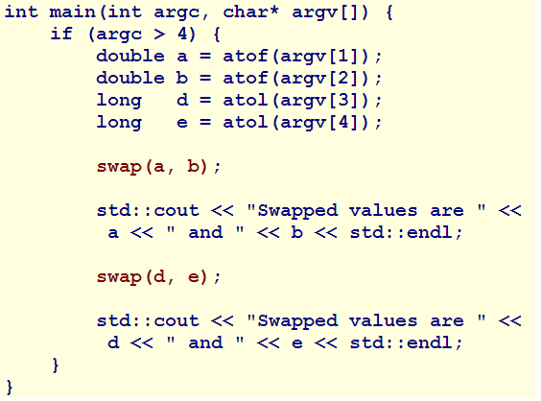
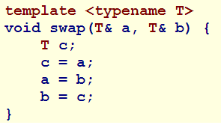
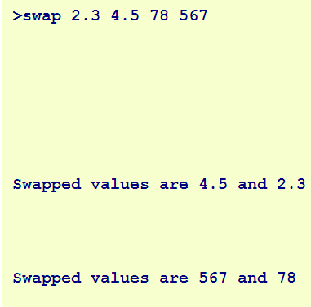
TEMPLATE SYNTAX - CONT

Slide 9
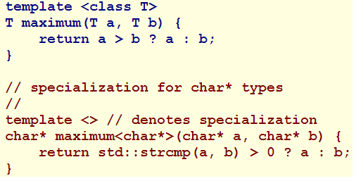
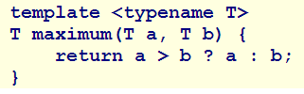
SPECIALIZATION
A template specialization defines an exception to a defined template
  Example: use of a pointer
  Uses an empty parameter list

Slide 10
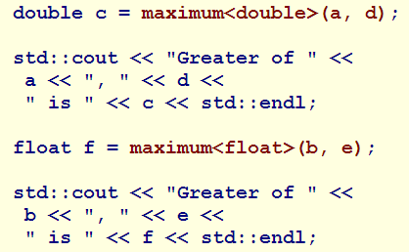
AMBIGUITIES
Ambiguities can be resolved by explicitly stating the type
  Use a casting style approach between < >

Slide 11
CLASS TEMPLATES
// Class Template - Array // array.h
template <typename T>
class Array
{
  T a[50];
  unsigned n;
  T dummy;
public:
  Array() : n{0u}, dummy{0} {}
  T& operator[](unsigned i)
  {
    return i < 50u ? a[i] : dummy;
  }
};

Slide 12
NON-TYPE TEMPLATE PARAMETERS
// Non-Type Template Parameters // array.h
template <class T, int size>
class Array
{
  T a[size];
  unsigned n;
  T dummy;
public:
  Array() : n{0u}, dummy{0} {}
  T& operator[](unsigned i)
  {
    return i < 50u ? a[i] : dummy;
  }
};

Slide 13
DEFAULT TEMPLATE PARAMETERS
// Default Template Parameter Values // array.h
template <class T = int, int size = 50>
class Array
{
  T a[size];
  unsigned n;
  T dummy;
public:
  Array() : n(0), dummy(0) {}
  T& operator[](unsigned i)
  {
    return i < 50u ? a[i] : dummy;
  }
};

Slide 14
TEMPLATES AND STATIC MEMBERS
// Static Data Member Declaration // array.h
template <typename T = int, int size = 50>
class Array
{
  T a[size];
  unsigned n;
  T dummy;
  static unsigned count;
public:
  Array() : n{0}, dummy{0} { ++count; }
  T& operator[](unsigned i) { return i < 50u ? a[i] : dummy; }
  static unsigned cnt() { return count; }
  ~Array() { --count; }
};

Slide 15
TEMPLATES AND STATIC MEMBERS
// Static Data Member Declaration // array.cpp
#include <iostream>
#include "array.h"
int main()
{
  Array<> s, t;
  Array<double> u;
  Array<int, 40> v;
  std::cout << Array<>::cnt() << std::endl;
  std::cout << Array<double>::cnt() << std::endl;
  std::cout << Array<int, 40>::cnt() << std::endl;
}

Slide 16
Thank You
Dr. (James) Elliott Coleshill, P.Eng
elliott.coleshill@senecacollege.ca
416-491-5050 x.33704

