Slide 1
Sequential Containers & Iterators
(STL)
By: Dr. (James) Elliott Coleshill, P.Eng

Slide 2
STANDARD TEMPLATE LIBRARY
provides a shell for various collections of elements
Containers are ordered linearly
Provide interfaces for encapsulating the way elements can be accessed
Iterators provide access for iterating on the collections
  Glue between the collections and the algorithms
STL Provides:
  array
  vector
  deque
  list

Slide 3
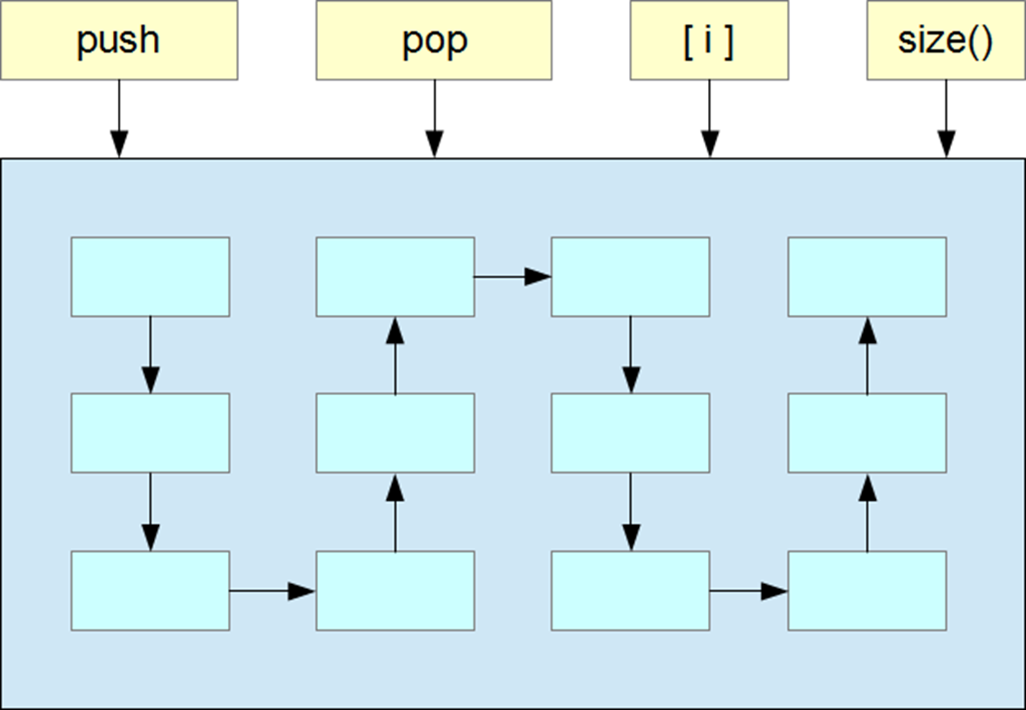

Slide 4

VECTOR
Class template represents data structures that can:
  Change in size
  Have their elements ordered in strict linear sequence
Use contiguous storage locations for elements
  Are as efficient as arrays
Use dynamic memory and adjust their size as required
  Template is optimized for fast random access

Slide 5

DEQUE
Class template represents a doubly-ended
  Can change in size from either end
  Elements are ordered in strict linear sequence
Insertion/deletion of elements at either end
  BUT: elements can be scattered throughout memory in different chunks of storage
  Contiguous storage is not guaranteed

Slide 6

LIST
Class template represents a doubly linked sequence
  Optimized for insertion and removal of elements
    Can be done anywhere throughout the list
    Link list

Slide 7
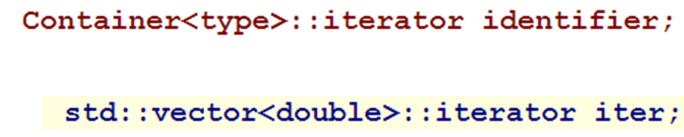
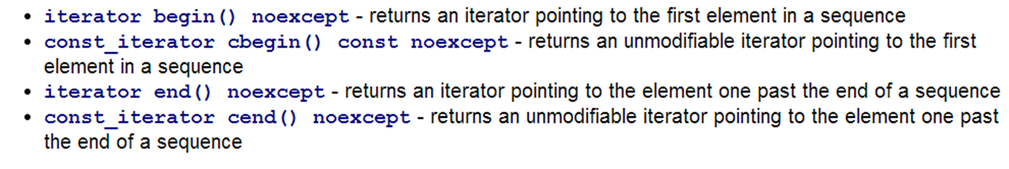
ITERATORS
An iterator is an object that points to an element in a sequence
STL iterators provide sequential access to elements
  Similar to accessing raw pointers or simple arrays
Required by container classes that do not implement contiguous storage of elements
used to insert/remove elements from a sequence
Each STL container class includes the following members to return iterators
  Begin()
  End()
(++) and (--) updates to the next or previous element
Applying (*) to an iterator returns the value of the element

Slide 8
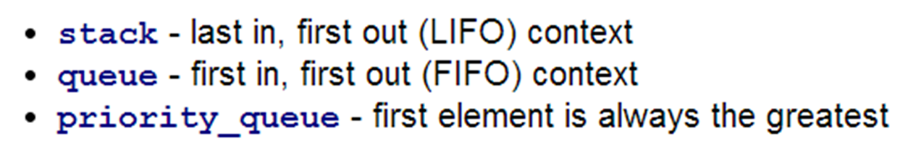
CONTAINER ADAPTORS
STL provides container adaptors for converting
  Making a container class operate in a specific context

Slide 9
Thank You
Dr. (James) Elliott Coleshill, P.Eng
elliott.coleshill@senecacollege.ca
416-491-5050 x.33704

