Slide 1
Algorithms
(STL)
By: Dr. (James) Elliott Coleshill, P.Eng

Slide 2
ALGORITHMS
STL includes a set of libs for performing operations on sequences
  Data elements must be of identical type
Three libs
  functional – standard function objects
  algorithm – standard algorithms
  numeric – standard numeric operations
Functions and class templates for these libs are in the std namespace

Slide 3

FUNCTIONS LIBRARY
Provides standard function objects
Can be passed as arguments to other functions
  Including algorithm templates
Has three distinct parts:
  Wrapper Classes
  Functions
  Operator Classes

Slide 4

ALGORITHM LIBRARY
Contains templates for operations on ranges of elements in a sequence
Element ranges are accessed through iterators
  Apply to strings and built-in arrays as well
Algorithm functions do not change the size or storage allocation of any container
Templates can be grouped into the following categories
  Queries
  Modifiers
  Manipulators
Template parameter types referred to are:
  InIter – an input iterator type
  OutIter – an output iterator type
  RanIter – a random access iterator type
  Fn – a function object type

Slide 5
File Stream Objects
By: Dr. (James) Elliott Coleshill, P.Eng

Slide 6
FILE STREAM OBJECT
File stream classes define containers that connect to files
  Part of standard library
A stream as a sequence of items of unspecified size and a byte stream as a sequence of byte of unspecified size
File stream classes manage the transfer of this data
  Between memory and file
  Or other source (more on this in BTN415)
2 hierarchies available
  ios
  wios

Slide 7
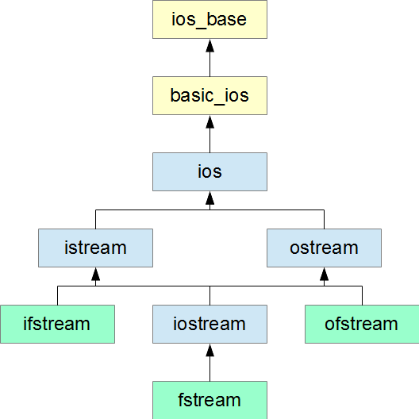
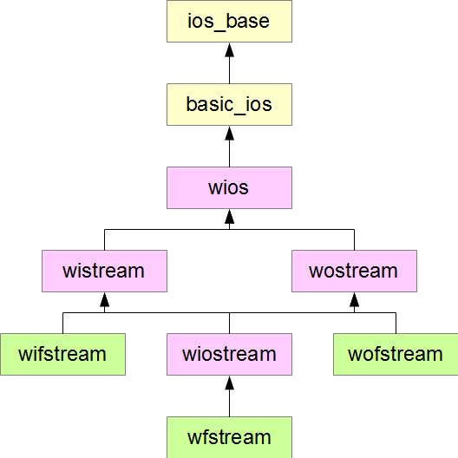
HIERARCHIES

Slide 8
IOS_BASE CLASS
ios_base class holds:
  Formatting information
  Stream state flags
  Stream opening mode flags
  Stream seeking direction flag
6 public member functions
  bool basic_ios::good() const - none of the flags is set
  bool basic_ios::fail() const - ios::failbit or ios::badbit is true
  bool basic_ios::eof() const - ios::eofbit is true
  bool basic_ios::bad() const - ios::badbit is true
  bool basic_ios::operator!() const - same result as fail()
  basic_ios::operator bool() const - same result as !fail()

Slide 9
OPENMODE FLAGS
6 member constants identify the open mode of a stream
  ios_base::in open for reading
  ios_base::out open for writing
  ios_base::app open for appending
  ios_base::trunc open for writing, but truncate if file exists
  ios_base::ate move to the end of the file when the file is opened
  ios_base::binary access the file as a binary file
Practical bit-wise combinations
  ios::in|ios::out open for reading and writing (default)
  ios::in|ios::out|ios::trunc open for reading and overwriting
  ios::in|ios::out|ios::app open for reading and appending
  ios::out|ios::trunc open for overwriting

Slide 10
FILE OBJECTS
File stream objects manage transfer of data between a program and file
  The a buffer
There are two access modes
  Text mode – stream of characters interpreted using an encoding sequence
  Binary mode – stream of characters without any interpretation/structure
#include <fstream>
std::ofstream fout("output.txt"); // opens output.txt for output
std::ifstream fin ("input.txt"); // opens input.txt for input
std::ofstream fo; // declares an output file named fo
fo.open("moreOutput.txt"); // connect fo to moreOutput.txt
std::ifstream fi; // declares an input file named fi
fi.open("moreInput.txt"); // connects fi to moreInput.txt

Slide 11
FILE OBJECTS
2 ways to check for valid connection
#include <fstream>
std::ofstream fout("output.txt"); // opens output.txt for output
if (!fout) {
std::cerr << "File failed to open" << std::endl;
} else {
// opened successfully
}
#include <fstream>
std::ofstream fout("output.txt"); // opens output.txt for output
if (!fout.is_open()) {
std::cerr << "File failed to open" << std::endl;
} else {
// opened successfully
}

Slide 12
CLOSE A CONNECTION
Member function close()
  Remember: It’s an Object
#include <fstream>
int main(int argc, char agrv[]) {
std::ifstream source;
std::ofstream destination(argv[3]);
source.open(argv[1]); // open first file
destination << source.rdbuf(); // copy
source.close(); // close first file
source.open(argv[2]); // open second file
destination << source.rdbuf(); // copy
}

Slide 13
DIRECT ACCESS
File objects can access the stream sequentially or directly
  Sequentially access progresses from the beginning to the end
  Direct access starts at a specified position
int main(int argc, char* argv[]) {
std::ofstream fo(argv[1]); // open for output
fo << "Line 1" << std::endl; // line 1
fo << "Line 2" << std::endl; // line 2
fo << "Line 3" << std::endl; // line 3
fo.seekp(0, std::ios::beg); // to the start of the file
fo << "****"; // overwrite four characters
fo.seekp(4, std::ios::cur); // 4 char's beyond current
fo << "#"; // overwrite one character
std::streampos p = fo.tellp(); // remember current position
fo.seekp(0, std::ios::end); // to end of the file
fo << "The last line\n"; // add a line
fo.seekp(p); // jump back to pos
fo << "^"; // overwrite one character
fo.close(); // close file

Slide 14
READING & WRITING
int main(int argc, char* argv[]) {
std::fstream f(argv[1], std::ios::in|std::ios::out|std::ios::trunc);
f << "Line 1" << std::endl; // line 1
f << "Line 2" << std::endl; // line 2
f << "Line 3" << std::endl; // line 3
f.seekp(0, std::ios::beg); // to the start of the file
f << "****"; // overwrite four characters
f.seekp(4, std::ios::cur); // 4 bytes beyond current
f << "#"; // overwrite one character
std::streampos p = f.tellp(); // remember current position
f.seekp(0, std::ios::end); // to end of the file
f << "The last line\n"; // add a line
f.seekp(p); // jump back to pos
f << "^"; // overwrite one character

Slide 15
BINARY ACCESS
Transfers data to and from member without formatting
  No conversion, insertion or extraction of records or field separators
Binary files are typically indecipherable when viewed in a text editor
  Why? What’s happening?

Slide 16
BINARY READ
#include <iostream>
#include <fstream>
int main(int argc, char* argv[]) {
char str[1025];
char* p = str;
std::ifstream f(argv[1], std::ios::in|std::ios::binary);
while(f)
f.read(p++, 1);
*--p = '\0';
std::cout << str << std::endl;
}

Slide 17
BINARY WRITE
#include <fstream>
int main(int argc, char* argv[]) {
char str[] = "Hello World";
std::ofstream f(argv[1], std::ios::out|std::ios::binary|std::ios::trunc);
f.write(str, sizeof str - 1);
}

Slide 18
Thank You
Dr. (James) Elliott Coleshill, P.Eng
elliott.coleshill@senecacollege.ca
416-491-5050 x.33704

