Slide 1
Bug Isolation via
Remote Program Sampling
Ben Liblit | Alex Aiken
Alice Zheng | Mike Jordan

Slide 2
Motivation: Users Matter
Imperfect world with imperfect software
  Ship with known bugs
  Users find new bugs
  Bug fixing is a matter of triage
Important bugs happen often, to many users
Can users help us find and fix bugs?
  Learn a little bit from each of many runs

Slide 3
Users as Debuggers
Must not disturb individual users
  Sparse sampling: spread costs wide and thin
Aggregated data may be huge
  Client-side reduction/summarization
Will never have complete information
  Make wild guesses about bad behavior
  Look for broad trends across many runs

Slide 4
Sampling the Bernoulli Way
Identify the points of interest
Decide to examine or ignore each site…
  Randomly
  Independently
  Dynamically
Global countdown to next sample
  Geometric distribution with some mean
  Simulates many tosses of a biased coin

Slide 5
Countdown Predicts the Future
“Fast path” when no sample is imminent
  Common case
  (Nearly) instrumentation free
“Slow path” only when taking a sample
Choose at top of each acyclic region
  Is countdown < max path weight of region ?
  Like Arnold & Ryder, but statistically fair

Slide 6
Sharing the Cost of Assertions
What to sample: assert() statements
Look for assertions which sometimes fail on bad runs, but always succeed on good runs
Overhead in assertion-dense CCured code
  Unconditional: 55% average, 181% max
  ¹/₁₀₀ sampling: 17% average, 46% max
  ¹/₁₀₀₀ sampling: 10% average, 26% max

Slide 7
Isolating a Deterministic Bug
What to sample:
  Function return values
  Client-side reduction
    Triple of counters per call site: < 0, == 0, > 0
Look for values seen on some bad runs, but never on any good run
Hunt for crashing bug in ccrypt-1.2
Notes:
This is not the only thing one might want to sample for all deterministic bugs; it’s just the thing we used for this one experiment.

Slide 8
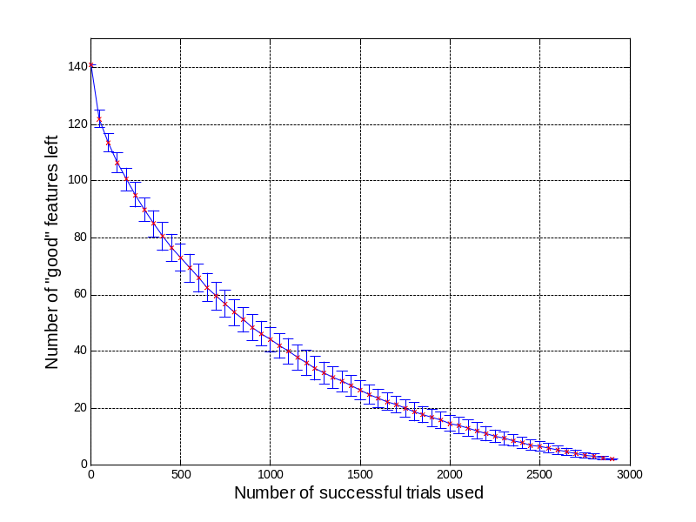
Winnowing Down the Culprits
1710 counters
  3 × 570 call sites
1569 are zero on all runs
  141 remain
139 are nonzero on some successful run
Not much left!
  file_exists() > 0
  xreadline() == 0
Notes:
This is all using a sampling rate of ¹/₁₀₀₀.

Slide 9
Isolating a Non-Deterministic Bug
At each direct scalar assignment
  x = …
For each same-typed in-scope variable y
Guess some predicates on x and y
  x < y x == y x > y
Count how often each predicate holds
  Client-side reduction into counter triples

Slide 10
Statistical Debugging
Regularized logistic regression
  S-shaped cousin to linear regression
  Predict crash/non-crash as function of counters
  Penalty factor forces most coefficients to zero
  Large coefficient ⇒ highly predictive of crash
Hunt for intermittent crash in bc-1.06
  30,150 candidates in 8910 lines of code
  2729 training runs with random input
Notes:
This is not the only thing one might want to sample for all non-deterministic bugs; it’s just the thing we used for this one experiment.

Slide 11
Top-Ranked Predictors
void more_arrays ()
{
…
/* Copy the old arrays. */
for (indx = 1; indx < old_count; indx++)
arrays[indx] = old_ary[indx];
/* Initialize the new elements. */
for (; indx < v_count; indx++)
arrays[indx] = NULL;
…
}
#1: indx > scale
#1: indx > scale
#2: indx > use_math
#1: indx > scale
#2: indx > use_math
#3: indx > opterr
#4: indx > next_func
#5: indx > i_base
Notes:
This is all using a sampling rate of ¹/₁₀₀₀.

Slide 12
Bug Found: Buffer Overrun
void more_arrays ()
{
…
/* Copy the old arrays. */
for (indx = 1; indx < old_count; indx++)
arrays[indx] = old_ary[indx];
/* Initialize the new elements. */
for (; indx < v_count; indx++)
arrays[indx] = NULL;
…
}

Slide 13
Conclusions
Implicit bug triage
  Learn the most, most quickly, about the bugs that happen most often
Variability is a benefit rather than a problem
There is strength in numbers
  many users
  + statistical modeling
  = find bugs while you sleep!

Slide 15
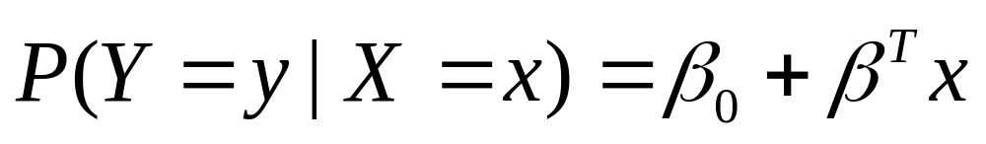
Linear Regression
Match a line to the data points
Outcome can be anywhere along y axis
But our outcomes are always 0/1

Slide 16
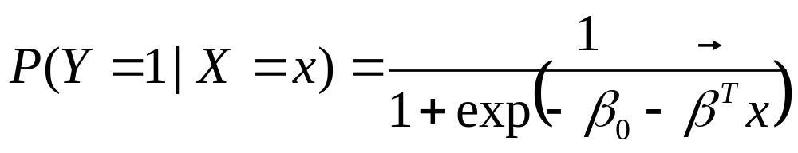
Logistic Regression
Prediction asymptotically approaches 0 and 1
  0: predict no crash
  1: predict crash

Slide 17
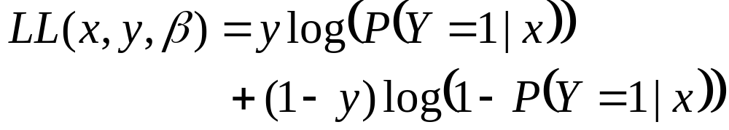
Training the Model
Maximize LL using stochastic gradient ascent
Problem: model is wildly under-constrained
  Far more counters than runs
  Will get perfectly predictive model just using noise

Slide 18
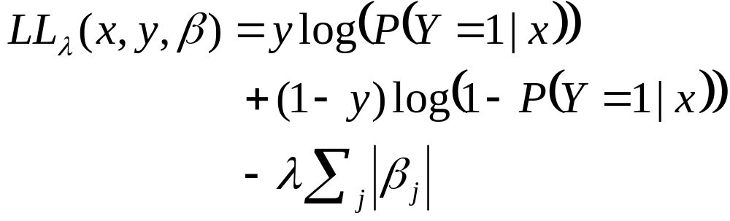
Regularized Logistic Regression
Add penalty factor for nonzero terms
Force most coefficients to zero
Retain only features which “pay their way” by significantly improving prediction accuracy

Slide 20
Deployment Scenarios
Incidence rate of bad behavior: ¹/₁₀₀
Sampling density: ¹/₁₀₀₀
Confidence of seeing one example: 90%
Required runs: 230,258
Microsoft Office XP
  First-year licensees: 60,000,000
  Assumed usage rate: twice per week
  Time required: nineteen minutes

Slide 21
Deployment Scenarios
Incidence rate of bad behavior: ¹/₁₀₀₀
Sampling density: ¹/₁₀₀₀
Confidence of seeing one example: 99%
Required runs: 4,605,168
Microsoft Office XP
  First-year licensees: 60,000,000
  Assumed usage rate: twice per week
  Time required: less than seven hours

