Slide 1
Bug Isolation via
Remote Program Sampling
Ben Liblit | Alex Aiken
Alice Zheng | Mike Jordan
UC Berkeley

Slide 2
There’s Always One More Bug
Imperfect world with imperfect software
  Ship with known bugs
  Users find new bugs
Bug fixing is a matter of triage
  Limited resources: time, money, people
Virtually no systematic feedback from field
  Triage is guesswork
  Would you build airplanes this way?

Slide 3
The Good News: Users Can Help
Important bugs happen often, to many users
  User communities are big and growing fast
  Users are networked
We can do better, with a little help!
  Open bug databases (Bugzilla)
  Crash reporting (Microsoft, Netscape)
  Software tomography; continuous profiling; recovery-oriented computing …
Notes:
Software vendors treat their users as beta testers. We want to make them better beta testers.
Office XP: 60 million licenses in first year; nearly 2 per second
Kazaa: 366 thousand downloads per day; more than 4 per second

Slide 4
Our Approach: Sparse Sampling
Generic sampling framework
  Adaptation of Arnold & Ryder
Suite of instrumentations / analyses
  Sharing the cost of assertions
  Isolating deterministic bugs
  Isolating non-deterministic bugs

Slide 5
Our Approach: Sparse Sampling
Generic sampling framework
  Adaptation of Arnold & Ryder
Suite of instrumentations / analyses
  Sharing the cost of assertions
  Isolating deterministic bugs
  Isolating non-deterministic bugs

Slide 6
Sampling the Bernoulli Way
Identify the points of interest
Decide to examine or ignore each site…
  Randomly
  Independently
  Dynamically
Cannot use clock interrupt: too decontextualized
Cannot be periodic: too unfair
Cannot toss coin at each site: too slow

Slide 7
Anticipating the Next Sample
Randomized global countdown
Selected from geometric distribution
  Simulates inter-arrival time
  How many tails before next head?
Mean of distribution = average sample rate

Slide 8
Amortized Coin Tossing
Each acyclic region:
  Finite number of paths
  Finite max number of instrumentation sites
5
4
3
3
2
2
1
1

Slide 9
Amortized Coin Tossing
Each acyclic region:
  Finite number of paths
  Finite max number of instrumentation sites
Clone each region
  “Fast” variant
  “Slow” variant
Choose at run time
>5?

Slide 10
Various Optimizations
Cache global countdown in local register
  Global → local at func entry & after each call
  Local → global at func exit & before each call
Identify and ignore “weightless” functions
Identify and ignore “weightless” cycles
Instrumentation-free prefixes & suffixes of region
  No clone of weightless or singleton regions
Static branch prediction at region heads

Slide 11
Our Approach: Sparse Sampling
Generic sampling framework
  Adaptation of Arnold & Ryder
Suite of instrumentations / analyses
  Sharing the cost of assertions
  Isolating deterministic bugs
  Isolating non-deterministic bugs
Notes:
Either:
- explicit outline
- pose the questions only as they are each going to be answered, rather than raising them all here

Slide 12
Sharing the Cost of Assertions
What to sample: assert() statements
Identify assertions that sometimes fail on bad runs, but always succeed on good runs
Case study: assertion-dense CCured code
  Unconditional: 55% average overhead
  ¹/₁₀₀ sampling: 17% average overhead
  ¹/₁₀₀₀ sampling: 10% average; half below 5%

Slide 13
Isolating a Deterministic Bug
Guess predicates on scalar function returns
  (f() < 0) (f() == 0) (f() > 0)
Count how often each predicate holds
  Client-side reduction into counter triples
Identify differences in good versus bad runs
  Predicates observed true on some bad runs
  Predicates never observed true on any good run
Notes:
Explicitly state what we mean by “(non)deterministic”
This is not the only thing one might want to sample for all deterministic bugs; it’s just the thing we used for this one experiment.

Slide 14
Case Study: ccrypt Crashing Bug
570 call sites
3 × 570 = 1710 counters
Simulate large user community
  2990 randomized runs; 88 crashes
Sampling density ¹/₁₀₀₀
  Less than 4% performance overhead

Slide 15
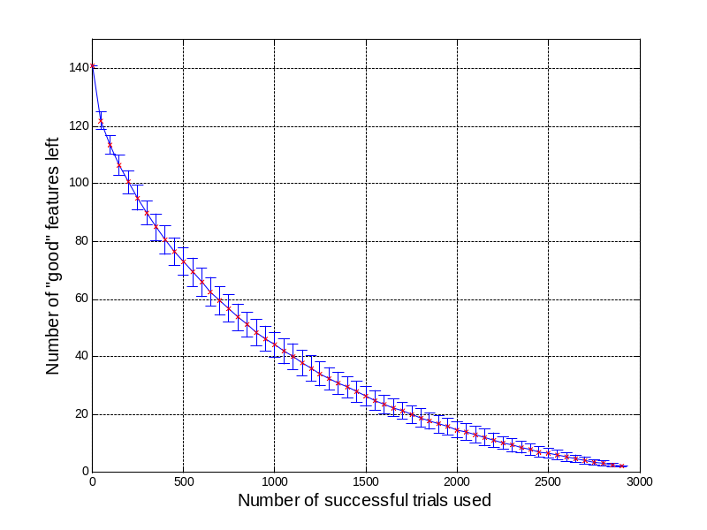
Winnowing Down the Culprits
1710 counters
1569 are always zero
  141 remain
139 are nonzero on some successful run
Not much left!
  file_exists() > 0
  xreadline() == 0

Slide 16
Isolating a Non-Deterministic Bug
At each direct scalar assignment
  x = …
For each same-typed in-scope variable y
Guess predicates on x and y
  (x < y) (x == y) (x > y)
Count how often each predicate holds
  Client-side reduction into counter triples

Slide 17
Case Study: bc Crashing Bug
Hunt for intermittent crash in bc-1.06
  Stack traces suggest heap corruption
2729 runs with 9MB random inputs
30,150 predicates on 8910 lines of code
Sampling key to performance
  13% overhead without sampling
  0.5% overhead with ¹/₁₀₀₀ sampling
Notes:
This is not the only thing one might want to sample for all non-deterministic bugs; it’s just the thing we used for this one experiment.

Slide 18
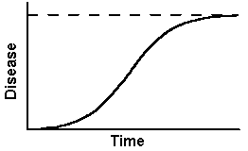
Statistical Debugging via Regularized Logistic Regression
failure
success
count
S-shaped cousin to linear regression
Predict success/failure as function of counters
Penalty factor forces most coefficients to zero
Large coefficient ⇒ highly predictive of failure

Slide 19
Top-Ranked Predictors
void more_arrays ()
{
…
/* Copy the old arrays. */
for (indx = 1; indx < old_count; indx++)
arrays[indx] = old_ary[indx];
/* Initialize the new elements. */
for (; indx < v_count; indx++)
arrays[indx] = NULL;
…
}
#1: indx > scale
#1: indx > scale
#2: indx > use_math
#1: indx > scale
#2: indx > use_math
#3: indx > opterr
#4: indx > next_func
#5: indx > i_base

Slide 20
Bug Found: Buffer Overrun
void more_arrays ()
{
…
/* Copy the old arrays. */
for (indx = 1; indx < old_count; indx++)
arrays[indx] = old_ary[indx];
/* Initialize the new elements. */
for (; indx < v_count; indx++)
arrays[indx] = NULL;
…
}

Slide 21
Summary: Putting it All Together
Flexible, low overhead sampling
Predicates probe program behavior
  Client-side reduction to counters
  Most guesses are uninteresting or meaningless
Seek behaviors that co-vary with outcome
  Deterministic failures: process of elimination
  Non-deterministic failures: statistical modeling

Slide 22
Conclusions
Bug triage that directly reflects reality
  Learn the most, most quickly, about the bugs that happen most often
Variability is a benefit rather than a problem
There is strength in numbers
  Find bugs while you sleep!

Slide 24
Deployment Scenarios
Incidence rate of bad behavior: ¹/₁₀₀
Sampling density: ¹/₁₀₀₀
Confidence of seeing one example: 90%
Required runs: 230,258
Microsoft Office XP
  First-year licensees: 60,000,000
  Assumed usage rate: twice per week
  Time required: nineteen minutes

Slide 25
Deployment Scenarios
Incidence rate of bad behavior: ¹/₁₀₀₀
Sampling density: ¹/₁₀₀₀
Confidence of seeing one example: 99%
Required runs: 4,605,168
Microsoft Office XP
  First-year licensees: 60,000,000
  Assumed usage rate: twice per week
  Time required: less than seven hours

Slide 27
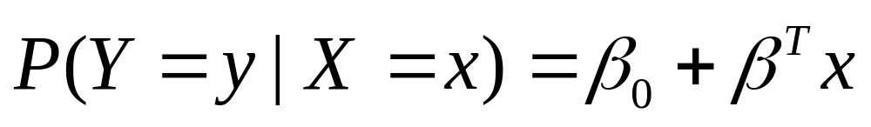
Linear Regression
Match a line to the data points
Outcome can be anywhere along y axis
But our outcomes are always 0/1

Slide 28
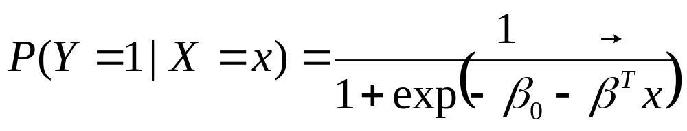
Logistic Regression
Prediction asymptotically approaches 0 and 1
  0: predict no crash
  1: predict crash

Slide 29
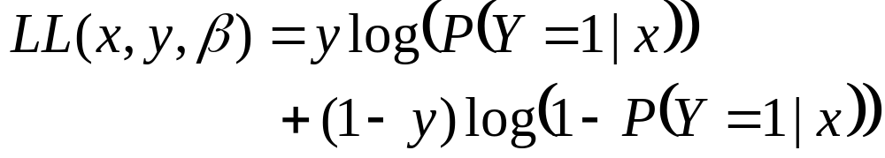
Training the Model
Maximize LL using stochastic gradient ascent
Problem: model is wildly under-constrained
  Far more counters than runs
  Will get perfectly predictive model just using noise

Slide 30
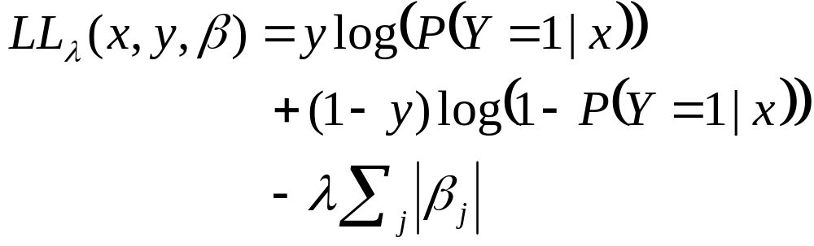
Regularized Logistic Regression
Add penalty factor for nonzero terms
Force most coefficients to zero
Retain only features that “pay their way” by significantly improving prediction accuracy

Slide 32
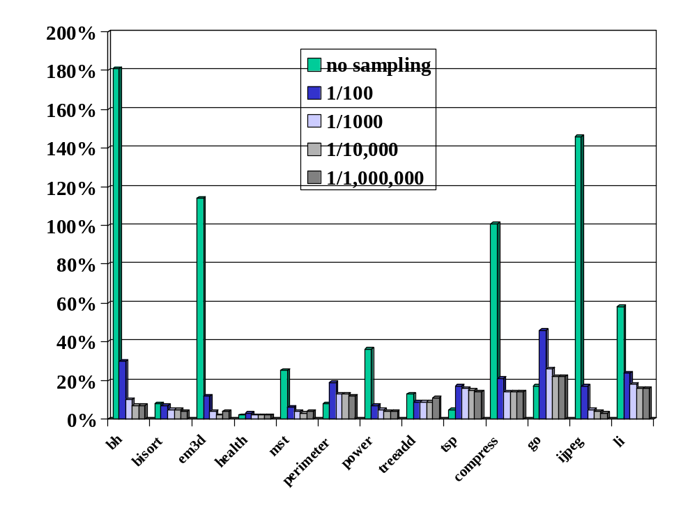

Slide 33
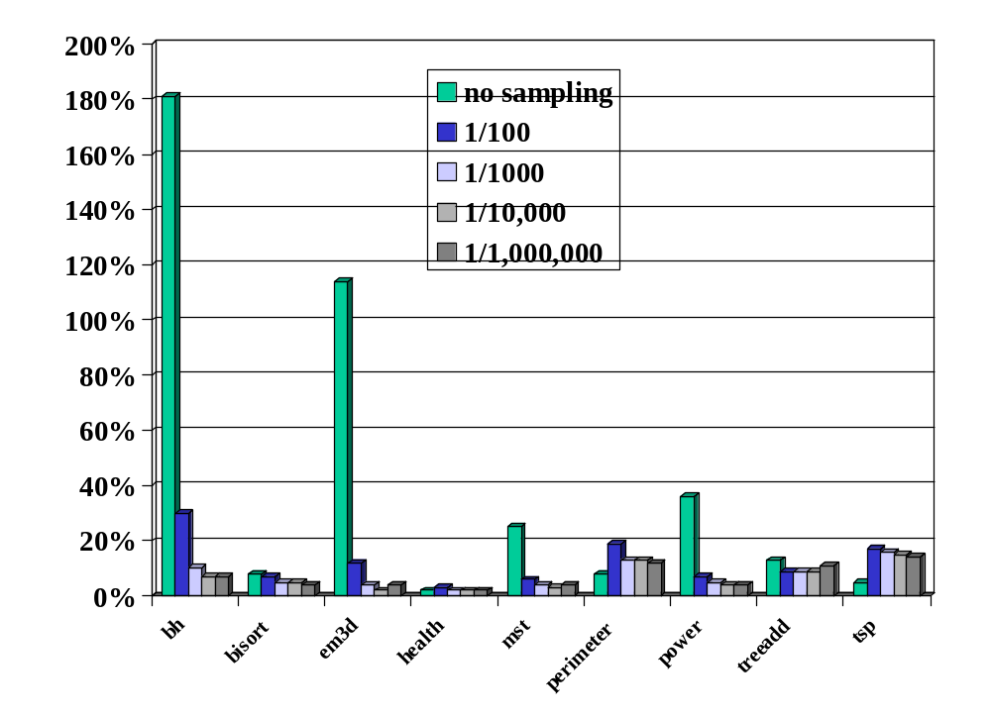

Slide 34
