Slide 1

EWMA Covariate
Shift Demo
Research progress review
Auditable CSE reconstruction for motor-imagery EEG
Classifier benchmarks and complementary PCA monitoring
Haocheng Lin
Notes:
PRESENTER PREPARATION — Opening
Suggested explanation (30–60 seconds):
My project investigates when a detected change in EEG features should lead to a model update. I have built the detection and adaptation components, stored benchmark evidence, and started controlled policy comparisons. I will separate published findings from my implementation and results.
Likely question and answer:
What is the contribution? An auditable reconstruction and experimental framework; validated novelty and general adaptive gains are still research goals.
Evidence and cautions:
Roadmap: literature, implementation, evidence, next experiment.

Slide 2
PRESENTATION GUIDE
Research narrative and evidence boundaries
From published methods to implementation, reproducibility and the PhD research agenda.
01
Problem and literature
EEG non-stationarity; research lineage; clinical evidence
02
Representation and detection
FBCSP features; frozen PCA coordinates; EWMA and Stage II
03
Adaptation and system policies
Updated SVM, label availability, Diethe and passive baselines
04
Validation and research plan
BCI datasets, reproducibility gaps, pilot evidence, next milestones
hlin863/ewma_covariate_shift_demo
Notes:
Topic-led ordering for a PhD progress discussion. Distinguish published findings, implemented components, saved experiment evidence, and unvalidated research goals.

Slide 3
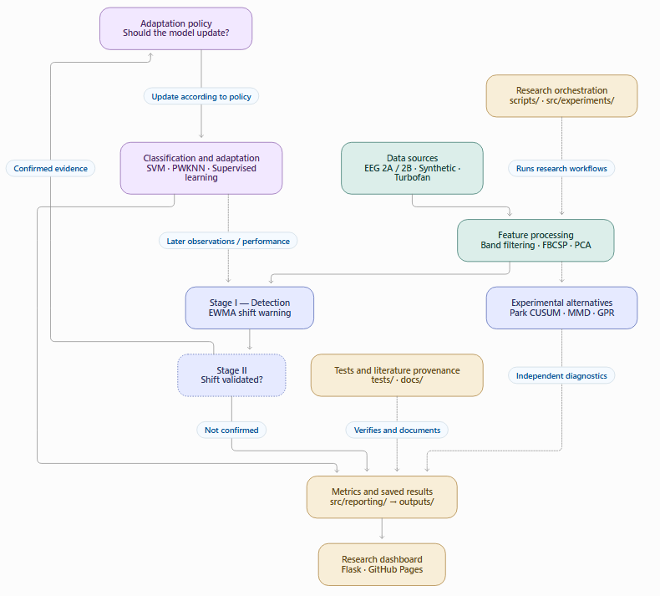

Slide 4
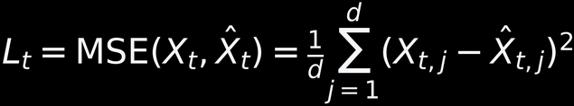
LITERATURE REVIEW
Reading informs the reconstruction and its limits
2015
2018
2019
Related
Raza: detector basis
Chowdhury: online BCI
Raza: CSE-UAEL
Rao and Heyden
EWMA warning logic
D2/D3/D4 audit
μ/β-band CSP
SVM and feedback
Two-stage CSE
Adaptation context
PCA subspaces
Residual monitoring
Diethe et al. (2019)
Monitoring, update policies and adaptation cost
Heyden et al. (2024): reconstruction loss basis
Alippi et al. (2017): hierarchical detection provides a related framework for warning and validation.
hlin863/ewma_covariate_shift_demo
03
Notes:
PRESENTER PREPARATION — Research lineage
Suggested explanation (30–60 seconds):
Raza motivates detector reconstruction. Chowdhury demonstrates online supervised BCI adaptation. The later CSE-UAEL work motivates transductive updates and ensembles. Rao and Heyden motivate the subspace question. Diethe provides a maintenance architecture.
Likely question and answer:
Why Diethe 2019 when Notion says 2018? The supplied PDF identifies a 2018 workshop and arXiv v2 dated March 2019. State the version being cited consistently.
Evidence and cautions:
Transition: first explain what the clinical BCI paper established.

Slide 5
LITERATURE INTEGRATION
Park and Raza: two stages, different questions
Read Park et al. (2023), Section 2.1 and second-order methodology; compare Raza et al. (2015) and Chowdhury et al. (2018).
PARK et al. (2023)
RAZA / CHOWDHURY
Step 1: aggregated feature-wise mean-CUSUM; estimate candidate split locations.
If mean change is not established: investigate second-order structure using wavelets and dynamic PCA.
Objective: type and location of structural change.
Stage I: sequential EWMA score and control-limit warnings.
Stage II: statistical validation (Hotelling T² or two-sample K–S, depending on formulation).
Objective: validate shift warnings before adaptation.
Key boundary: retrospective CUSUM peak ≠ calibrated online alarm; EWMA warning ≠ confirmed shift.
Research progress | hlin863/ewma_covariate_shift_demo | Oct 2026

Slide 6
PARK READING INSIGHT
Several CUSUM peaks ≠ several confirmed changes
Interpret peak structure as competing change-point evidence, not as a multimodal EEG probability distribution.
What the curves provide
What needs investigation
ν_max(t): strongest feature-wise normalised mean contrast at candidate t.
ν_avg(t): mean contrast across features.
Both identify candidate locations; their global maxima can disagree.
Several local peaks could reflect heterogeneous feature responses, multiple changes, or stochastic fluctuations.
Inspect feature-wise traces, segmentation, dependence and metadata; do not infer an external cause from peaks alone.
Sources: Park et al. (2023), DOI 10.29220/CSAM.2023.30.4.369; Fearnhead & Rigaill (2020), DOI 10.1002/sta4.291.
Research progress | hlin863/ewma_covariate_shift_demo | Oct 2026

Slide 7

CODE-TO-MANUSCRIPT BOUNDARY
Park extension: implemented calculations versus open tests
Source: src/detection/stage1/park_mean_cusum.py and manuscript §§3.2, 4.8.
IMPLEMENTED
NOT YET VERIFIED
Positive-mean input validation and channelwise normalised mean-CUSUM
Maximum and average aggregation across channels
Raw and LOESS-style smoothed peak estimates (span=0.1)
Peak-location agreement gaps and exploratory visualisation
Park unimodality and peak-agreement confirmation.
Multiple-change-point detection.
Calibrated false-alarm control.
Matched EEG feature-space comparisons.
Numerical Python/MATLAB parity evidence.
Park et al. (2023), Eq. 2.2
d: channel · T: observations · t: candidate change-point position
Research question RQ4: candidate localisation is implemented; confirmation and statistical validity remain open.
Research progress | hlin863/ewma_covariate_shift_demo | Oct 2026

Slide 8
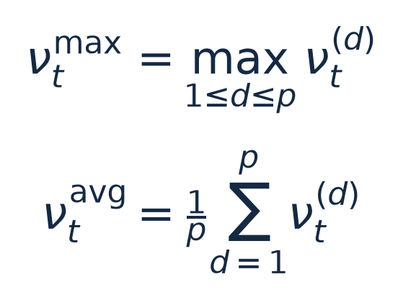
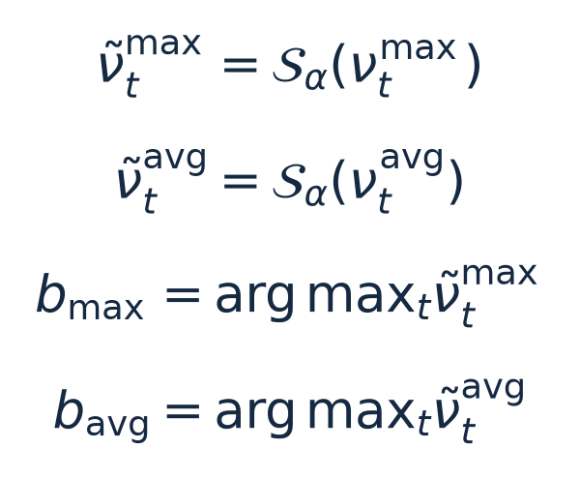
From Channelwise Mean-CUSUM to Smoothed Change-Point Estimates
STEP 1: Aggregation Across Channels
STEP 2: Smooth the Aggregated Curves
Source: Park et al. (2023), §2.3, Algorithm 1, Step 2, p. 377; smoothing motivation in §2.1, p. 373.
Research question RQ4: candidate localisation is implemented; confirmation and statistical validity remain open.
Research progress | hlin863/ewma_covariate_shift_demo | Oct 2026

Slide 9

MATHEMATICAL READING UPDATE · 12 OCTOBER 2026
Kronecker delta identifies matching indices
Index equality gives a compact way to express identity and orthogonality.
i and j label coordinates or components.
The comparison concerns indices, even when two observed values happen to be equal.
The matrix [δᵢⱼ] is the identity matrix.
A delta expression alone does not specify a random variable’s variance or independence.
Source: today’s Park Notion annotations and mathematical clarification. General identities, not a verbatim paper equation.
Notes:
Formula source (LaTeX): \delta_{ij}=1\ (i=j),\qquad \delta_{ij}=0\ (i\ne j)
Updated 12 October 2026. Research discussion and current Park Notion notes provide the learning context. No fresh repository audit was performed. Existing numerical results retain their historical provenance. Park full-text retrieval was unavailable, so explanatory identities are not labelled as exact Park equations.

Slide 10
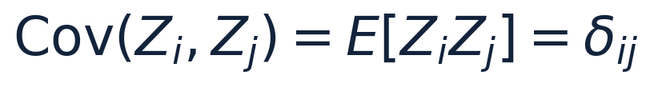
MATHEMATICAL READING UPDATE · 12 OCTOBER 2026
Covariance and independence require separate assumptions
Zero-mean, unit-variance innovations can have identity covariance.
Diagonal entries equal 1 under unit variance. Off-diagonal entries equal 0 under zero covariance.
Without zero means, E[ZᵢZⱼ] also includes the product of the means.
Uncorrelated variables need not be independent.
For a jointly Gaussian vector, zero covariance between components implies independence.
The observed EEG channels can still be dependent.
Source: 12 October chat analysis. Illustrative standardised-innovation condition, not verified as Park’s exact notation.
Notes:
Formula source (LaTeX): \mathrm{Cov}(Z_i,Z_j)=E[Z_iZ_j]=\delta_{ij}
Updated 12 October 2026. Research discussion and current Park Notion notes provide the learning context. No fresh repository audit was performed. Existing numerical results retain their historical provenance. Park full-text retrieval was unavailable, so explanatory identities are not labelled as exact Park equations.

Slide 11
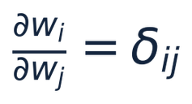
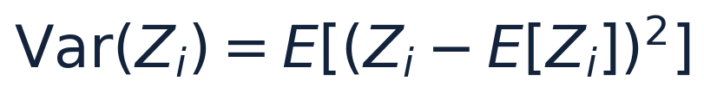

MATHEMATICAL READING UPDATE · 12 OCTOBER 2026
A coordinate derivative describes sensitivity
The derivative in today’s notes and statistical variance answer different questions.
The derivative is an entry of the identity Jacobian when wᵢ are independent coordinates.
Variance measures expected squared deviation from a random variable’s mean.
This is a separate online learning rule. Define the error convention and learning rate before interpreting it.
Source: user’s Park Notion notes, corrected through today’s mathematical discussion.
Notes:
Formula source (LaTeX): \frac{\partial w_i}{\partial w_j}=\delta_{ij}
Formula source (LaTeX): \mathrm{Var}(Z_i)=E[(Z_i-E[Z_i])^2]
Formula source (LaTeX): w_i(t+1)=w_i(t)+\eta e(t)x_i(t)
Updated 12 October 2026. Research discussion and current Park Notion notes provide the learning context. No fresh repository audit was performed. Existing numerical results retain their historical provenance. Park full-text retrieval was unavailable, so explanatory identities are not labelled as exact Park equations.

Slide 12
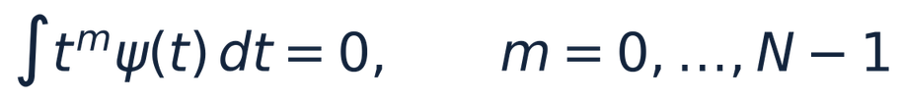
MATHEMATICAL READING UPDATE · 12 OCTOBER 2026
Daubechies wavelets resolve local variation
Wavelet scale and position describe where different patterns occur in time.
ψ is the wavelet. N is its number of vanishing moments.
The integral vanishes for polynomial components below degree N, helping isolate local detail.
Compact support localises the wavelet in time.
Scale controls the duration of patterns. Position controls their location.
Longer filters trade localisation for additional smoothness or vanishing moments.
Next: verify Park’s filter convention, scale range and boundary treatment.
Sources: Park Notion reading target; Wavelet background, Biometrika (2018), 105(4), 833–848. Specific Park settings remain to verify.
Notes:
Formula source (LaTeX): \int t^m\psi(t)\,dt=0,\qquad m=0,\ldots,N-1
Updated 12 October 2026. Research discussion and current Park Notion notes provide the learning context. No fresh repository audit was performed. Existing numerical results retain their historical provenance. Park full-text retrieval was unavailable, so explanatory identities are not labelled as exact Park equations.

Slide 13
MATHEMATICAL READING UPDATE · 12 OCTOBER 2026
Transfer matrices can create observed dependence
Identity covariance of innovations does not force identity covariance of observations.
For a ≠ 0, the observed components have nonzero cross-covariance.
Time-varying transfer coefficients can change variance or dependence while leaving the mean unchanged. This motivates the second-order reading pathway.
Source: explanatory linear-transform identity. Park’s full locally stationary wavelet construction requires separate source verification.
Notes:
Formula source (LaTeX): Y=A Z,\quad \mathrm{Cov}(Z)=I\quad\Rightarrow\quad\mathrm{Cov}(Y)=AA^{\mathsf{T}}
Formula source (LaTeX): Y_1=Z_1,\quad Y_2=aZ_1+Z_2,\quad \mathrm{Cov}(Y_1,Y_2)=a
Updated 12 October 2026. Research discussion and current Park Notion notes provide the learning context. No fresh repository audit was performed. Existing numerical results retain their historical provenance. Park full-text retrieval was unavailable, so explanatory identities are not labelled as exact Park equations.

Slide 14
PAPER CONTEXT
Chowdhury et al. (2018): online adaptive BCI
Calibration and task
Signal and adaptation
10 healthy participants + 10 stroke patients
80 calibration trials, then 40 online trials
Left- versus right-hand motor imagery
Initial linear SVM and CSD parameters
μ 8–12 Hz and β 16–24 Hz
CSP yields four log-variance features
PC1 EWMA warning, then Hotelling T²
Validated shift triggers SVM retraining
Online output
Visual feedback and hand-exoskeleton movement follow MI classification.
Comparator: EEG-NAC replays the same recorded data offline with a fixed classifier.
Source: §II.B, p. 1072 · §II.D–E, pp. 1073–1075 · Figs. 1, 3 and 4
hlin863/ewma_covariate_shift_demo
04
Notes:
PRESENTER PREPARATION — Chowdhury protocol
Suggested explanation (30–60 seconds):
Each participant completed 80 calibration trials and 40 online trials. The classifier distinguishes left versus right imagery, not healthy versus stroke participants. The adaptive system ran online; the nonadaptive comparator replayed the recorded data offline.
Likely question and answer:
Did your repository reproduce the clinical system? No. It uses BCI Competition data and a different feature pipeline; the paper provides methodological context.
Evidence and cautions:
Chowdhury II.B p1072; II.D–E p1073; II.E.3 pp1074–1075.

Slide 15
REPORTED ACHIEVEMENTS
Decoding improved relative to the fixed classifier
Group | EEG-NAC | EEG-CSAC | Gain
Healthy (n = 10) | 75.25 ± 5.46% | 81.50 ± 4.89% | +6.25 pp
Stroke (n = 10) | 70.25 ± 3.43% | 75.75 ± 3.92% | +5.50 pp
Both accuracy comparisons: p < 0.01
Kappa also improved significantly. Every participant could trigger the exoskeleton.
Source: §III, p. 1076, Tables II–IV and Fig. 6 · §IV, p. 1078
hlin863/ewma_covariate_shift_demo
05
Notes:
PRESENTER PREPARATION — Published accuracy
Suggested explanation (30–60 seconds):
The reported healthy-group gain is 6.25 percentage points and stroke-group gain is 5.50 points. Both paired comparisons were significant. These are paper results, not my repository results.
Likely question and answer:
Does this prove recovery? No. It demonstrates better decoding and online feasibility, without longitudinal motor-recovery outcomes.
Evidence and cautions:
Chowdhury III p1076 Tables II–IV. Mean ± SD; paired Wilcoxon significance.

Slide 16
DETECTOR EVIDENCE
Stage-II validation reduced retraining triggers
Group | Stage-I CSW | Stage-II CSV
Healthy | 15.75 ± 5.65% | 9.25 ± 3.54%
Stroke | 16.75 ± 2.89% | 9.00 ± 2.10%
Rates are percentages of trials. Both reductions: p < 0.01.
Validated-shift rate and accuracy gain correlate: r = 0.853, p < 0.01.
Interpretation: fewer retraining triggers do not independently quantify false alarms.
Source: §II.E.4, p. 1075, Eqs. (10)–(11) · §III, p. 1077, Tables VI–VIII and Fig. 7
hlin863/ewma_covariate_shift_demo
06
Notes:
PRESENTER PREPARATION — Validation evidence
Suggested explanation (30–60 seconds):
CSW and CSV here are percentages of trials. Validation reduces the fraction triggering retraining. The correlation with accuracy gain is an association, not an isolated causal effect of the detector.
Likely question and answer:
Were rejected warnings false alarms? We cannot determine that without independent shift truth. Rejection is a statistical outcome, not a ground-truth label.
Evidence and cautions:
Chowdhury II.E.4 Eqs10–11 p1075; III p1077 Tables VI–VIII and Fig7.

Slide 17
AUTHOR-STATED LIMITATIONS
Limitations acknowledged by the authors
Representation and comparison
Labels and online control
Binary left/right MI classification
Fixed μ/β bands for all participants
No direct test against other adaptive BCIs
Supervised adaptation assumes cue compliance
Synchronous BCI, one feedback event per trial
Continuous/asynchronous control remains future work
Artefacts and external noise
Online preprocessing adds latency. The authors acknowledge that contaminated EEG can reduce decoding accuracy.
Source: §IV, p. 1078 (scope, frequency bands, comparator, noise) · pp. 1078–1079 (control and labels)
hlin863/ewma_covariate_shift_demo
07
Notes:
PRESENTER PREPARATION — Author-stated limitations
Suggested explanation (30–60 seconds):
Fixed bands, binary tasks and known cue labels constrain transfer to other settings. The authors also discuss continuous and asynchronous operation as extensions.
Likely question and answer:
Why are cue labels imperfect? The intended task is known, but actual participant compliance is assumed.
Evidence and cautions:
Chowdhury IV pp1078–1079. Transition: distinguish these statements from my design-derived critique.

Slide 18
DESIGN-DERIVED LIMITATIONS
Limits of the experimental evidence
Small cohort and short follow-up
Comparison and recovery
10 participants in each group
One 40-trial online feedback run
Limited evidence across patient subgroups
and repeated rehabilitation sessions
Fixed baseline applied offline to the same data
No parallel online nonadaptive condition
Reported metrics concern BCI performance
Durable motor recovery remains untested
Supported conclusion
The study establishes online technical feasibility and improved decoding. Longer-term reliability and rehabilitation benefit require further evaluation.
Source: §II.B, p. 1072 · §II.D–E, p. 1073 · §III, pp. 1075–1077
hlin863/ewma_covariate_shift_demo
08
Notes:
PRESENTER PREPARATION — Design-derived limitations
Suggested explanation (30–60 seconds):
My critical interpretation concerns small cohorts, a short feedback run and the offline baseline. The study supports short-term feasibility; it leaves generalisation and therapeutic efficacy unresolved.
Likely question and answer:
Are these author admissions? These are inferences from the protocol and outcome measures, not all direct limitations stated by the authors.
Evidence and cautions:
Chowdhury II.B p1072; II.D–E p1073; III pp1075–1077. Notion limitations page reviewed.

Slide 19
PAPER-TO-PROJECT MAPPING
Relevance to the current EWMA project
Methodological connection
Existing next-step priorities
EWMA warning followed by shift validation
Selective adaptation motivates event auditing
Paper uses two bands and four CSP features
Current deck uses 10-band FBCSP on 2A/2B
Lock the reproduction configuration
Explain accepted and rejected Stage-II events
Measure synthetic false alarms and delay
Export real EEG score/residual traces
Evidence boundary
Keep the paper’s online results separate from repository benchmarks. Numerical reproduction and real EEG extension evidence remain open in the current deck.
Sources: Chowdhury et al. (2018), §II.E and §III–IV; repository review at f3ef2e8.
hlin863/ewma_covariate_shift_demo
09
Notes:
PRESENTER PREPARATION — Paper-to-project bridge
Suggested explanation (30–60 seconds):
The shared mechanism is warning, validation and selective adaptation. The paper uses two bands and four CSP features; the repository uses ten-band FBCSP for its Competition protocols. I preserve those distinctions when interpreting reproduction.
Likely question and answer:
Why not copy every paper detail? Some temporal sample and update-batch choices are underspecified; alternatives should be named and tested.
Evidence and cautions:
Notion Methods & equation evidence audit; PhD questions & repository connections.

Slide 20

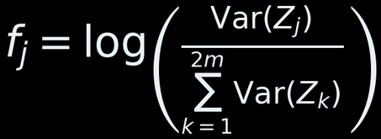

FEATURE EXTRACTION
From EEG signals to the monitored PCA score
Two frequency bands: μ 8–12 Hz and β 16–24 Hz. Fit the transformations on calibration data.
01 Spatial filtering
Combine EEG channels using learned CSP filters.
E: one EEG trial; W: spatial filters; Z: filtered signals.
02 Log-variance features
Express each selected signal’s variance relative to the total.
The paper retains two features per band: four per trial.
03 PCA and PC1 selection
Transform the feature vector, then monitor its first PC score.
The classifier uses features; Stage I monitors the scalar xᵢ.
Chowdhury et al. (2018), §II.E.1 and §II.E.3, Eqs. (1), (2), (4), pp. 1073–1074.
Indices clarified; PCA shown with explicit calibration centring. Code: fbcsp.py; detection/preprocessing.py.
hlin863/ewma_covariate_shift_demo
10
Notes:
Explain the three steps: spatial projection, log-normalised variance, and fixed calibration PCA. f is a feature vector; x is the scalar first-PC score. Equation 2 uses clarified indices. PCA is an implementation-explicit reformulation of Eq4, not a verbatim transcription. The code selects extreme CSP components before normalising variances; the paper prose describes 12 elements followed by first/last selection. Record that convention explicitly. The paper uses two bands and four features; the Table-I repository path uses ten-band FBCSP. Sources: Chowdhury II.E pp1073–1074; src/bci/fbcsp.py; src/detection/preprocessing.py.

Slide 21
REPRESENTATION VERSUS ADAPTATION
What is fixed and what changes during SVM updates
The stored training set grows and a new linear SVM is fitted; the feature and monitoring mappings are not refitted.
EEG → FBCSP
FBCSP → PCA monitor
FBCSP → prediction
Eₜ is a trial; φ₀ is the mapping fitted at calibration. Not refitted during SVM updates.
μ₀ and P₀ define the initial PCA coordinates. qₜ is a monitoring score, not the SVM input.
gθₜ acts on fₜ; θₜ changes when the SVM is retrained on accumulated examples.
Implementation boundary: refitting the classifier does not imply calling fit_fbcsp() or fit_cse_pca().
Fixed mapping means fixed fitted parameters — not constant features or scores over time.
hlin863/ewma_covariate_shift_demo
Notes:
The notation clarifies the current implementation. phi_0, P_0 and mu_0 denote initial fitted mappings. theta_t denotes classifier parameters after possible retraining. A fit of the linear SVM is not a recalibration of EEG feature extraction. This is an implementation interpretation, not a claimed equation from Chowdhury et al.

Slide 22


DETECTOR MATHEMATICS
How PCA scores become warnings and confirmations
Stage I: EWMA warning
Stage II: Hotelling validation
State and one-step prediction error
Repository pooled two-sample mode
Control limits use the previous variance
Decision and dimensionality condition
Smoothed error variance • Eq. (8)
H: observations per window; d: retained dimensions.
αtest is distinct from variance smoothing.
Confirmation is available after the second window.
Check current limits first; update state and variance afterwards.
αᵥ is the variance-smoothing weight (paper: 0.05).
Chowdhury §II.E.3, Eqs. (3), (5)–(9). Eq. (9) uses separate covariance terms; pooled mode is a repository choice.
Eq. (8) describes the always-update variance mode. The Diethe pilot uses frozen variance.
hlin863/ewma_covariate_shift_demo
12
Notes:
Explain x_i as the PC1 score and e_i as a score prediction error, not classification error. Limits use previous variance. Equation8 updates the variance for subsequent trials. Alpha_v is a clarified name for the paper alpha, distinct from Stage-II test significance. Paper L=2; use the configured repository value when describing a run. Repository supports always, frozen, non_alarm variance modes; Diethe pilot used frozen. Paper warns strictly outside limits; repository sd_ewma includes equality. Pooled Stage-II equation is the repository mode, not direct Chowdhury Eq9. The degrees-of-freedom condition does not ensure covariance invertibility or valid inference. Sources: Chowdhury II.E.3 pp1074–1075; src/detection/stage1/sd_ewma.py; src/detection/stage2/paper_two_sample_hotelling.py.

Slide 23
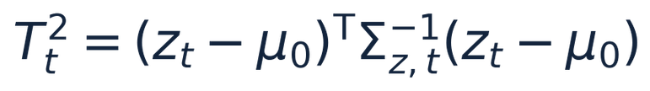
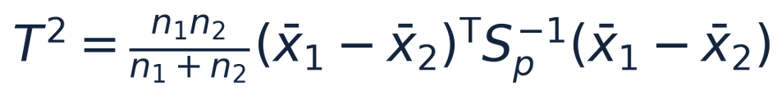
MATHEMATICAL READING UPDATE · 12 OCTOBER 2026
Two statistics called T² monitor different objects
A multivariate EWMA chart and a two-sample mean test use different reference structures.
Multivariate EWMA: compare a smoothed vector with a reference mean, using the covariance of that smoothed vector.
Pooled two-sample Hotelling: compare two window means. Sₚ is pooled within-window covariance. This mode assumes a common covariance and appropriate sampling conditions.
Source: standard statistical comparison, linked to the existing detector mathematics slide. Calibration assumptions must match the chosen method.
Notes:
Formula source (LaTeX): T_t^2=(z_t-\mu_0)^{\mathsf{T}}\Sigma_{z,t}^{-1}(z_t-\mu_0)
Formula source (LaTeX): T^2=\frac{n_1n_2}{n_1+n_2}(\bar{x}_1-\bar{x}_2)^{\mathsf{T}}S_p^{-1}(\bar{x}_1-\bar{x}_2)
Updated 12 October 2026. Research discussion and current Park Notion notes provide the learning context. No fresh repository audit was performed. Existing numerical results retain their historical provenance. Park full-text retrieval was unavailable, so explanatory identities are not labelled as exact Park equations.

Slide 24
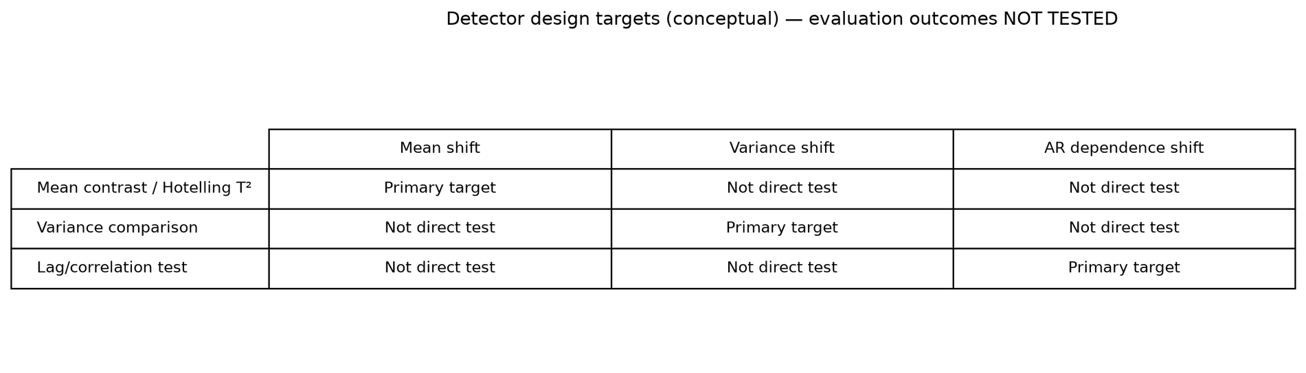
MATHEMATICAL READING UPDATE
Which structural changes do statistical tests target?
Conceptual comparison: mean, variance and temporal dependence require different statistical tests.
Conceptual test targets. Sources: Chowdhury et al. (2018), Eq. (9); Park et al. (2023), §3.1.
Notes:
Formula source (LaTeX): Q=(\bar{x}_1-\bar{x}_2)^{\mathsf{T}}\left(\frac{S_1}{n_1}+\frac{S_2}{n_2}\right)^{-1}(\bar{x}_1-\bar{x}_2)
Updated 12 October 2026. Research discussion and current Park Notion notes provide the learning context. No fresh repository audit was performed. Existing numerical results retain their historical provenance. Park full-text retrieval was unavailable, so explanatory identities are not labelled as exact Park equations.

Slide 25
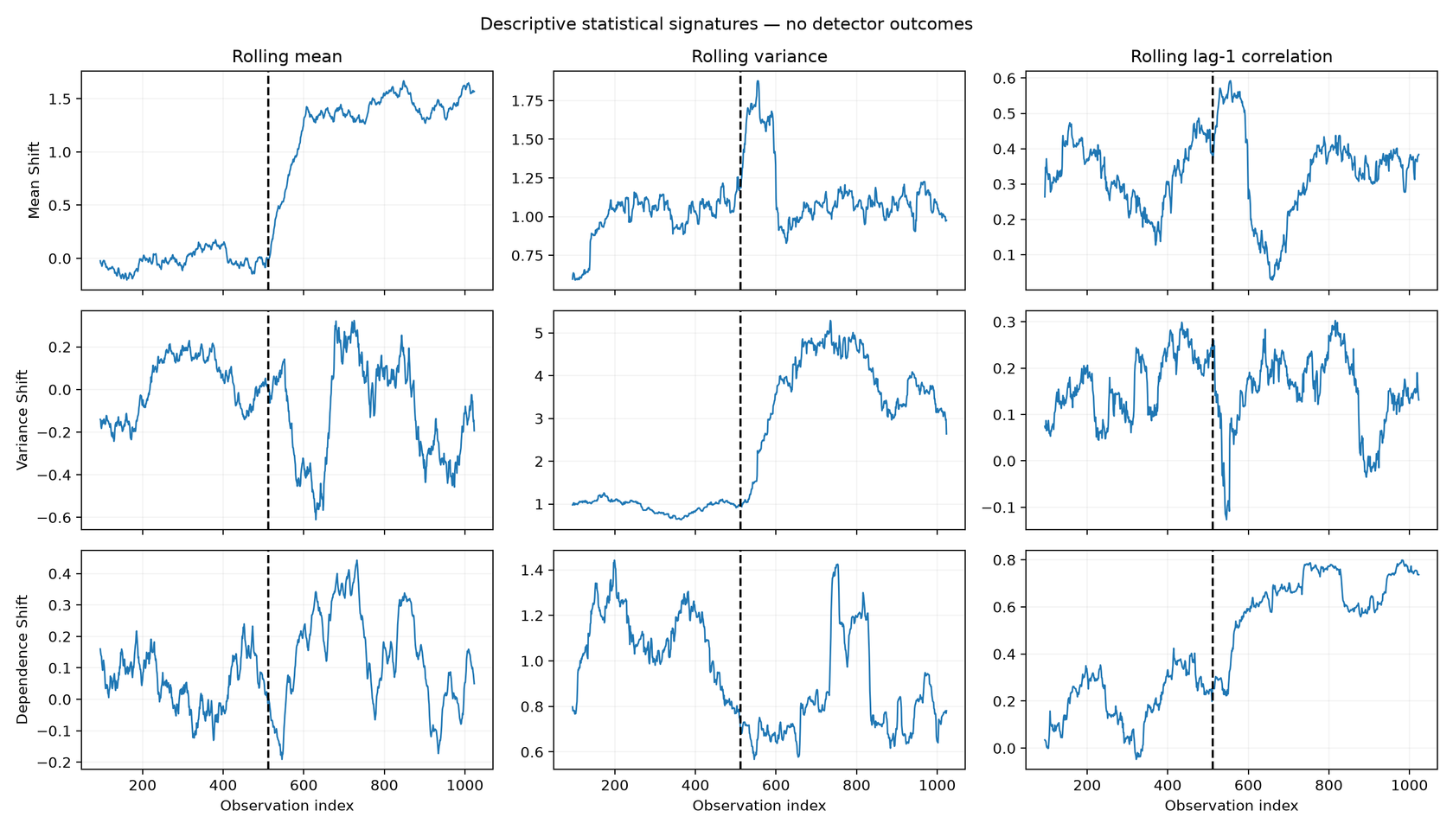
MATHEMATICAL READING UPDATE
How structural changes appear in rolling statistics
Mean, variance and AR dependence shift independently in controlled synthetic data.
ROWS
Mean shift
Variance shift
AR-dependence shift
COLUMNS
Rolling mean
Rolling variance
Lag-1 correlation
Dashed line: t₀ = 512
KEY FINDING
Temporal dependence can shift without a mean shift. Mean-based validation cannot establish covariance stability.
Source: scripts/generate_slide22_structural_visuals.py · n = 1024 · t₀ = 512 · seed 42 · window 96. Synthetic, descriptive; detector outcomes untested.
Notes:
Formula source (LaTeX): Q=(\bar{x}_1-\bar{x}_2)^{\mathsf{T}}\left(\frac{S_1}{n_1}+\frac{S_2}{n_2}\right)^{-1}(\bar{x}_1-\bar{x}_2)
Updated 12 October 2026. Research discussion and current Park Notion notes provide the learning context. No fresh repository audit was performed. Existing numerical results retain their historical provenance. Park full-text retrieval was unavailable, so explanatory identities are not labelled as exact Park equations.

Slide 26
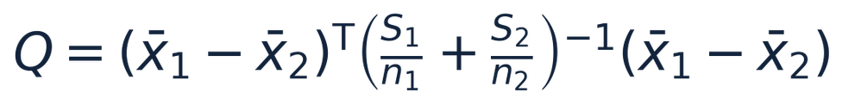
MATHEMATICAL READING UPDATE · 12 OCTOBER 2026
Mean validation has a variance-change limitation
Covariance scaling adjusts the mean contrast but does not make it a direct covariance-equality test.
Different structural changes affect different statistical properties.
Q and the pooled T² both start from a difference in means.
A pure variance or dependence change can therefore escape detection. Finite-sample mean fluctuations can still produce alarms.
Separate covariance terms need their own justified calibration. The pooled F conversion is not automatically exact.
Next comparison: mean-only, variance-only and dependence-only changes at matched false-alarm budgets.
Sources: existing detector slide; Chowdhury et al. (2018), Eq. (9). This expression preserves separate covariance terms.
Notes:
Formula source (LaTeX): Q=(\bar{x}_1-\bar{x}_2)^{\mathsf{T}}\left(\frac{S_1}{n_1}+\frac{S_2}{n_2}\right)^{-1}(\bar{x}_1-\bar{x}_2)
Updated 12 October 2026. Research discussion and current Park Notion notes provide the learning context. No fresh repository audit was performed. Existing numerical results retain their historical provenance. Park full-text retrieval was unavailable, so explanatory identities are not labelled as exact Park equations.

Slide 27
IMPLEMENTED PIPELINE
How evidence becomes an update decision
Responsibility | Implemented behaviour
Representation | Cue-aligned EEG; FBCSP; PCA fitted on training data
Detection and validation | EWMA warnings; explicit Stage-II interpretations
Update policy | Never, periodic, warning, validated or performance-drop
Label regime | Supervised labels or confidence-gated PWKNN pseudo-labels
Audit outputs | Predictions, accepted/rejected evidence and update events
Score-plus-residual monitoring is a separate Stage-I extension.
The Diethe comparison currently uses the fixed CSE detector.
Repository evidence: 2a8d20b. Implemented capabilities and stored results are distinguished.
hlin863/ewma_covariate_shift_demo
13
Notes:
PRESENTER PREPARATION — Implementation responsibilities
Suggested explanation (30–60 seconds):
The update policy consumes evidence. A warning, a confirmation and performance deterioration are different signals. Labels can be supervised or pseudo-labelled. The current Diethe experiment uses fixed CSE, not the complementary score/residual extension.
Likely question and answer:
Is the whole model continuously learning? The current loop appends data and retrains; representation and detector stay fixed in Diethe.
Evidence and cautions:
src/adaptation/experiments/diethe.py and docs/diethe_experiments.md.

Slide 28
CSE TABLE-I DATA PROTOCOL
CSE development and held-out evaluation
BCI Competition IV 2A
BCI Competition IV 2B
Session I develops the model
Sessions I–III develop the model
Stratified 70/30 split within Session I
Fit FBCSP and PCA on training only
Transform validation with fitted models
Hold out Session II, left/right trials
Stratified 70/30 split within Sessions I–III
Fit FBCSP and PCA on training only
Transform validation with fitted models
Hold out Sessions IV–V
Shared rule
Evaluation trials do not enter feature-model fitting.
Record the split seed and effective detector configuration.
Classifier benchmark: 2A fits Session I and tests II.
The stored 2B benchmark fits I–II and tests labelled Session III.
hlin863/ewma_covariate_shift_demo
14
Notes:
PRESENTER PREPARATION — Protocol separation
Suggested explanation (30–60 seconds):
Fit preprocessing only on development training data and reuse it for held-out evaluation. CSE reproduction and classifier benchmarking have distinct split contracts.
Likely question and answer:
Why does 2B use different sessions in different slides? Different experiments answer different questions. Use the protocol table on slide16 to keep them explicit.
Evidence and cautions:
Repository dataset runners and stored bagging evaluation_scope fields.

Slide 29
DATA PROTOCOL
Dataset roles differ across experiments
Experiment | 2A | 2B
Table-I CSE | Session I development; Session II evaluation | I–III development; IV–V evaluation
Stored classifier benchmark | Fit I; evaluate II | Fit I–II; evaluate III
Complementary EEG runner | I: training/calibration split; II evaluation | Fit I–II; calibrate III; evaluate IV–V
Diethe policy laboratory | Synthetic feature streams by default; prepared EEG features accepted by CLI | Raw EEG loading is not automatically integrated
Real EEG alarm traces describe alert burden. They do not supply ground-truth shift times.
Source: current runners and stored result files at 2a8d20b. Evaluation data do not fit the feature representation.
hlin863/ewma_covariate_shift_demo
15
Notes:
PRESENTER PREPARATION — Dataset roles
Suggested explanation (30–60 seconds):
Read this as a protocol map. For complementary 2B, I–II fit the representation, III calibrates thresholds, and IV–V evaluate. That differs from the classifier benchmark and Table-I path.
Likely question and answer:
Are real EEG warnings true detections? They are descriptive alarms unless independently annotated or experimentally injected shifts provide ground truth.
Evidence and cautions:
scripts/run_complementary_bci.py. Prepared Diethe arrays require the caller to enforce non-overlapping splits.

Slide 30
DIETHE POLICY LABORATORY
Diethe: separate change, performance and action
Question | Repository experiment
Has the input changed? | Shared CSE warnings and Stage-II validation records
Has prediction quality changed? | Rolling accuracy against a held-out validation reference
Should the model update? | Five explicit rules compared on the same stream
What does updating cost? | Update count, fitting time, prediction time and training size
Initial five-policy pilot is historical; a sixth evidence-sufficiency policy is now implemented.
Repeated matched comparisons across scenarios and seeds remain pending. This is not a Diethe reproduction.
Sources: Diethe et al. (2019), §§3–5; docs/diethe_experiments.md; src/adaptation/experiments/diethe.py.
hlin863/ewma_covariate_shift_demo
16
Notes:
PRESENTER PREPARATION — Diethe architecture
Suggested explanation (30–60 seconds):
Diethe separates data monitoring, prediction monitoring and update policy. My implementation operationalises part of this architecture using five explicit rules and saved evidence.
Likely question and answer:
Have you implemented Diethe completely? No. The paper discusses much broader state, actions, provenance and policy learning. My rules do not implement rollback, learned policy optimisation or energy accounting.
Evidence and cautions:
Supplied Diethe PDF: §4.1–4.2 and §5 p4; §5.2 p5; §3.3 p3. First run now saved.

Slide 31
SEPARATE EXPERIMENTAL CONTEXT
The Diethe policy lab uses supplied feature vectors
Do not conflate the real-EEG FBCSP/PCA monitoring pipeline with the synthetic policy-comparison branch.
Real-EEG branch
Diethe laboratory branch
EEG trial → calibrated FBCSP → feature vector fₜ
PCA is used by monitoring; SVM receives fₜ.
Supplied / synthetic features → classifier and CSE detector
No EEG extraction or FBCSP step is present.
Shared research question: should a confirmed distribution change trigger an update, and does that update help predictive performance?
Repository interpretation: run_policy_comparison(); the five-policy comparison is a controlled laboratory, not proof of clinical BCI benefit.
hlin863/ewma_covariate_shift_demo
Notes:
Synthetic feature vectors are provided directly to the Diethe policy comparison. PCA belongs to a detector branch; do not claim that the comparison passed through EEG or FBCSP. Clearly separate current repository implementation from the cited reference architecture.

Slide 32
DIETHE EXPERIMENT DESIGN
Six policies, three controlled scenarios
Policy | Update trigger
Never / periodic | No update / every configured interval
Warning / validated | Stage-I warning / available Stage-II confirmation
Performance drop | Rolling accuracy drops below the validation reference
No shift: baseline alert and update burden.
Feature shift: P(X) changes; the label rule stays fixed.
Relationship shift: the label rule changes; P(X) stays fixed.
Predict before revealing each label. Training expands after updates.
Delayed labels, rollback and energy measurement remain outside this experiment.
Source: docs/diethe_experiments.md and current CLI. Defaults: 240 trials, 20-trial interval, 30-trial performance window.
hlin863/ewma_covariate_shift_demo
18
Notes:
PRESENTER PREPARATION — Controlled scenarios
Suggested explanation (30–60 seconds):
No shift measures baseline burden. Feature shift changes inputs while preserving the label rule. Relationship shift changes the label rule with the same input stream, so input monitoring can miss performance deterioration.
Likely question and answer:
When are labels available? Immediately after prediction, before any update. The validated policy waits for validation_time, not the earlier warning time.
Evidence and cautions:
DietheConfig: 120 training, 80 validation, 240 evaluation observations by default. These are feature vectors, not raw EEG.

Slide 33
ADAPTATION POLICY PROGRESS
Six policy families — one exploratory laboratory
Repository HEAD 98908f08f; Diethe-oriented comparison is not a reproduction of Diethe et al. (2019).
POLICIES
VALIDATION BOUNDARIES
1. Never update (baseline)
2. Periodic retraining (passive)
3. EWMA warning-triggered update
4. Validated shift-triggered update
5. Performance-drop-triggered update
6. Evidence-sufficiency heuristic
Three scenarios: stationary, marginal feature shift, changed label relationship.
Labels arrive immediately after prediction; historical training data accumulate.
Precision-gain proxy is not optimal welfare value. Repeated seeds, delayed labels, energy and forgetting remain open.
Sources: docs/diethe_experiments.md; src/adaptation/evidence_value.py; Diethe et al. (2019).
Research progress | hlin863/ewma_covariate_shift_demo | Oct 2026

Slide 34
CONTINUAL LEARNING UPDATE
Hurtado-aligned passive updating: count new experience, not global trial position
Source: Hurtado et al. (2023), §4.1.2; policy refinement for src/adaptation/policies.py
BEFORE: CLOCKED SCHEDULE
POLICY UPDATE
AFTER: PASSIVE STREAM BASELINE
Absolute trial index
New data since last update
(trial_index + 1) % interval == 0
trials_since_update >= interval
semantics
Can retrain soon after a separate update event.
Updates only after enough fresh streaming observations.
Why this matters for PdM
Cleaner experiment axis
Next passive baseline
Hurtado’s passive side assumes a continuously evolving stream.
Separate when to update from which data or labels enter training.
Add ContinuousRetrain(batch_size) for mini-batch or per-observation updates.
Achievement: policy taxonomy now distinguishes active triggers from passive stream updates, supporting continual-learning experiments for predictive maintenance.
hlin863/ewma_covariate_shift_demo
19

Slide 35
DIETHE PILOT RESULT
A detected shift does not guarantee a useful update
Synthetic feature shift; seed 42; 240 trials; shift starts at index 120.
Policy | Accuracy | Updates | Gain vs never
Never | 97.92% | 0 | 0.00 pp
Periodic | 98.33% | 12 | +0.42 pp
Warning | 97.50% | 3 | −0.42 pp
Validated | 97.50% | 1 | −0.42 pp
Performance drop | 97.92% | 0 | 0.00 pp
Periodic updating gains one correct prediction overall for 12 updates.
Validated updating finishes one prediction below never-update.
One-run illustration, not a policy ranking. Next: matched comparisons across scenarios and seeds.
Source: outputs/diethe/20261004T111759599003Z/summary.csv; generating commit 2a8d20b.
hlin863/ewma_covariate_shift_demo
20
Notes:
PRESENTER PREPARATION — First Diethe result
Suggested explanation (30–60 seconds):
The unchanged model gets 235 of 240 predictions correct. Periodic updating gets 236 with 12 updates. Warning and validated policies get 234; performance-drop matches never with zero updates. This illustrates why detection and update utility should be assessed separately.
Likely question and answer:
Is periodic best? Not established from one seed. Post-change accuracy is 99.17% for never and performance-drop versus 98.33% for the other three. The one-prediction overall advantage does not establish post-shift benefit.
Evidence and cautions:
Run 20261004T111759599003Z: feature_shift seed42 magnitude2; source commit2a8d20b. Three warnings; two rejected and one confirmed. Warning116 validates136, spanning true change120: do not label it an advance detection. Shared detector time≈29.71ms; retraining≈12.53ms periodic,3.12ms warning,1.21ms validated. Timing is one-machine wall time, not energy. Final periodic update239 cannot improve another prediction in this run.

Slide 36

TRACKED EXPERIMENT RESULTS
Classifier and complementary-monitoring results
Real EEG classifier benchmark
Complementary Stage-I monitoring
Mean accuracy across 9 subjects per dataset
Detection within 20 samples, 100 seeds, magnitude 3
Dataset | Single SVM | Bagged SVM
2A | 76.00% | 75.85%
2B | 74.86% | 75.42%
Shift | Score | Residual | Combined
PC1 | 35% | 21% | 31%
PC2 | 21% | 100% | 100%
Both | 26% | 100% | 99%
Mean change: −0.15 pp (2A), +0.56 pp (2B).
No consistent gain across both datasets.
Magnitude 6: PC1 detection rises to 88%
(score) and 82% (combined).
2A: Session II evaluation
2B: Session III GDF-only holdout
No-shift 20-sample alarm rate: 21–26%.
Per-sample false-alarm rate: about 1%.
CI at 2a8d20b: 255 passed, 1 failed. Homepage test expects /diethe; route is /results/diethe.
hlin863/ewma_covariate_shift_demo
21
Notes:
PRESENTER PREPARATION — Stored benchmark evidence
Suggested explanation (30–60 seconds):
Bagging changes accuracy only slightly and inconsistently across datasets. In synthetic monitoring, residuals detect orthogonal shifts missed by PC1, but combination has sensitivity and alarm-burden trade-offs.
Likely question and answer:
Does 100% PC2 detection establish superiority? Only for the specified synthetic conditions. The no-change window alarm rate and PC1 trade-off must also be reported.
Evidence and cautions:
outputs/metrics/bagging_bci_real.csv; outputs/complementary_100/summary.csv; magnitude6 summary. CI numbers on slide are explicitly the 2a8d20b snapshot, not a new test run.

Slide 37
REPRODUCTION EVIDENCE
B01: two saved runs give different validation totals
B01 evidence | Warnings | Validated shifts
Published reference | 14 | 10
Standalone diagnostic | 17 | 5
Combined Table-I file | 17 | 0
What this means
Both stored runs differ from the published result. Neither file proves that one run supersedes the other.
Next: record the Stage-II mode, window settings and generating commit for each run.
Sources: outputs/metrics/bci_2b_table1_results.csv and bci_table1_comparison.csv at 2a8d20b.
hlin863/ewma_covariate_shift_demo
22
Notes:
PRESENTER PREPARATION — B01 discrepancy
Suggested explanation (30–60 seconds):
Two committed files agree on 17 warnings but disagree on validated totals, five versus zero. This is why result provenance matters. I cannot infer that one run supersedes the other from these tables alone.
Likely question and answer:
What caused the difference? Not established by the saved CSVs. Check validation mode, windows, covariance, input representation and generating configuration.
Evidence and cautions:
outputs/metrics/bci_2b_table1_results.csv and bci_table1_comparison.csv.

Slide 38
MANUSCRIPT EVIDENCE
Numerical reproduction remains unresolved
Mean validated-shift count | Computed | Published
Dataset 2A | 0.33 | 5.56
Dataset 2B | 0.67 | 10.33
Evidence available
Evidence to complete
Subject-level comparisons
Classifier benchmarks
Synthetic score/residual ablations
One configuration per reproducible run
Stage-II acceptance/rejection analysis
Real EEG traces and repeated Diethe runs
Source: outputs/metrics/bci_table1_comparison.csv at 2a8d20b; means calculated across nine subjects per dataset.
hlin863/ewma_covariate_shift_demo
23
Notes:
PRESENTER PREPARATION — Reproduction boundary
Suggested explanation (30–60 seconds):
The combined results remain far below published validation counts. I can claim an executable reconstruction with measured discrepancies, but cannot claim numerical reproduction.
Likely question and answer:
Should parameters be tuned to match published test counts? That would risk fitting to the evaluation target. Select on development data and report sensitivity separately.
Evidence and cautions:
Combined Table-I file; means across nine subjects in each dataset. Not the standalone B01 result.

Slide 39
PROJECT PROGRESS
CSE reconstruction and policy prototypes implemented
Workstream | Current position
CSE reconstruction | EEG features, EWMA warnings and Stage-II diagnostics
Supervised adaptation | Predict first, then update using the revealed label
Transductive adaptation | PWKNN pseudo-labels; confidence-gated training updates
Policy experiments | Five Diethe-inspired policies on matched streams
Evidence still needed | Matched reproduction runs and saved adaptation comparisons
Full dynamic CSE-UAEL ensemble growth and weighted voting remain open.
hlin863/ewma_covariate_shift_demo
24
Notes:
PRESENTER PREPARATION — Implemented achievements
Suggested explanation (30–60 seconds):
The main engineering milestone is the separation of representation, detection, validation and adaptation. Supervised updates use revealed labels; the transductive path uses confidence-gated pseudo-labels. Neither is yet the full dynamic CSE-UAEL ensemble.
Likely question and answer:
Does implemented mean validated? No. Code and tests support behaviour; experiments must establish scientific benefit.
Evidence and cautions:
Repository README and src/adaptation/transductive.py; inspected at f3ef2e8.

Slide 40





PROJECT TIMELINE
Year 1 timeline · Part 1: WP1–WP3
October 2026 – September 2027 | Foundations, detection evidence and adaptation
Oct–Dec 2026
Jan–Mar 2027
Apr–Jun 2027
Jul–Sep 2027
planning horizon; exact package dates not yet validated
CURRENT EVIDENCE
NEXT DELIVERABLE
WP1 · Theory and architecture
EWMA / Stage-II pipeline,
research architecture drafted
Documented CPD–CL–digital-twin architecture
CURRENT EVIDENCE
NEXT DELIVERABLE
WP2 · CPD benchmarking
Mean-CUSUM smoothing, Park simulation models and controlled scenario visualisations
Calibrated multi-seed benchmarks and Stage-II gap investigation
WP3 · Continual learning and sustainability
CURRENT EVIDENCE
NEXT DELIVERABLE
Six adaptation-policy prototypes and supervised/pseudo-label experiments
Forgetting, replay, update-cost
and energy evaluation
Evidence boundary: Implemented code # validated detection or reproduction; BOCPD, density ratios and energy benchmarking remain planned.
hlin863/ewma_covariate_shift demo | October 2026 status

Slide 41









PROJECT TIMELINE
Year 1 timeline · Part 2: WP4–WP6
October 2026–September 2027 · planned work packages.
Foundation
Evaluation
Synthesis
WP4 · Digital twin
co-evolution
WP5 · Cross-domain evaluation
WP6 · Synthesis and engagement
BCI and phonic maintenance
Manuscript, open research artifacts, stakeholder review
Joint updates, disagreement, safety
Deliverable: twin framework and testbed
Deliverable: comparative transfer benchmarks
Deliverable: submission and release roadmap
Dependency: verified CPD and repeated adaptation benchmarks
precede twin safety evaluation and cross-domain claims.
hlin863/ewma_covariate_shift demo · Planned milestones, Oct 2026

Slide 42
NEXT MILESTONE
Next milestone: a reproducible evidence package
1. Reconcile the saved reproduction runs
Lock settings and explain the Stage-II accepted, rejected and ineligible events.
2. Generate adaptation and real EEG evidence
Extend the saved Diethe pilot across three scenarios and 20 seeds. Export 2A/2B complementary traces.
3. Align tests, slides and research notes
Resolve the homepage route assertion. Refresh Notion implementation status and link every numerical claim to its run.
Repository evidence: 2a8d20b. Implemented capabilities and stored results are distinguished.
hlin863/ewma_covariate_shift_demo
26
Notes:
PRESENTER PREPARATION — Closing
Suggested explanation (30–60 seconds):
The next milestone is a reproducible evidence package: reconcile detector runs, repeat the policy experiment across scenarios and seeds, and generate real EEG complementary traces. Then judge benefit alongside update burden and uncertainty.
Likely question and answer:
What would count as success? Traceable configurations, repeated results with variability, a clear failure analysis, and evidence supporting a specific update policy under stated assumptions.
Evidence and cautions:
Closing question: when does a detected change justify updating the model? Return to this rather than claiming the full problem is solved.

Slide 43
MATHEMATICAL READING UPDATE · 12 OCTOBER 2026
Reading, writing and project management reinforce each other
Today’s learning turns a notation correction into a clearer research claim and a testable next step.
Reading
Writing
Project management
Strength: interrogating symbols and connecting methods.
Next: record each symbol’s role, assumptions and equation location.
Strength: maintaining explicit evidence boundaries.
Next: separate mathematical identity, modelling assumption and empirical finding.
Strength: linking notes with code and a research diary.
Next: keep one dated claim ledger and define a falsifiable test for each open question.
Sources: supplied learning image and today’s chat. Assessment reflects discussion evidence, not a scored evaluation.
Notes:
Updated 12 October 2026. Research discussion and current Park Notion notes provide the learning context. No fresh repository audit was performed. Existing numerical results retain their historical provenance. Park full-text retrieval was unavailable, so explanatory identities are not labelled as exact Park equations.

Slide 44
RESEARCH SOURCE TRAIL
Reading map and evidence hierarchy
Separate the original papers, code implementation, verified experimental findings and future research goals.
ORIGINAL LITERATURE
CURRENT EVIDENCE
Raza et al. (2015, 2019): CSE and adaptive ensemble.
Chowdhury et al. (2018): online BCI, validated EWMA warnings.
Park et al. (2023): mean versus second-order changes.
Fearnhead & Rigaill (2020): broader change-in-mean methodology.
Reconstructed CSE, multiple Stage-II options.
Park candidate curves, not confirmation.
Six-policy supervised lab, not conclusive rankings.
Published EEG subject-level count agreement unresolved.
No validated energy or continual-learning retention result.
Next: report matched configurations, validation statuses, seeds, provenance and numerical outcomes before upgrading claims.
Research progress | hlin863/ewma_covariate_shift_demo | Oct 2026

