Slide 1
WB智慧保養 Phase (II) Bond Head移動訊號分析模式開發 使用分群方法做波形切割驗證
清華/紫式：簡禎富、陳暎仁、徐彥婷、高聖翔、張黃齡
2022.11.8

Slide 2
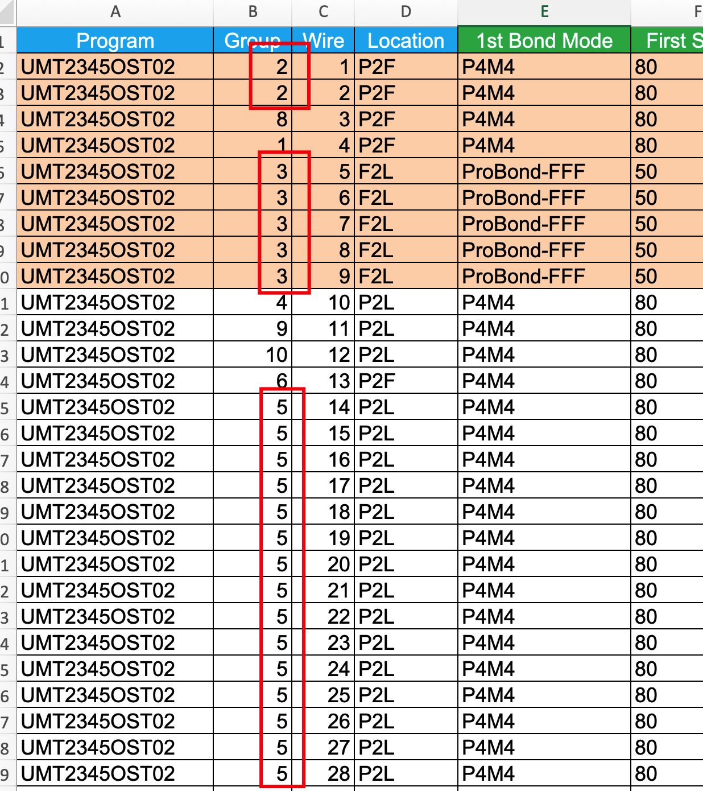
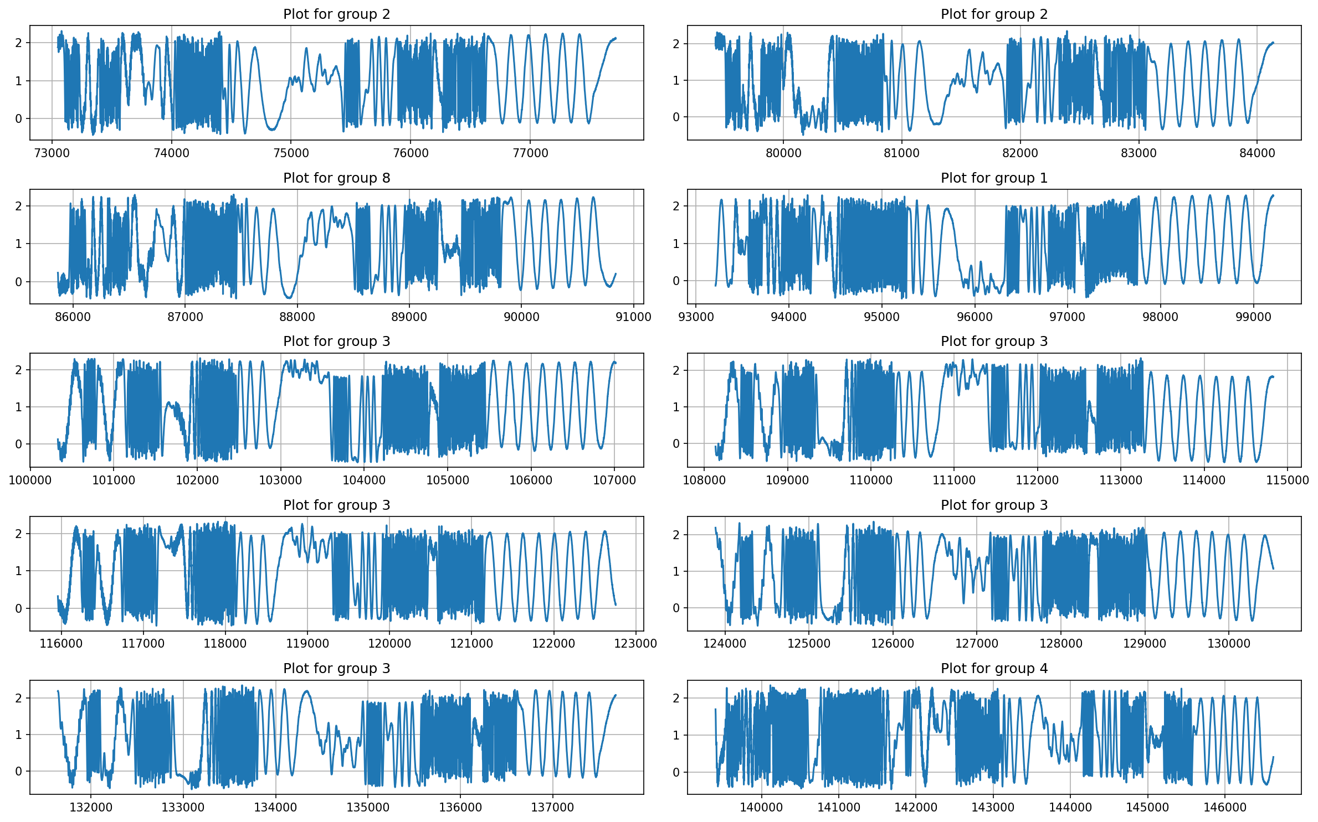
Group Classifications
Objective: Fault diagnosis and Remaining useful life prediction
Group intervals that belong to the same group since it share same pattern overtime
Crop intervals from a continuous signals (a .csv file)
Program group label for each looping interval

Slide 3
Group Classifications
As is | To be | Notes
Using Change point detection algorithm | New cropping algorithm | Since csv file too large, old algorithm run slowly New algorithm run faster and more precisely
Using 1D raw signal to classify group | Transform to 2D image Apply wavelet transform | The difference between group seem more clearly when represent in 2D format
Using Dynamic Time Wraping to classify group | Use CNN model to classify groups Use 2D data | Classfication performance > 80% of accuracy

Slide 4
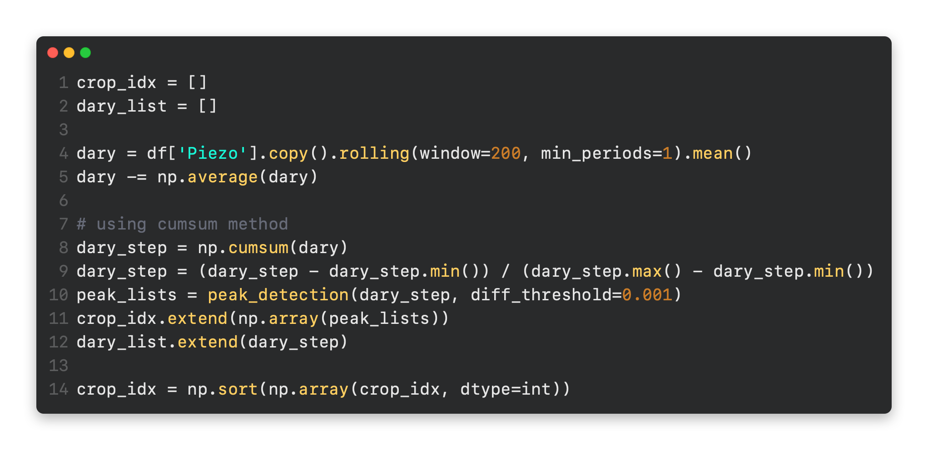
New cropping algorithm
Moving average
Cumulative sum
Detect peak
Each peak is the index of start and end of a looping interval

Slide 5
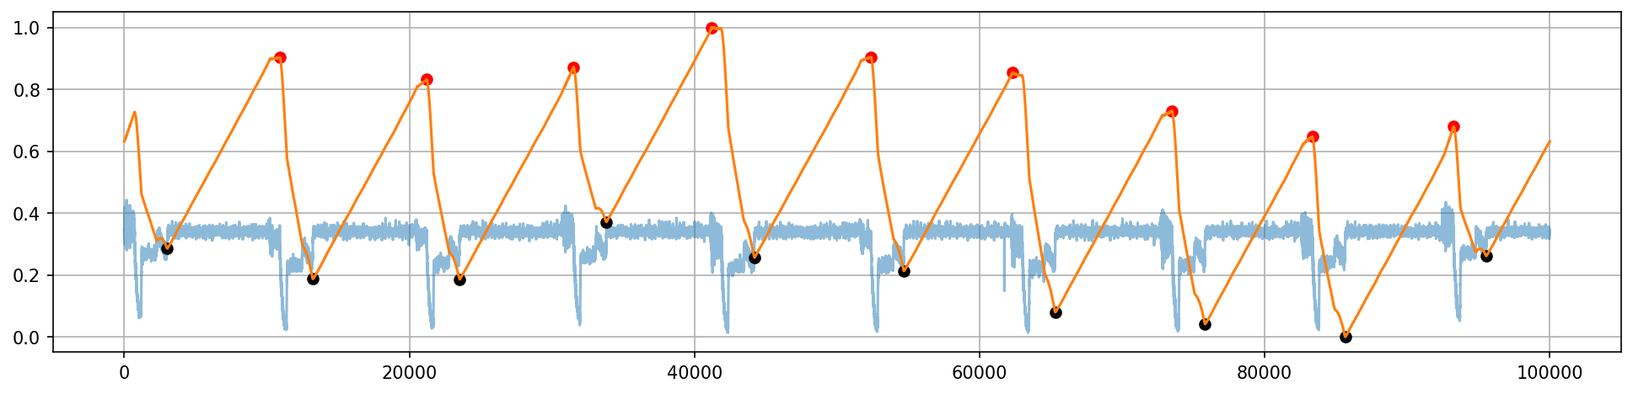
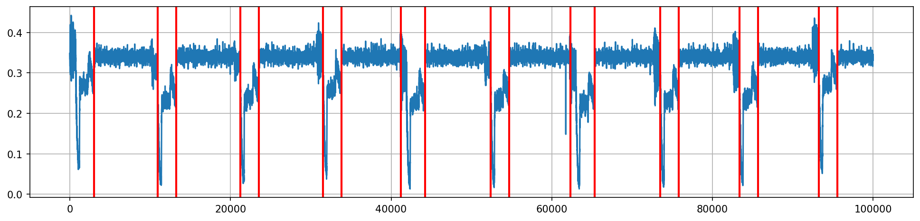
New cropping algorithm
Detect peak

Slide 6
Group classification

Slide 7
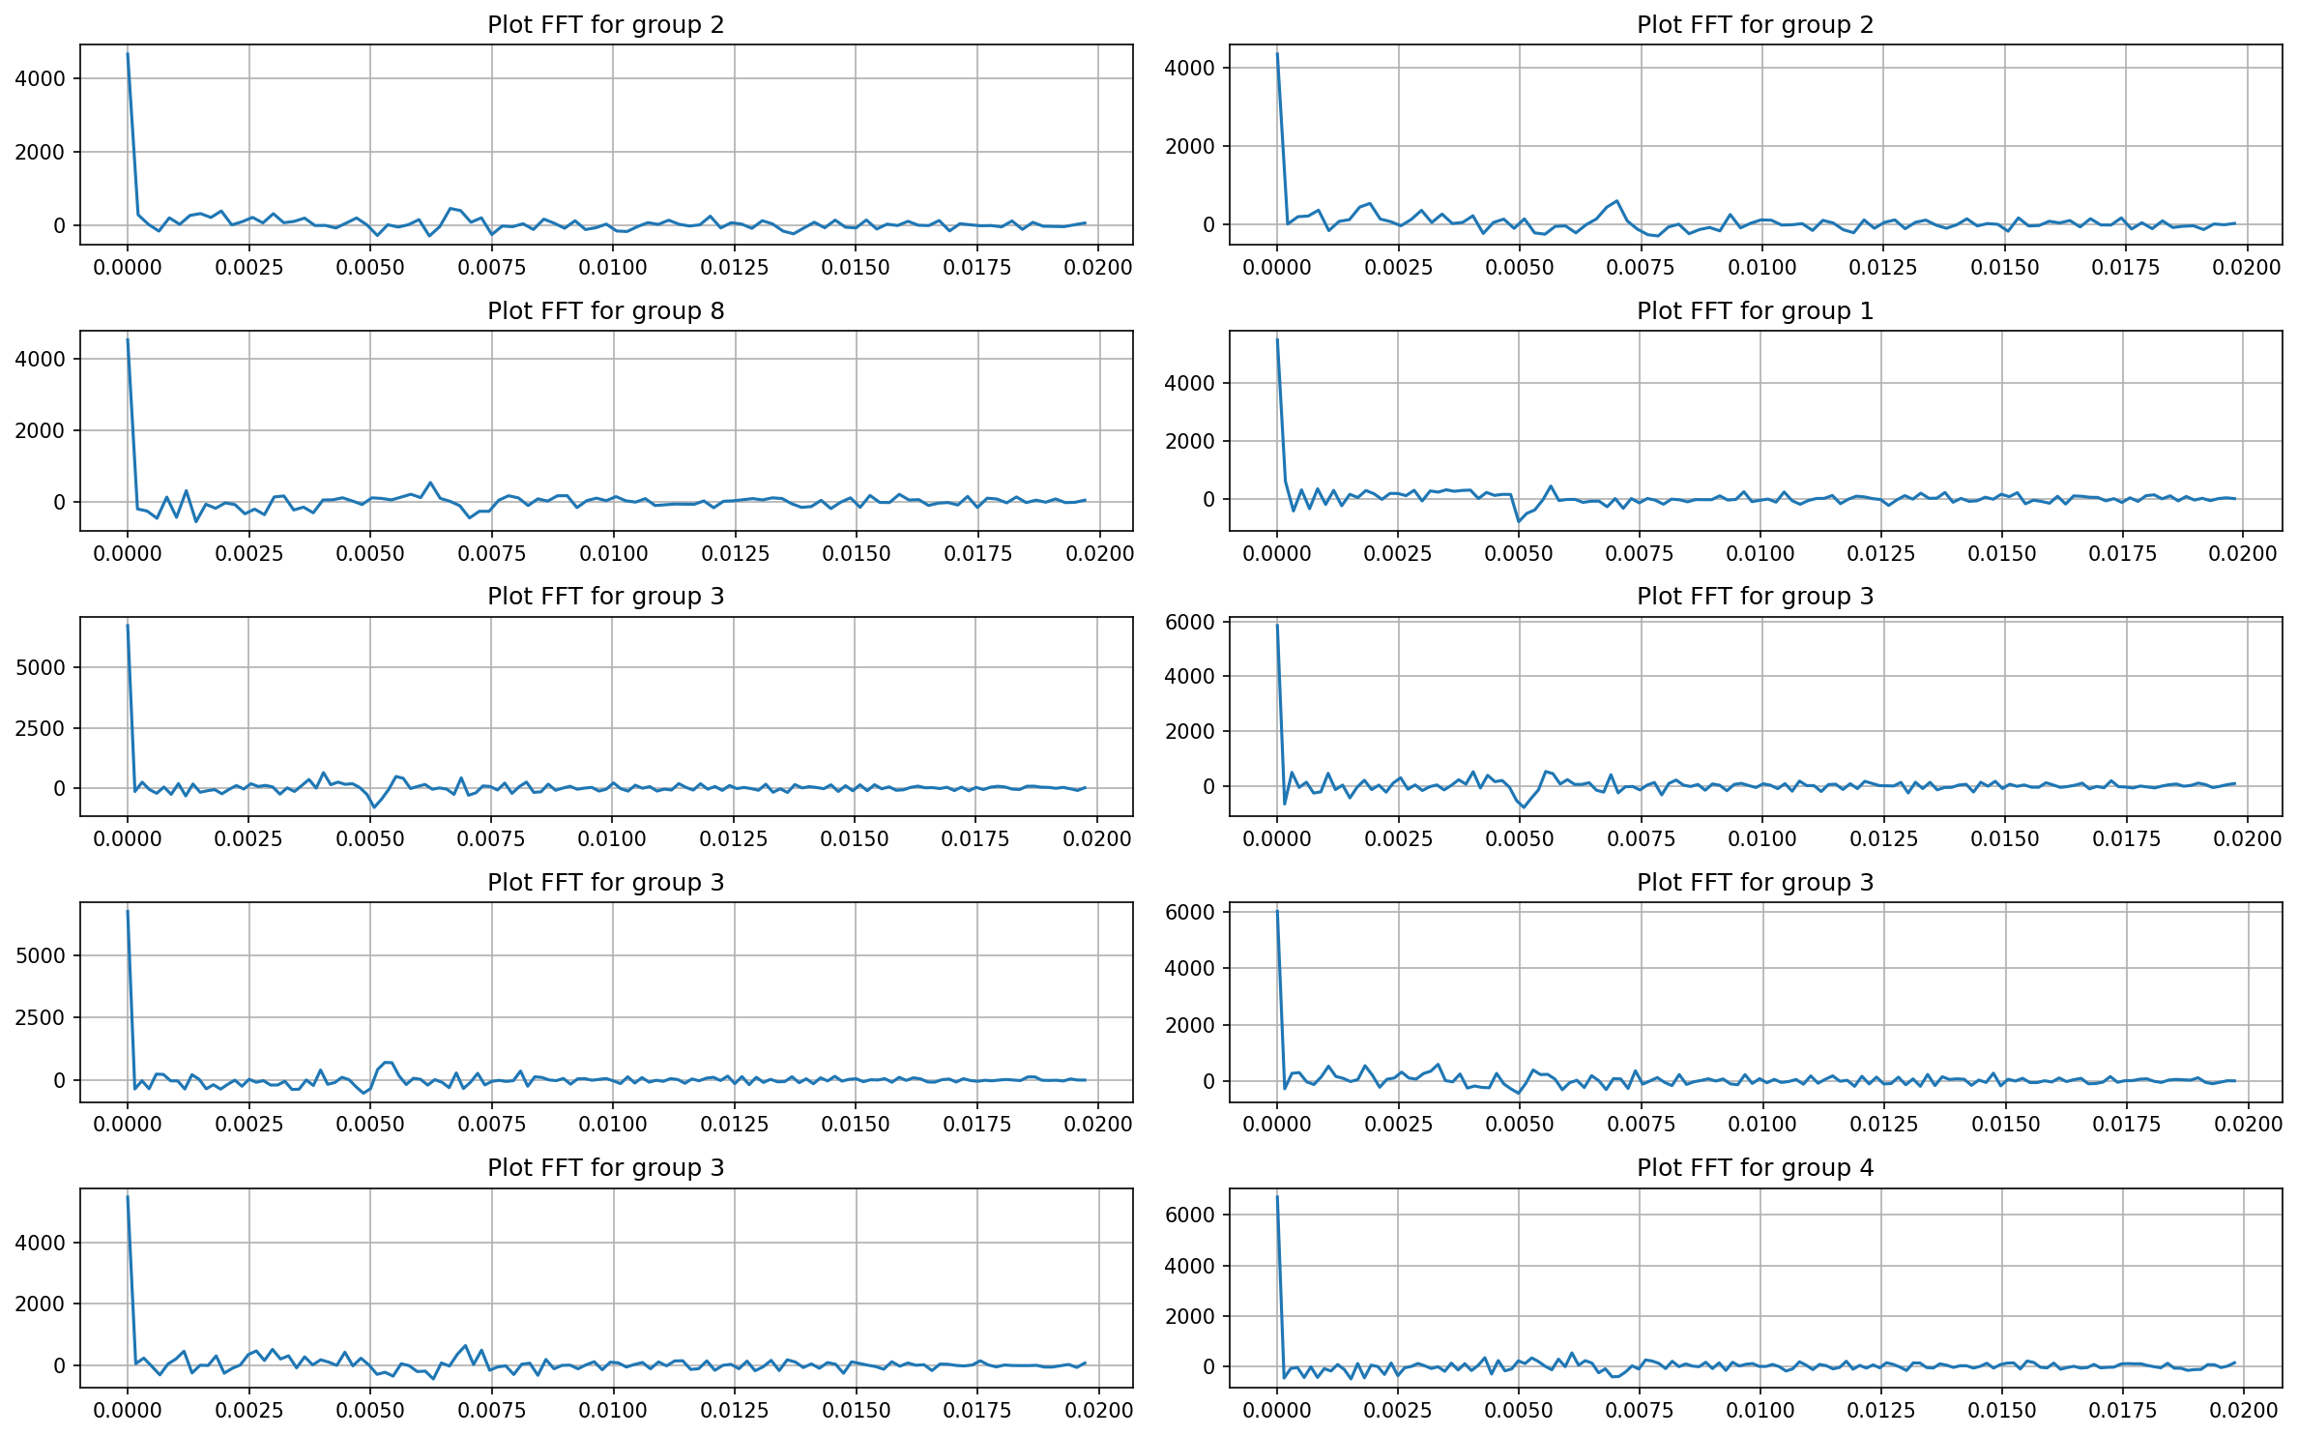
Group classification Transform raw signal to 2D images by using FT
Use Fourier transform from raw signal to frequency domain
→ Not show different pattern between groups

Slide 8
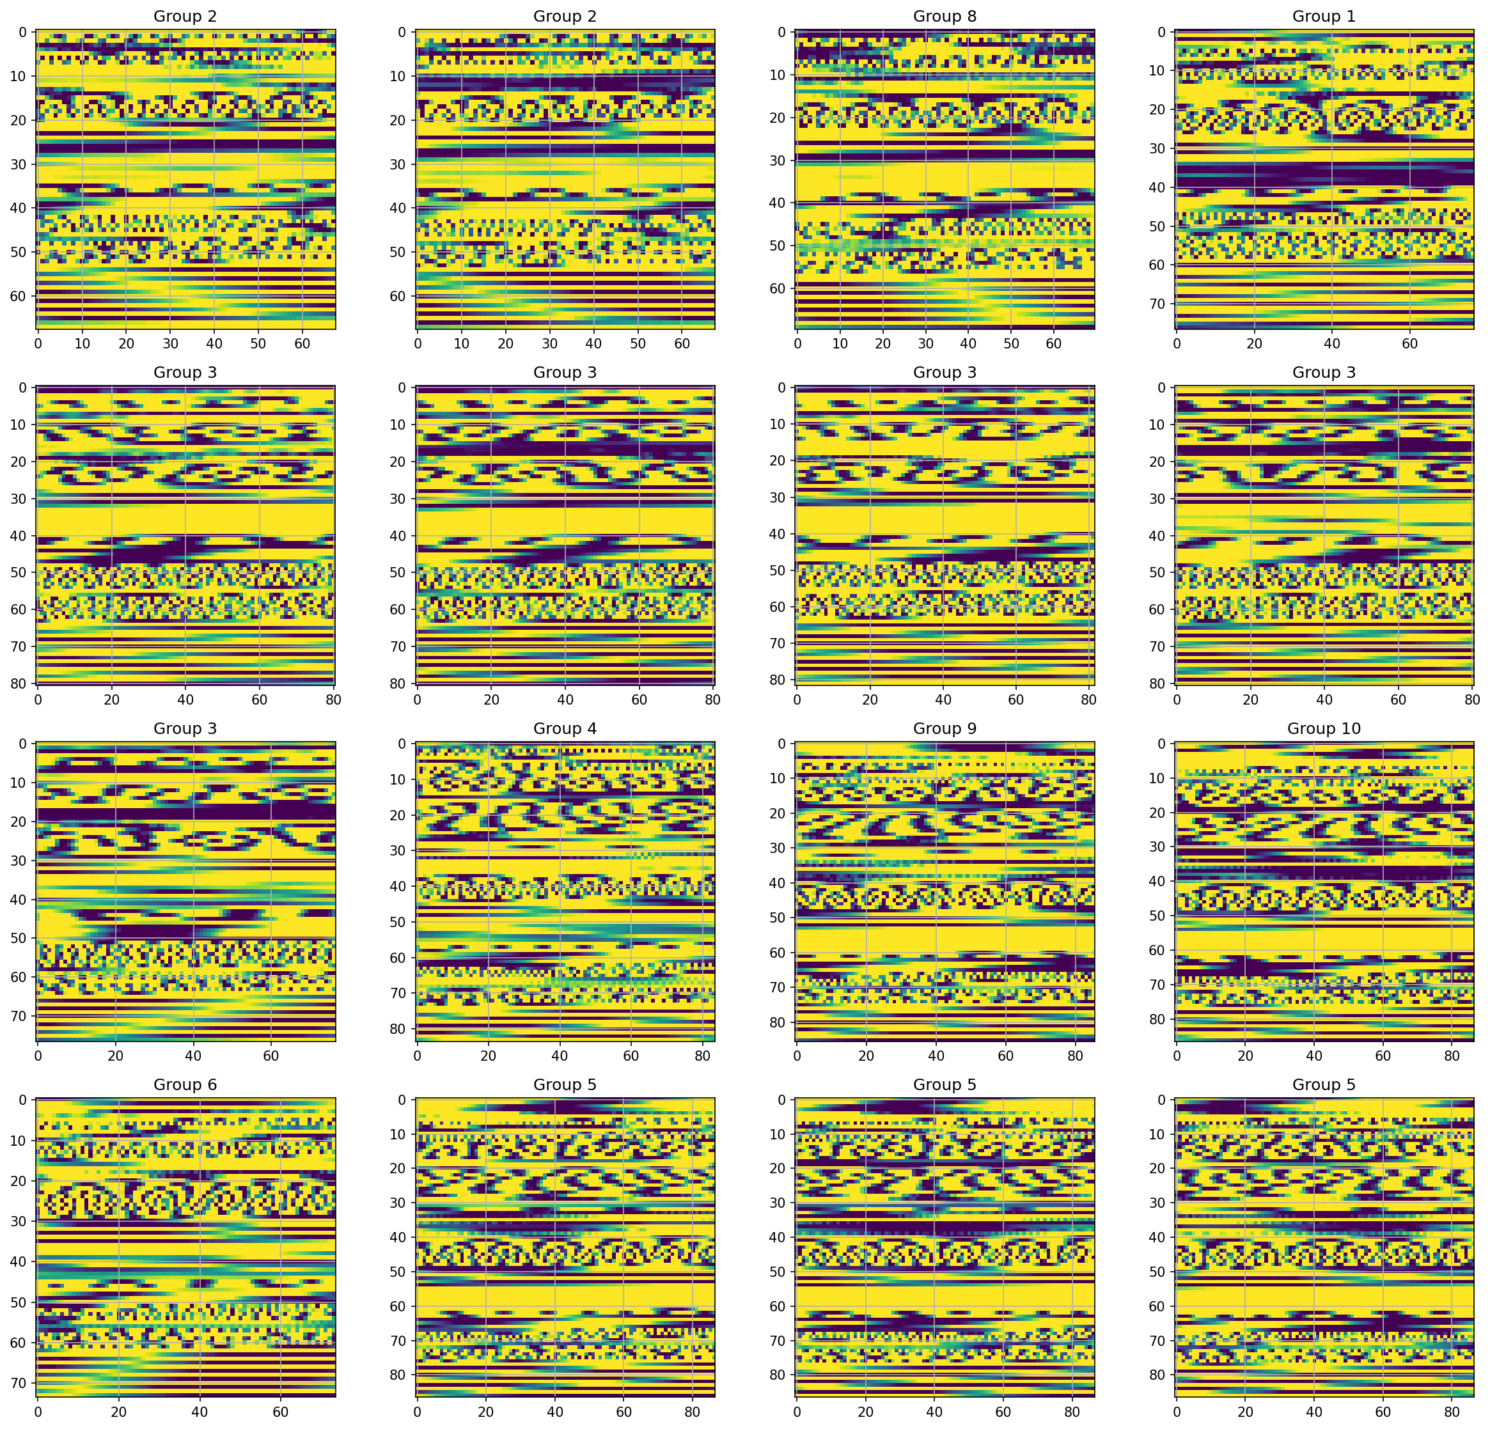
Group classification Transform raw signal to 2D images

Slide 9
Group classification Transform raw signal to 2D images

Slide 10
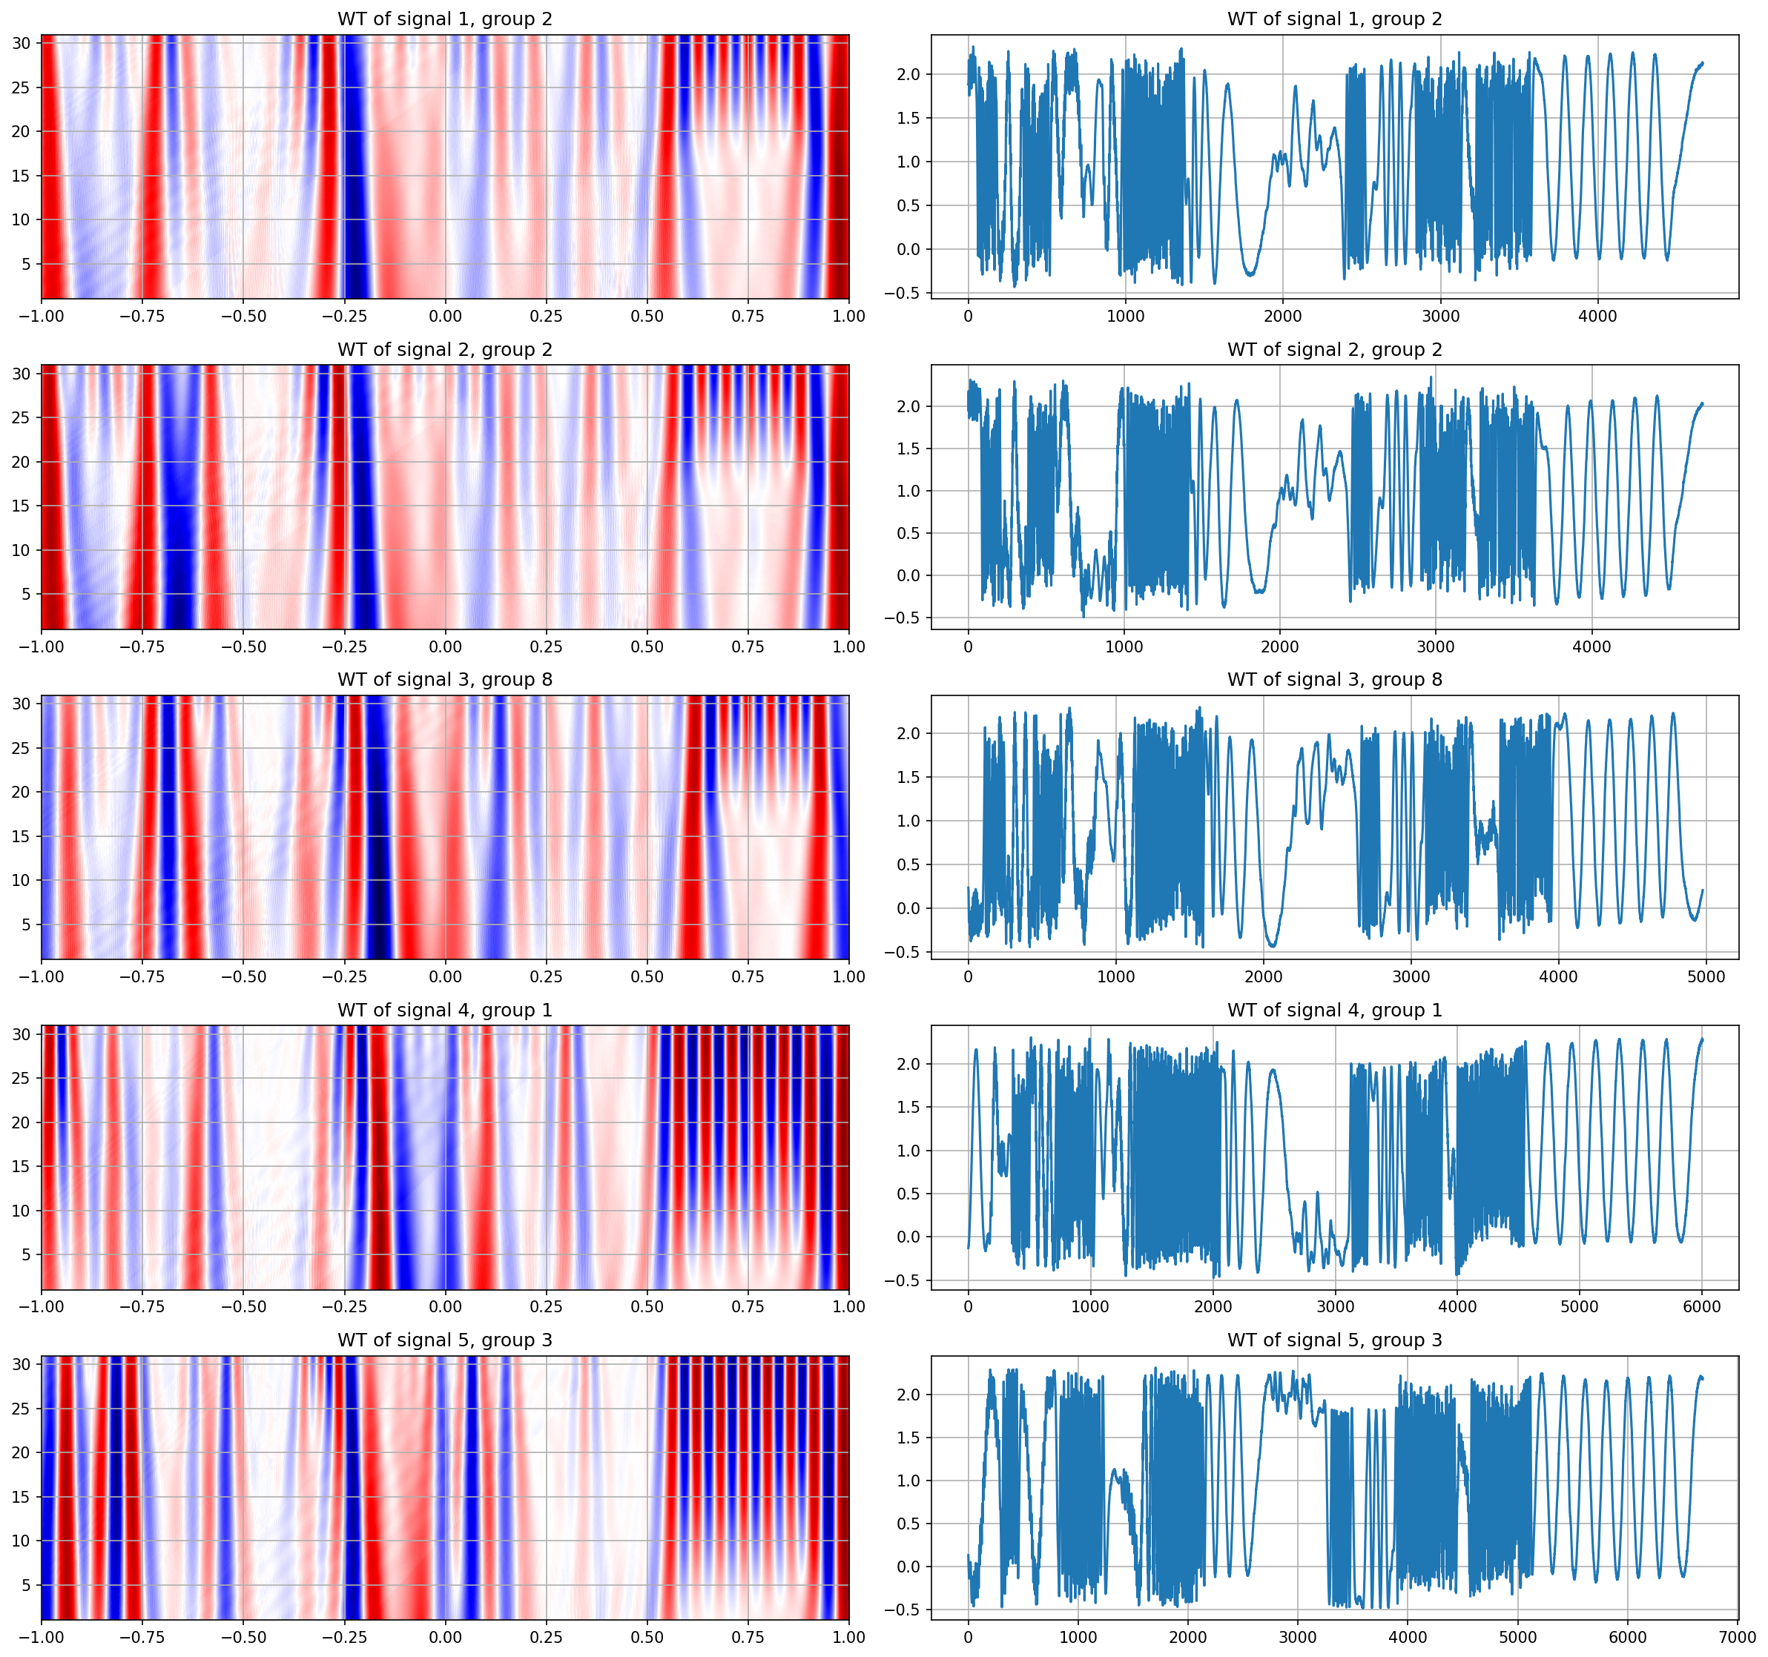
Group classification Transform raw signal to 2D images by using WT
There are different in pattern between groups
Could be used as a input for CNN model

Slide 11
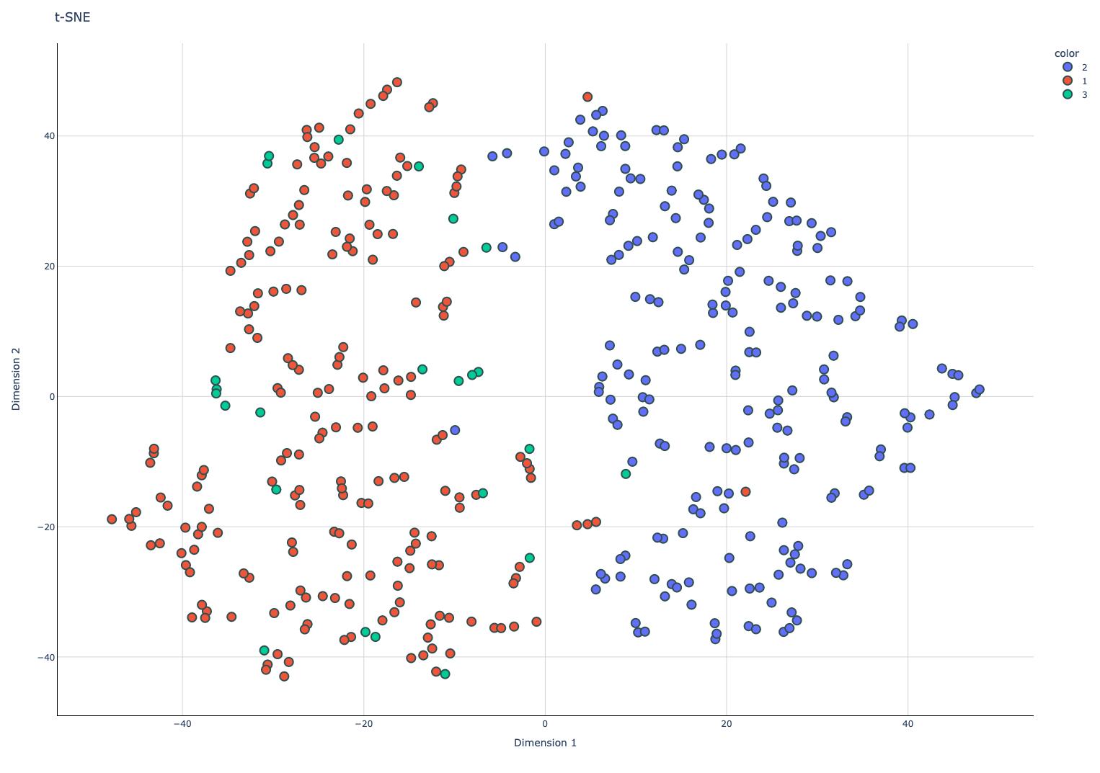
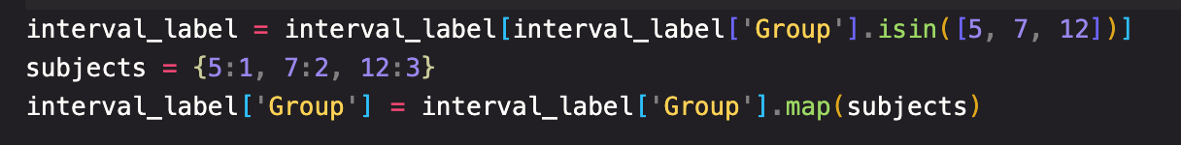
Group classification Classfication performance of CNN model by using 2D data
Since most of group are belong to group 5, 7 and 12, other classes seem to be imbalance → classfy as minor class (class 4)
Classfication performance between group 5, 7 and 12

