Slide 1
Comparison of Knowledge Tracing Methods on Large Datasets
Ha Linh Nguyen (A0113022H)
Hong Trieu Le (A0057066A)
Parul Bansal (A0268257R)
Pratik Karmakar (A0267612A)
Vedhika Agarwal (A0248336Y)
Notes:
hi everyone,
today I will introduce our group project, a comparison of knowledge tracing methods on large datasets

Slide 2
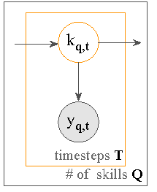
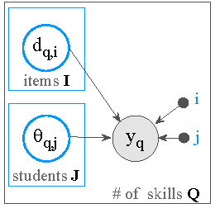
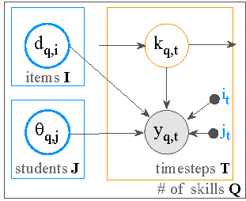
Introduction
Knowledge tracing (KT)
Item Response Theory (IRT)
Integration
Integrating Knowledge Tracing and Item Response Theory: A Tale of Two Frameworks
Notes:
first of all, what is the knowledge tracing problem? given a set of past learning activities of a student, we want to predict the probability that the student
will answer the next question correctly. it is a problem that large online learning platforms like Duolingo
would like to solve, since it lets them monitor the students' progress effectively and allow them to propose adaptive,
personalized learning strategies
Simple knowledge tracing framework models this problem as a hidden markov model, where the latent
knowledge state k indicates whether the skill has been mastered at time t, and binary variable y represents
whether the student gets a correct answer
however, this HMM model here assumes that all students and problems are the same, which is usually not the case.
item response theory is another framework which addresses this shortcoming.
One of the simplest IRT model is presented here. The probability of getting a correct answer is a function of the student ability theta and the question difficulty d. This simple IRT model does not take into account the change in student’s ability like Knowledge tracing, however.
The large amount of data involved leads us naturally to thinking about deep learning solutions, but some recent survey papers showed that deep learning do not always dominate more traditional approaches. Deep learning methods are also quite difficult to train and interpret. In this project, we want to investigate a few methods that combine deep learning with IRT, and find which method works better under which circumstances

Slide 3
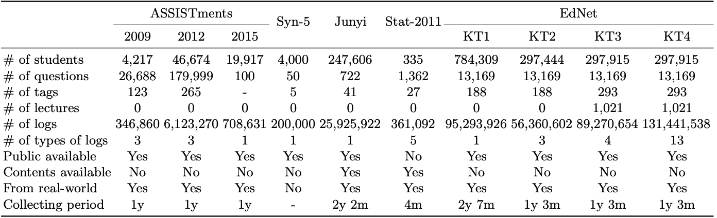
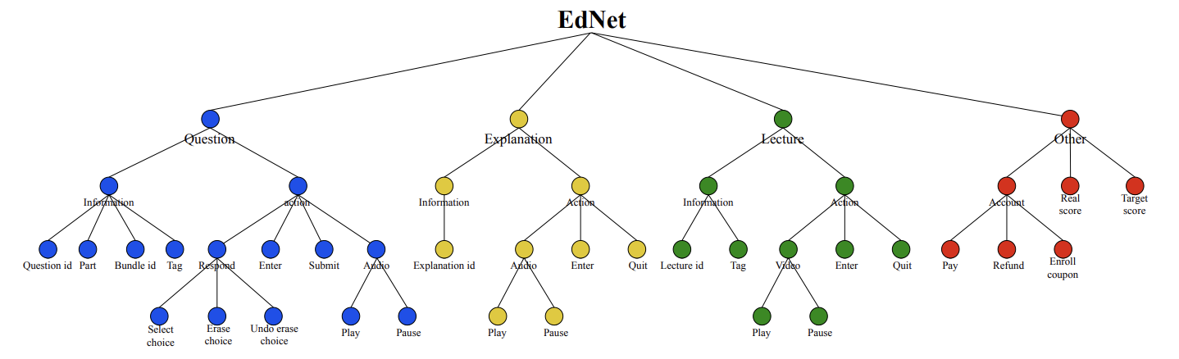
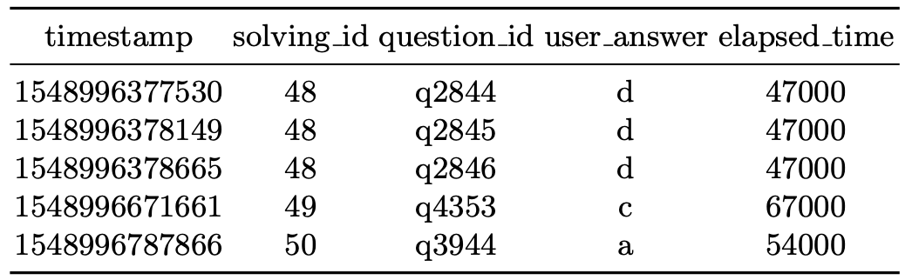
Dataset
EdNet is the dataset of all student-system interactions collected over 2 years. The dataset is
Large scale
Diverse
Multi-platform.
The structure of the dataset is hierarchical:
Comparison with other existing datasets
A glimpse of EdNet KT1 dataset
Images and Tables reference: EdNet: A Large-Scale Hierarchical Dataset in Education by Y Choi et al. (2019)
Notes:
Before introducing our experiment settings, let me quickly talk about the dataset we would be using. Ednet is a large and diverse dataset collected over 2 years, with the number of recorded interactions and the number of students far exceeding that of previous datasets. It is divided into 4 levels, and we only use the simplest level in our project which includes the question id, the student answers and the time it takes to answer

Slide 4
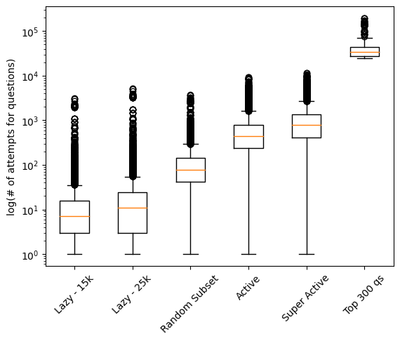
Methodology
Sample different parts of EdNet KT1
Compare the following methods
Maximum likelihood estimation
Maximum A Posteriori
Variational Inference
DeepIRT
Saint-PLUS
Notes:
We sample different parts of ednet level 1 to explore the effect of the density of the student question interaction matrix. For example we pick a set of 15k students who have answered fewer than 10 questions, denoted as lazy for a sparse matrix, a set of students who have answered more than 100 questions, denoted active for a denser matrix, and a set with 300 most answered questions with a large number of students. We compare mle and map method, where we train a decoder to map student id to latent abilities and question id to item features using a neural network, and optimize the parameters with the loss calculated from the logistic IRT function. While MLE and MAP focus solely on the decoding phase, a Variational Inference based method trains both encoding and decoding end-to-end by maximizing a modified Evidence Lower Bound.
Deep-IRT combines knowledge tracing and IRT. it produces point estimates of ability and item difficulty at each time step, which are then passed into an IRT function to produce the probability of answering the item correctly.
SaintPlus is a transformer based method that is the state of the art on Ednet dataset.

Slide 5
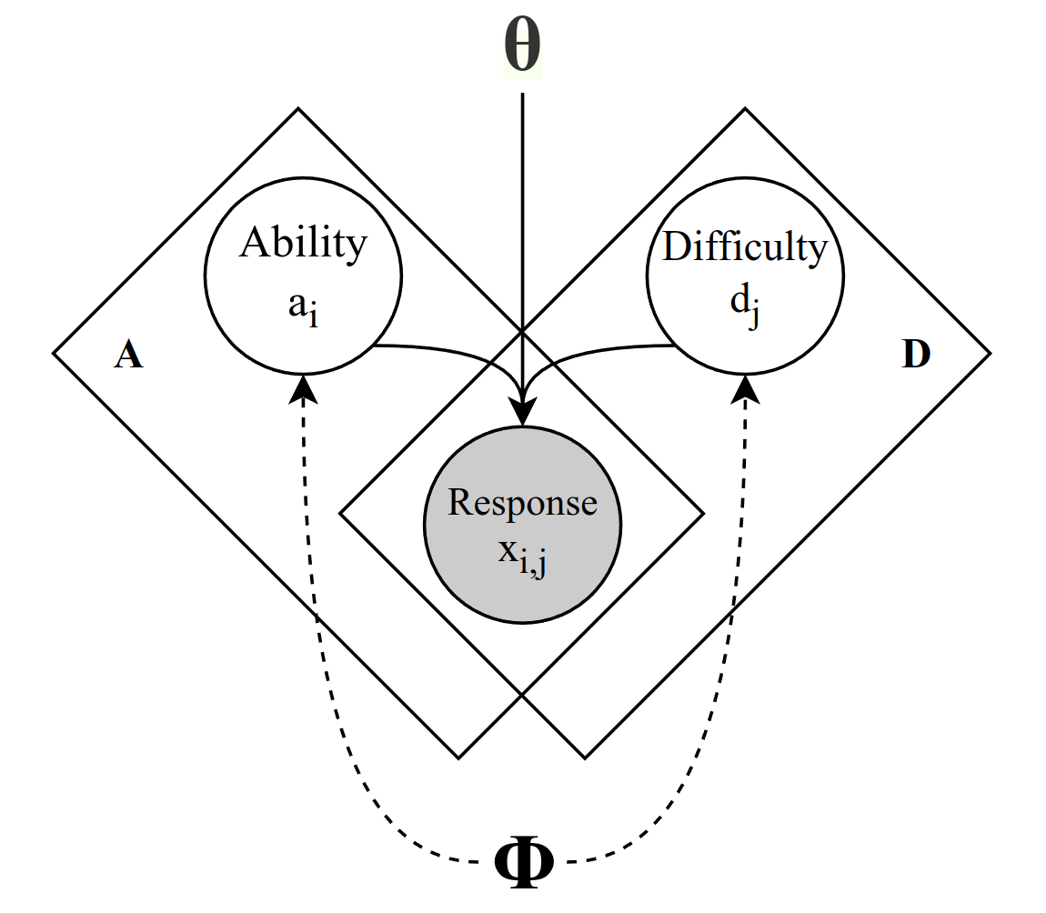
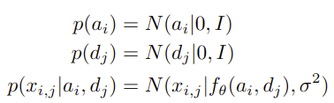



Methodology - Variational Inference
Globally shared 𝚽 (encode) and 𝚹 (decode)
Decode
Encode
Notes:
Let’s go into a bit of detail into how the variational inference is designed here
We employed an architecture similar to Variational Autoencoder.
Both encoding phi and decoding theta parameters are shared globally across all observations. It significantly reduces the number of parameters to be learned, enabling scalability for large datasets and generalization to unseen observations.
We applied product of experts to capture the effect that a user’s ability increases as the number of correctly answered questions rises.

Slide 6


Methodology - Variational Inference
Evidence Lower Bound (ELBO)
Stochastic gradient ascent learns 𝚽 and 𝚹 by maximizing ELBO with reparameterization trick.
Notes:
Here is the Evidence Lower Bound which we optimized to learn both encoding and decoding parameters end-to-end

Slide 7
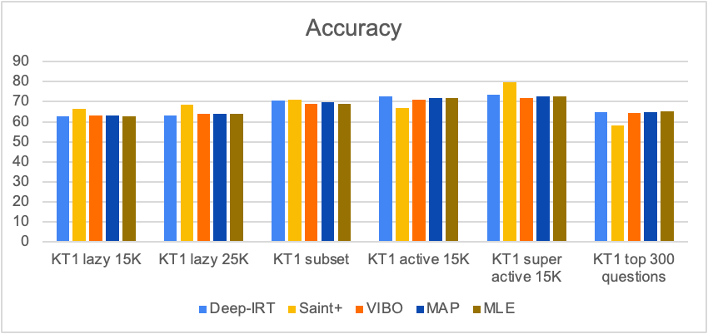
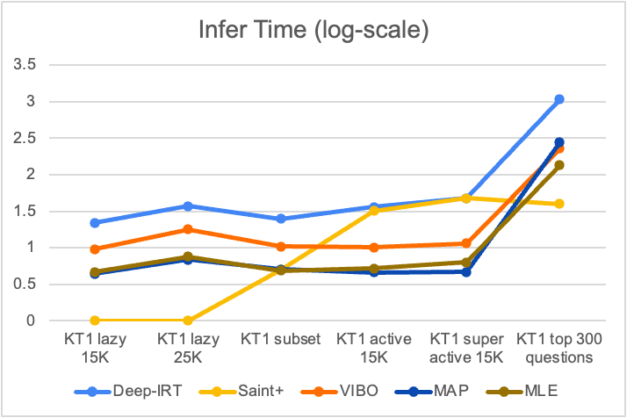
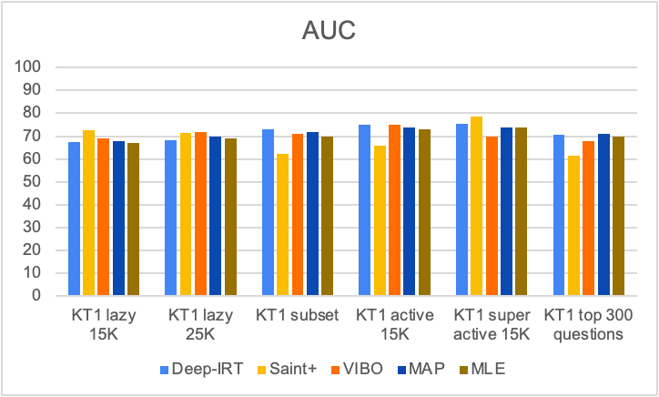
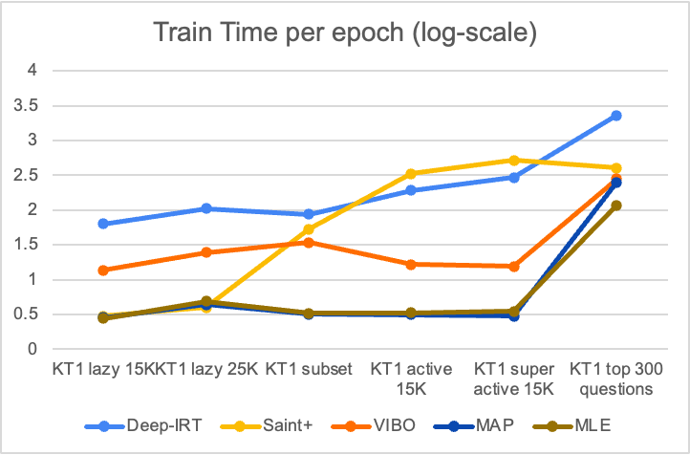
Initial Results
Notes:
We compare the methods on accuracy and area under operating curve. Surprisingly MLE and MAP works comparably well to variational inference as well as deep-irt in all settings, with lower training time and inference time. However for mle and map, in the large dataset setting the number of parameters and the training time as well as inference time increase dramatically. This holds for all methods we tested, except for saint plus. It is also very surprising that saint+ was outperformed by the rest in our largest set which is the top 300 question setting. We expected the active set, which includes student with more than 100 answers, and super active set, which includes student with more than 300 answers to have similar trend with respect to the methods’ performance, but the performance of saint+ and variational inference change quite a bit. We are still running more experiments with larger subsets of ednet to get a more definite conclusion.

Slide 8
Thank You

