Slide 1

Self-driving money.
The regulator holds the brakes.
Praetor
An AI agent runs your wallet. Its limits live on-chain. A bank, a regulator and an operator on FISCO BCOS can stop it in seconds.
FinTechathon 2026 · International Track · Topic F, Agent Wallet · [Team: alex Huou, EPFL · Stan, [university]]
Notes:
Hi, we are Praetor. In one line: an AI agent manages your money on its own, but the limits it works within live on a blockchain, and a consortium of a bank, a regulator and an operator can pull the brake at any time.

Slide 2
AI agents are starting to hold money. Today’s wallets give them two bad options.
THE PROBLEM
Hand it the key
Approve every step
No brake for anyone else
The agent can do anything. One bad prompt or one leaked key and the wallet is empty.
The human clicks yes on each payment. Safe, but then the agent is not doing the work.
Banks and regulators have no lever on a wallet an agent controls, so licensed finance can’t use one.
Notes:
Agents that pay, trade and rebalance are arriving. A wallet today gives them either the whole key, which is dangerous, or nothing, so a human approves every step. And no institution can step in. That last point is what keeps agent wallets out of regulated finance.

Slide 3



The agent acts alone, inside a mandate that lives on-chain.
THE IDEA
Autonomous
Bounded
Regulated
Rebalances your gold, silver and dollars back to their bands. Pays known payees.
Every call is checked by the Mandate hook on Base. Anything outside asks you, with Face ID.
A bank, a regulator and an operator on FISCO BCOS. One signature freezes; loosening needs two of three.
Notes:
Praetor answers all three. The agent works alone inside a mandate. The mandate is enforced by a smart contract, not by the agent’s good behaviour. And a consortium on FISCO BCOS, WeBank’s own chain, holds the authority over it.

Slide 4
What the user sees
ONE WEEK WITH PRAETOR
1 · Sign up
2 · Agent works
3 · Asks you
4 · Brake
KYC, a decentralised ID, a passkey. The agent gets a mandate credential.
Gold rises; it rebalances to the bands. Rent goes out on the 1st. No taps.
A payment to a new payee: one Face ID in WeChat, checked on-chain.
The payee hits a sanctions list. The regulator freezes it. Base enforces it 6 s later.
Notes:
Here is one week. Sign-up gives the user an identity and gives the agent a mandate. Most days the agent just works: rebalancing, paying rent. When it hits a limit, the request appears in WeChat and the user approves with Face ID, and that approval is checked by the contract itself. And if something is wrong, the regulator freezes the agent, and the freeze reaches Base in about six seconds.

Slide 5


Two chains, one rulebook
ARCHITECTURE
You
AI agent
Base · holds the money
WeChat mini program with SOTER Face ID · web app with a passkey
DeepSeek in OpenCode, calling our wallet over MCP. Its key sits in a TEE signer.
ERC-4337 smart account (Safe7579) + our Mandate hook: caps, payees, price bands. On-chain Face ID check. Refusal log.
WeCross · signed, 6 s measured
Identity · WeIdentity
FISCO BCOS · holds the authority
Decentralised IDs for user, agent and staff. KYC credential and the agent’s mandate credential.
Bank, regulator, operator nodes. Freeze, loosen, sanctions, caps, jurisdictions. Audit chain.
Notes:
Two chains, each doing what it is good at. Base, a public Ethereum chain, holds the money in a smart account. Our Mandate hook checks every single call the agent makes. FISCO BCOS is the permissioned chain where the bank, the regulator and the operator run nodes and take decisions. Those decisions are signed and carried to Base over WeCross, WeBank’s cross-chain bridge, in about six seconds, measured on our stack. WeIdentity gives everyone a decentralised ID and holds the KYC and mandate credentials.

Slide 6
Who must say yes, by risk
SECURITY · PERMISSION TIERS
Tier | Who decides | Examples
T0 | Never allowed | Sanctioned payee, blocked jurisdiction
T1 | Agent alone | Rebalance inside bands, pay a known payee under cap
T2 | You, Face ID in WeChat or a passkey | New payee, or above the agent’s limit; single-use, checked on-chain
T3 | You, as owner | Change the mandate itself
T4 | Consortium | Freeze: 1 of 3 · loosen limits: 2 of 3
Notes:
This is the permission ladder the judges asked for. Tier 0 is never allowed. Tier 1 the agent does alone. Tier 2 needs you: Face ID inside WeChat, or a passkey in the web app. Each approval works exactly once, and the contract on Base checks it, not our server. Tier 3 is changing the mandate. Tier 4 is the consortium: any one member can freeze, loosening needs two of three.

Slide 7




A hacked agent still can’t break the rules.
Every call passes an ERC-7579 hook on the account
SECURITY · THE MANDATE HOOK
Face ID approvals verified on-chain (P-256, WebAuthn)
Every refusal is written on-chain, with its reason
The limits are checked by the wallet contract before any money moves, not by the agent or our server.
Consortium decisions arrive as signed attestations
Notes:
The key security idea: the rules live in the wallet contract. Even if someone takes over the agent, its calls still go through the Mandate hook, which refuses anything outside the mandate. Face ID approvals are verified by the contract using the P-256 precompile, and every refusal is logged on-chain with its reason, so an auditor can see what the agent tried and why it was stopped.

Slide 8
One signature stops it. Two of three let it go further.
COMPLIANCE · THE CONSORTIUM
Bank, regulator and operator each run a FISCO BCOS node. Freezing is easy on purpose; loosening needs a quorum. Decisions reach the wallet on Base, signed, over WeCross: measured 6.3 s to freeze, 7.5 s to loosen.
Notes:
This asymmetry is deliberate. Stopping the agent should be easy: any one of the three can freeze it. Giving it more power should be hard: two of the three must agree. Besides freeze and loosen, the consortium manages the sanctions list, spending caps, allowed jurisdictions and a heartbeat: if the consortium goes silent, the wallet tightens on its own.

Slide 9


Know your customer, and know your agent
COMPLIANCE · IDENTITY AND AUDIT
KYC + KYA on WeIdentity
Tamper-evident audit
The user, the agent and each staff member get a decentralised ID. KYC and the agent’s mandate (“know your agent”) are verifiable credentials.
Every action joins a hash chain on FISCO, anchored on Base. Statements export as ISO 20022, the format banks already read.
Notes:
For compliance we cover both sides. Know your customer: KYC through a provider, issued as a WeIdentity credential. Know your agent: the agent has its own ID and a mandate credential that says what it may do. Every action is recorded in a hash chain on FISCO, anchored on Base, so tampering is detectable, and statements come out in ISO 20022, the standard bank message format.

Slide 10



Approve inside WeChat. One glance, one Face ID.
INTERACTION
WeChat mini program
Or the web app
What you see is what you sign
The same request, approved with a passkey. Its signature is verified by the contract.
Portfolio, chat with the agent, approvals with Tencent SOTER Face ID. Never leave WeChat.
Each screen recomputes the payment’s fingerprint itself. If it differs, it refuses to sign.
Notes:
Interaction is built around WeChat, because that is where users are. The mini program shows the portfolio, lets you chat with the agent, and approves payments with Tencent's SOTER Face ID. The same request also appears in the web app, where a passkey approves it and the contract verifies the signature. Whichever you use first executes. And neither trusts our server: each recomputes the payment's fingerprint itself and refuses to sign if it differs. We tested this on a real iPhone: both screens showed the same fingerprint.

Slide 11
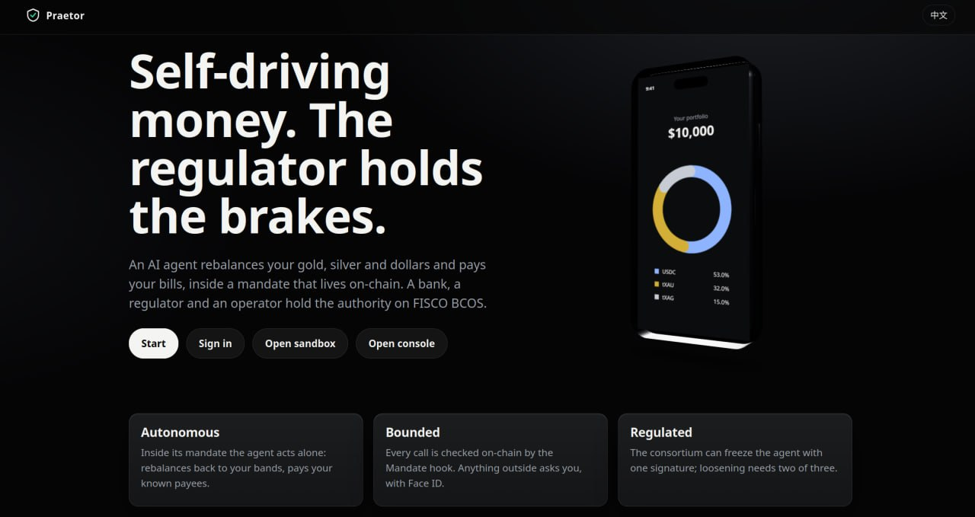
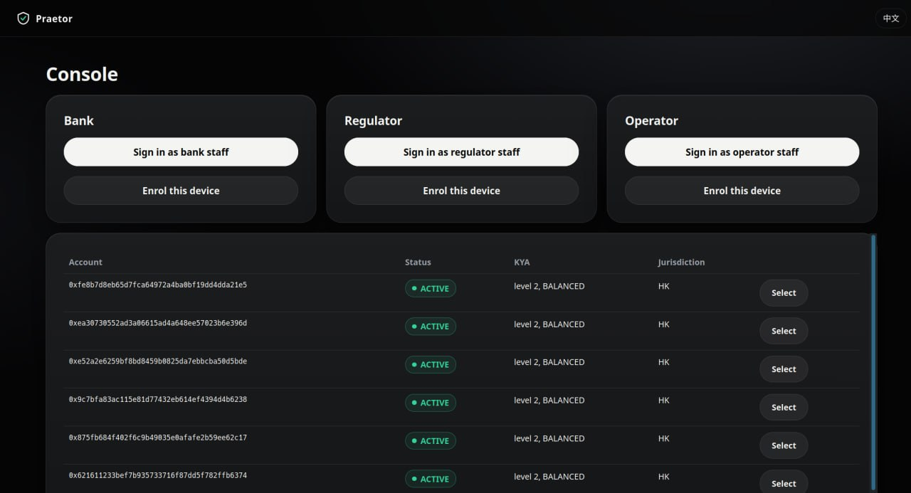
One app for the user, one console for the consortium
THE PRODUCT
User app: portfolio, approvals, mandate, payments, chat with the agent
Console: bank, regulator and operator staff sign in with a passkey and act on agents
Notes:
Two front ends. The user app shows the portfolio, pending approvals, the mandate, payments and a chat with the agent. The consortium console is where bank, regulator and operator staff sign in with their own passkeys and freeze, loosen or inspect any agent. Both are in English and Chinese.

Slide 12
We pulled the brake on a real iPhone.
TASK COMPLETION · MEASURED, NOT PROMISED
6.3 s
1×
=
700+
regulator freeze on FISCO, enforced on Base
each Face ID approval; a replay is refused on-chain
phone and web recompute the same digest before you sign
automated tests, plus end-to-end flows F1 to F10
Tested end to end, iPhone + WeChat | Result
Agent asks; owner approves 270 USDC with WeChat Face ID (SOTER) | Executed on Base
Same approval sent again | Refused: DigestUsed
Regulator freezes; agent tries to pay | Refused: FROZEN, app turns red
Bank + regulator loosen | Live again in 7.5 s
Notes:
Task completion is forty percent of the score, so here is what we measured, on a real iPhone with a real WeChat account. The agent asked for a payment outside its mandate; I approved it with Face ID inside WeChat, and it executed on Base. Sending that same approval again was refused by the contract: every approval works once. Then the regulator froze the account on FISCO: 6.3 seconds later Base enforced it, the app turned red and the agent could not pay. Loosening took the bank and the regulator together, 7.5 seconds. Behind this, more than seven hundred automated tests and end-to-end flows F1 to F10. [Add the Base Sepolia transaction hashes from the live run.]

Slide 13
Four firsts, in one wallet
INNOVATION · WHAT IS NEW
A consortium brake across chains
WeChat Face ID that moves money on-chain
FISCO governs a wallet on a public chain, over WeCross
SOTER approvals, single-use, enforced by the contract
Know your agent
Refusals are evidence
The agent has its own WeIdentity ID and mandate credential
Every blocked attempt is logged on-chain, with its reason
Notes:
What we believe is new, together in one wallet. First, a permissioned consortium chain governing a wallet on a public chain. Second, WeChat's own Face ID moving money on-chain: each approval is single-use and enforced by the contract. Third, the agent has its own identity and a credential stating its mandate, so compliance can treat it as a participant. Fourth, refusals are evidence: everything the agent tried and was stopped from doing is on-chain, with the reason, for an auditor.

Slide 14
Agents can hold money when someone can stop them.
Praetor
Autonomous for the user. Bounded by the contract. Regulated by the consortium.
github.com/hliosone/Praetor · [Demo video] · [Team contact]
Notes:
To close: AI agents can be trusted with money once the people responsible for money can stop them. Praetor makes that true: autonomous for the user, bounded by the contract, regulated by the consortium. Thank you.

