Slide 1
Intro to Vim
Subil Abraham
Oak Ridge Leadership Computing Facility
Oak Ridge National Laboratory
January 20, 2021

Slide 2
Questions to answer
What is Vim?
How do I use Vim?
Where can I learn more about Vim?

Slide 3
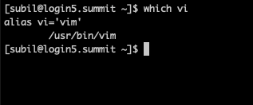
What is Vim?
“Vim is a highly configurable text editor built to enable efficient text editing. It is an improved version of the vi editor distributerd with most UNIX systems”
Modal command-line text editor
Common in HPC environments
Edit source code, job submission scripts, config files, & others!
Vi and Vim are often used synonymously
Vim is a superset of Vi

Slide 4
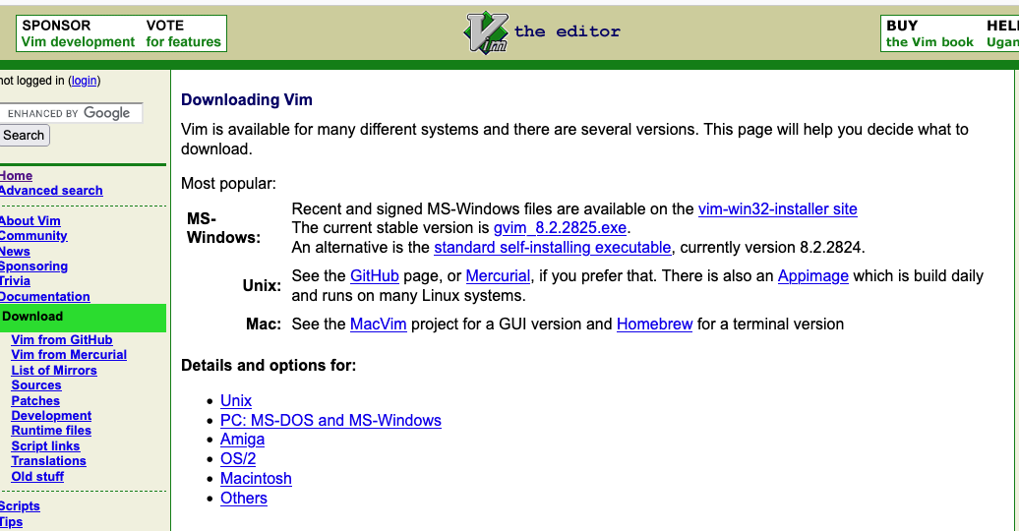
Installing Vim
Available by default on all OLCF systems
Easily installable to your own laptop

Slide 5
How do I use Vim?
Let’s go to the command line
$ wget https://www.olcf.ornl.gov/wp-content/uploads/2018/06/intro_vim_txt.txt

Slide 6
Where can I learn more about Vim?
In command line: $ vimtutor
vim-adventures.com
www.vim.org/docs
Help reference in Vim: `:help`

