Slide 1
Song Suggestion using Spotify Playlist
Guanchen Liu

Slide 2
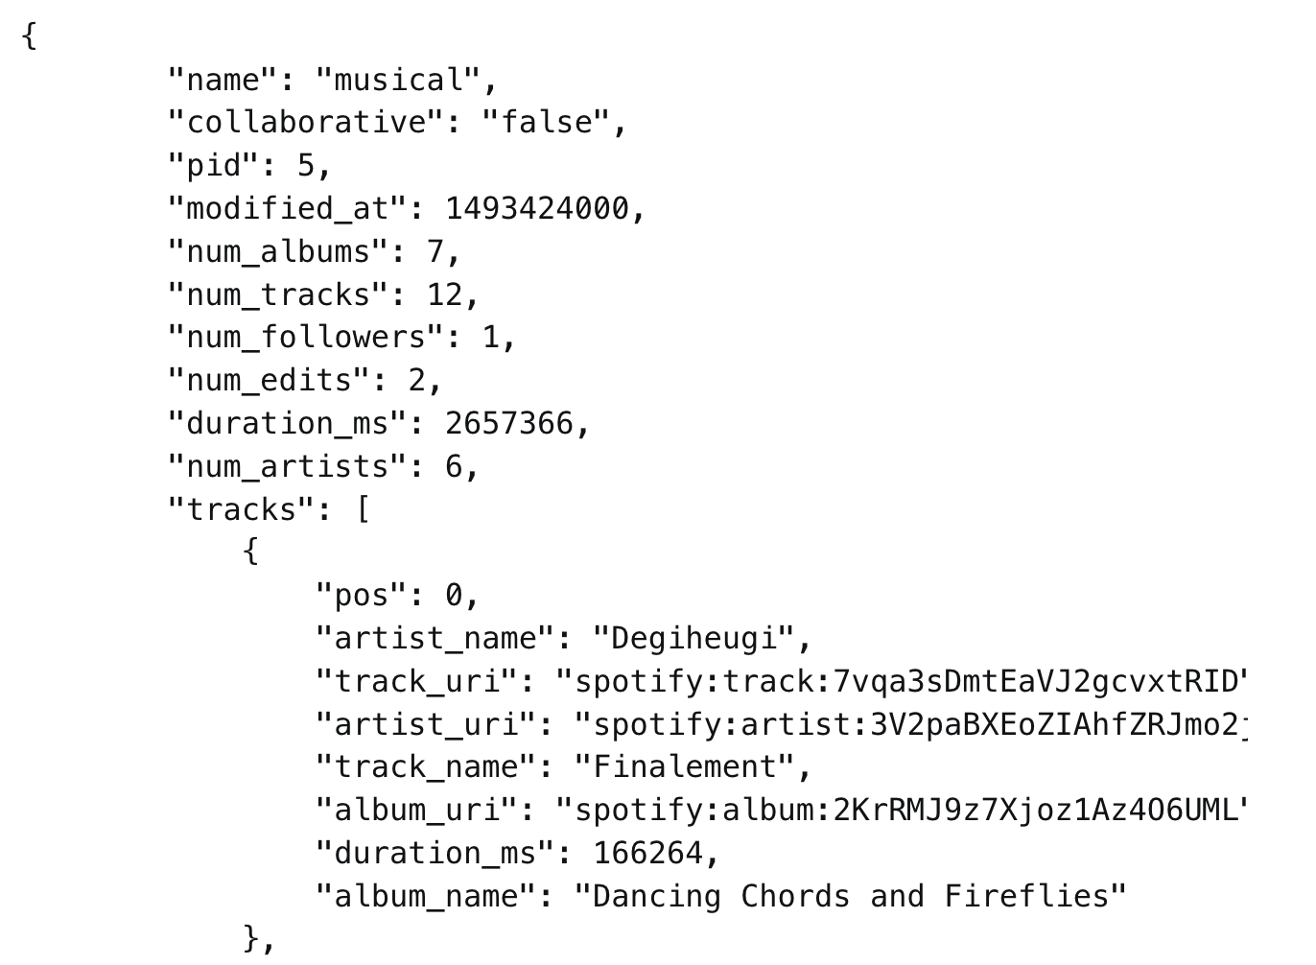
Introduction
Task: Generate list of song recommendations based on provided playlist
Generate recommendations without using metadata from outside source(Spotify API, …)
Data Source: Spotify Million Playlist Dataset
1000 JSON files – 33GB
1 million playlist from Spotify users in US
2 million unique tracks from 300,000 artists
Features: playlist name, pid, num_albums, num_tracks,
track_name, track_uri, …

Slide 3
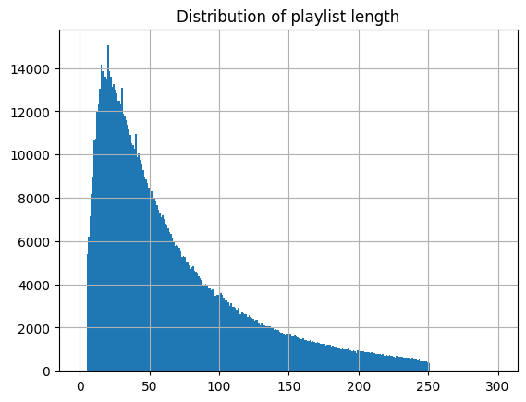
Preprocessing
Convert 1000 JSON files into CSV file
Features: TrackID, ArtistName, PID(Playlist ID)
Reduced to 5GB
Playlist length from 5 – 250 songs

Slide 4
Fit data into graph and get the K-Core of the graph
K-Core is the subgraph where each vertex has K edges
K = 25 and 50 to get rid of small playlists where less information is available
Reduced edges from 60 million to 56 and 43 million
Prepare data for Collaborative Filtering
Features: PID and TrackID

Slide 5
Collaborative Filtering
Use Spark ALS(Alternating Least Squares)
Implicit feedback problem
No explicit ratings for each track
Song preference are judged as they are present in playlist
Add new column ‘rating’ to Spark Dataframe and set to 1
Perform Cross Validation and Grid Search to optimize hyperparameters (80-20 split)
RMSE: 0.83

Slide 6
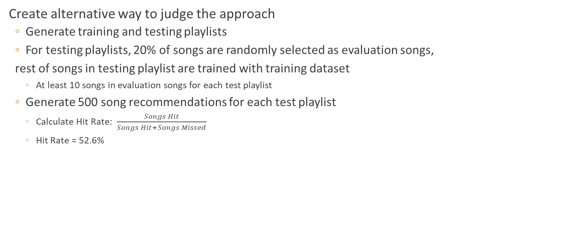
Create alternative way to judge the approach
Generate training and testing playlists
For testing playlists, 20% of songs are randomly selected as evaluation songs,
rest of songs in testing playlist are trained with training dataset
At least 10 songs in evaluation songs for each test playlist
Generate 500 song recommendations for each test playlist
Calculate Hit Rate: $\frac{Songs Hit}{Songs Hit+Songs Missed}$
Hit Rate = 52.6%

Slide 7
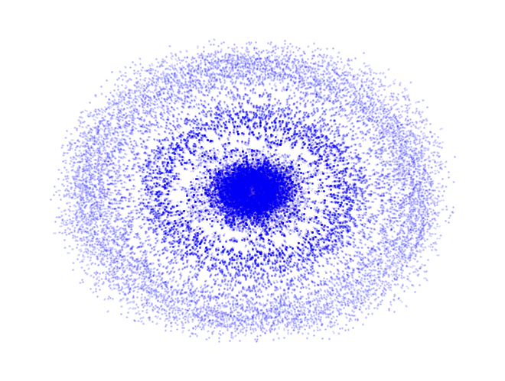
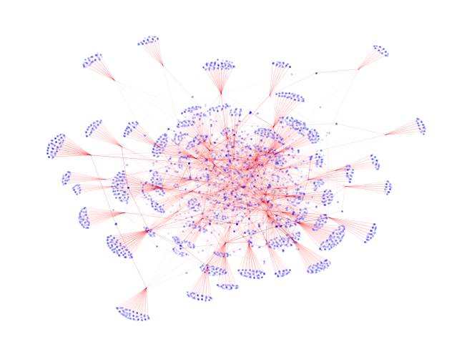
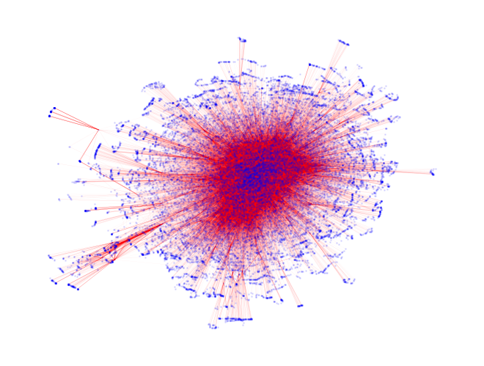
Clustering with GraphFrame
500,000 random edges
10,000 edges by playlist
100,000 edges by playlist

Slide 8
Collaborative Filtering with Nearest Neighbor
Perform nearest neighbor on playlist
Only retain playlists that share 15 songs with the playlist being recommended
Eliminate playlists with length greater than 75 songs
Assume similarity between the subset of playlists
Randomly choose 20% of playlists as training data
Perfect hit rate given 50 song recommendations for 25-croe dataset
 | Baseline |  | Graph Clustering
 | RMSE | Hit Rate (500) | RMSE | Hit Rate (50)
25-core | 0.891 | 0.435 | 0.0767 | 1
50-core | 0.832 | 0.526 | 0.212 | 0.8

Slide 9
Computation Time
Baseline:
Graph Clustering
 | Personal Computer | Cluster
25-core | 90m 24s | 12m 50s
50-core | 79m 40s | 10m 43s
 | Personal Computer | Cluster
25-core | 4m 22s | 43s
50-core | 11m 8s | 1m 52s

Slide 10
Conclusion
Improved performance on baseline drastically
Created model that is lightweight and adaptable
Small dataset used
Fast training time
Only require a graph network with playlists and songs associated
Given enough computing power, pipeline can be finished within seconds

