Slide 1

How to solve real world problems with Python: an introduction to practical coding

Slide 2
Week 0: Getting set up
Who am I?
What is this course about?
What do we need to get started?
What is Python and why are we using it?
How to access resources?
How to access me?
First line of code?

Slide 3
Week 0: Getting set up
Who am I?
What is this course about?
What do we need to get started?
What is Python and why are we using it?
How to access resources?
How to access me?
First line of code?

Slide 4

Who am I?
Background in mathematics
Teaching Python for 5 years
Currently working as a PGR studying artificial intelligence in biology

Slide 5
What is this course about?
Learn the Python programming language and apply it to solve real world problem with a focus on artificial intelligence
Project/portfolio based, hands-on and practical
Build confidence to approach projects independently

Slide 6
What is this course about?
Set Up
Intro to Python
Visualization
Intro to AI
AI models
Natural Language Processing*
Deep Learning*
Final Project

Slide 7
What is this course about?
Every week*:
2 hour workshop session
Companion video
Tasks on what is covered that week
Extension tasks

Slide 8
What do we need to get started?
Option A (very highly recommended):
Google Colab
Option B (emergency)
Anaconda

Slide 9
What is Python and why are we using it?
High level language
Extremely versatile, popular and well supported
Industry standard for AI*
Relatively easy to learn

Slide 10
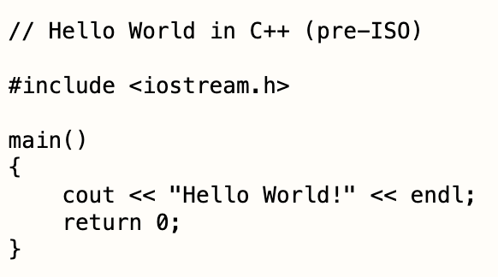
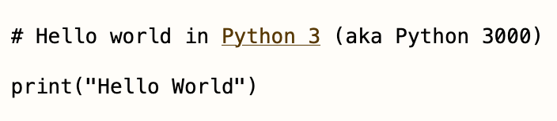
HELlo World!

Slide 11
How to access resources
https://github.com/stmball/PracticalPython

Slide 12
HOW to access me
Email: s.t.m.ball@liverpool.ac.uk
Twitter: @stmball

Slide 13
First line of code
Open up Colab (or Anaconda) and get started!

