Slide 1
An Introduction to PsychoPy
Frank Gasking and John Allen

Slide 2
First of all
Download materials for today
Download the materials from SP850 (zip file)
Or for those not on SP850 from here:
http://www.kent.ac.uk/school-of-psychology/downloads/part1.zip
WARNING!!
You must unzip the file first by right clicking
and selecting “Extract all”.

Slide 3
Learning outcomes from training
At the end of this session you will be familiar with:
What PsychoPy and some similar applications can be used for.
The PsychoPy programming environment
The flow of an PsychoPy experiment
The display objects and their response objects
Routines and Loops
At the end of the session you will be able to:
Get yourself around the PsychoPy basic interface
Run experiments
Do basic editing on a pre-existing experiment
Be prepared for the next session

Slide 4
Experimental software
Applications used at Kent for the presentation of stimuli and the collection of data:
Application | Cost | Platforms | Comments
E-Prime | $$ | Windows only | Easy for simple experiments. Can get complicated quickly. Can be used with EEG & Eye-trackers
PsychoPy | FREE | Windows, Mac, Linux | Uses Python, a powerful and flexible free language. Routinely used with EEG/TMS based experiments. Has been used with EyeLink, and we’ve managed to get things working with the Tobii EyeTracker recently. Also web browser based experiment capabilities in Beta stage at the moment. Not yet fully stable.
Inquisit | $ | Windows, Mac | Lab & Web components. Web Browser based to run experiments
Matlab | $ | Windows, Mac, Linux | Use Psychophysics toolbox to run experiments. Some good internal expertise. Somewhat idiosyncratic.
Superlab | $$ | Windows only | Limited use @Kent. Legacy experiments only as a rule.

Slide 5
PsychoPy: Why might I want to use it?
In Psychology - a need for:
Constructing experiments to:
display stimuli
capture user responses
Examples:
Eprime, PsychoPy, SuperLab, MatLab, JSPsych, Qualtrics (logic flow)
PsychoPy is free and is written in a computing language called Python, which means:
works on Windows/MAC/LINUX
is VERY widely used:
GOOGLE, FACEBOOK, Finance, Science...
has lots of support
Adaptable:
run experiments, analyse data, scripting
libraries, libraries, libraries,...

Slide 6
Using and installing PsychoPy
For all of 2019/20 we are using v1.85.03 of PsychoPy
Fixed for consistency across School
Sticking on an older version for now due to stability issues with the latest version
Experiments created in an older version should upgrade fine.
Let us know if you have any problems with any upgrade process.
Warning! - Experiments created in an newer version WILL NOT run properly on an older version!
Installation instructions
Student/staff PC’s (like you are on now), should already have it installed on the PC you are on. We show how to load it a few slides on…
For home use, download from:
Windows:
https://github.com/psychopy/psychopy/releases/download/1.85.3/StandalonePsychoPy-1.85.3b-win32.exe
Mac: (Version 1.85.4 due to a Mac specific bug in previous version)
https://github.com/psychopy/psychopy/releases/download/1.85.4/StandalonePsychoPy-1.85.4b-OSX_64bit.dmg

Slide 7
Know your file types
Experimental files:
*.psyexp : these are PsychoPy BUILDER source files
*.py : these are Python source code files. Your PsychoPy CODER files
*.pyc : these are your ‘byte compiled’ files. You can safely ignore them for now.

Slide 8

Starting PsychoPy
PsychoPy icon …
On UoK ‘managed build’ Windows PCs
Student PC’s (N1.04, Oaks, MSc computing room)
START | Search for PsychoPy
Lab PC’s
START | PsychoPy
If still not present, please contact psychsupport@kent.ac.uk
Staff PC’s
Install by going to “Software Center”
Then … START | PsychoPy

Slide 9
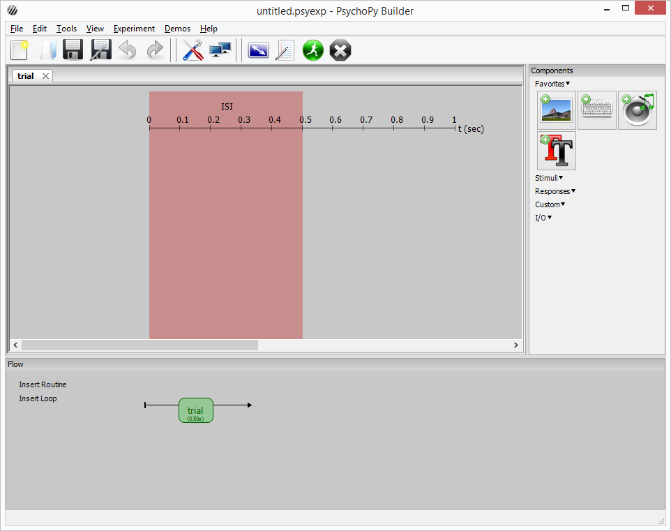
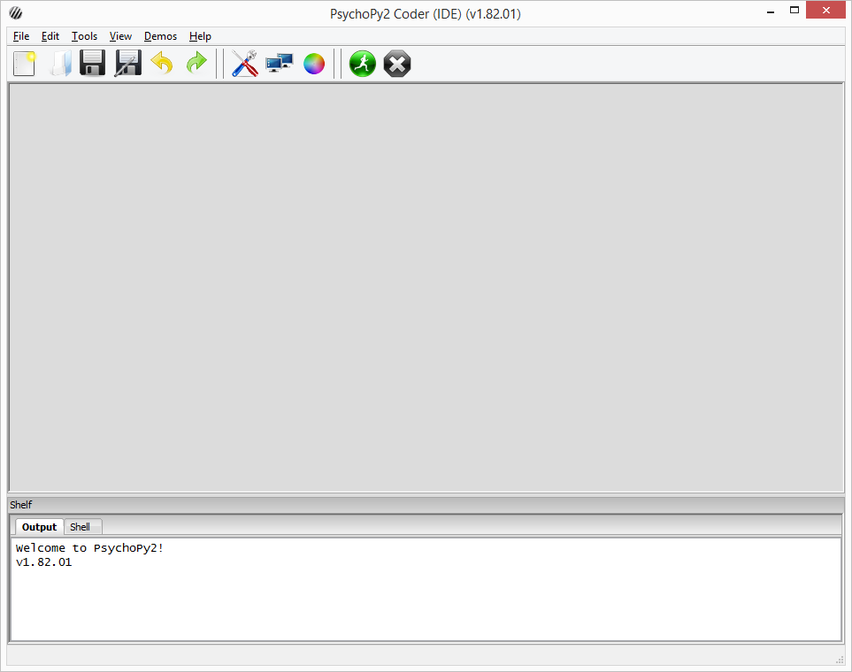
Builder Vs Coder views
A brief overview of both and what they are
Will be sticking with Builder
Builder
Coder
Demo – Try for yourself

Slide 10
Exercise 1 Run the stroop demo
Exercise 1.1
From the downloaded materials - open up stroop/stroop.psyexp from within your extracted directory
Don’t worry what everything is just yet, we’ll cover it later!
Click the green icon at the top to run it for yourself
See what it does.
Exercise 1.2
Look inside the /data folder and see what is produced
Open one of the most recent CSV files that you find
Study the file, noting the column headings.

Slide 11
Demo: What comes out from PsychoPy?
What builder generates
Lets see what happens when PsychoPy runs (Demo of code generated)
Data output
Default area for data output is within a data sub-folder
4 files are generated:
csv – main data
xlsx - slightly simplified version of the csv file
psydat - complex - but useful for batch processing of results files. Possibly of interest if you are familiar with matplotlib
log - chronological record of everything BUT depends on what settings you use.
These are all generated automatically.
Filename based on Session/Participant and date number
Will cover more in next part about how to add our own data
and extras to this output to help with our analysis.

Slide 12

Result files and adding information
How do we add extra information to our data output?
1. Start up parameters
By default – prompted at the start for Participant and Session ID
To add your own, click the experiment settings icon
2. Add to Excel data file
You can add a new column in your data file – that is it!
It will appear in your output files automatically.
3. Through embedded Python code
Possible to run complex calculations and store into our data file
Outside the scope of this session, but it is possible!

Slide 13

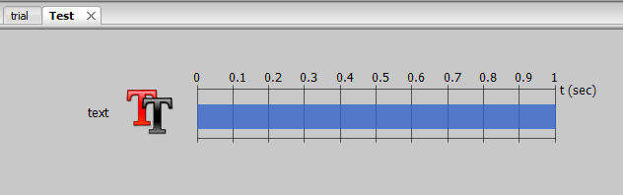
An overview of the interface
Menus (key items)
Routines
One tab per routine
components in this routine
WARNING: closing a TAB deletes the routine!
Preferences
Monitor settings
Experiment settings
Run experiment
Stop experiment

Slide 14

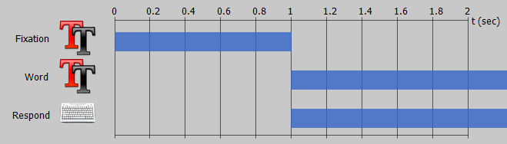
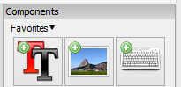
Continued…
Experiment flow
sequential order of execution
Routine timelines
Concurrent objects/components controlled by start/duration
Components
5 sections - drop-down menus
More details coming up…
Experiment starts here
And ends
here
Timeline start
Fixation finishes
Components set to start after 1 second
Components on the timeline
Drawing order is top first, when items drawn at same time!
Both these components end times are “open-ended”
Finishes, when user responds!
Fixation could have been separated – but better if not.

Slide 15



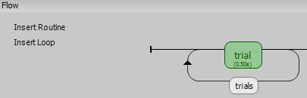
Key components
A quick look at a few of the key and basic components you can use:
Text box (display component)
Keyboard (response component)
Can record data automatically in results file
Mouse (response component)
Can record data automatically in results file
Loops (flow component)
Data feeds and repetitions
When you add a component, you must give it a sensible name
(No spaces, something meaningful so you remember what it is!)
Each component comes with its own set of properties and attributes
These allow us to make them do different things.
Loop created called “Trials” which repeats the routine called “trial”

Slide 16
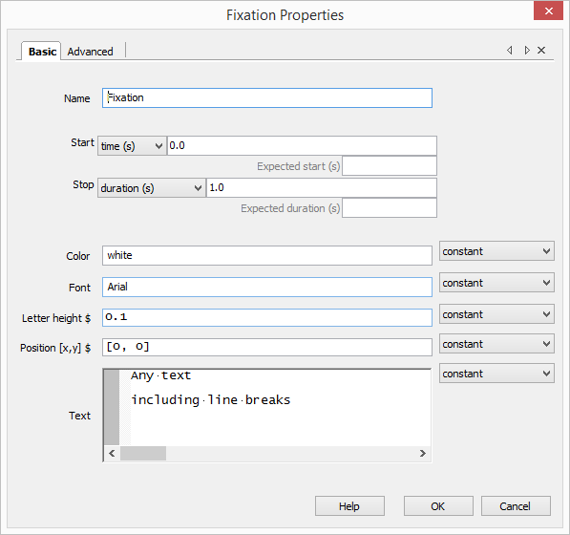
Key component properties
When adding a new component or double clicking a pre-existing one to edit on your timeline, you’re presented with a properties box.
Including properties such as:
Position
Color
Text (where applicable)
Start time
Duration
….
…. And so on. Depending on the type of component.
These affect the behaviour of the component within our experiment!

Slide 17
“Loops”
Loops are where we want to repeat something a number of times.
You may hear the word “Iteration” used to describe a repetition.
In PsychoPy we mostly want to present stimuli or trials
Often routines are repeated using a “Loop”
This usually represents our trials for an experiment
Text, Image or other components are repeated within our routine/s
But the actual text/image may need to change each time to represent trial stimuli.
How?...

Slide 18
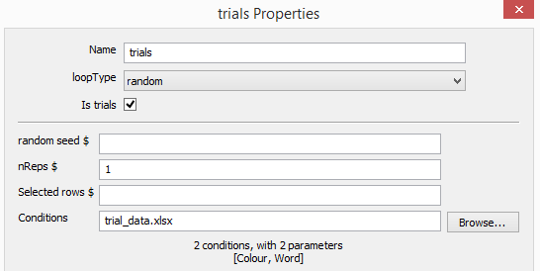


By using a data source!
Created in Excel or package that can create CSV files.
Headings refer to “Attributes” that are created for us that we can
use to pull in our trial data.
Excel/csv data file
Attached to loop
Via “Conditions” property
PsychoPy automatically picks up the headers and treats them as “Attributes” (or Python Variables). These are CASE SENSITIVE. There should be NO WHITE SPACE!
These are now available to the “trial” routine and the components within.

Slide 19
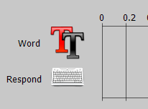
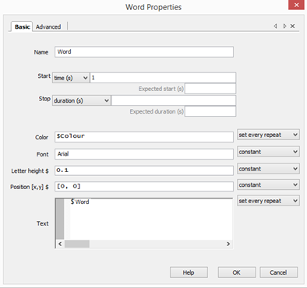
Accessing those attributes
“Word” and “Colour” now become available to use in the Text component
We use the dollar sign ($) to tell PsychoPy that we are using an attribute, which will contain data for our current trial from the Excel list.
Crucially, we MUST change the update method from “Constant” to “Set every repeat”.
So we are saying – “This value will change on every repetition/loop/trial”

Slide 20
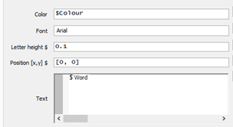
So when the trials run…
1) We come into the trial routine…
2) And fetch a row
3) “Hello” and “Red” are passed into their attributes.
Done automatically by PsychoPy
Color = “Red”
Word = “Hello”
4) These are passed to the Text component in the trial routine.
5) This enables display when we run the experiment!
Hello
6) When the trial ends, we then fetch our next trial data…
7) And the cycle repeats until we have no data left to use!

Slide 21
Some “Gotchas”
1) Update properties
It is key to set the properties where you have an attribute coming in from “Constant” (never changes) to “Set every repeat” = (update and change on every repetition/trial/loop). Keeping as Constant will cause an error!
NOTE: The “Set every frame” option updates component at every single screen refresh
= Overkill!
2) Making updates to the data file (i.e new columns)
When a trial list is updated with new columns, you should re-attach the CSV file. This is to make sure PsychoPy picks up the new attributes you add!
3) Attributes are “CaSe SeNsItIvE” and must not contain white space!

Slide 22
Exercise 2: Modify the Stroop demo
Open up /stroop/stroop.psyexp from Exercise 1
Change the intro text and the first line “OK. Ready for the real thing?” to “Instructions”
Change keys from “left”, “down”, “right” to “a”, “s”, “d”
Ensure you update the instructions
Add another 5 trials to the Stroop
Edit the trialTypes.xlsx is where the source trial data is!
Try adding a new routine which will act as a title page for the experiment
HINT: the “instruct” routine should give you some clues
Look at the properties of the Text and Keyboard component and replicate
Re-Run and see what you get
Look at the result file, has your new data column come over?

Slide 23
Components - Part 2
Brief overview of remaining components in brief.
Stimuli:
Sound – Playback of sound
Image – Display of image
Aperture – Add a circular effect onto image component
Grating – Wrapped texture that can be cycled in 2 dimensions
Movie – Playback of movie files
Dots – Presentation of Random Dot Kinematogram to participants
Polygon – Shape presentation of different sides (square, rectangle, octagon)
Responses:
Mouse – Take responses from the mouse
Mic – Only records sound, doesn’t register response to sound
Scale – Mouse friendly scale to choose a value
ioBox, Cedrus – Input options for external hardware devices and button boxes
Other:
Parallel icon – Send signals down a cable (EEG)
Static – A static period to allow for pre-loading images or other operations
More details can be found at http://www.psychopy.org/builder/components.html

Slide 24
Demo: Psychopy preferences + Experiment settings
Some additional settings hidden away in PsychoPy.

Slide 25
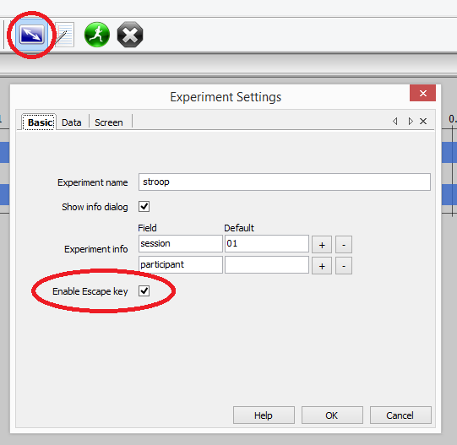
Escaping from your experiment
One of the key settings you may want to consider changing!
By default, when running an experiment you can press ESC
This will halt the experiment
And save any data recorded so far.
This can be disabled:
E.g.

Slide 26
Exercise 3 Turn stroop into a Picture based stroop
Simply add images to the stroop trials as a distractor.
Close your previous Stoop task if still open.
Now open up the picture-stroop folder in your directory
Open up the picture-stroop.psyexp file
/picture-stroop/images contains 6 images for you to use and link to each of the 6 trials.
Hints:
You will need to enter a “relative” path for each image
E.g. “images/1.jpg” (without the quotes)
Hint - Create a new attribute called “image_path”
That path then needs to be passed to an image component
Remember: when trial data is updated, Excel link needs refreshing.
Attributes are accessed with $ and name of excel header
We will come round and help
If you don’t get chance to finish, have a go at home.

