Slide 1
PsychoPy Intermediate
Frank Gasking and John Allen

Slide 2
A quick recap/overview
Quick recap in PsychoPy of:
Routines
Timelines
Basic components
Paths (relative/full) – came up last week
(DEMO)

Slide 3

Result files revisited!
How do we add extra information to our data output?
Start up parameters
By default – prompted at the start for Participant and Session ID
To add your own, click the experiment settings icon
http://www.psychopy.org/builder/settings.html
Add to Excel data file
Which we did in the first week
Add a new column in your data file – that is it!
Through embedded Python code
Possible to run complex calculations and store into our data file
Outside the scope of this session, but it is possible!

Slide 4
Monitor settings
PsychoPy has concept of a ‘Monitor’
Allows you to:
store information about multiple monitors
keep track of multiple calibrations for the same monitor.
TOOLS | MONITOR CENTER
Means you can:
specify the size and location of stimuli in units that are independent of your particular setup.e.g.
pixels
cm of screen
degrees of visual angle
easy to port programs to different setups as PsychoPy calculate appropriate pixel size for you

Slide 5
Positioning components
Positioning of components within a routine
Stacking order is important!
Refers to order they are drawn
Components rendered at the same time
Those at same position will overlap!
Screen divided by a coordinate system
Other options available too which you can read about here:
http://www.psychopy.org/general/units.html
Y
This would be
X = 0.5
Y = 0.5
1
X
0
-1
0
1
This would be
X = 0.5
Y = -0.5
-1
Screen

Slide 6
Exercise 1: Modify ordering and positions
We have given you a sample screen with a bunch of random objects
Open and run ex1-positions/experiment.psyexp
Press space to finish the demo at any time
Now try and modify the layering order of the objects
Right click the item in the flow and use the move options.
Also try playing with positioning
Try adding some more polygon or image objects if you like.
Get familiar to the stacking and positioning in PsychoPy
We’ll take 5 minutes for this task.

Slide 7
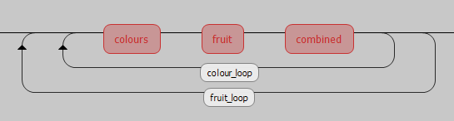
Nested loops and lists
Repeated stimuli with different conditions can cause repetition
(DEMO – combined-data.xlsx)
Using nested loops/lists in PsychoPy, we can reduce this
A nested loop in PsychoPy:
Lets look at the example in action… (DEMO)
Outer loop
(Starts first)
Inner loop
(Starts second, runs and
Completes each time)

Slide 8
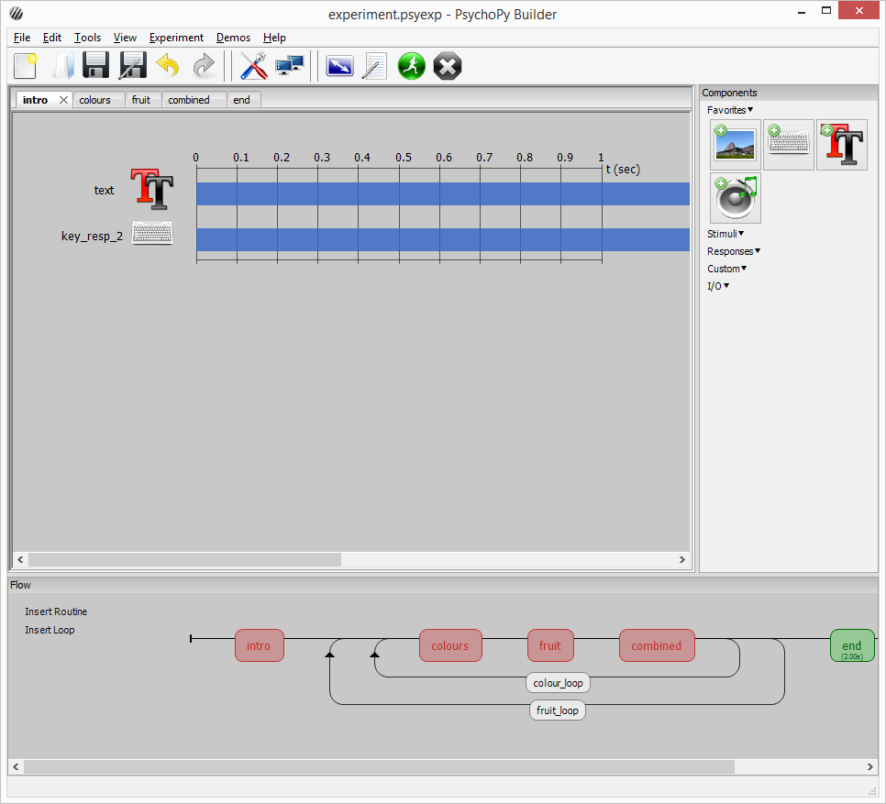
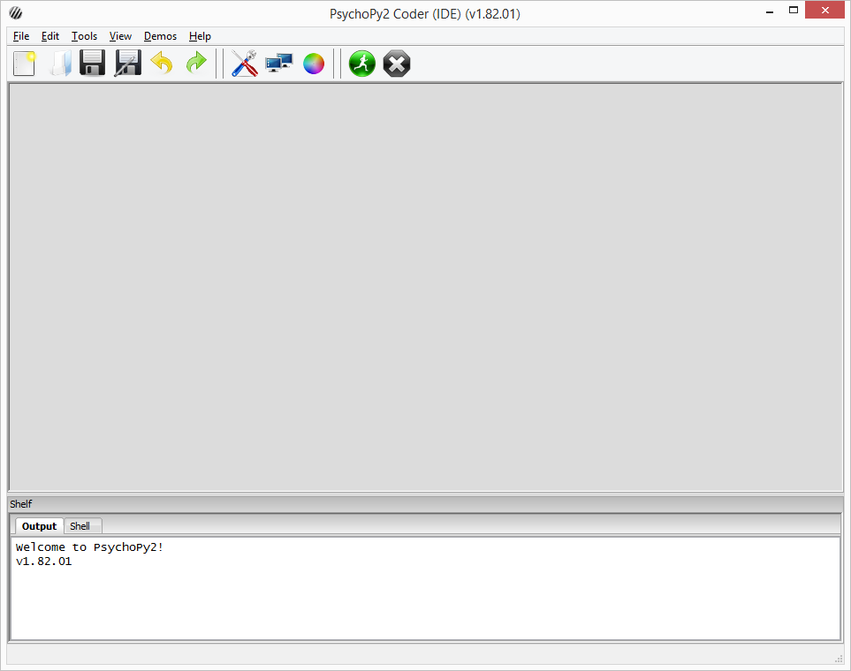
Using Coder instead of Builder
Writing pure Python code using PsychoPy library
Too advanced to cover in detail on this course
Unlikely you will ever need to use it
Sometimes we do if an experiment is outside scope of builder
Here is a quick demo of something which can be achieved
with Coder… (CARD GAME DEMO)
Builder view
Coder view

Slide 9

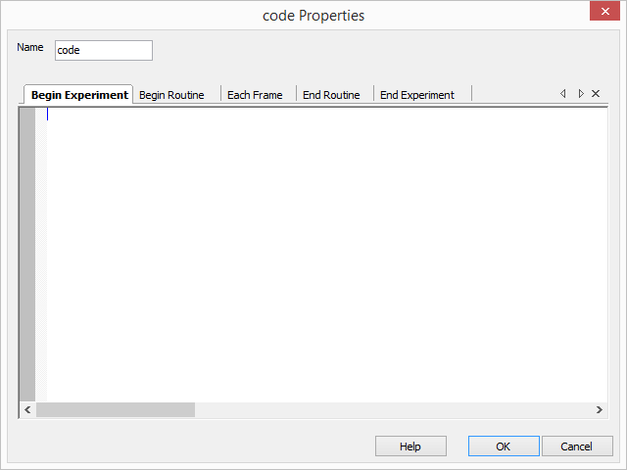
Using Python code in builder
The card game could have been done in builder
Structure/nested loops required would have been complex
However, even using builder can occasionally require us to have
to dip into Python code
Often to produce something builder cannot handle.
A limit to what a builder interface can achieve.
We can drop in snippets of code using code components

Slide 10
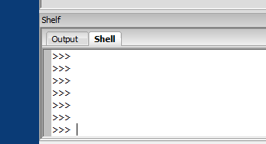
Tip: Testing simple Python code
You can also test bits of Python code via the “Shell” tab
In the coder view…
Demo
firstname = "John"
firstname.upper()
firstname.lower()

Slide 11
Exercise 2: Using snippets of code in Builder
Open up ex2-code-blocks/experiment.psyexp and spend
5 minutes by doing the following:
Run it first and see what happens
Where are the numbers coming from for the calculation?
Look at the “trial” routine
Click onto the code block called “calculation”
Then the “Begin routine” tab
See how the calculation is being done
What is int() doing, and why do we use it?
How do we then print that calculation in the Text component?
Open up the Text component - what is str() doing?
Remember why “text” is “set every repeat”?
A number of new concepts we have just thrown at you there
- without warning!
Lets cover them briefly and some more!....

Slide 12
A whistle stop tour of simple programming concepts…
Will give a bit of context for the use of int()and str()

Slide 13
Variables/attributes & data types
Containers for data (i.e. “answer” in the last exercise)
Or otherwise known as variables / attributes
age = 10
age = 15
Can use in calculations, concatenations (joining), loops and more…
age = age + 5
first_name = "Frank"
Full_name = first_name + " Gasking"
Should give meaningful names for reference
No spaces in variables (ever!) – use "_" or "–" if you must have
some spaces.
Variables store different data types – which we’ll cover now…

Slide 14
Simple data types
Integer
age = 10
Float
pi = 3.14
Boolean
bilingual = True
or bilingual = 1 (in some languages is valid)
Char
initial = "M" … number = "1"
String
first_name = "John"
phone_number = "+44 01227 888999"

Slide 15
Operators
You will probably remember these from Maths…
Math
+, -, *, /, mod
total = number1 * number2
Boolean
AND, OR, NOT
Comparison
=, == (equivalence)
=== (exact equivalence)
<>, != (not equivalance)
<, >, <=, >=
BIDMAS/BODMAS
((1+1)+(2+2)) * 2

Slide 16
Conditional statements
Used to help make decisions in your experiment
E.g. if … then … else
Uses data types, variables and operators
if age < 18:
print("Sorry, you’re too young to drink!")
elif age < 100:
print("Have a drink on us!")
else:
print(“Wow, have two drinks on us!")
Question - How do we make decisions in PsychoPy?
Answer - Using code blocks!

Slide 17
Exercise 3: Using conditionals and variables
Open up file ex3-conditionals/experiment.psyexp and
spend the next 5-10 minutes by doing the following:
Run it and see what happens
How is the correct gender-based Excel data file read?
Look at the “setup” code block under routine “start”
Go to the “Begin Experiment” tab
Read the comments (in green/red) and see what is happening.
How does it work out which data file to use?
How are we then using that data file reference?
Where is “gender” set and how to we create new prompts?
Click onto this icon and take a look
Try and add “Colour” as a new option

Slide 18
Adding functionality via code blocks
You can add functionality to PsychoPy in a number of ways:
Not just by creating our own snippets of code like we did previously
But also by bringing in other people’s ready-made code
Thanks to PsychoPy being built on Python, we can:
Import from libraries/3rd party code
Use custom functions (either our own or outsourced)

Slide 19
What are functions?
A “container” of reusable code that does “something”
Defined under a given (sensible) name
Benefits:
Write once, use many times
Reduces redundancy and repetition
Declutters your program
Only runs when called
Variables can be passed to a function
Called “parameters”
Functions always give back something
A value of some kind, depending what the purpose of the function is.
int() and str() are Python functions!
They take a value
They give back either an integer or string value

Slide 20
Exercise 4: Adding functions to your experiment
Open ex4-import-code/experiment.psyexp and
spend the next 5-10 minutes by doing the following:
Run experiment to check what happens
Select the “intro” routine and then click on the “code” component, and then “begin experiment” tab
Read the comments in green/red.
What is single line of code doing?
Hint – look for something similarly named inside the experiment folder.
Select “my_function_test” routine, then click on the “text_3” component and observe what is in the Text box
getRandomMonthID() will fetch a number from between 0 and 11
getMonth() takes a number from between 0 and 11 and gives back a text month
“$” is used to tell PsychoPy that we are about to run a small snippet of Python code
Now create a Excel data source which will load in a month numbers 1-12
Feed it into “trials_2” loop as a data source
Replace getRandomMonthID() with the header from the
Excel file

Slide 21
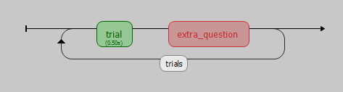
Branching in PsychoPy
Sometimes we may want to skip a particular routine
Maybe the user should only be prompted for a particular
question if they answered previously with a particular answer?
Conditionals in a Code block come in handy for this!
Example:
So how do we bypass this routine based on an answer under “trial”?
Time for a quick demo… demos/3-Branching-example/experiment.psyexp

Slide 22
Creating user breaks
It is good to ensure the user gets a break.
Especially if you have something like 200 trials!
Method is very similar to “Branching” like before
One last demo… demos/4-Break-demo/experiment.psyexp

Slide 23
Error messages / debugging
Fixing errors can be tricky, especially when its with an unfamiliar
system, or someone else’s experiment!
Here are some tips if you encounter any issues:
Read the error message carefully
Look for references to line numbers which indicate the line at fault
Be wary of case sensitivity: Python is very particular
e.g. “if” (not “If”)
Check the experiment .log file under /data for any extra hints
Google the exact error message as a starting point
Check the online help/manuals
Check forums/communities for similar problems
If you get really stuck – pop to the support hatch
(Offices - Frank – A1.5, John – A1.2)

Slide 24
General best practices
When lab testing, ensure you test your experiment in there 24 hours before
Label your routines/loops and components clearly
Good naming convention
“Age = 10” is meaningful in comparison to “a = 10”
“Question_display” is meaningful as a routine name than “routine_1”
Be careful of using RESERVED WORDS
Some of you encountered this problem last week (with “image”)
These are Python language terms, which cannot be re-used
i.e. def, list, dict
PsychoPy should warn you if a name is already in use.
Make regular backups!!
We cannot stress this enough!
Don’t just rely on USB sticks (can be unreliable)
Watch out for memory leaks – from video stimuli in particular!
Check your data output and ensure its solid
Make sure you are getting the data you need to later analyse
Worse thing that could happen is to check after your tests and find
you haven’t got what you need.
Basically do some quick analysis early to make sure!

Slide 25
Where can I get extra help?
PsychoPy:
PsychoPy built-in HELP
Remember, there are separate help sections for Builder and Coder!
PsychoPy website – http://www.psychopy.org/index.html
PsychoPy discourse (Main support forum) - http://discourse.psychopy.org/
Google groups forum (mostly replaced by Discourse site) – https://groups.google.com/forum/#!forum/psychopy-users
Pre-made scripts by us - http://www.kent.ac.uk/psychology/technical/experiments.html
Python:
http://www.python.org/doc/
Google is your friend!
Anything else:
Psychology Technical Team (A1.2 or A1.6)
Check out FAQ handout in the directory (will grow over time)

Slide 26
Exercise 5: Create an experiment
For the rest of the lesson (hopefully we have left enough time!) –
we have given you an experiment specification handout.
See (or via print out):
ex5-image-ratings/Exercise-docs.docx
We are going to let you build a complete experiment from this,
with deliberately vague instructions to test what you have learnt
so far.
Follow the instructions and we will come round and help and
periodically demonstrate on the main screen. If you don’t manage
to start or finish, then try having a go at home!
We will upload the solution onto Moodle later on.

Slide 27
Feedback
Please take a moment to leave any feedback for
future workshops at:
https://goo.gl/lBg0Em

