Slide 1
PsychoPy workshop
John Allen and Frank Gasking

Slide 2
While you’re waiting…
Go to c:\Work
Create directory c:\Work\{your_username}
Download todays materials from
https://www.kent.ac.uk/school-of-psychology/fyp.zip
Save the ‘.zip’ file into your folder (see #2 above)
Right click on the downloaded file and select ‘Extract all’
Please make sure you unzip the file and not click onto it!

Slide 3
Learning outcomes from training
At the end of this session you will be familiar with:
What PsychoPy and some similar applications can be used for.
The PsychoPy programming environment
The flow of an PsychoPy experiment
The display objects and their response objects
Routines and Loops
At the end of the session you will be able to:
Get yourself around the PsychoPy basic interface
Run experiments
Do basic editing on a pre-existing experiment

Slide 4
PsychoPy: Why might I want to use it?
In Psychology we often want to:
display stimuli PRECISELY
capture user responses
key presses, mouse clicks
eye movements, brain responses (EEG), heart rate,…
(often) with very accurate response times (RTs)
PsychoPy is free and is written in a computing language called Python, which means:
works on Windows/MAC/LINUX
has lots of support
We focus on PsychoPy – alternatives exist,
e.g. E-Prime, Matlab (PsychToolbox), Superlab, Inquisit

Slide 5
Using and installing PsychoPy
For all of 2019/20 we are using v1.85.03 of PsychoPy
Fixed for consistency across School
Sticking on an older version for now due to stability issues with the latest version
Experiments created in an older version should upgrade fine.
Let us know if you have any problems with any upgrade process.
Warning! - Experiments created in an newer version MAY not run properly on an older version!
Installation instructions
Student/staff PC’s (like you are on now), should already have it installed on the PC you are on. We show how to load it a few slides on…
For home use, download from:
Windows:
https://github.com/psychopy/psychopy/releases/download/1.85.3/StandalonePsychoPy-1.85.3b-win32.exe
Mac: (Version 1.85.4 due to a Mac specific bug in previous version)
https://github.com/psychopy/psychopy/releases/download/1.85.4/StandalonePsychoPy-1.85.4b-OSX_64bit.dmg

Slide 6
Know your file types
Firstly, show file extensions in Windows file explorer
Open up a folder view
Press ALT + V
Tick the “File name extensions” box.
Experimental files:
*.psyexp : these are PsychoPy BUILDER source files
*.py : these are Python source code files. Your PsychoPy CODER files
(see FAQ for how to see full filenames)

Slide 7

Starting PsychoPy
PsychoPy icon …
On UoK ‘managed build’ Windows PCs
Student PC’s (N1.04, Oaks)
START
Enter PsychoPy in the search field
Lab / Staff PC’s
START | PsychoPy
(Staff PC) If not present, open up “Software Center” and download
If still not present - please contact psychsupport@kent.ac.uk

Slide 8
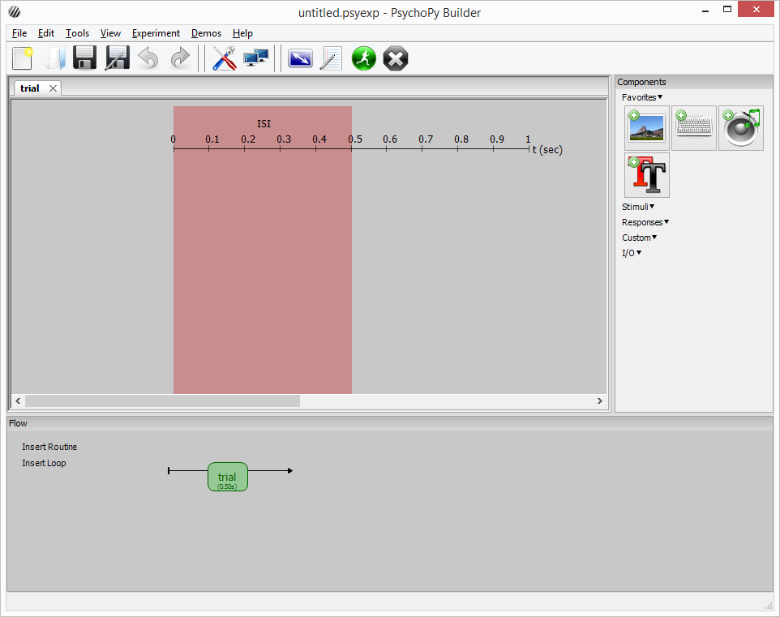
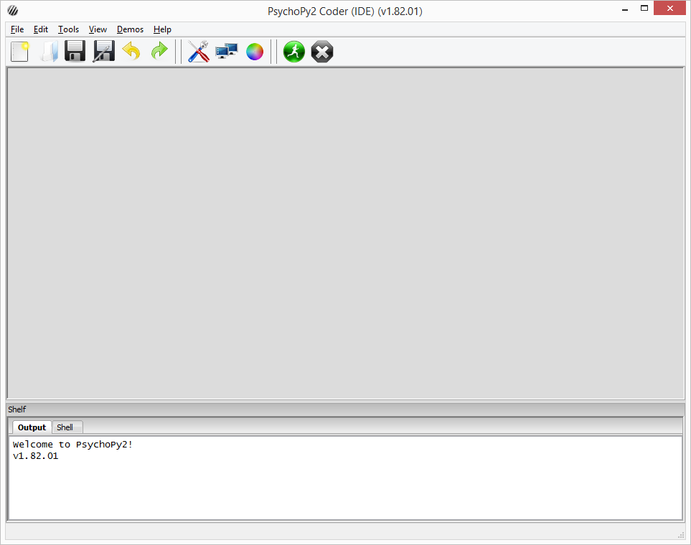
Builder Vs Coder views
Mostly we only use Builder
If you’re in CODER view, then in the menu click View/Goto Builder view
Builder
Coder

Slide 9

Exercise 1 Run a stroop demo
Exercise 1.1
Open up stroop/stroop.psyexp from within your C:/work directory
Don’t worry what everything is just yet, we’ll cover it later!
Click the green icon at the top to run it.
Follow the instructions and see what it does.
Exercise 1.2
Look inside the /data folder and see what is produced
Open one of the most recent CSV files that you find
Study the file, noting the column headings.

Slide 10
Demo: What comes out from PsychoPy?
Data output
Default area for data output is within a data sub-folder
4 files are generated:
csv – main data
xlsx - slightly simplified version of the csv file
psydat - complex - but useful for batch processing of results files. Possibly of interest if you are familiar with matplotlib
log - chronological record of everything BUT depends on what settings you use.
These are all generated automatically.
Filename based on Session/Participant and date number
It is possible to add extra data to results files – Ask for help

Slide 11

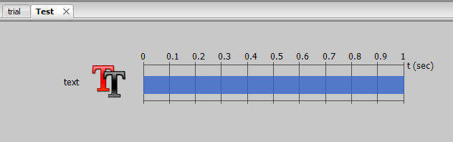
An overview of the interface
Menus (key items)
Routines
One tab per routine
components in this routine
WARNING: closing a TAB deletes the routine!
Preferences
Monitor settings
Experiment settings
Run experiment
Stop experiment

Slide 12

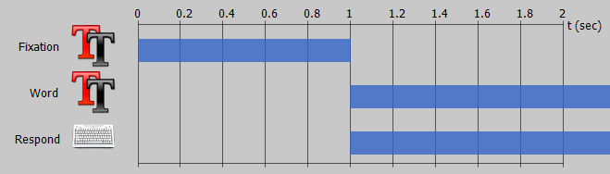
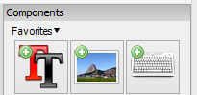
Continued…
Experiment flow
sequential order of execution
Routine timelines
Concurrent objects/components controlled by start/duration
Components
5 sections - drop-down menus
More details coming up…
Experiment starts here
And ends
here
Timeline start
Fixation finishes
Components set to start after 1 second
Components on the timeline
Drawing order is top first, when items drawn at same time!
Both these components end times are “open-ended”
Finishes, when user responds!

Slide 13



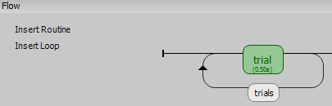
Key components
A quick look at a few of the key and basic components you can use:
Text box (display component)
Keyboard (response component)
Can record data automatically in results file
Mouse (response component)
Can record data automatically in results file
Loops (flow component)
Data feeds and repetitions
When you add a component, you must give it a sensible name
(No spaces, something meaningful so you remember what it is!)
Each component comes with its own set of properties and attributes
These allow us to make them do different things.
Loop created called “Trials” which repeats the routine called “trial”

Slide 14
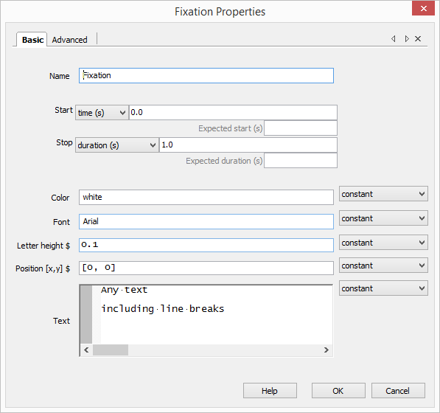
Key component properties
When adding a new component or double clicking a pre-existing one to edit on your timeline, you’re presented with a properties box.
Including properties such as:
Position
Color
Text (where applicable)
Start time
Duration
….
…. And so on. Depending on the type of component.
These affect the behaviour of the component within our experiment!

Slide 15
Exercise 1.3
Exercise 1.3
Study the Stroop experiment to observe some of what we’ve just discussed and
try changing the colour of the instructions
Increase the font size of the target word stimuli

Slide 16
“Loops”
Loops are where we want to repeat something a number of times.
You may hear the word “Iteration” used to describe a repetition.
In PsychoPy we want to present stimuli or trials
Often routines are repeated using a Loop
This usually to represent our trials
Text, Image or other components are repeated within our routine/s
Including their timelines and settings.
But the actual text/image may need to change each time to represent trial stimuli.
But how?...

Slide 17
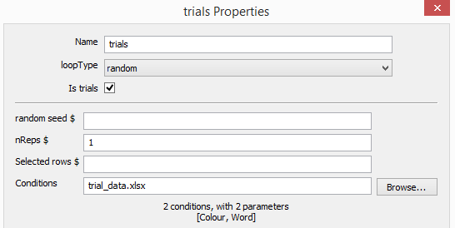


By using a data source!
Created in Excel or package that can create CSV files
Headings refer to “attributes” that are created for us that we can use as our trial data
Excel/csv data file
Attached to loop
Via “Conditions” property
PsychoPy automatically picks up the headers and treats them as “Attributes” (or Python Variables). These are CASE SENSITIVE. There should be NO WHITE SPACE!
These are now available to the “trial” routine and the components within.

Slide 18
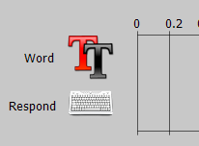
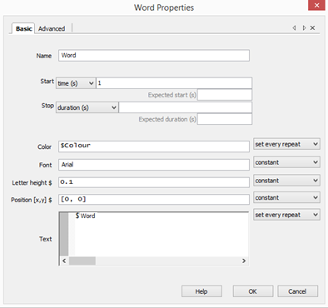
Accessing those attributes
“Word” and “Colour” now become available to use in the Text component
We use the dollar sign ($) to tell PsychoPy that we are using an attribute, which will contain data for our current trial
Crucially, we MUST change the update method from “Constant” to “Set every repeat”.
So we are saying – “This value will change on every repetition/loop/trial”

Slide 19
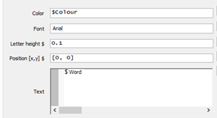
So when the trials run…
1) We come into the trial routine…
2) And fetch a row
3) “Hello” and “Red” are passed into their attributes.
Done automatically by PsychoPy
Color = “Red”
Word = “Hello”
4) These are passed to the Text component in the trial routine.
5) This enables display when we run the experiment!
Hello
6) When the trial ends, we then fetch our next trial data…
7) And the cycle repeats until we have no data left to use!

Slide 20
Exercise 2: further modifications of the Stroop demo
Open up /stroop/stroop.psyexp from Exercise 1
Change the intro text and the first line “OK. Ready for the real thing?” to “Instructions”
Update keys from “left”, “down”, “right” to “a”, “s”, “d”
Ensure you update the instructions
Add another 5 trials to the Stroop
Edit the trialTypes.xlsx is where the source trial data is!
Try adding a new routine which will act as a title page for the experiment
HINT: the “instruct” routine should give you some clues
Look at the properties of the Text and Keyboard component and replicate
Re-Run and see what you get
Look at the result file, has your new data column come over?

Slide 21
Some “Gotchas”
1) Update properties setting
It is key to set the properties where you have an attribute coming in from “Constant” (never changes) to “Set every repeat” = (update and change on every repetition/trial/loop). Keeping as Constant will cause an error!
NOTE: The “Set every frame” option updates component at every single screen refresh
= Overkill!
2) Making updates to the data file (i.e new columns)
When a trial list is updated with new columns, you must re-attach the CSV file. This is so PsychoPy will pick up the new attributes you add!

Slide 22

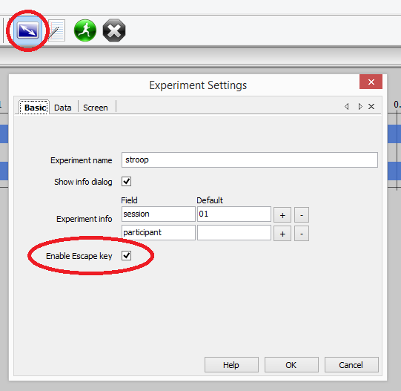
File Preferences (menu option)& Experiment Settings (icon)
Escaping from your experiment
One of the key settings you may want to consider changing!
By default, when running an experiment you can press ESC
This will halt the experiment
And save any data recorded so far.
This can be disabled:
E.g.

Slide 23
General best practices
When lab testing, ensure you test your experiment in there 24 hours before
Label your routines/loops and components clearly
Make regular backups!!
We cannot stress this enough!
Don’t just rely on USB sticks (can be unreliable)
Check your data output and ensure its solid
Make sure you are saving ALL the data you need for your analysis

Slide 24
Where can I get extra help?
PsychoPy:
PsychoPy built-in HELP
Remember, there are separate help sections for Builder and Coder!
PsychoPy website – http://www.psychopy.org/index.html
PsychoPy discourse (Main support forum) - http://discourse.psychopy.org/
Google groups forum (mostly replaced by Discourse site) – https://groups.google.com/forum/#!forum/psychopy-users
Pre-made scripts by us - http://www.kent.ac.uk/psychology/technical/experiments.html
Python:
http://www.python.org/doc/
Google is your friend!
Anything else:
Psychology Technical Team (A1.2 or A1.6)
Check out FAQ handout in the directory (will grow over time)

Slide 25
Bonus exercise (if time) Turn stroop into a Picture based stroop
Simply add images to the stroop trials as a distractor.
First close the old Stroop task if you already have it open.
Open up the picture-stroop folder in your directory
/picture-stroop/images contains 6 images for you to use and link to each of the 6 trials.
Hints:
You will need to enter a “relative” path for each image
E.g. “images/1.jpg” (without the quotes)
Hint - Create a new attribute called “image_path”
That path then needs to be passed to an image component
Remember: when trial data is updated, Excel link needs refreshing.
Attributes are accessed with $ and name of excel header
We will come round and help
If you don’t get chance to finish, have a go at home.

Slide 26
Feedback
Please take a moment to leave any feedback for
future workshops at:
https://goo.gl/lBg0Em

Slide 27
Miscellaneous extras
For info only

Slide 28
More components
Overview of remaining components in brief.
Stimuli:
Sound – Playback of sound
Image – Display of image
Aperture – Add a circular effect onto image component
Grating – Wrapped texture that can be cycled in 2 dimensions
Movie – Playback of movie files
Dots – Presentation of Random Dot Kinematogram to participants
Polygon – Shape presentation of different sides (square, rectangle, octagon)
Responses:
Mouse – Take responses from the mouse
Mic – Only records sound, doesn’t register response to sound
Scale – Mouse friendly scale to choose a value
ioBox, Cedrus – Input options for external hardware devices and button boxes
Other:
Parallel icon – Send signals down a cable (EEG)
Static – A static period to allow for pre-loading images or other operations
More details can be found at http://www.psychopy.org/builder/components.html

Slide 29
Positioning components
Positioning of components within a routine
Stacking order is important!
Refers to order they are drawn
Components rendered at the same time
Those at same position will overlap!
Screen divided by a coordinate system
Other options available too which you can read about here:
http://www.psychopy.org/general/units.html
Y
This would be
X = 0.5
Y = 0.5
1
X
0
-1
0
1
This would be
X = 0.5
Y = -0.5
-1
Screen

Slide 30
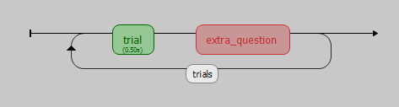
Branching in PsychoPy
Sometimes we may want to skip a particular routine
Maybe the user should only be prompted for a particular
question if they answered previously with a particular answer or you might want to let them have a rest in the middle of a long experiment?
Conditionals in a Code block come in handy for this!
Example:
So how do we bypass this routine based on an answer under “trial”?
See /demos/2-Branching-example for how!

Slide 31
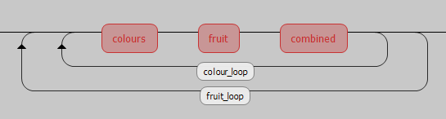
Nested loops and lists
Useful for randomising order of blocks (outer level)
Outer loop
(Starts first)
Inner loop
(Starts second, runs and
Completes each time)

Slide 32
Monitor settings
PsychoPy has concept of a ‘Monitor’
Allows you to:
store information about multiple monitors
keep track of multiple calibrations for the same monitor.
TOOLS | MONITOR CENTER
Means you can:
specify the size and location of stimuli in units that are independent of your particular setup.e.g.
pixels
cm of screen
degrees of visual angle
easy to port programs to different setups as PsychoPy calculate appropriate pixel size for you

