Slide 1
PsychoPy Intermediate
Frank Gasking and John Allen

Slide 2
First of all
Download materials for today
Download the materials from SP850 (zip file)
Or for those not on SP850 from here:
http://www.kent.ac.uk/psychology/technical/part2.zip
REMEMBER! Then unzip by right clicking and selecting “Extract all”.

Slide 3
A quick recap/overview
Quick recap in PsychoPy of:
Routines
Timelines
Basic components
Paths (relative/full) – came up last week
(QUICK DEMO)

Slide 4

Result files revisited!
How do we add extra information to our data output?
1. Start up parameters
By default – prompted at the start for Participant and Session ID
To add your own, click the experiment settings icon
2. Add to Excel data file
You can add a new column in your data file – that is it!
It will appear in your output files automatically.
3. Through embedded Python code
Possible to run complex calculations and store into our data file
Outside the scope of this session, but it is possible!

Slide 5
Positioning components
Positioning of components within a routine
Stacking order is important!
Refers to order they are drawn
Components rendered at the same time
Those at same position will overlap!
Screen divided by a coordinate system
Other options available too which you can read about here:
Visual degree of angles, pixels etc … see:
http://www.psychopy.org/general/units.html
Y
This would be
X = 0.5
Y = 0.5
1
X
0
-1
0
1
This would be
X = 0.5
Y = -0.5
-1
Screen

Slide 6
Exercise 1: Modify ordering and positions
We have given you a sample screen with a bunch of random objects
to play with their ordering/stacking.
Open and run ex1-positions/experiment.psyexp
Press space to finish the demo at any time
Now try and modify the layering order of the objects
Right click the item in the flow and use the move options.
Also try playing with positioning
Try adding some more polygon or image objects if you like.
Get familiar to the stacking and positioning in PsychoPy
We’ll just take approximately 5 minutes for this task.

Slide 7
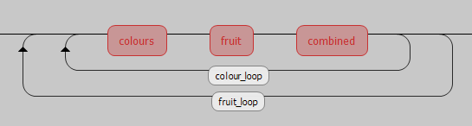
Nesting loops
It is possible to do a loop within a loop
A nested loop in PsychoPy:
Lets look at the example in action…
(DEMO)
Outer loop
(Starts first)
Inner loop
(Starts second, runs and
Completes each time)

Slide 8

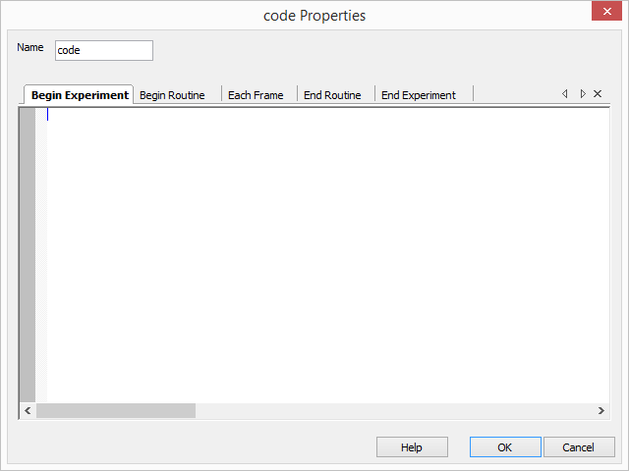
Using Python code in builder
Using builder can occasionally require us to have
to dip into Python code
Often to produce something builder cannot handle.
Limits to what a builder alone can achieve.
We drop in snippets of code using code components

Slide 9
Exercise 2: Using snippets of code in Builder
Close any other PsychoPy windows you have open.
Then open up ex2-code-blocks/experiment.psyexp and spend
5 minutes by doing the following:
Run it first and see what happens – How does it work?
Where are the numbers coming from for the calculation?
Explore the “trial” routine
Click onto the code block called “calculation”
Then the “Begin routine” tab
See how the calculation is being done
What is int() doing, and why do we use it?
How do we then print that calculation in the Text component?
Open up the Text component - what is str() doing?
Remember why “text” is “set every repeat”?
A number of new concepts we have just thrown at you there
- without warning!
Lets cover them briefly and some more!....

Slide 10
Simple data types and variables
Variables are Containers for data
(i.e. “answer” in the previous exercise)
Integer
age = 10
Float
pi = 3.14
Boolean
bilingual = True
or bilingual = 1 (in some languages is valid)
Char
initial = "M" … number = "1"
String
first_name = "John"
phone_number = "+44 01227 888999"

Slide 11
Working with variables
You can change the contents of a variable:
age = 10
age = 15
Can use in calculations, concatenations (joining), loops and more…
age = age + 5
first_name = "Frank"
Full_name = first_name + " Gasking“
Important:
Give variables meaningful names
No spaces in variables (ever!) – use "_" or "–" if you must.

Slide 12
Operators
Math
+, -, *, /, mod
total = number1 * number2
Boolean (Logic)
AND, OR, NOT
Comparison
=, == (equivalence)
=== (exact equivalence)
<>, != (not equivalance)
<, >, <=, >=
BIDMAS/BODMAS
((1+1)+(2+2)) * 2

Slide 13
Conditional statements
Used to help make decisions in your experiment
E.g. if … then … else
Uses data types, variables and operators
if age < 18:
print("Sorry, you’re too young to drink!")
elif age < 100:
print("Have a drink on us!")
else:
print(“Wow, have two drinks on us!")
Question - How do we make decisions in PsychoPy?
Answer - Using code blocks!

Slide 14
Exercise 3: Using conditionals and variables
Close any other PsychoPy windows you have open.
Open up file ex3-conditionals/experiment.psyexp and
spend approximately 5 minutes by doing the following:
Run it and see what happens
How is the correct gender-based Excel data file read in?
Look at the “setup” code block under routine “start”
Go to the “Begin Experiment” tab
Read the comments (in green/red) and see what is happening.
How does it work out which data file to use?
How are we then using that data file reference?
Where is “gender” set and how to we create new prompts?
Click onto this icon and take a look
Try and add “Colour” as a new option

Slide 15
Functions
A “container” of reusable code that does “something”
Defined under a given name
Benefits:
Write once, use many times
Reduces redundancy and repetition
Declutters your program
Only runs when called
Variables (which we just looked at) can be passed to a function
Also called “parameters”
Functions always give back something
A value of some kind, depending what the purpose of the function is.
int() and str() are Python functions!
They take a value
They give back either an integer or string value

Slide 16
Exercise 4: Adding functions to your experiment
Close any other PsychoPy windows you have open.
Open ex4-import-code/experiment.psyexp and
spend approximately next 5 minutes by doing the following:
Run experiment to check what happens
Select the “intro” routine and then click on the “code” component, and then “begin experiment” tab
Read the comments in green/red.
Notice the month_funcs.py file in same directory.
Try opening the file in Notepad++ (Windows search for it) and see what it contains.
Select “my_function_test” routine, then click on the “text_3” component and observe what is in the Text box
getRandomMonthID() will fetch a number from between 0 and 11
getMonth() takes a number from between 0 and 11 and gives
back a text month
“$” is used to tell PsychoPy that we are about to run a small snippet of Python code

Slide 17
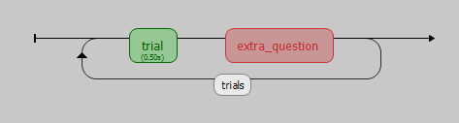
Branching in PsychoPy
Sometimes we may want to skip a particular routine
Maybe the user should only be prompted for a particular
question if they answered previously with a particular answer?
Conditionals in a Code block come in handy for this!
Example:
So how do we bypass this routine based on an answer under “trial”?
Time for a quick demo… demos/3-Branching-example/experiment.psyexp

Slide 18
Creating user breaks
It is good to ensure the user gets a break.
Especially if you have something like 200 trials!
Method is very similar to “Branching” like before
One last demo… demos/4-Break-demo/experiment.psyexp

Slide 19
Error messages / debugging
Fixing errors can be tricky, especially when its with an unfamiliar
system, or someone else’s experiment!
Here are some tips if you encounter any issues:
Read the error message carefully
Look for references to line numbers which indicate the line at fault
Be wary of case sensitivity: Python is very particular
e.g. “if” (not “If”)
Check the experiment .log file under /data for any extra hints
Google the exact error message as a starting point
Check the online help/manuals
Check forums/communities for similar problems

Slide 20
General best practices
Test experiment in actual lab at least 24 hours before
Label your routines/loops and components clearly
Good naming convention (variables,routines,loops)
Be careful of using RESERVED WORDS
i.e. Don’t use a variable name with the same name as a routine!
e.g. “image”
Make regular backups!!
Don’t just rely on USB sticks (can be unreliable)
Check your data output and ensure it’s solid
Make sure you are getting the data you need to later analyse
Basically do some quick analysis early to make sure!

Slide 21
Where can I get extra help?
PsychoPy:
PsychoPy built-in HELP
Remember, there are separate help sections for Builder and Coder!
PsychoPy website – http://www.psychopy.org/index.html
PsychoPy discourse (Main support forum) - http://discourse.psychopy.org/
Google groups forum (mostly replaced by Discourse site) – https://groups.google.com/forum/#!forum/psychopy-users
Pre-made scripts by us - http://www.kent.ac.uk/psychology/technical/experiments.html
Python:
http://www.python.org/doc/
Google is your friend!
Check out FAQ handout in the directory

Slide 22
Final exercise: Create an experiment
For the rest of the lesson we have given an experiment specification handout.
See (or via print out):
ex5-image-ratings/Exercise-docs.docx
We are going to let you build a complete experiment from this,
with deliberately vague instructions to test what you have learnt
so far.
Follow the instructions and we will come round and help and
periodically demonstrate on the main screen. If you don’t manage
to start or finish, then try having a go at home!
We will upload the solution onto Moodle later on.

Slide 23
Feedback
Please take a moment to leave any feedback for
future workshops at:
https://goo.gl/lBg0Em
Contact details:
Email: psychsupport@kent.ac.uk
Offices: A1.2 (John), A1.5 (Frank)

Slide 24
Additional reading
Book + Additional slides of interest.

Slide 25
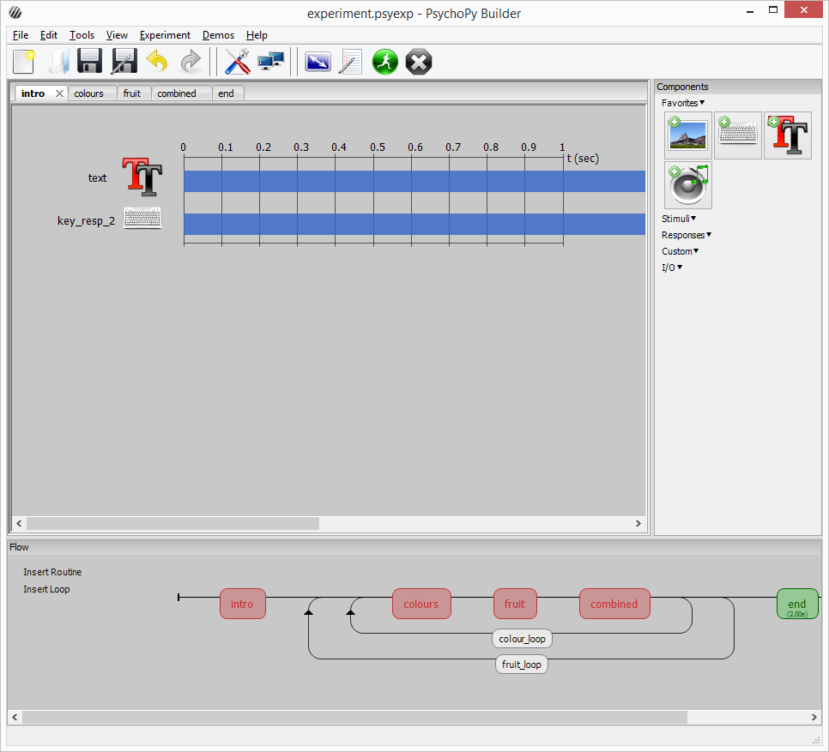
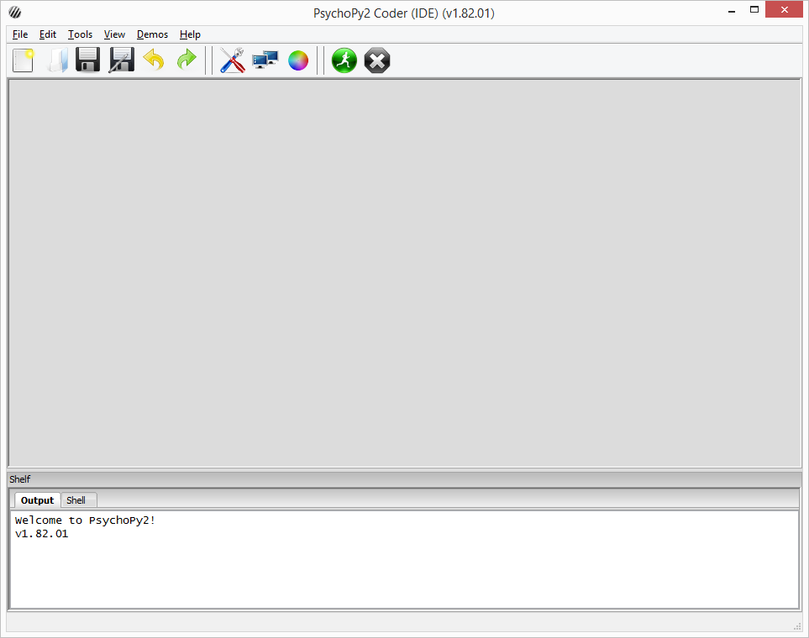
Using Coder instead of Builder
Writing pure Python code using PsychoPy library
Too advanced to cover in detail on this course
Unlikely you will ever need to use it
Sometimes we do if an experiment is outside scope of builder
See the Card Game demo in the demo folder as an example of
what can be achieved.
Builder view
Coder view

Slide 26
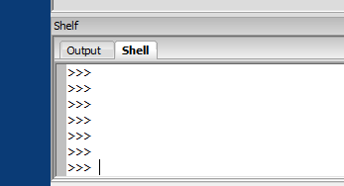
Testing simple Python code
You can also test bits of Python code via the “Shell” tab
In the coder view…
Demo
firstname = "John"
firstname.upper()
firstname.lower()

Slide 27
Monitor settings
PsychoPy has concept of a ‘Monitor’
Allows you to:
store information about multiple monitors
keep track of multiple calibrations for the same monitor.
TOOLS | MONITOR CENTER
Means you can:
specify the size and location of stimuli in units that are independent of your particular setup.e.g.
pixels
cm of screen
degrees of visual angle
easy to port programs to different setups as PsychoPy calculate appropriate pixel size for you

