Slide 1
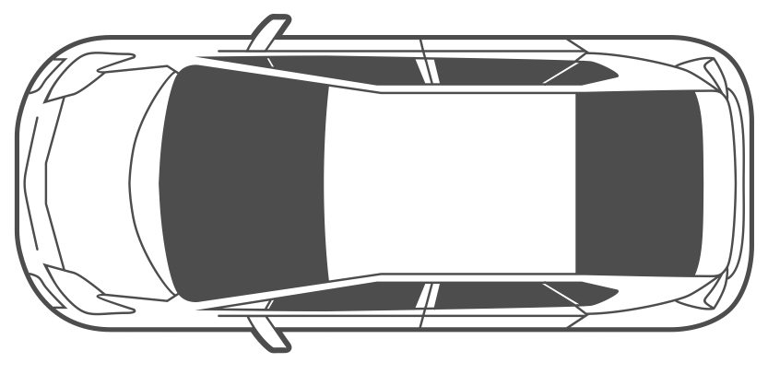
Charging Bay 1
Charging Bay 2
Charging Bay N
EV Charging Station
EV Charging Station
EV Charging Station
Wind Turbine Generator
…
AC/DC
…
Solar PV (MPPT)
DC/DC
Battery Swapping Station
Battery Swapping Station
…
Battery Swapping Station
Grid
Inverter
…
…
…
DB
DB
DB
Auxiliary Loads
…
…
…
FB
FB
FB
Bidirectional DC/DC
Battery Storage
Battery Storage
Battery Storage
DC-Bus
…
Charging System
BESS 1
BESS 2
BESS N

