Slide 1
rater1
rater2
(…)
3MonthsEasy
(…)
12MonthsEasy
12MonthsNormal
3MonthsEasy
12MonthsEasy
12MonthsNormal
Articulation
Dynamics
Rhythm
Fluency
Pitch
Expressivity
Articulation
Dynamics
Rhythm
Fluency
Pitch
Expressivity
Articulation
Dynamics
Rhythm
Fluency
Pitch
Expressivity
Articulation
Dynamics
Rhythm
Fluency
Pitch
Expressivity
Articulation
Dynamics
Rhythm
Fluency
Pitch
Expressivity
Articulation
Dynamics
Rhythm
Fluency
Pitch
Expressivity
(…)
Subject no. 1, subject no. 2, (…)
Notes:
how to rate musical improvement or performance objectivity?
scale from 1 to 7 (one being bad, 7 being perfect)
184 recordings plus 30 randomly chosen again to check intrareliability
rater checked for reliability using ICC
have 7 rater at the moment, waiting for 2 to finish their ratings - in total 9, we need more?
obviously hierarchical r

Slide 2
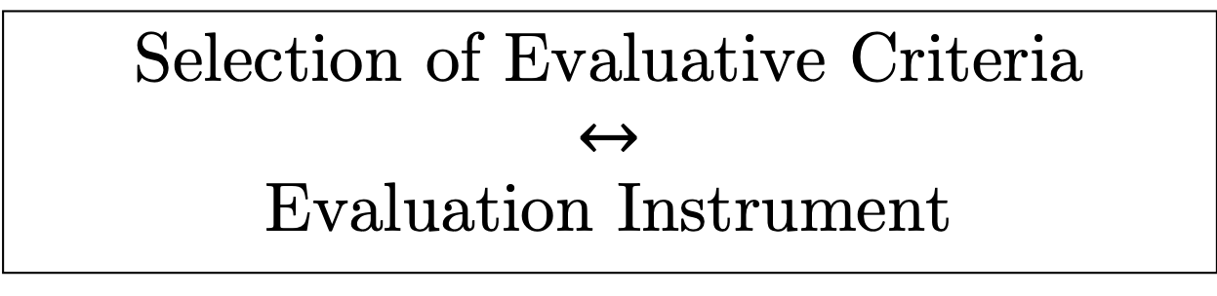
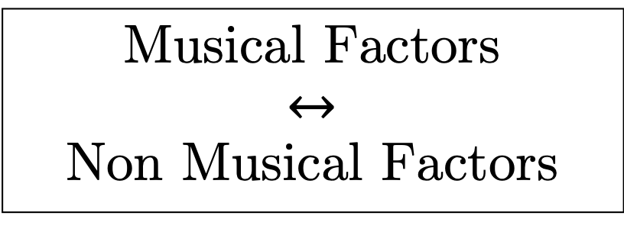
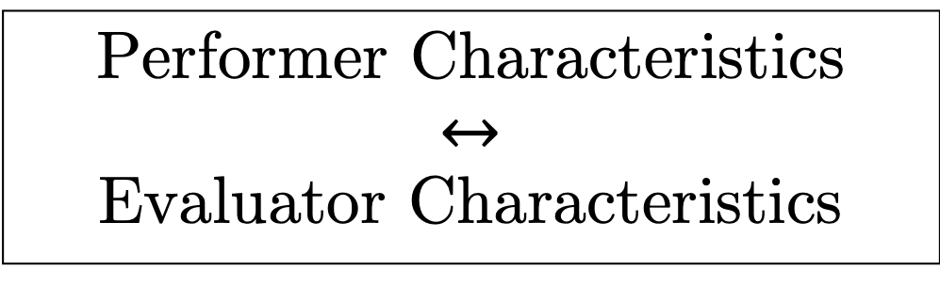
Performance Context
Musical Factors
$$↔$$
Non Musical Factors
The Musical Performance
Purpose of Assessment
Selection of Evaluative Criteria
$↔$
Evaluation Instrument
Performer Characteristics
$$↔$$
Evaluator Characteristics
Evaluation Process
Final Assessment
Data Analysis
Use of Result
Feedback (to Performer)

Slide 3
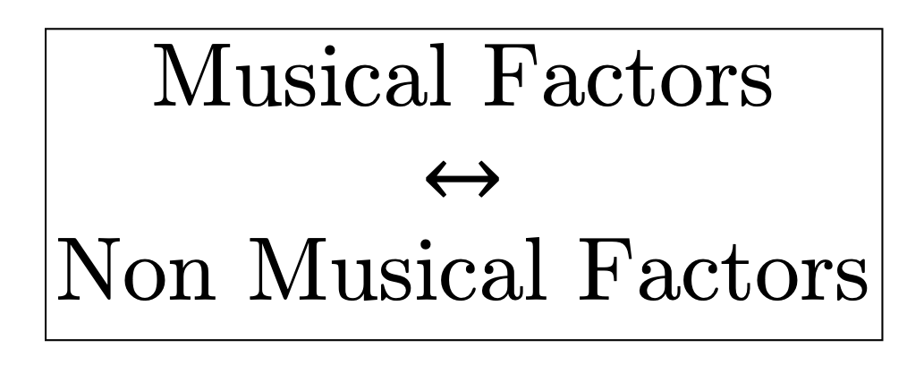
The Musical Performance
Musical Factors
$$↔$$
Non Musical Factors
Performer Characteristics

Slide 4
Difficult 0 time 0
Expressivity
0.848
Fluency
0.843
Rhythm
0.837
Musicality
Pitch
0.766
0.688
Articulation
0.602
Dynamics

Slide 5
Difficult 0 time 1
Expressivity
0.76
Fluency
0.83
Rhythm
0.86
Musicality
Pitch
0.67
0.70
Articulation
0.77
Dynamics

Slide 6
Difficult 1 time 1
Expressivity
0.82
Fluency
0.92
Rhythm
0.88
Musicality
Pitch
0.71
0.75
Articulation
0.73
Dynamics

Slide 7
FA_{0,0}
FA_{1,0}
FA_{1,1}
Expressivity
0.848
0.86
0.92
Fluency
0.843
0.83
0.88
Rhythm
0.837
0.77
0.82
Musicality
Pitch
0.766
0.76
0.75
Articulation
0.688
0.70
0.73
Dynamics
0.602
0.67
0.71

Slide 8
 | technical |  |  |  |  |  | musical
 | Articulation | Intonation | Rhythmic accuracy/continuity | Pitch/Note accuracy | Tone quality | Technique | Tempo | Dynamics | Interpretation/Musical Expression | Timbre | Overall quality | Phrasing | Form
Alessandri et al (2016) | x |  | x |  |  | x | x | x | x |  |  | x
Russell (2010) | x | x | x |  | x | x |  | x | x | x
Duerkson (1972) |  |  | x | x | x |  | x | x | x |  | x | x
Abeles (1973) | x | x | x |  | x |  | x |  | x
Kelly (1955) | x |  | x |  | x | x | x | x | x |  |  | x | x
Saunders (1993) | x | x |  | x | x |  | x |  | x
Bergee (1988) |  | x | x |  | x |  | x |  | x
Mills (1991) |  |  | x | x |  | x | x | x |  |  | x | x
Schuber & Fabian (2010) | x |  | x |  |  | x | x | x | x | x |  | x | x
ABRSM | x | x | x | x | x |  |  |  | x |  |  |  | x
Lerch et al. (2021) | x | x | x | x |  |  | x | x |  | x

Slide 9
Higher scores, baseline
More improvement
Higher scores, after invention
Geneva
Hannover
higher income
Higher CogTel
Higher CogTel
More Cogntive Reserve
less Cogntive Reserve
More Cogntive Reserve
younger
younger
More homework
More homework
male
Low perceptual abilities
high perceptual abilities
Low musical engagement
high musical emotions
Low musical emotions
Low singing abilities
Low general sophistication
high general sophistication
Low musical training

