Slide 1
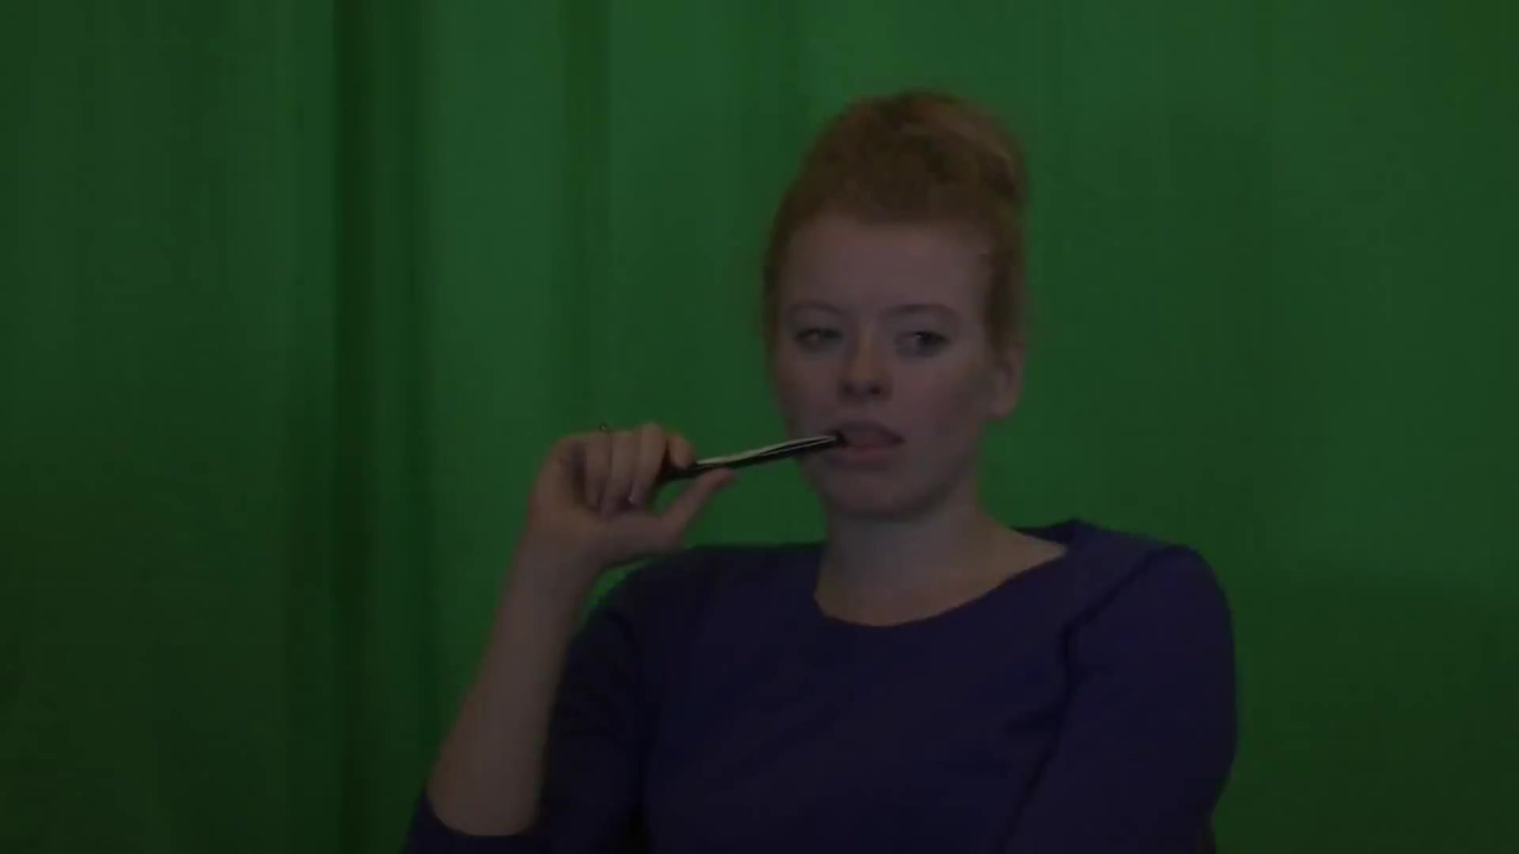
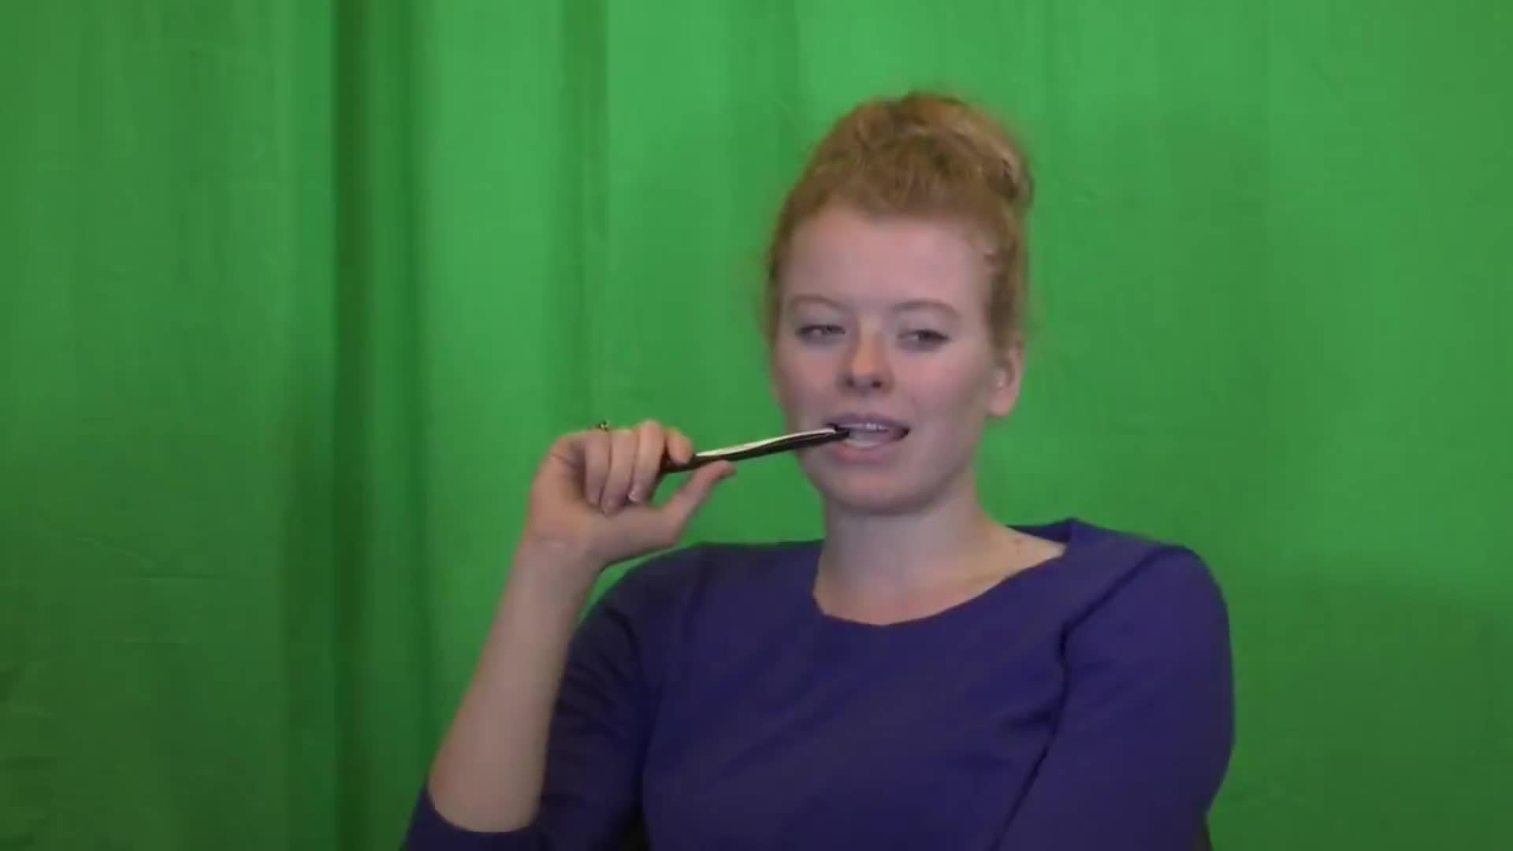
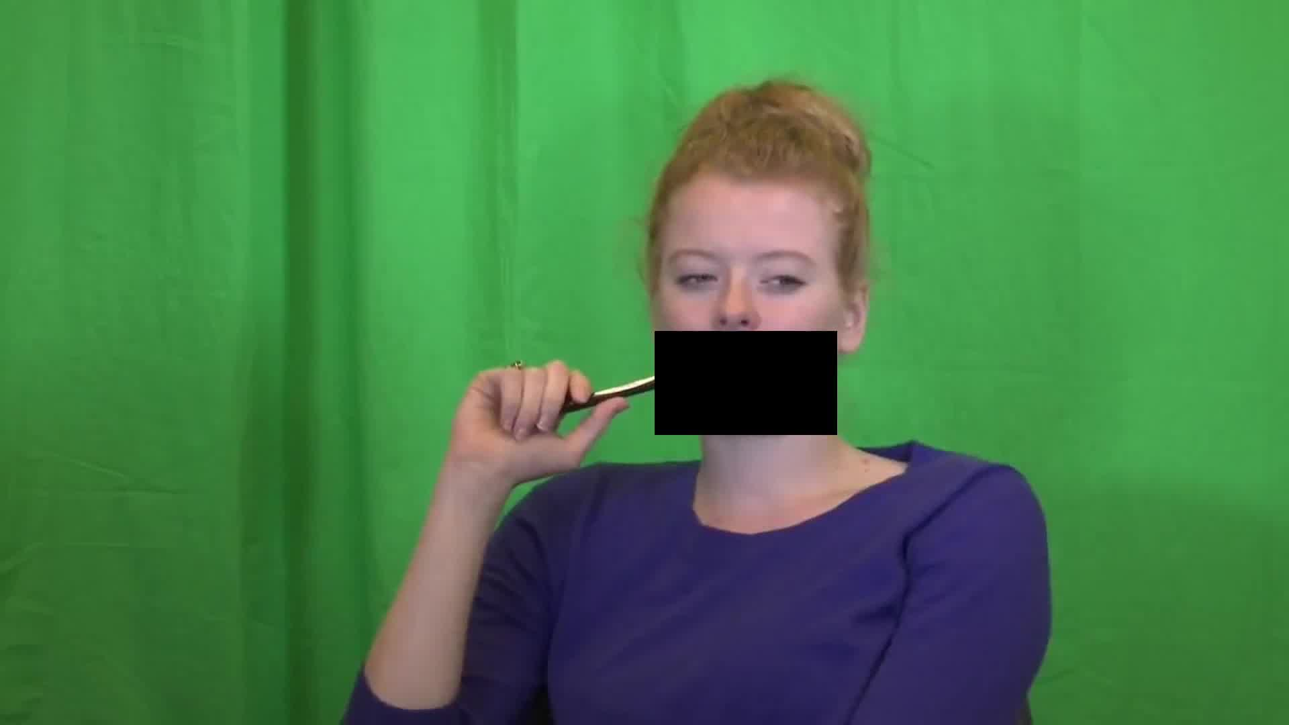



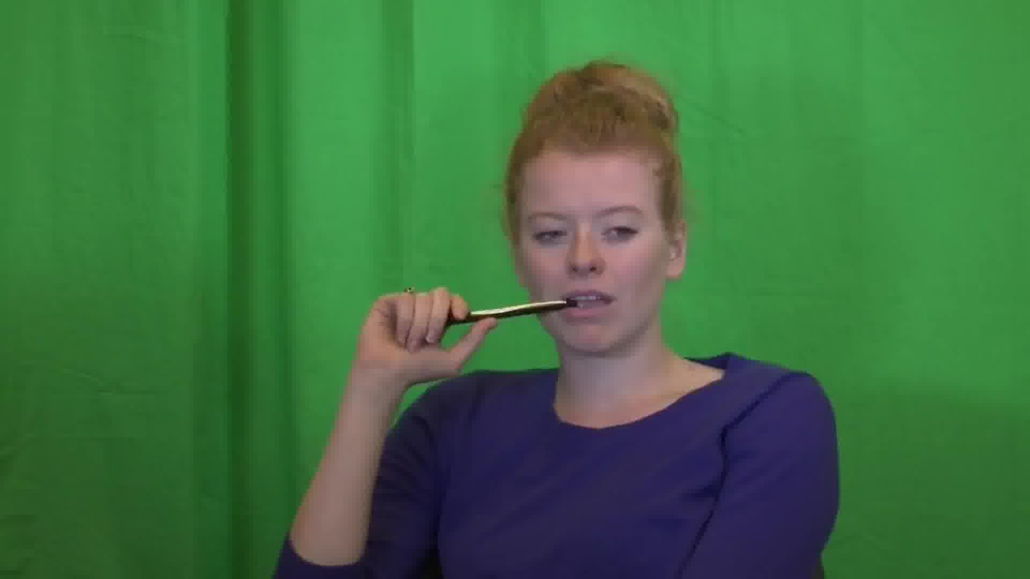
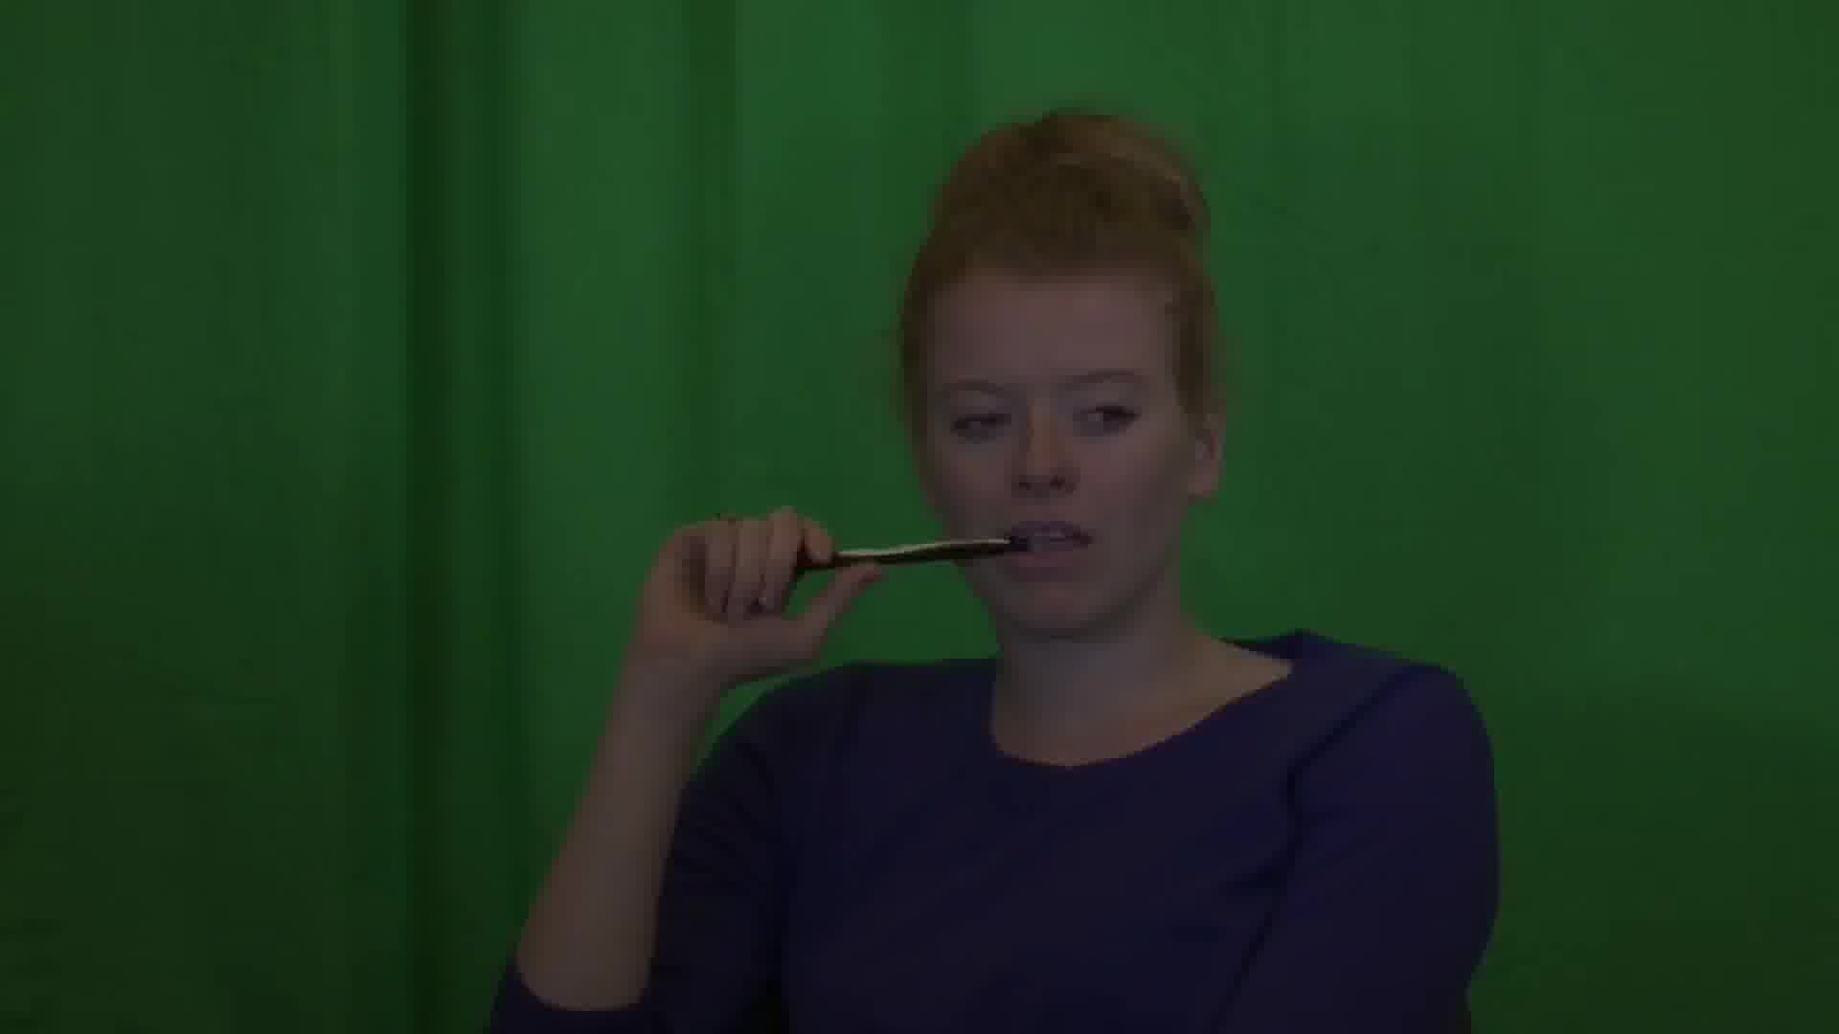
/a/
/s ? ʃ/
/i/

Slide 2
Pen visible in mouth after word offset
Pen visible in mouth at video onset
Articulators occluded through entire fricative production
/a/
/s ? ʃ/
/i/
Audio duration 750 ms
Full video duration

