Slide 1
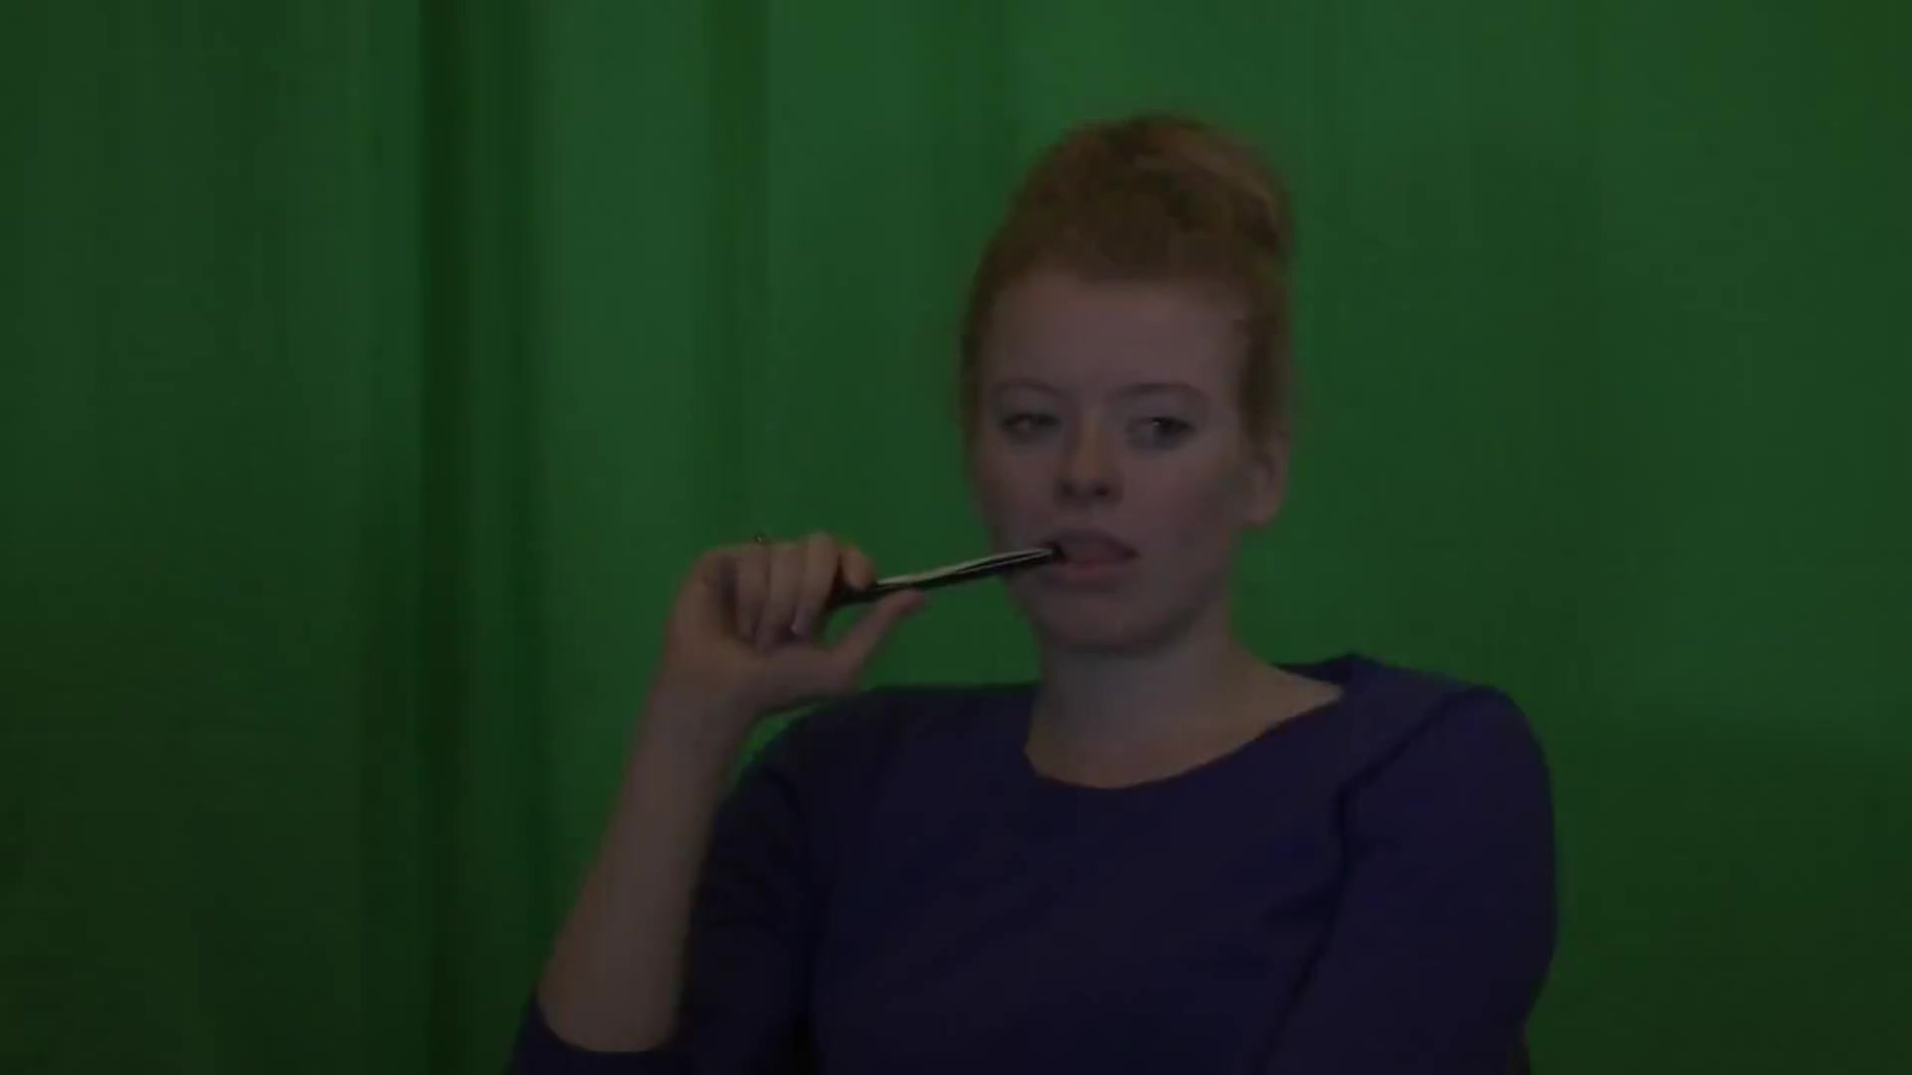
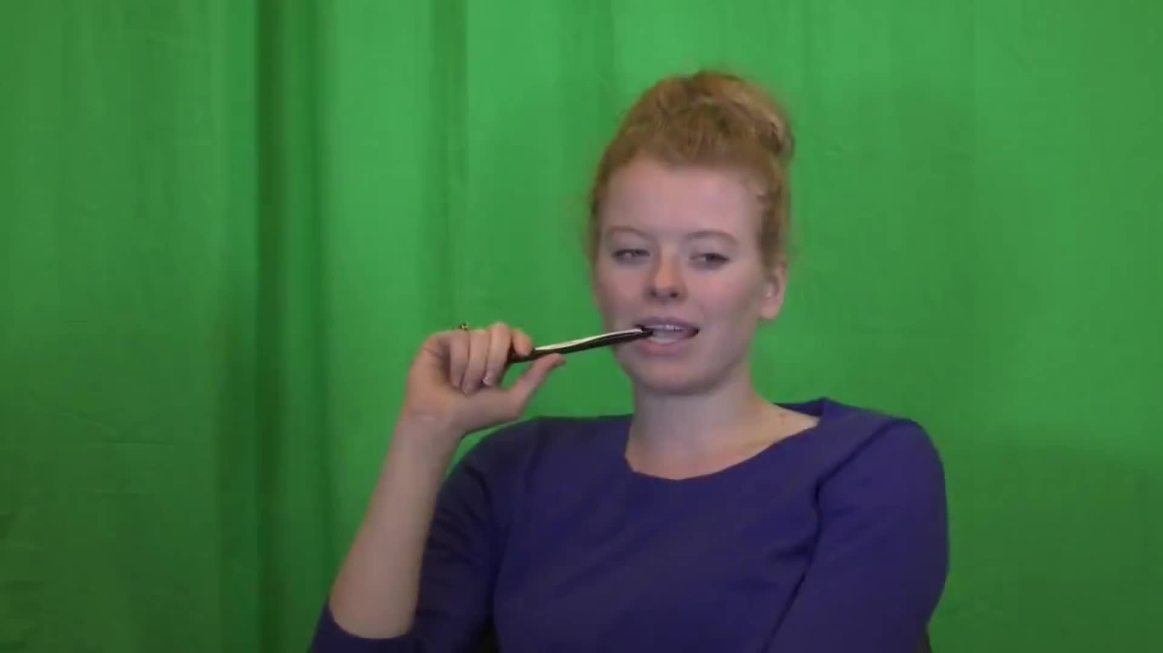
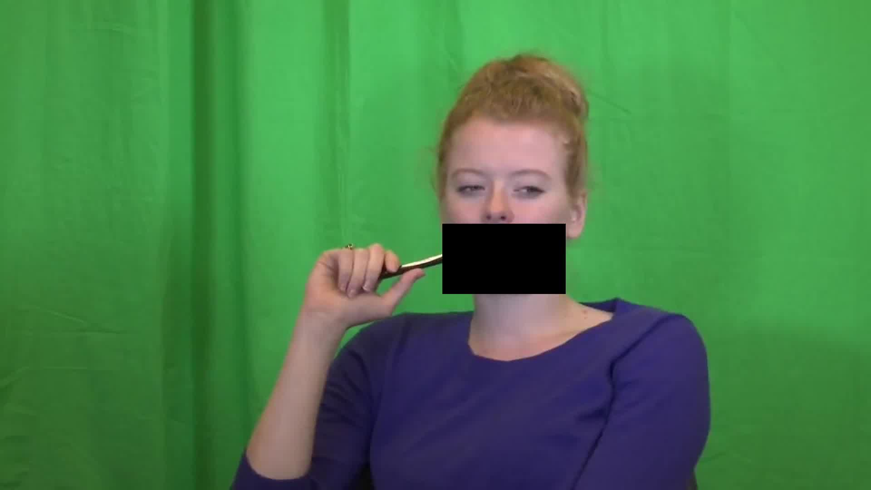

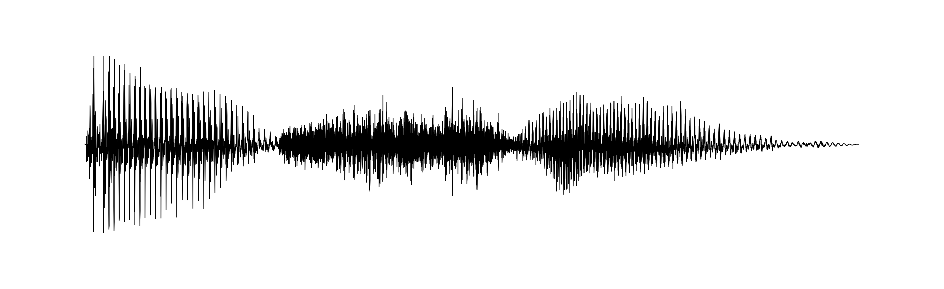

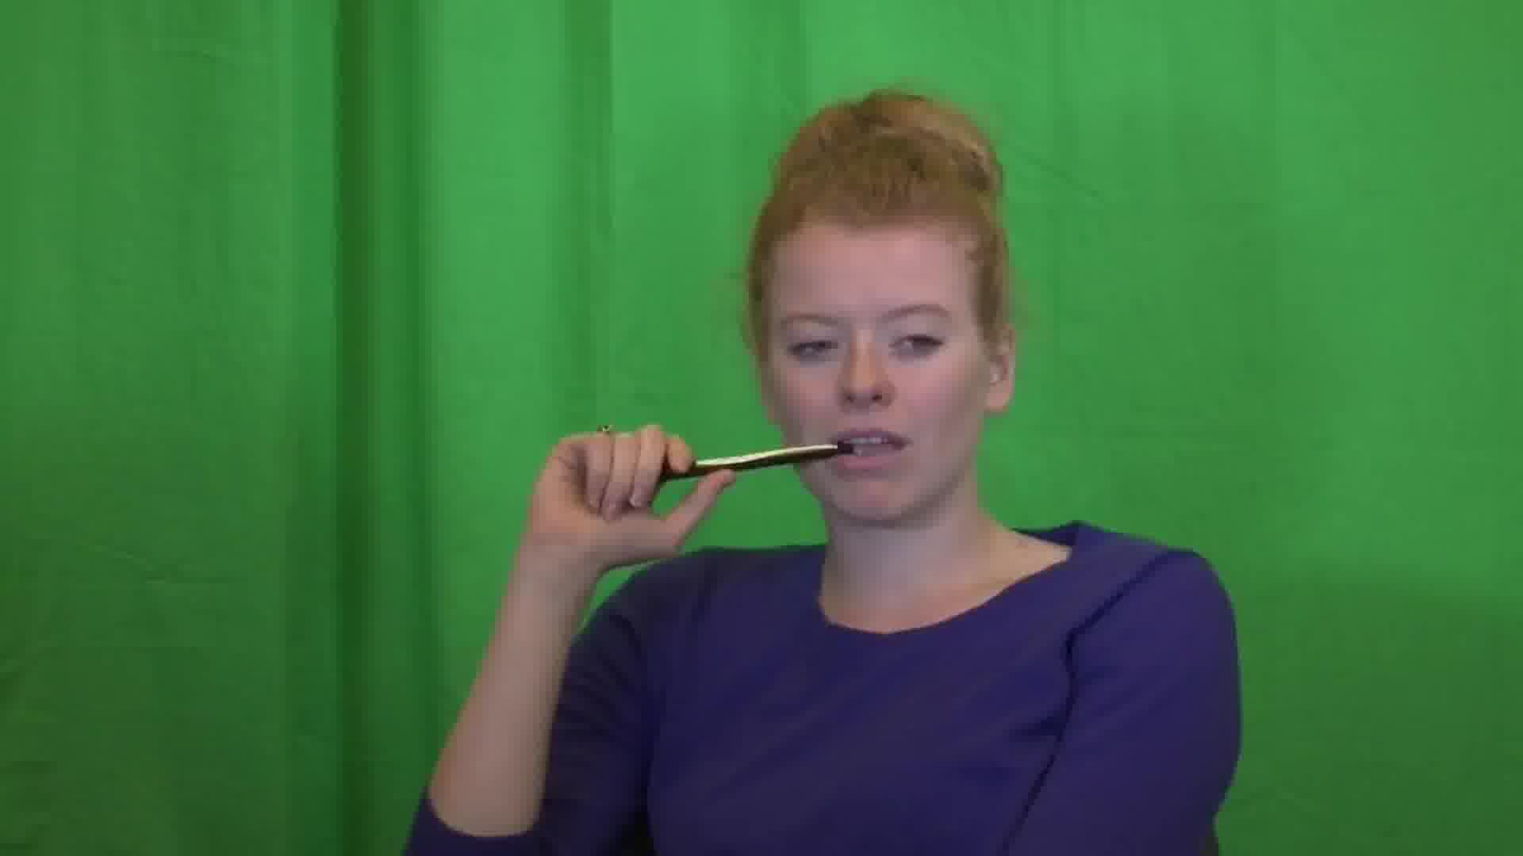
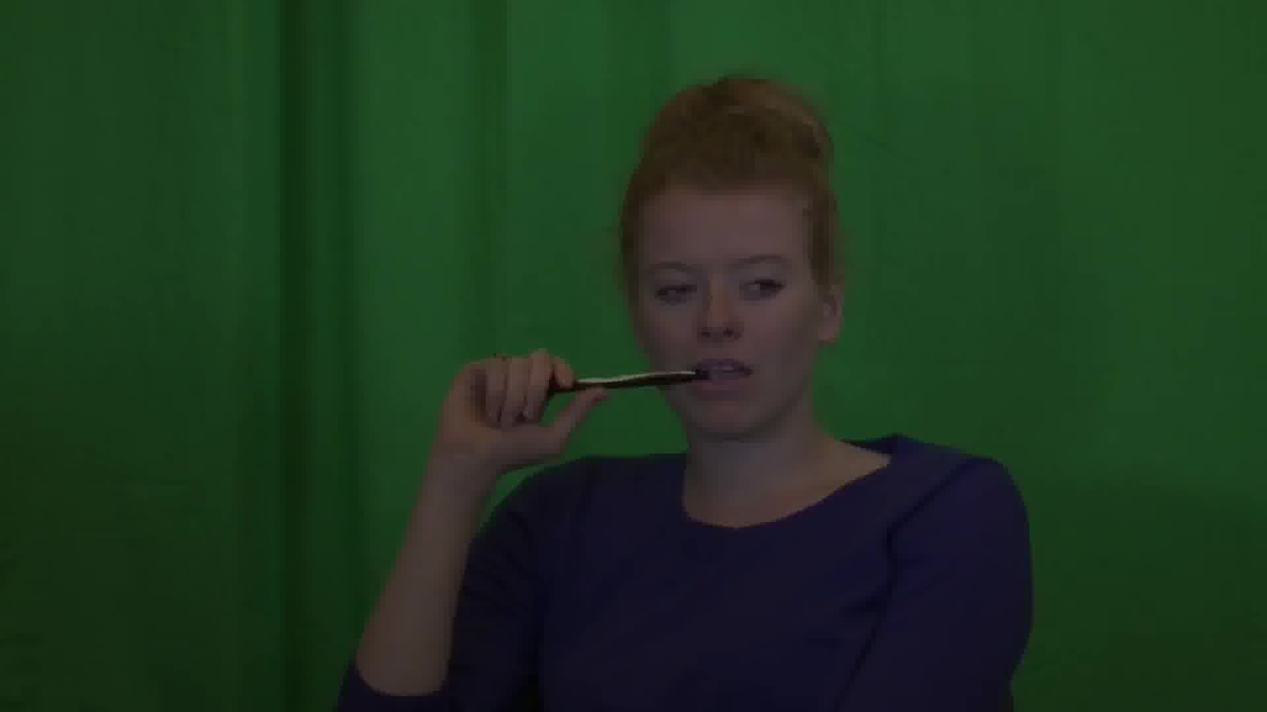
/a/
/s ? ʃ/
/i/

Slide 2
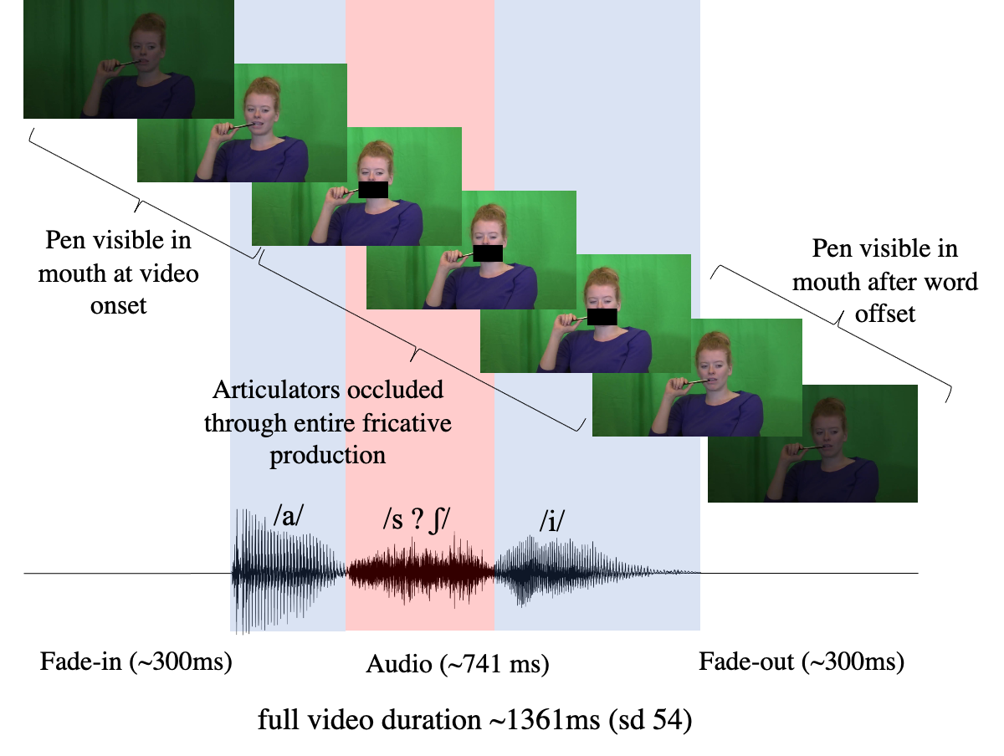
Pen visible in mouth at video onset
Pen visible in mouth after word offset
Articulators occluded through entire fricative production
/a/
/s ? ʃ/
/i/
Fade-in (~300ms)
Audio (~741 ms)
Fade-out (~300ms)
full video duration ~1361ms (sd 54)

