Slide 2
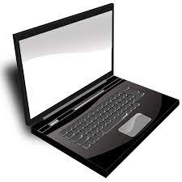








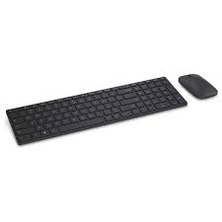
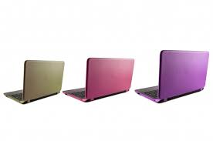

Experimenter’s computer
Create HITs that point to URL on webserver
Download worker’s responses from completed HITs
during/after experiment
Store worker’s responses in MTurk HTML form fields
Upload experiment
HTML, Javascript, stimuli, etc. (e.g., via scp)
Browse & accept HITs
Embed experiment in MTurk frame with HTML form fields.
Display HITs & create HIT assignments
Serve experiment & collect worker’s responses
Complete experiment
Webserver with experiment
MTurk workers

