Slide 1
Social Media: Friend or Foe?
Kallayah Henderson, Hannah Rittenhouse, Camden Carter, Avery Hinchman, Lily Bodolay and Mason Layfield

Slide 2
Research Problem + Significance
Research Problem: The decreasing quality of face-to-face interactions amongst FSU Undergraduate students, as a result of social media use and how this impacts the mental well-being of students.
Significance:
Students acquiring the ability to communicate and build relationships effectively will benefit them as they look for work in the future and continue to create a healthy lifestyle for themselves.
this research benefits the Florida State University Health Services by giving them information regarding the effects of technology and social media on the mental and emotional wellbeing of young adults.
It could potentially help social media companies better understand why this demographic of users like or do not like to use social media platforms, this can help improve their platforms

Slide 3
Research Questions
RQ1: Do FSU undergraduates believe that social media has negatively impacted their ability to communicate in a physical environment? How? Why?
RQ2: Do students think the use of social media has personally impacted them in non-social aspects of life (Physical/Mental Health, etc.)? How?
RQ3: With the knowledge of the negative impact that heavy social media use has, will FSU undergraduates change their communication habits and or social media use?

Slide 4
Data Collection Methods
FSU Qualtrics Survey was distributed to 103 Florida State University Undergraduate students
Mixture of open and close-ended questions
It was distributed via email, text and social media post

Slide 5
Research population, sample + sampling techniques
Target population: Current FSU Undergraduate students from any major
Sample: 103 current FSU Undergraduate students from various majors(IT, ICT, Biology, Political Science, etc.)
Sampling Techniques: Voluntary Sampling(Facebook post, group chat posts with link of survey) and Convenience Sampling(email link of survey to professors from different courses in CCI)

Slide 6
Recruitment strategy + process
We posted the survey in respective groups that each researcher had access to. We did this for about three weeks to collect data. Every survey was distributed virtually to current FSU students.

Slide 7
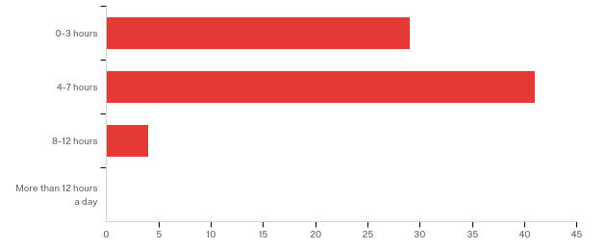
Findings RQ1
Daily usage of social media for undergraduate students. Through our survey questions, we found that 32 participants (38%) use social media 0-3 hours per day. One respondent used it for more than 12 hours a day, while slightly more than 5% used their social media 8-12 hours a day. However, a much larger number of participants, 46 (54%) indicated that they use social media for 4-7 hours every day.
Figure 1. How much time FSU undergraduate sample spent on social media per day

Slide 8
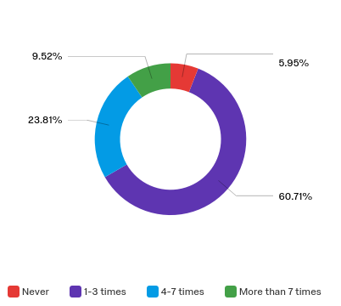
Findings RQ1
Face-to-face communication. Delving deeper into FSU students’ use of social media in the presence of others, we found that 51 participants (60%) used social media 1-3 per week instead of interacting with family and friends. Additionally, 20 participants (23%) used social media 4-7 times per week when they could have been interacting with family and friends in person, and only 4 participants (5%) stated they do not use social media when in the presence of family and friends.
Figure 2. use of social media per week when in the presence of friends/family

Slide 9
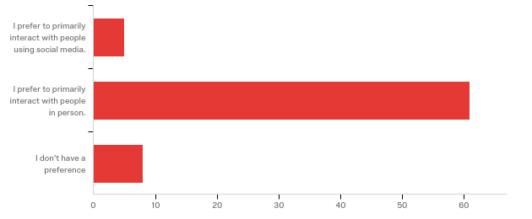
Findings RQ1
Figure 3. Primary interaction medium
When asked if they prefer communicating in person or via social media majority, 67 (79%), of the students preferred face-to-face communication. 10 people (11%) responded that they had no preference. Figure 4 shows the visual results of this specific revelation.

Slide 10
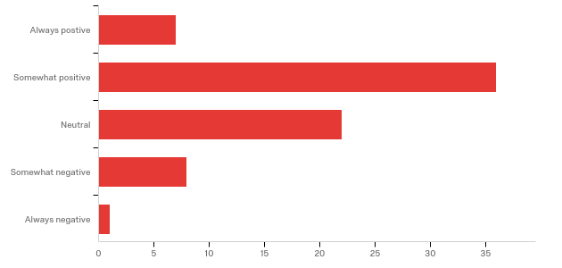
Findings RQ1
Figure 4. Attitude towards social media use to communicate
Perceived emotions in response to social media. Students had a rather positive outlook when evaluating their attitude towards social media as a communication medium. 41 students (48%) responded that they had a “somewhat positive” attitude for using social media to communicate with others. The other majority, 25 students (29%), had an indifferent response in regards to their attitude about using social media in this way.

Slide 11
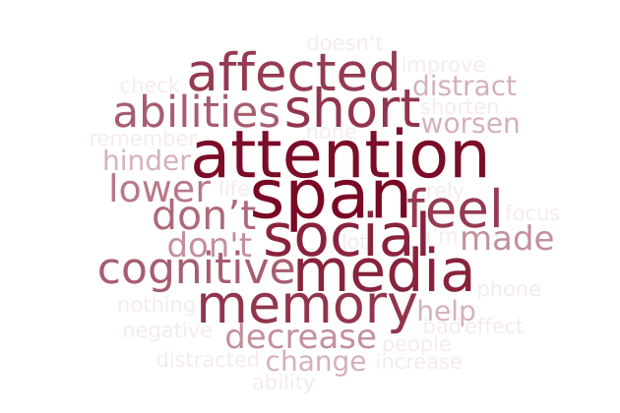
Findings RQ2
Figure 5. Word cloud demonstrating common words used to describe relationship between social media and mental health
Student’s correlation between time spent using social media and mental health. When students were asked how they think their social media use affects their cognitive abilities, half or 50% of the students responded with negative response, alluding to having a shorter attention span and being more easily distracted out of a sample size of 40. 40% of students responded positively, claiming that social media does not negatively affect their cognitive abilities, while the remaining percentage claimed to have neither positive nor negative effects. The word cloud represented by Figure 5 shows the top 40 words used by students when asked if they think that social media has any effects on their cognitive abilities.

Slide 12
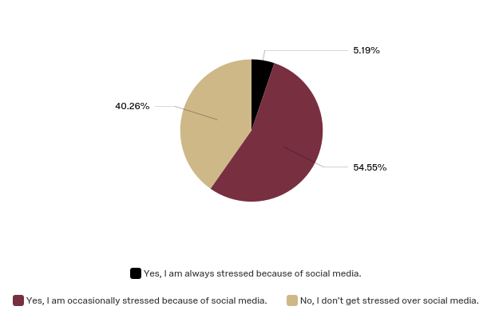
Findings RQ2
Student’s correlation between social media and whether or not it causes them stress
When students were asked whether or not social media has caused stressed the majority of students, 54.55%, responded by saying that, yes, social media does occasionally leave the student feeling stressed out, (Figure 6). Also, there was a small chunk of students, 5.19%, responded, saying yes, social media always leaves them stressed. This shows about 6 in every 10 students are stressed when it comes to social media.
Figure 6. Students responses to which they believe if social media causes them stress

Slide 13
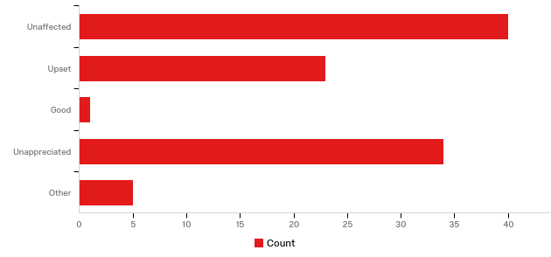
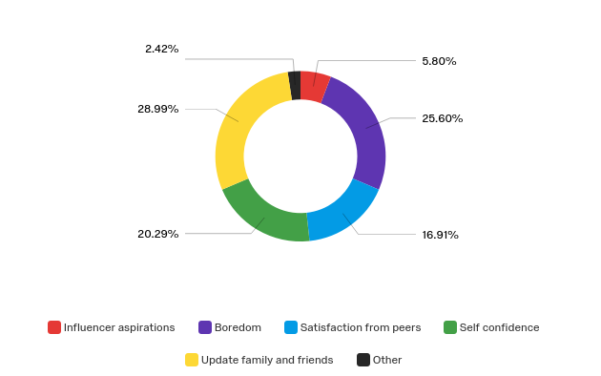
Findings RQ2
Figure 7. Student responses to emotions felt when a post does not get the attention they expected
Do FSU undergraduate students think the time they spend using social media affects their self-esteem?
Looking deeper into the mental effects that social media has had on FSU undergraduates, 53% of students reported that they felt upset or underappreciated when one of their social media posts didn’t receive the recognition that they expected (Figure 7). Additionally, 43% of students reported that their main purpose for posting on social media was “self confidence”, “satisfaction from peers”, or “influencer aspirations.” These two statistics When students were asked whether or not social media ~40% of students surveyed reported that “Self Confidence” or “Satisfaction from peers” was their purpose for posting on social media.
Figure 8. Student purposes for posting on social media

Slide 14
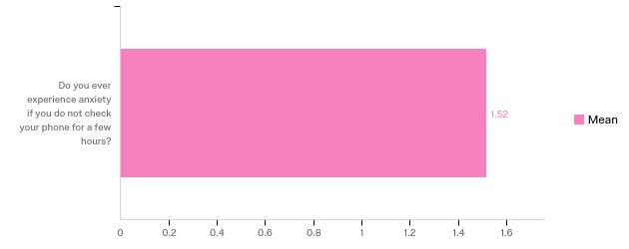
Findings RQ2
Figure 9. Student sample mean for students response to feeling anxious when they haven’t checked their phone for a few hours

Slide 15
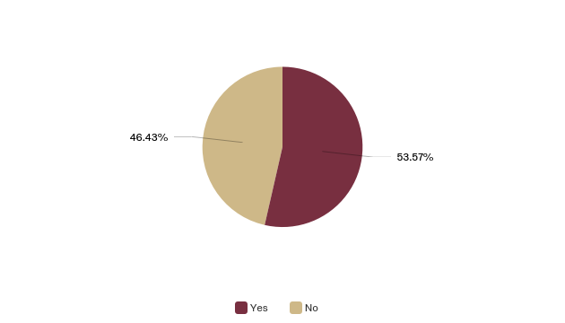
Findings RQ2
Relationship between time spent using social media helping or hindering healthy lifestyle.
Based off of the responses from students, there is a slight majority of them, 53.57%, are in agreeance that the quick availability of social media has hindered the attitude towards in person communication, (Figure 10). In other words, because of social media, the majority of students think that it has affected the in person communication.
Figure 10. Student responses when asked if social media hinders their attitude towards in person communication.

Slide 16
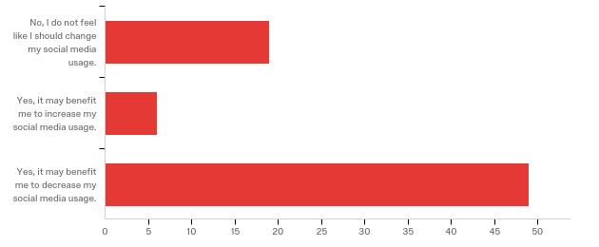
Findings RQ3
Change in social media tendencies
Students were asked whether or not they feel like they would benefit from a decreased use of social media, the results showed that 49 (66%) felt that they would in fact benefit from a decrease. While only 19 (25%) students felt that they did not feel a need to change their social media usage.
Figure 11..Change in social media tendencies

Slide 17
Limitations + Future Plans
The two major limitations of our study were in getting our sample population to take our survey, and in gathering accurate responses from those who did. Out of the thousands of FSU undergraduates, we only managed to gather responses from slightly over 100 of them. Additionally, of these 100 responses, at least one-fifth of them did not respond to every question on the survey.
In the future, we could seek out a larger platform to distribute our survey on. Finding somebody with a large audience, such as a professor or the Dean, to distribute our survey would make our results more accurate and representative.

Slide 18
Conclusion from research
Overall, students do believe that social media is having a negative effect on both their mental health and in-person communication skills.
Regardless of its negative effects, a majority of the students surveyed still believe that social media is an effective medium for general communication.
Despite being aware of the negative effects, we found that the average student still uses social media anywhere from 4-7 hours per day.

