Slide 1
openPASS
User Guide for the Doxygen Framework

Slide 2
most relevant for each “newbie”
information already at least partly available
Getting started
Where to get Information?
Where to get the sources?
How to build the application?
User Guide
Covered Use cases
How to use the application
Application output
Architecture Description
Structure of the application?
Description of Framework elements
Description of the Modules
Source Code Description
Description of classes
Description of attributes
Description of functions
Appendix
Wording / Global Definitions
most relevant for each user
divided in two Parts: General/Use Case specific
most relevant for SC/AC
already at least partly available
most relevant for developer
already at least partly available
most relevant for every user/member
information already at least partly available

Slide 3
Preparation
System Requirements
Windows 7/8/10
Software Installation
Doxygen v1.8.9.1 or later
http://www.doxygen.nl/download.html
Graphviz v2.38 or later
https://graphviz.gitlab.io/download/
HTML Help Workshop
https://www.microsoft.com/en-us/download/details.aspx?id=21138

Slide 4



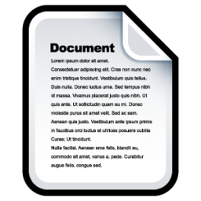
Documentation Concept
Docs generation using DoxyGen
Doxygen configurations
Support inclusion of other .doxy files
.doxy file
input
call
output
.bat Win batch file
DoxyGen
(with Graphviz)
.chm docs
Make sure to have the following configurations in .doxy file
DOT_PATH = "C:/Program Files (x86)/Graphviz2.38/bin"
HAVE_DOT = YES
HHC_LOCATION = "C:/Program Files (x86)/HTML Help Workshop/hhc.exe"
@INCLUDE = common_content

Slide 5
Documentation Concept
Docs generated by DoxyGen
 | Developer | Function
Open Source | Class definitions of open source code | Behavior of open source code
Proprietary | Class definitions of open source and proprietary code | Behavior of open source and proprietary code

Slide 6
Documentation Concept
Developer Doc Template
/**
* \addtogroup Components_PCM openPASS components pcm
* @{
* \addtogroup Init_Agent
*
* \brief Init Component to provide parameters.
*
* \details This component provides parameter of the agent.
*
* @}
*/
/*!
* \copydoc Init_Agent
* \ingroup Init_Agent
*/
class Init_Agent_Implementation : public InitInterface
{
public:
...
/*!
* \brief Update Inputs
*
* Function is called by framework.
*
* Refer to module description for input channels and input ids.
*
* @param[in] localLinkId Corresponds to "id" of "ComponentInput"
* @param[in] data Referenced signal (copied by sending component)
* @param[in] time Current scheduling time
*/
virtual void UpdateInput(int localLinkId, const std::shared_ptr<SignalInterface const> &data, int time);
...
}

Slide 7
Documentation Concept
Function Doc Template
/**
* @defgroup module_tt Two-track vehicle model
* The dynamics of the vehicle is modelled in 2 dimensions */
/** @addtogroup module_tt
* Abbreviations
*/
/**
* @ingroup module_tt
* @defgroup init_tt Initialization
*/
Dynamics_TwoTrack_Implementation::Dynamics_TwoTrack_Implementation(...)
{
/** @addtogroup init_tt
*/
vehicle->InitSetEngine();
/** @addtogroup init_tt
* Define vehicle's geometry
*/
vehicle->InitSetGeometry();
/** @addtogroup init_tt
* Define vehicle's tire properties
*/
vehicle->InitSetTire();
}

Slide 8
Developer vs. Function Documentation
Commonalities in .doxy
Config | Value | Meaning
EXTRACT_PACKAGE | NO | not all members with package or internal scope are included
HIDE_UNDOC_CLASSES | NO | do no hide all undocumented classes
INPUT | /Components_PCM, /Components_XXX
IMAGE_PATH | ./images | specify image location to be included
GROUP_GRAPHS | YES | generate a graph for groups showing group dependencies

Slide 9
Developer vs. Function Documentation
Differences in .doxy
.doxy config | Developer | Function | Meaning
EXTRACT_PRIVATE | YES | NO | whether to include private members of a class
EXTRACT_STATIC | YES | NO | whether to include static members of a class
EXTRACT_LOCAL_CLASSES | YES | NO | whether to include locally defined class and structs
INPUT | /Common, /Common_XXX, /Common_PCM, /CoreFramework, /CoreModules, /CoreModules_PCM, /Interfaces | /CoreModules_PCM/World_PCM
FILE_PATTERNS | *.dox, *.h, *.md | *.cpp
INLINE_SOURCES | NO | YES | whether to include body of functions, classes and enums
HTML_EXTRA_FILES | openPASS_Setup_StepByStep.pdf |  | specify source files that should be copied to the output directory
CLASS_DIAGRAMS | YES | NO | whether to generate a class diagram for class with base or super classes
HAVE_DOT | YES | NO | whether the dot tool is available
CLASS_GRAPH | YES | NO | whether to generate a graph for each class showing interitance relations
COLLABORATION_GRAPH | YES | NO | whether to generate a graph for each class showing implementation dependencies

Slide 10
Framework Folder Structure
DoxyGen
Common ➔ common files to be reused by all
Developer ➔ for generating the open source developer doc
Developer_XXX ➔ for generating the proprietary developer doc
Function ➔ for generating the open source function doc
Function_XXX ➔ for generating the proprietary function doc

Slide 11
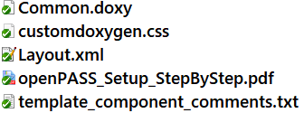
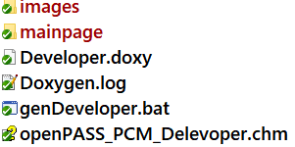
Open Source Developer doc
DoxyGen
Common
Developer
include
execute this file
output file

Slide 12
Proprietary Developer doc
DoxyGen
Common
Developer
Developer_XXX
include
execute this file
output file

Slide 13
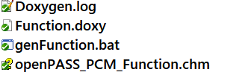
Open Source Function doc
DoxyGen
Common
Function
include
execute this file
output file

Slide 14
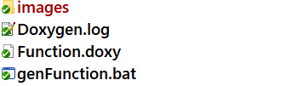
Proprietary Function doc
DoxyGen
Common
Function
Function_XXX
include
execute this file
output file

