Slide 1
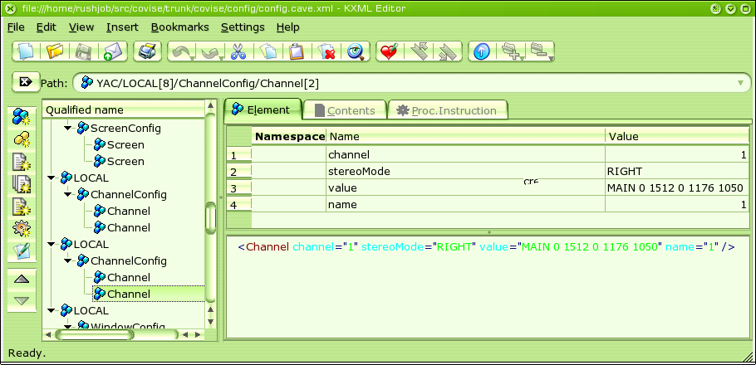
Covise Configuration
Since COVISE 6.0, new configuration files are used:
  XML based
  Split into a global configuration file and a local user configuration file located in ~/.covise
  Entries can be written to the configuration by COVISE-modules

Slide 2
Covise Config – General Rules
Tags and attributes are always case sensitive.
COVERConfig != coverconfig != CoverConfig
The first entry that matches is taken, thus if you have
<TEST value="1"/>
<TEST value="2"/>
"1" is taken as "value".
Entries from local configuration take precedence to global ones.
Additionally loaded configurations take precedence to already loaded ones in the order they were added.
You have to make sure, that the entries are syntactically correct. It is recommended to use an XML-editor.
The environment variable $COCONFIG specifies the configuration file to load. This configuration is searched in $COVISEDIR/config and the entries in $COVISPATH with <dir> and <dir>/config
Default is config.xml.
in contrary to the old CoviseConfig, placing a configuration file into the current directory will not cause this configuration to override the global one.

Slide 3
Covise Configuration – Top Level Structure
Top-level is enclosed in the tags <YAC>…</YAC> (required)
The next level contains tags of the form <GLOBAL>…</GLOBAL> or <LOCAL host="hostname">…</LOCAL>
<GLOBAL> contains all configuration entries valid for all hosts
<LOCAL> contains configuration entries valid for certain hosts only.
It is possible to provide a list of hosts with host="host1,host2,..."
You can have multiple <GLOBAL> and <LOCAL> entries, even for the same hosts or other combinations of hosts.
It is possible here to include other files using
<INCLUDE [configname="name"] [global="1"]>config.xml</INCLUDE>
configname and global are optional attributes, whereof only global is important, prefering files from global configuration directories to local ones.

Slide 4
Covise Config – General Structures
A configuration entry has the following structure
<Tag attribute1="value" attribute2="value"…>
Text or other entries
</Tag>
If there is no text or other configuration entry in between, the closing tag can be shortcut as <Tag attribute1=... />
Values are character strings
Quotation marks within the values can be expressed as entity &quot;
Boolean values can have the values true/false, on/off, 1/0. Here, case does not matter.

Slide 5
Covise Config – Standard Attributes
name name of an entry. If you have in one section more
than one tag of the same type, you have to choose
different names for them.
Example:
<ChannelConfig>
<Channel channel="0" value="FRONT 0 0 0 1024 768" name="0" />
<Channel channel="1" value="FRONT 0 1008 0 1024 768" name="1" />
</ChannelConfig>
for Channel 1 and 2, respectively
arch is used to make an entry dependent on the architecture
COVISE is running on. Values for this tag can be:
x11, unix, windows, mac, or an $ARCHSUFFIX
Example:
<CRB>
<ModuleAlias name="Renderer/Renderer" value="Renderer/IvRenderer" arch="x11"/>
<ModuleAlias name="Renderer/Renderer" value="Renderer/OpenSG" arch="windows"/>
<ModuleAlias name="Renderer/Renderer" value="Renderer/QtRenderer" arch="mac"/>
</CRB>
value denotes normally the value of an entry.

Slide 6
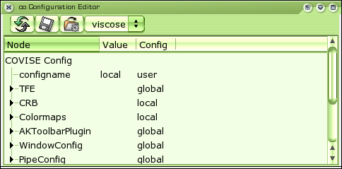
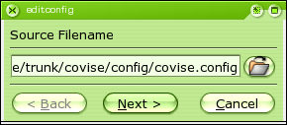
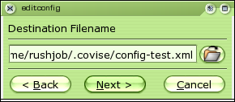
Covise Config – Transition from Old to New
Start the command editconfig
Select the Import Icon
Choose the old configuration file
Choose a destination for the new configuration

Slide 7
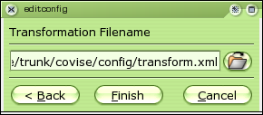
Covise Config – Transition from Old to New
Select a file with the transformation information.
The transformation file is provided by us. Normally you should leave this untouched, but for own configurations of own modules, it may be necessary to create a custom transformation file.
You can use the configuration editor for checking the resulting file.
Editing the configuration is alpha, as of now, so better don’t touch the save button while valuable configuration files are loaded.

Slide 8
Covise Config API - Basics
Library: coConfig (libcoConfig.so/coConfig.dll)
Includes should be made this way
#include <config/coConfig.h>
There are two application programming interfaces to coConfig.
Legacy interface mimicking the old CoviseConfig interface:
#include <config/CoviseConfig.h>
  Does not use Qt
  Returns C-Strings
  Allows read-only access
  Limited functionality
New interface:
#include <config/coConfig.h>
  Uses Qt (needs a license for commercial development)
  Returns QStrings
  Allows read-write access
  Is needed for accessing the full functionality

Slide 9
Covise Config API
// Example configuration:
// <Renderer>
// <Threading>
// <Aspects value="3" />
// </Threading>
// <AutoGenNormals value="on" angle="0" />
// <Plugin name="de.hlrs.ObjectList" >
// <AutoStart value="true" />
// </Plugin>
// <Plugin name="de.hlrs.VolumePlugin" >
// <AutoStart value="false" />
// <Hidden value="false" />
// </Plugin>
// </Renderer>
#include <config/coConfig.h>
// Get the global configuration
coConfig config = coConfig::getInstance();

Slide 10
Covise Config API – Getting Values
QString aspects;
// Returns "3" as string
aspects = config->getValue("Renderer.Threading.Aspects");
// Same as above
aspects = config->getValue("value", "Renderer.Threading.Aspects");
// If no entry exists in the configuration, assign a default value of "2"
aspects = config->getValue("value", "Renderer.Threading.Aspects", "2");
// Check if normals should be generated automatically (with a default of
// false). The crease angle is also read from the configuration
if (config->isOn("Renderer.AutoGenNormals", false))
generateNormals(config->getInt("angle", "Renderer.AutoGenNormals", 5));
// Select entry by name: (note that the dot's in the configuration file
// are converted to '_')
if (config->isOn("Renderer.Plugin:de_hlrs_ObjectList.AutoStart"))
startPlugin("ObjectList");
if (config->isOn("Renderer.Plugin:de_hlrs_VolumePlugin.AutoStart"))
startPlugin("VolumePlugin");

Slide 11
Covise Config API – Advanced Operations
// Get as integer. The value is cached to speed up consecutive reads.
// Use this, if an entry is only accessed from one place or read-only
coConfigInt aspectsInteger("Renderer.Threading.Aspects");
// The same, but do not cache. Use this, if the variable is used read-write
coConfigInt aspectsIntegerNonCached("Renderer.Threading.Aspects", true);
// Assign directly to int
int aspectsInt = aspectsIntegerNonCached;
// Set the number of aspects in the configuration to 4
aspectsIntegerNonCached = 4;
// Prints the cached value "3" (the obsolete value)
COCONFIGLOG(aspectsInteger)
// Update the cache
aspectsInteger->update();
// Prints "4" (the new value)
COCONFIGLOG(aspectsInteger)

Slide 12
Covise Config API – Using Own Configurations
// Create an own configuration
coConfigGroup * group = new coConfigGroup("Renderer");
// Add a configuration tree to the group
group->addConfig(
// Load the configuration from ~/.covise/renderer.xml
coConfigDefaultPaths::getDefaultLocalConfigFilePath() + "renderer.xml",
// Call the configuration "local"
"local",
// And create it, if it does not already exist
true);

Slide 13
Covise Config API – Using Own Configurations
// Get a value from the new group
coConfigInt aspectsIntegerGroup(group, "Renderer.Threading.Aspects");
// Assign a new value within the group
aspectsIntegerGroup = 5;
// Prints "5"
COCONFIGLOG(aspecsIntegerGroup)
// Prints "4"
COCONFIGLOG(aspecsIntegerNonCached)
// Add the new group to the global configuration (not required)
config->addConfig(group);
// Prints "5"
COCONFIGLOG(aspecsIntegerNonCached)
// Saves the group to disk – before that, changes are just in the memory
group->save();
// Save all configurations (use with caution, best not at all!
// Better save your own groups only)
config->save();

Slide 14
Covise Config - Programming Pitfalls
Configurations are evaluated last in first. Thus, if there are other configurations loaded after your own, those values may override yours, or even worse: when writing you write to another configuration than intended. Better use your own group or use the special setValueInConfig method.
When assigning values to configuration objects (coConfig{Int/Float/String/Bool}), those values will be stored to the configuration if you call config->save(). There is currently no way to selectively save configuration entries.
Saving the configuration is not selectively saving changed entries. The whole configuration is written out. As of now, comments are discarded, so don't save your in many hours well-commented configuration. For security reasons, the initial global and local configuration files are read-only by default.

